Slide 1
pet insurance claim

Slide 2
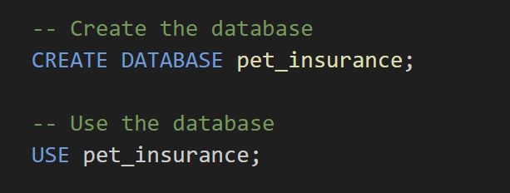
Describe your approach to completing each below task, including the identification and rectification of any data integrity issues, any useful data fields that aren't provided, and outline processes to proactively maintain data integrity. Please provide relevant SQL statements in any SQL based environment?
Task 1.1: Expand the Dataset to Include Audit Status
1. Create the Database and Use It

Slide 3
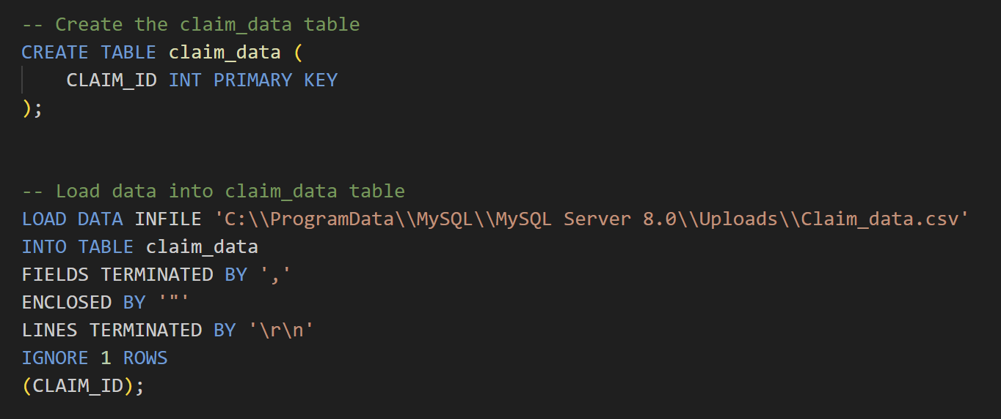
2. Create Tables and Load Data:

Slide 4
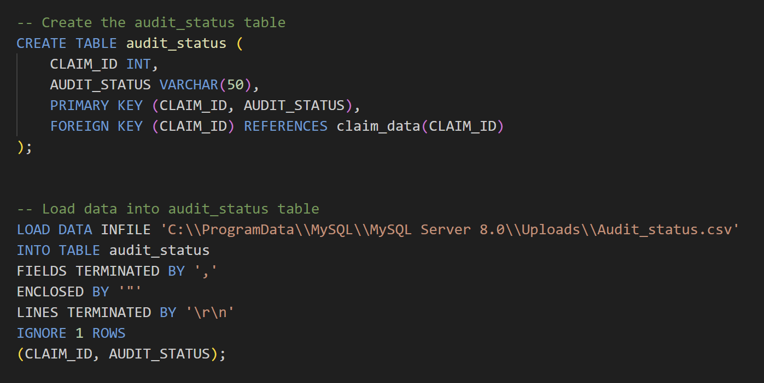

Slide 5
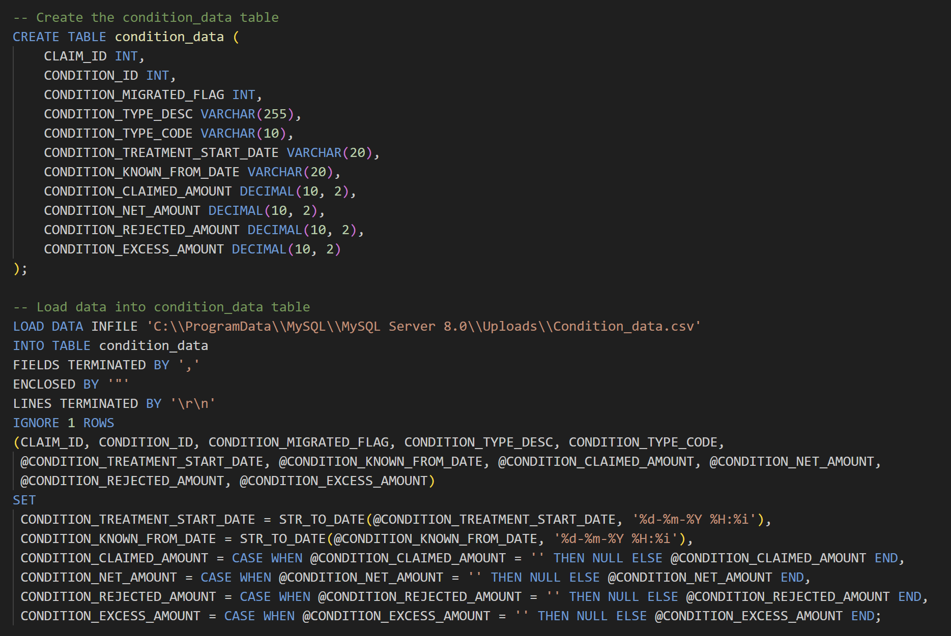

Slide 6
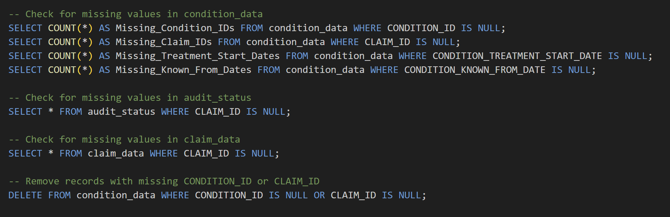
3. Check for Missing Values and Rectify Data Integrity Issues

Slide 7
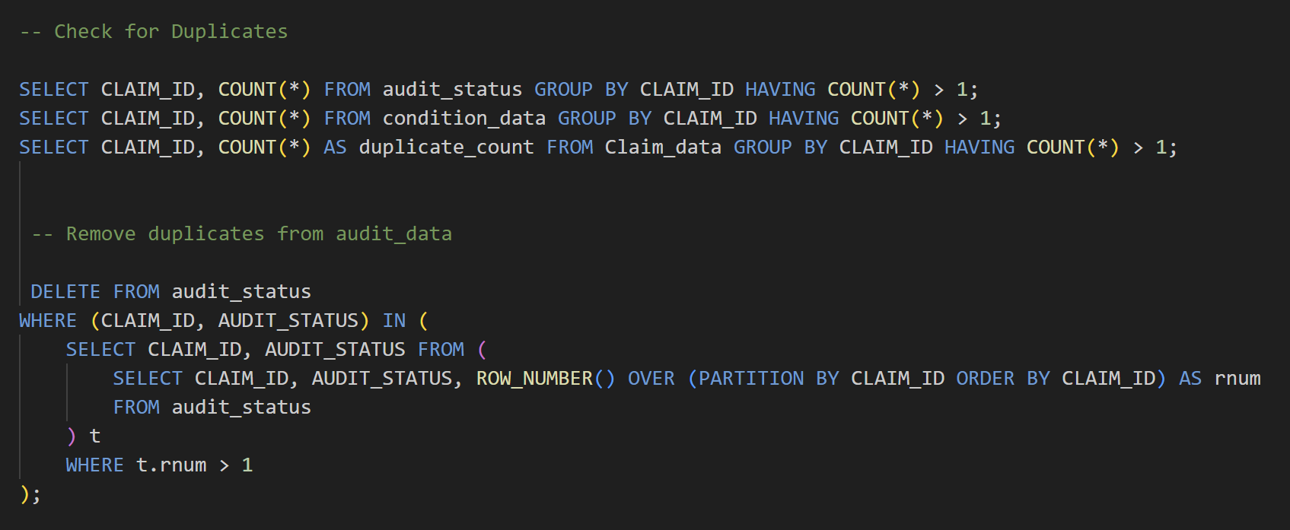
4. Check for Duplicates and Remove Them:

Slide 8
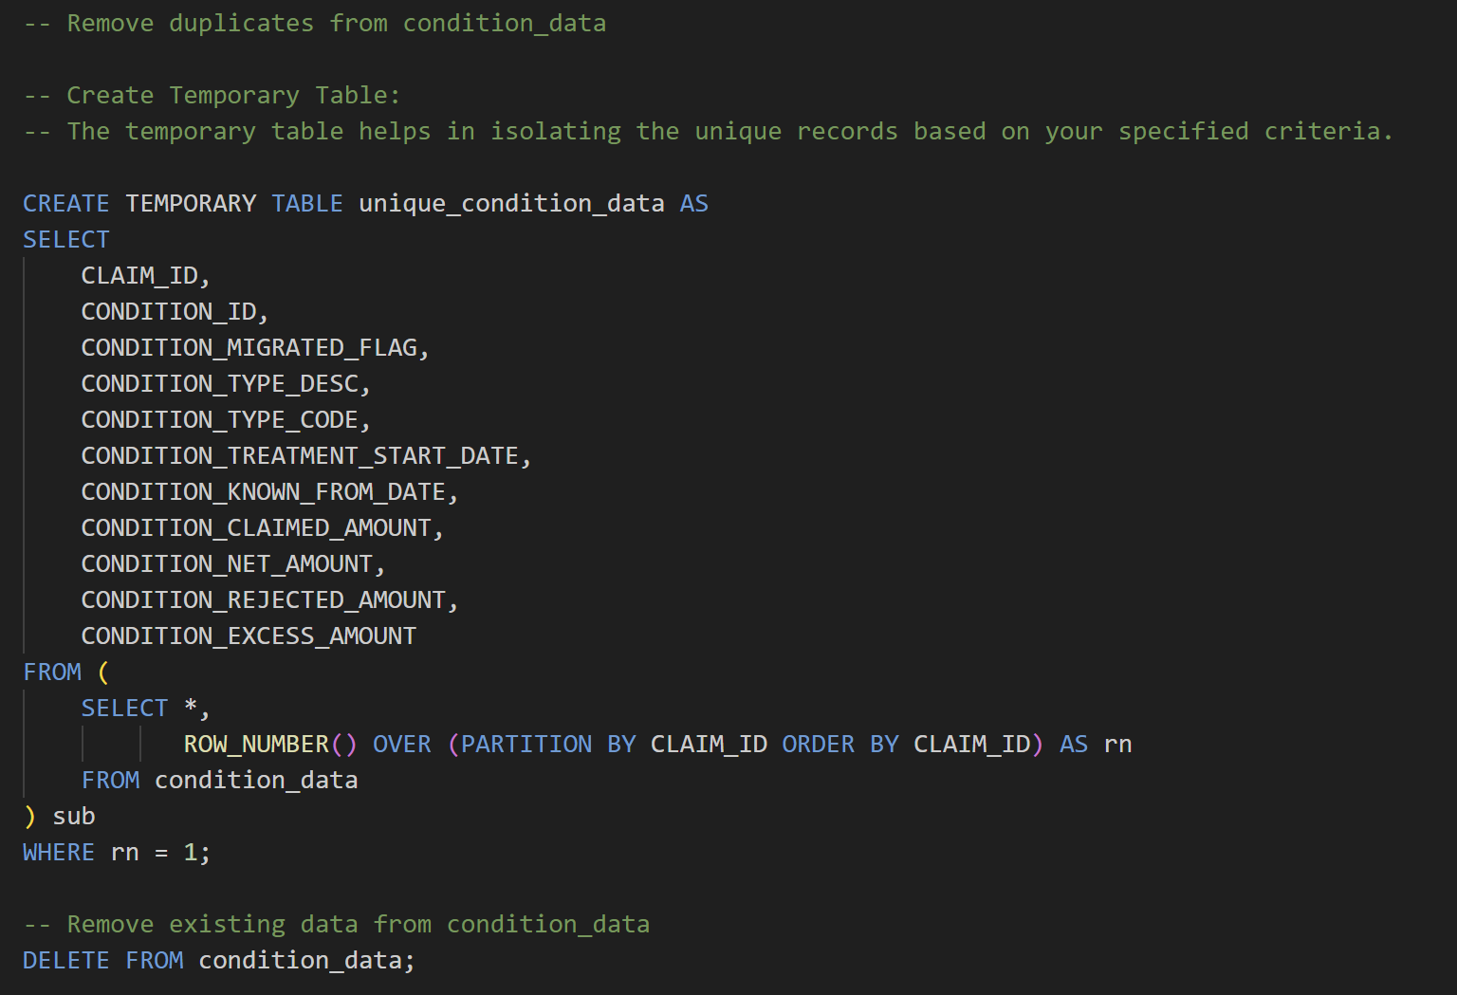

Slide 9
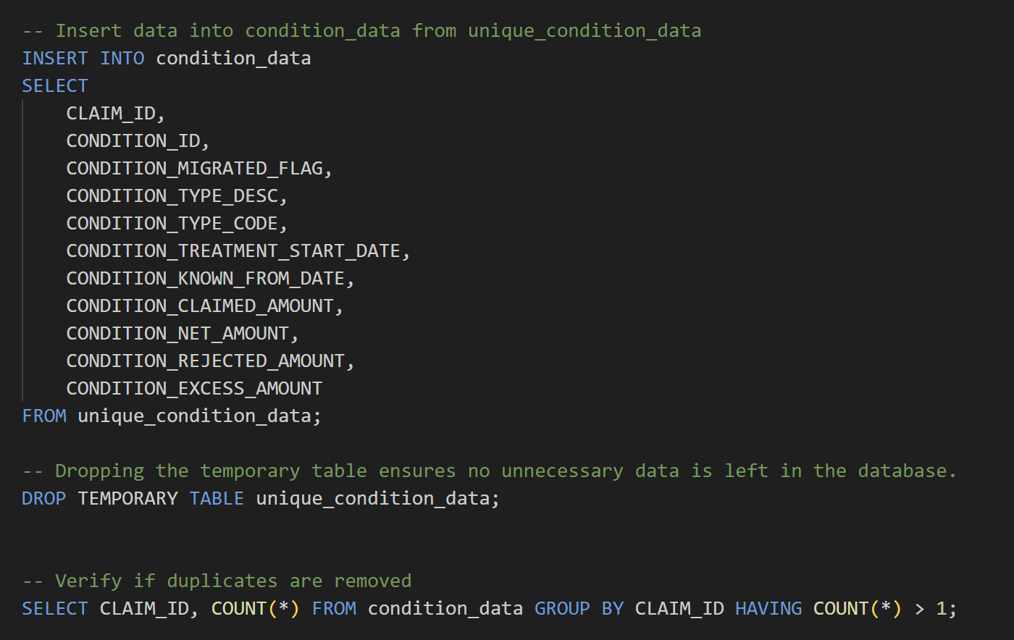

Slide 10
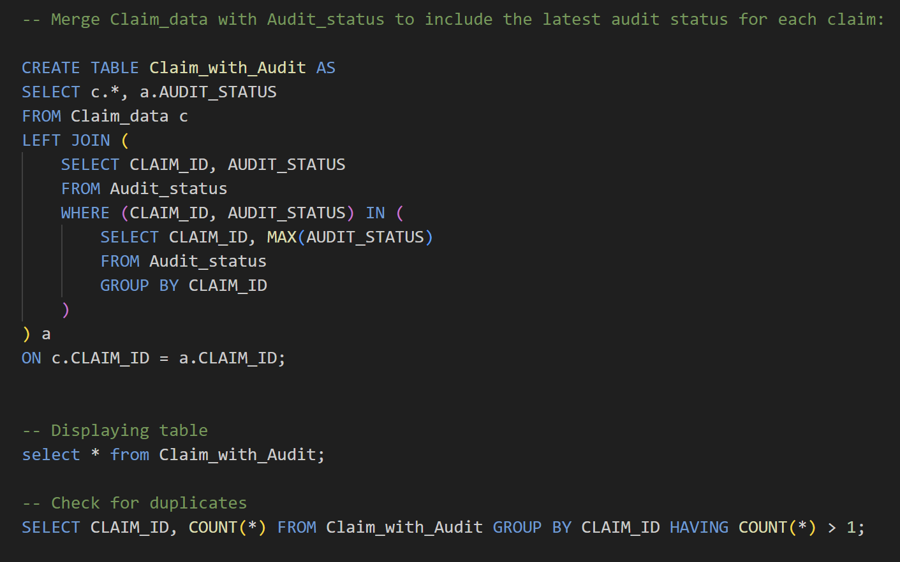
5. Merge Claim_data with Audit_status

Slide 11
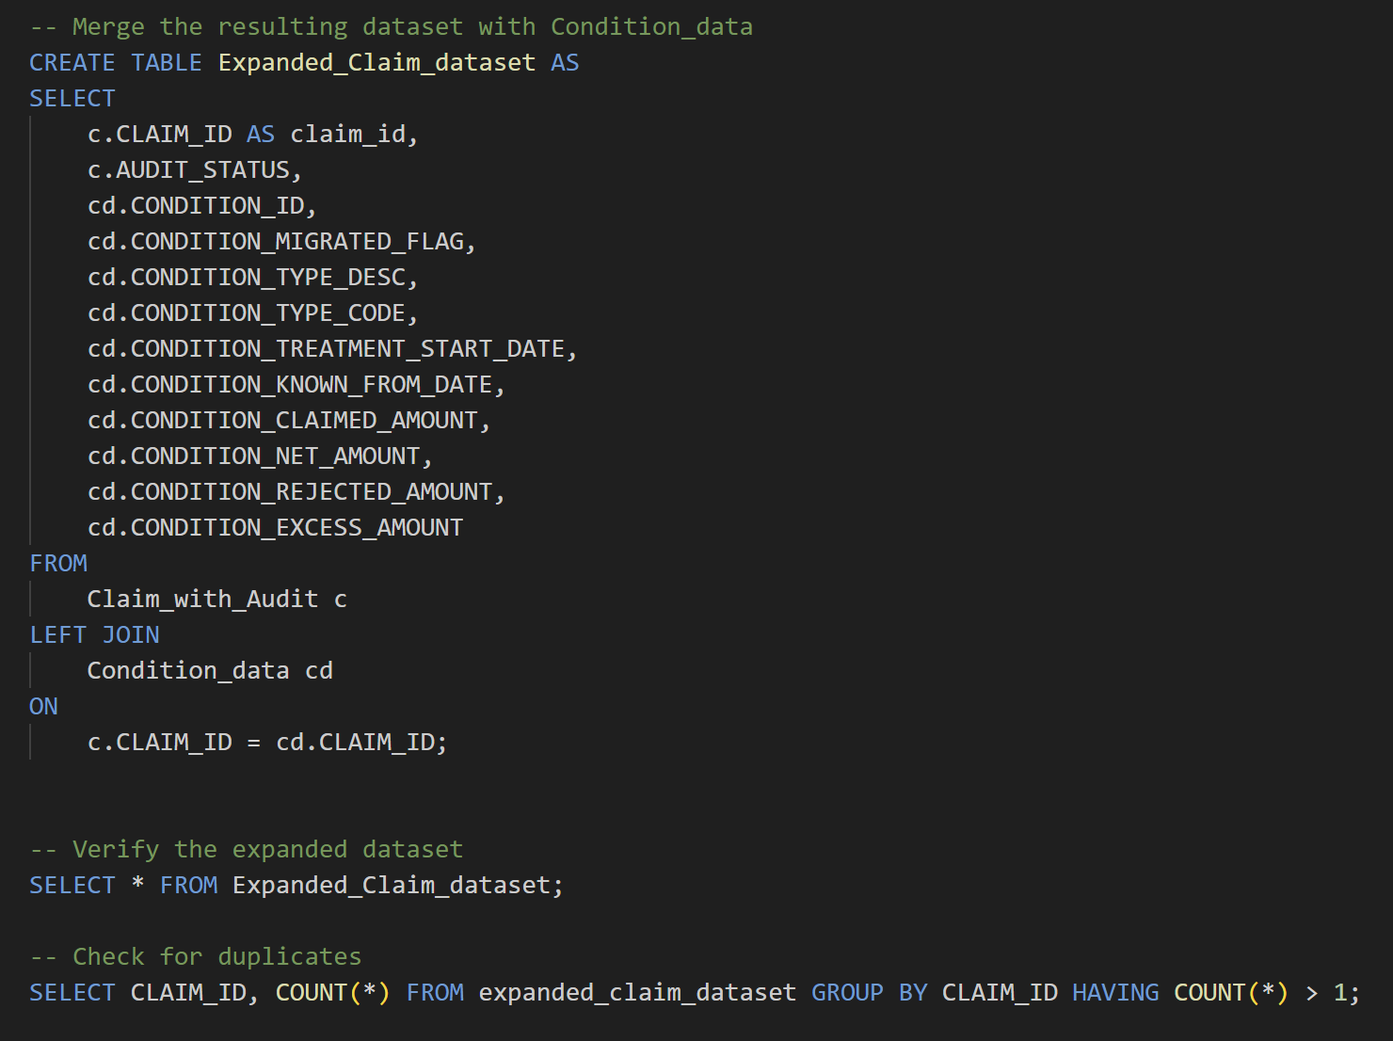
6. Merge the resulting dataset with Condition_data

Slide 12
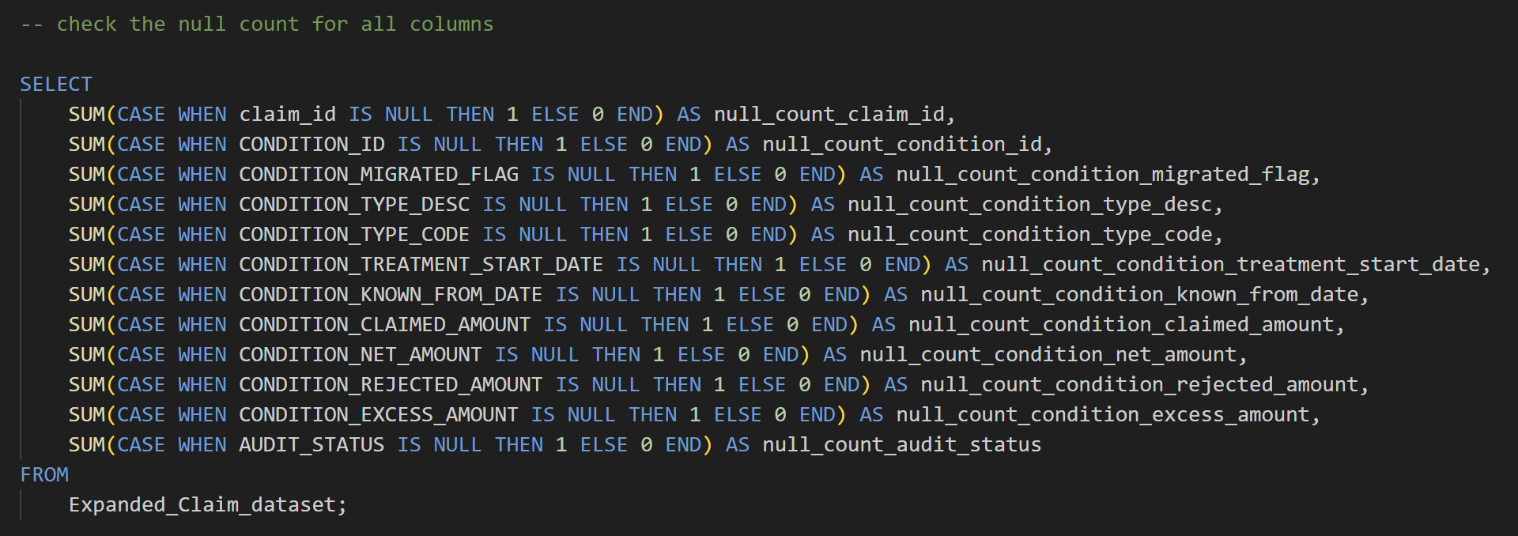
7. Check the null count for all columns

Slide 13
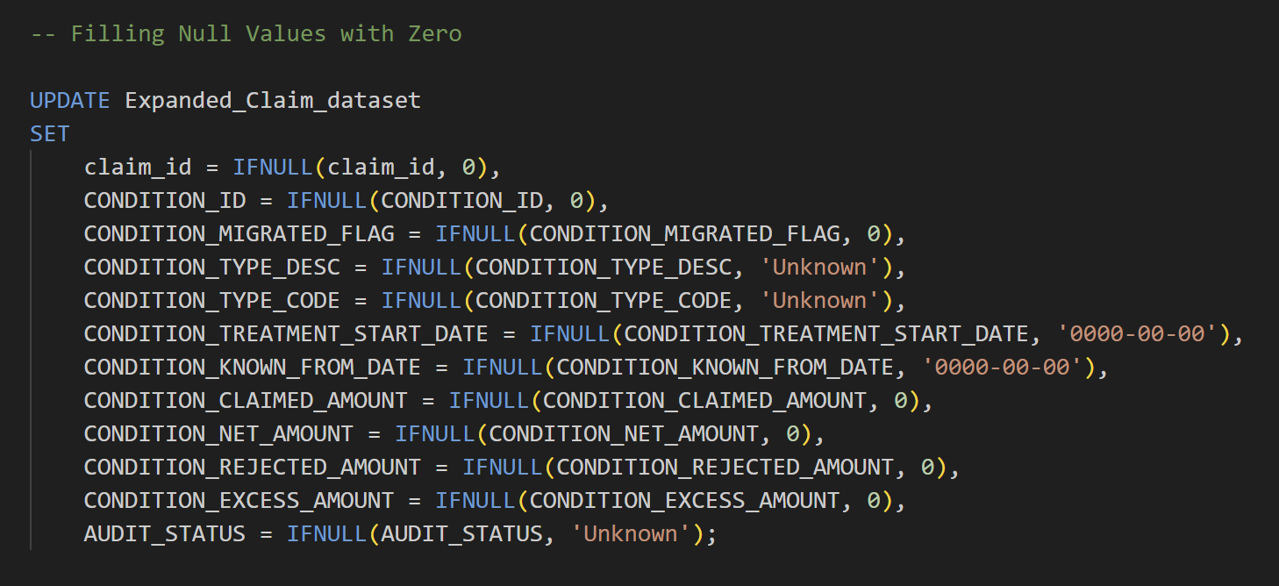
8. Filling NULL values

Slide 14
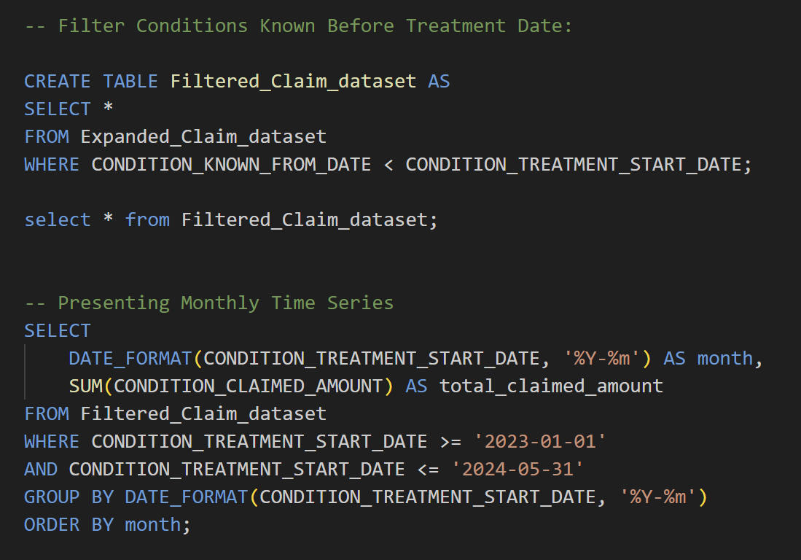
Task 1.2: Presenting Monthly Time Series

Slide 15
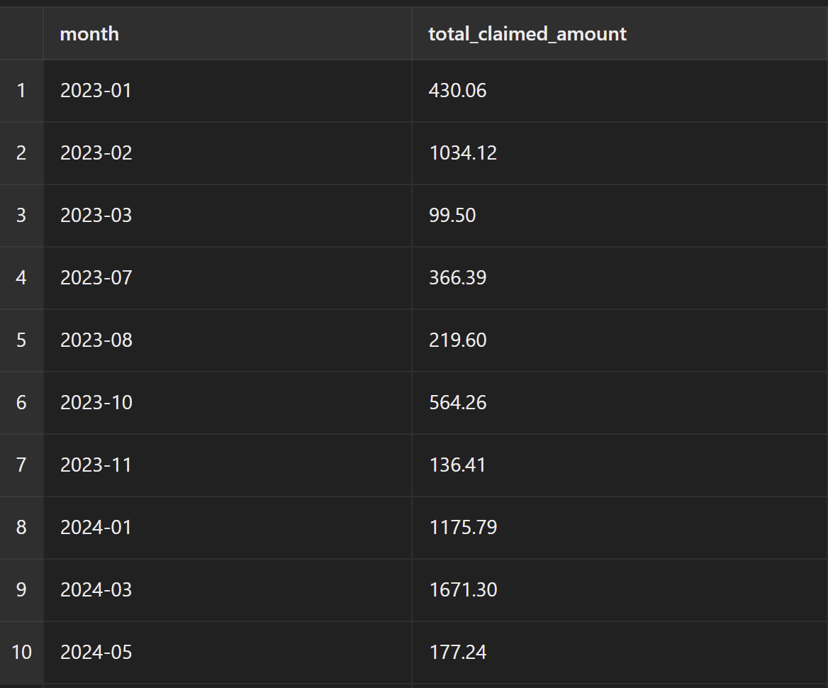
Output

Slide 16
Additional fields that might be useful include
Treatment_End_Date
Purpose: To calculate the duration of the treatment.
Description: This field will help in understanding how long each treatment lasted, which can be crucial for cost analysis and patient care assessment.
2. Patient_ID
Purpose: To identify unique patients and analyze claims per patient.
Description: Linking each claim to a unique patient allows for tracking of patient histories, better understanding of patient-specific costs, and analysis of treatment outcomes.

Slide 17
3. Doctor_ID
Purpose: To analyze claims per doctor or treatment provider.
Description: This field helps in evaluating the performance and cost-effectiveness of different doctors, as well as identifying any patterns in claims that might indicate fraudulent activities.
4. Hospital_ID
Purpose: To analyze claims per hospital.
Description: By linking claims to specific hospitals, it’s possible to assess the cost and quality of care provided by different hospitals, which can inform network management and contract negotiations.

Slide 18
Identification and Rectification of Data Integrity Issues
1. Missing Values
Identification:
Missing values can lead to inaccurate analyses and insights. Critical fields such as CLAIM_ID, POLICY_HOLDER_ID, POLICY_ID, CLAIM_DATE, and CLAIM_AMOUNT should not have any missing values.
Rectification:
Depending on the nature and extent of the missing data, different strategies can be applied:
Removal: If only a few records have missing critical values, they can be removed.
Imputation: If the missing data can be reasonably inferred or filled in, imputation methods can be used.

Slide 19
2. Inconsistent or Incorrect Data
Identification:
Data inconsistency occurs when similar data is recorded in different formats or when there are obvious errors in the data (e.g., negative claim amounts).
Rectification:
Standardization: Convert all data entries to a consistent format.
Correction: Identify and correct obvious errors.
3. Duplicate Records
Identification:
Duplicate records can skew analyses and should be identified and removed.
Rectification:
Removal: Remove duplicate records, keeping only one instance of each record.

Slide 20
4. Date Consistency
Identification:
Dates should be logical and consistent. For instance, the CONDITION_KNOWN_FROM_DATE should always be on or before the CONDITION_TREATMENT_START_DATE.
Rectification:
Removal: Remove records with inconsistent dates.
Correction: Correct date entries where possible.

Slide 21
Processes to Proactively Maintain Data Integrity
1.Data Validation
Implement validation checks during data entry and loading to ensure that all data conforms to the expected formats and constraints.
Example Checks:
  Ensure dates are in the correct format and valid.
  Verify that numeric fields contain only numbers.
  Check that foreign key references are valid.
2. Regular Audits
Schedule regular data audits to identify and correct inconsistencies. This could involve comparing data across different systems or time periods to spot anomalies.

Slide 22
3. Automated Alerts
Set up automated alerts for anomalies or data quality issues, such as unexpected spikes in claim amounts or inconsistencies in audit statuses.
4. Documentation
Maintain thorough documentation for data handling procedures, including data entry guidelines, data transformation processes, and error handling protocols. This ensures consistency and helps new team members quickly understand the processes.
5. Regular Training
Train data entry personnel on best practices to minimize data entry errors and maintain high data quality.
6. Data Quality Dashboards
Develop dashboards to track data quality metrics and visualize data integrity issues in real-time.

Slide 23
2. Additional Improvements for Production-Ready Dataset
1. Normalization
Normalize the dataset to reduce redundancy and improve data integrity. This involves creating separate tables for related data and establishing relationships between them. It helps to reduces data duplication, Simplifies updates and maintenance and enhances data integrity through foreign key constraints.
Example: Separate tables for Patients, Doctors, Hospitals, etc.
2. Indexing
Add indexes to improve query performance, particularly on frequently queried columns. It will speeds up data retrieval operations and enhances performance for complex queries involving joins.
3. Data Validation Rules
Implement strict data validation rules during data ingestion to prevent invalid data from entering the system. It prevents invalid data from entering the system and ensures consistency and reliability of data.

Slide 24
4. Backup and Recovery
Establish a robust backup and recovery strategy to prevent data loss. Regularly back up the database and test the recovery process. It ensures data availability and integrity in case of system failures and Provides a safety net for disaster recovery.
Example Strategy
Daily incremental backups.
Weekly full backups.
Store backups in a secure, off-site location.
5. Monitoring and Logging
Implement monitoring and logging to track data changes and access. This helps in auditing and troubleshooting. It helps in auditing and troubleshooting, and provides insights into data usage and access patterns.

Slide 25
6. Security Enhancements
Implement security measures to protect data from unauthorized access and breaches. Its protects sensitive data and Ensures compliance with data protection regulations.
Example Strategies
Use encryption for sensitive data.
Implement role-based access control (RBAC).
Regularly update and patch the database software.
7. Scalability Planning
Plan for scalability to handle increasing data volumes and user loads. It ensures system performance remains optimal as data grows. Supports business growth and changing requirements.
Example Strategies
Partitioning large tables.
Implementing load balancing.
Using database replication.

Slide 26
Prioritization of Changes and Reasons
1. Data Validation Rules
Priority: High
Reason: Ensuring data quality is paramount. Invalid data can lead to incorrect analyses and decision-making. By implementing strict data validation rules during data ingestion, we can prevent errors from entering the system, thereby maintaining data integrity from the start.
2. Backup and Recovery
Priority: High
Reason: Data loss can be catastrophic for any organization. Establishing a robust backup and recovery strategy ensures that data can be restored in case of hardware failures, software issues, or other disasters. Regular backups are critical for data security and business continuity.

Slide 27
3. Normalization
Priority: High
Reason: Normalization reduces redundancy and improves data integrity, making the database easier to maintain and update. It also simplifies querying and ensures that relationships between data entities are clearly defined, which is crucial for accurate data analysis.
4. Indexing
Priority: High
Reason: Indexing is essential for optimizing query performance. As the dataset grows, the time taken to retrieve data can increase significantly. Adding indexes on frequently queried columns will speed up data retrieval and ensure that the system remains responsive.

Slide 28
5. Security Enhancements
Priority: Medium
Reason: Protecting sensitive data and ensuring compliance with data protection regulations is vital. Implementing security measures such as encryption, role-based access control, and regular updates helps safeguard data against breaches and unauthorized access. This step is crucial but can be implemented after ensuring that data quality and performance are addressed.
6. Monitoring and Logging
Priority: Medium
Reason: Monitoring and logging are important for auditing, troubleshooting, and maintaining operational oversight. While not as critical as immediate data integrity and recovery, they provide insights into data usage, help identify performance issues, and ensure that unauthorized access or changes are detected and addressed promptly.

Slide 29
7. Scalability Planning
Priority: Medium to Low
Reason: Planning for scalability is essential for handling future growth in data volume and user load. However, it is typically less urgent than immediate data integrity, performance optimization, and security. Once the system is stable and secure, scalability measures such as partitioning, load balancing, and replication can be implemented to support long-term growth.

Slide 30
3. Enhancements for the Data Dictionary
Include Data Types: Clearly specify the data type for each field.
Add Constraints: Document any constraints, such as PRIMARY KEY, FOREIGN KEY, UNIQUE, etc.
Provide Examples: Include example values for each field to illustrate expected data.
Describe Relationships: Detail relationships between tables (e.g., foreign key references).
Update Frequency: Specify how often the data is updated and any related procedures.
Source Information: Document the source of the data and any transformations applied

Slide 31
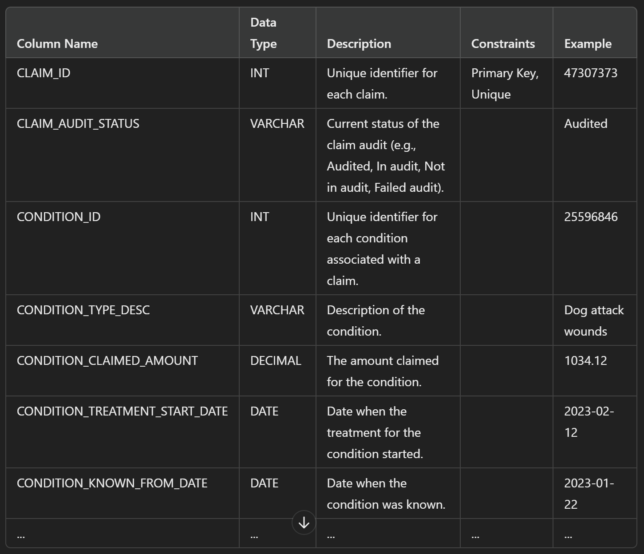
Example

Slide 32
Thank You
Sreekutty Thankappan

