Slide 1
Allianz Telematics

Slide 2
Dataset Description
The dataset contains aggregated data for 335 drivers, including personal, policy, and driving details. Below is a detailed description of each attribute:
1) Policy Number:
  Description: Unique identifier for each insurance policy.
  Use: Identify individual policies for detailed analysis or customer-specific queries.
2) Inception Date:
  Description: The date when the insurance policy started.
  Use: Track the duration of policies and analyse trends over time, such as the impact of policy duration on driving behaviour.
3) Months since Inception:
  Description: The number of months since the policy started.
  Use: Correlate the duration of policy ownership with driving scores to see if longer-term policyholders have better scores

Slide 3
4) Gender:
  Description: The gender of the driver (M for male, F for female).
  Use: Analyse differences in driving behaviour and risk between genders to tailor insurance premiums and products.
5) Age:
  Description: The age of the driver.
  Use: Study the relationship between age and driving risk to adjust premiums and identify high-risk age groups.
6) Vehicle:
  Description: The make and model of the vehicle.
  Use: Evaluate if certain vehicle types are associated with higher or lower driving scores, influencing underwriting decisions.
7) Postcode:
  Description: The postal code of the driver's residence.
  Use: Geographic risk assessment to determine if certain areas have higher claims, which can impact regional premium pricing.

Slide 4
8) Premium Charged:
  Description: The amount charged for the insurance premium.
  Use: Analyse the relationship between premium amounts and driving scores or risk events to ensure pricing accuracy.
9) Distance:
  Description: The total distance driven by the driver.
  Use: Determine if mileage is correlated with driving scores and risk, which can inform mileage-based insurance products.
10) Journeys:
  Description: The number of journeys taken by the driver.
  Use: Assess the impact of journey frequency on driving scores and risk, identifying patterns in driving behaviour.
11) Overall Risk %:
  Description: The overall risk percentage associated with the driver.
  Use: Evaluate overall driver risk and its correlation with other attributes, guiding underwriting and risk management strategies.

Slide 5
12) High Risk Event:
  Description: The number of high-risk events recorded.
  Use: Analyse the frequency of high-risk events and their impact on driving scores and claims likelihood.
13) High Risk Event %:
  Description: The percentage of high-risk events.
  Use: Compare high-risk event percentages across different demographics to identify high-risk groups.
14) Medium Risk Event:
  Description: The number of medium-risk events recorded.
  Use: Similar to high-risk events, used to assess the impact on driving scores and insurance risk.
15) Medium Risk Event %:
  Description: The percentage of medium-risk events.
  Use: Evaluate medium-risk event percentages and their relationship with other risk factors.

Slide 6
16) Speeding Events:
  Description: The number of speeding events recorded.
  Use: Investigate the impact of speeding on driving scores and claim likelihood, adjusting premiums accordingly.
17) SpeedingEventsPerMile:
  Description: The rate of speeding events per mile driven.
  Use: Provide a normalized measure of speeding behaviour, which can be more insightful than raw counts.
18) DriverScore:
  Description: A score representing the overall driving behaviour, with higher scores indicating safer driving.
  Use: Predict future claims likelihood, adjust premiums, and identify drivers for safe driving incentives.

Slide 7
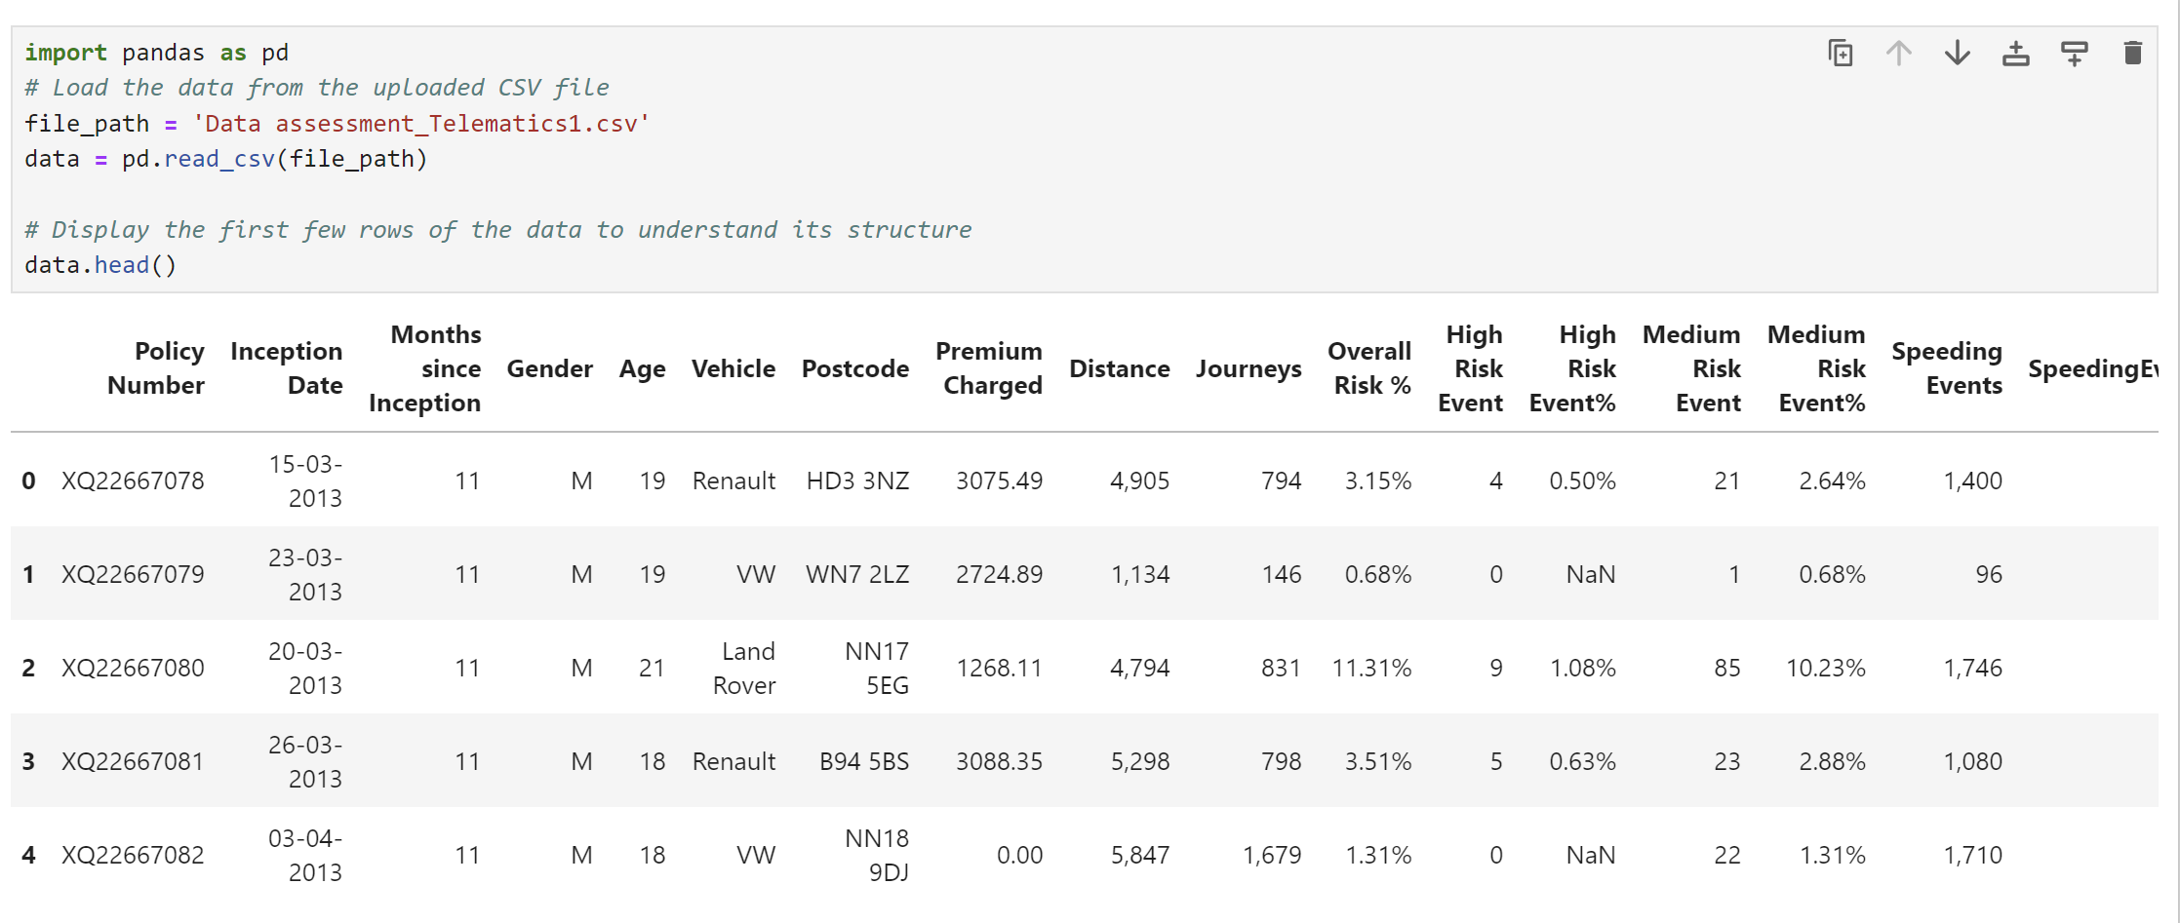
Data Preprocessing

Slide 8
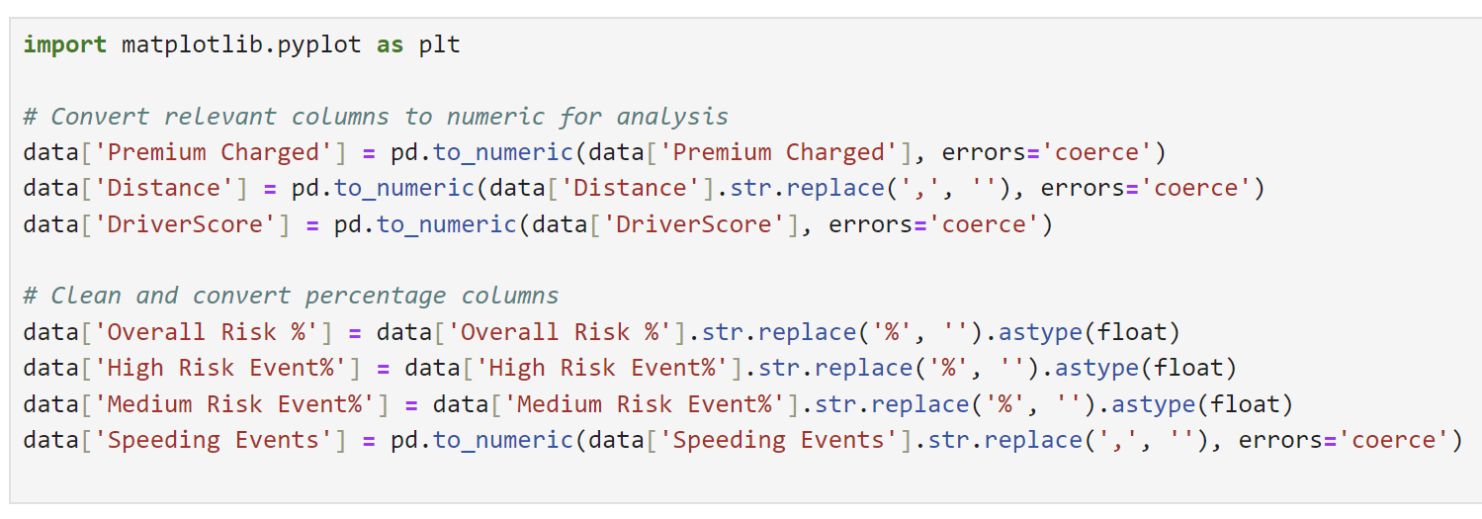

Slide 9
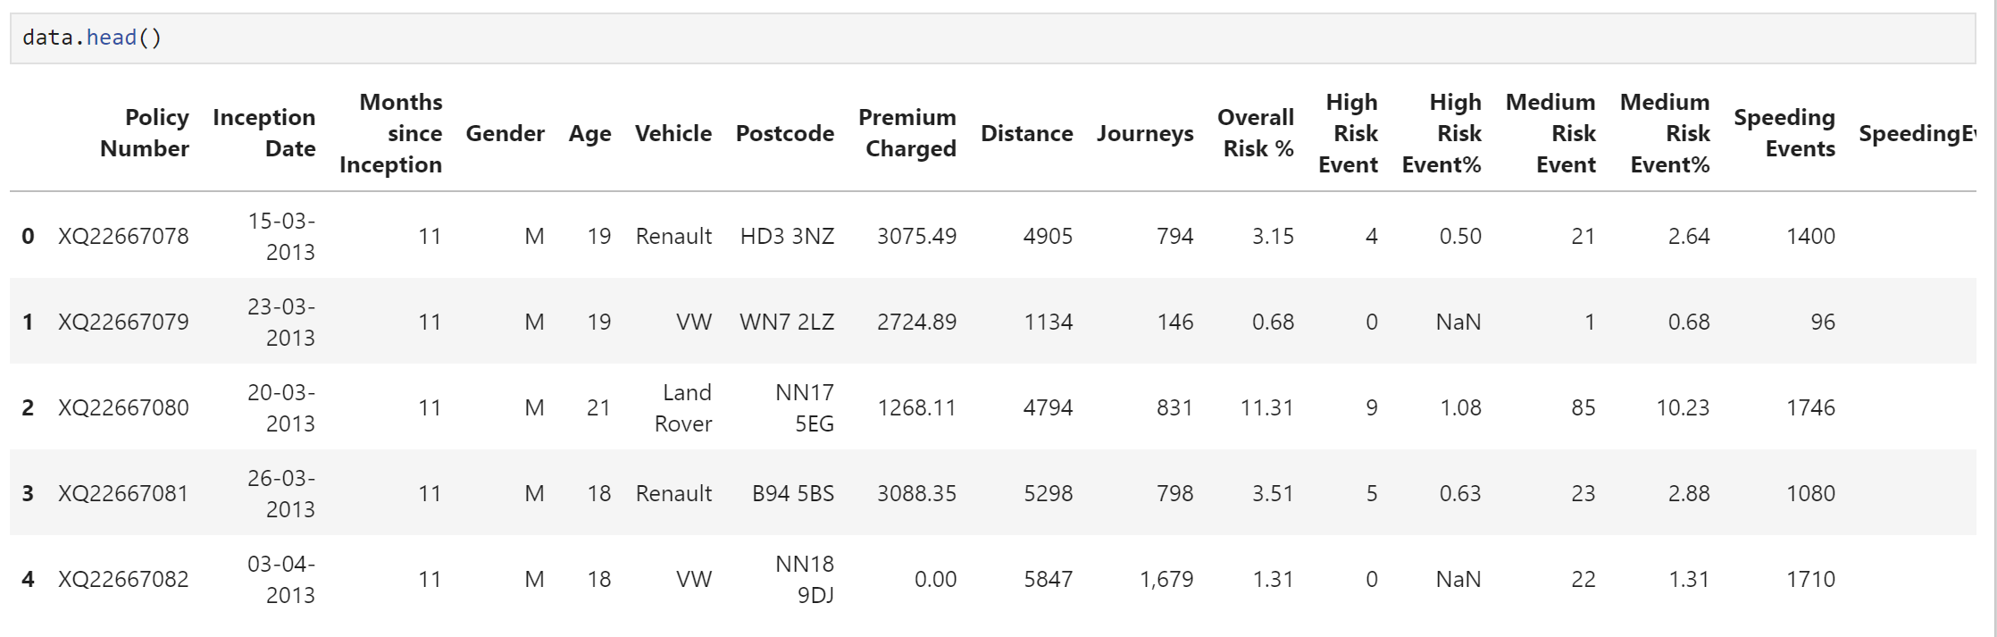
Displaying the first few rows of the preprocessed data

Slide 10
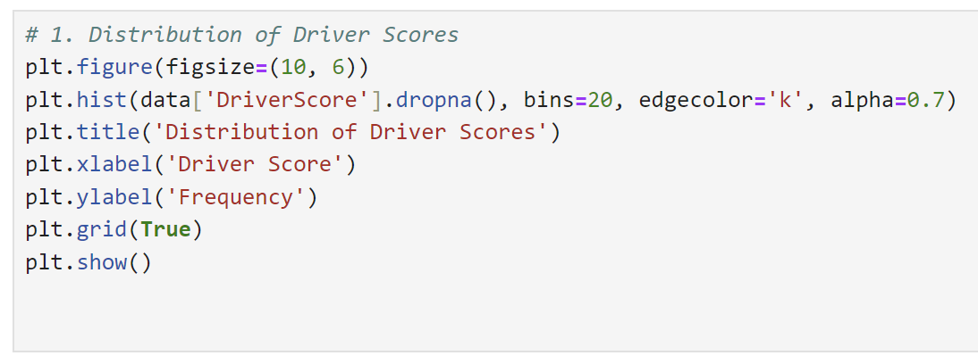
Distribution of Driver Scores

Slide 11
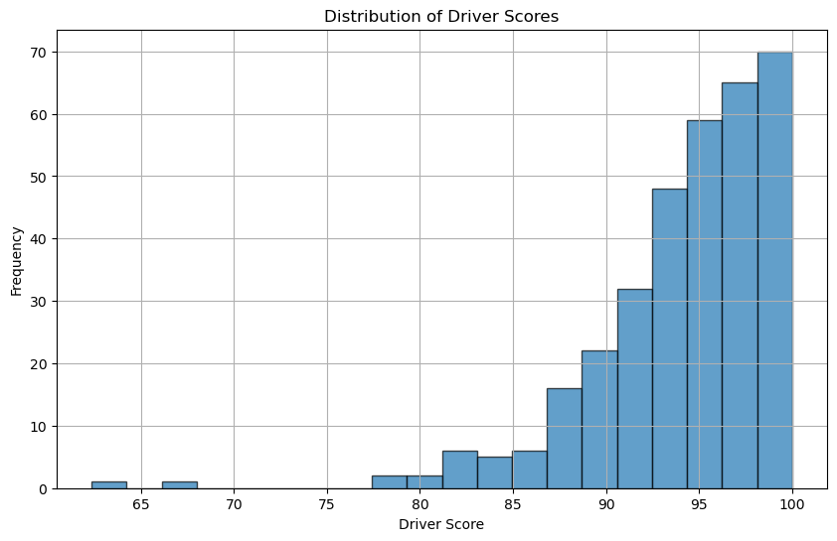
The distribution of driver scores shows that most drivers have scores between 92 and 98, indicating a generally high level of safe driving. This helps in identifying the overall risk profile of the insured drivers.

Slide 12
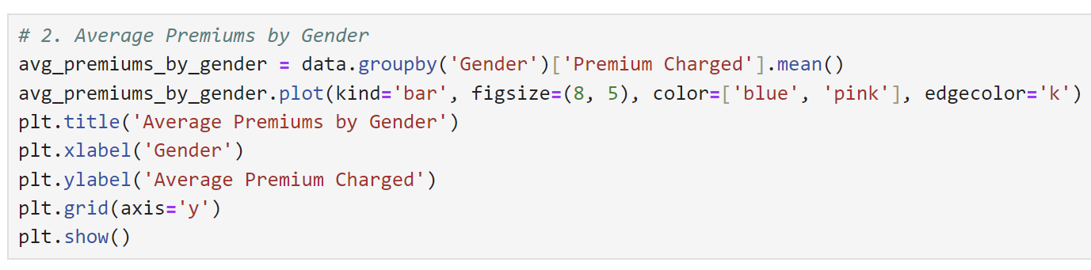
Average Premiums by Gender

Slide 13
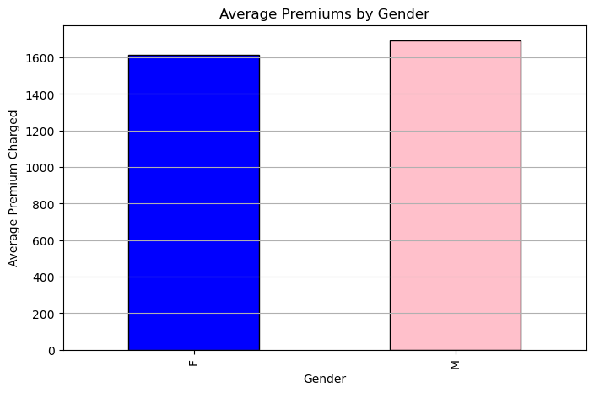
Male drivers have a slightly higher average premium compared to female drivers, suggesting that male drivers might be considered higher risk. This insight can help insurers in adjusting premiums based on gender-related risk factors.

Slide 14
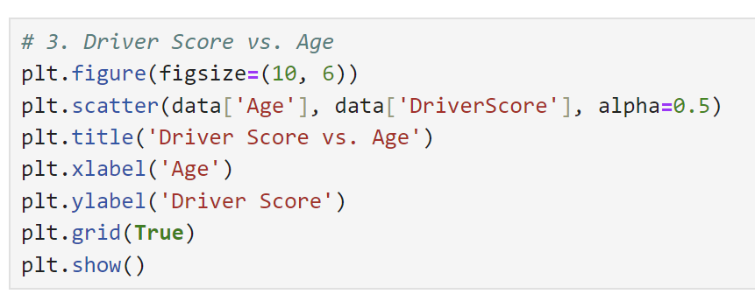
Driver Score vs. Age

Slide 15
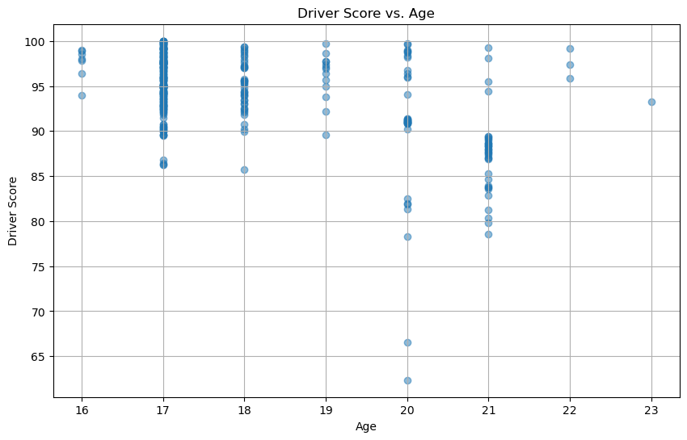
There is a moderate negative correlation between age and driver score, indicating that younger drivers tend to have lower scores. Insurers can use this information to adjust premiums for different age groups, with younger drivers potentially facing higher premiums due to higher risk.

Slide 16
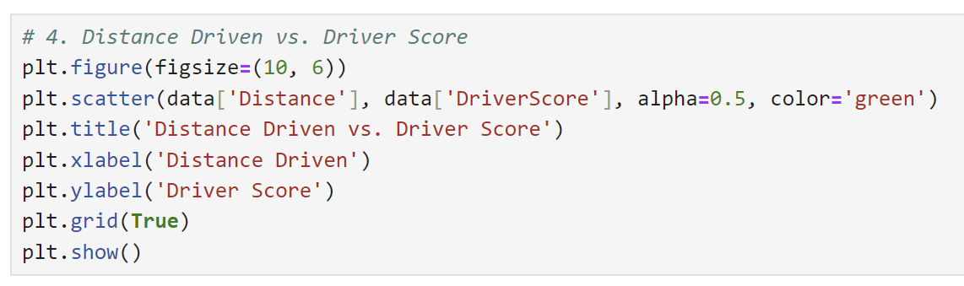
Distance Driven vs. Driver Score

Slide 17
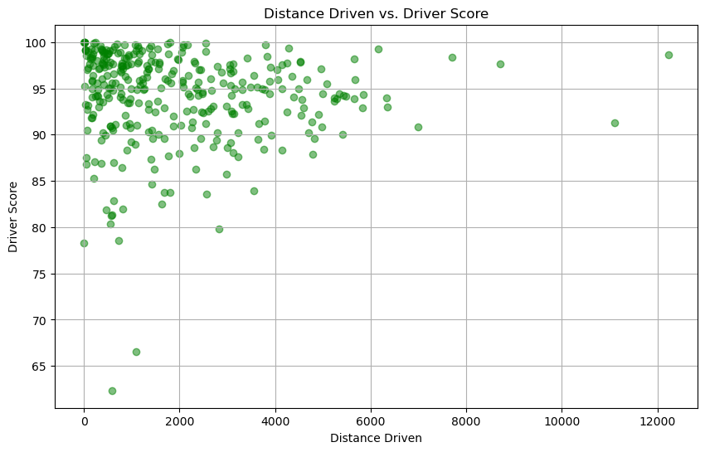
Analyzing the relationship between distance driven and driver score can help determine if higher mileage is associated with better or worse driving scores. This can inform mileage-based insurance products and pricing strategies.

Slide 18
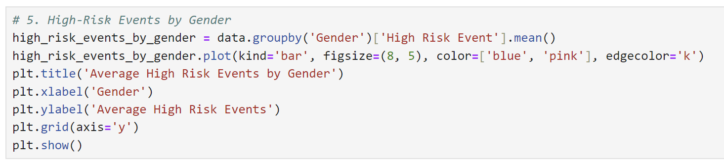
High-Risk Events by Gender

Slide 19
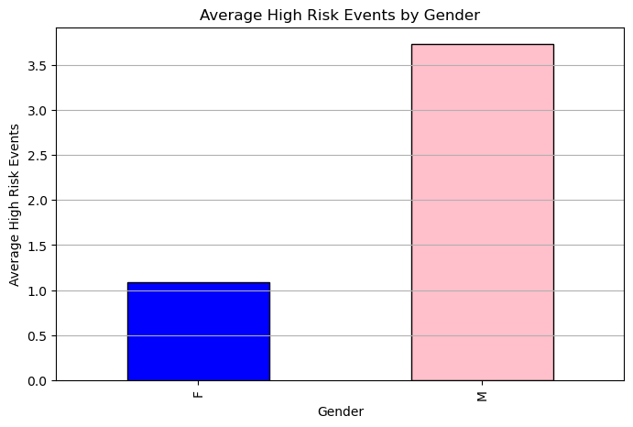
The comparison of high-risk events by gender can reveal if one gender is more prone to high-risk driving behavior. This insight is useful for tailoring risk assessment and premium pricing based on gender.

Slide 20
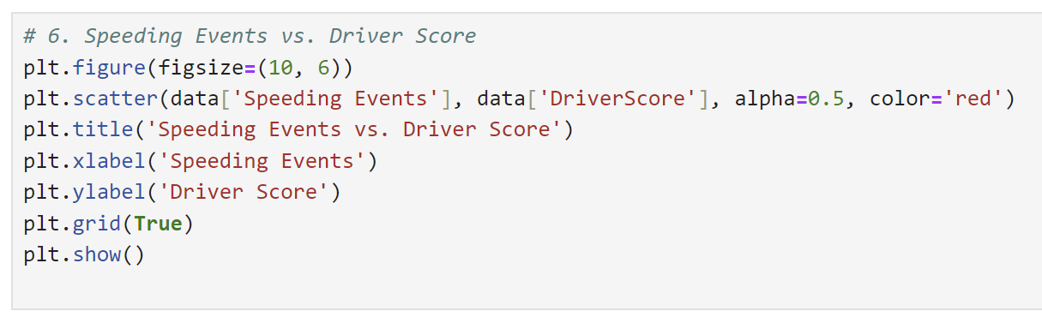
Speeding Events vs. Driver Score

Slide 21
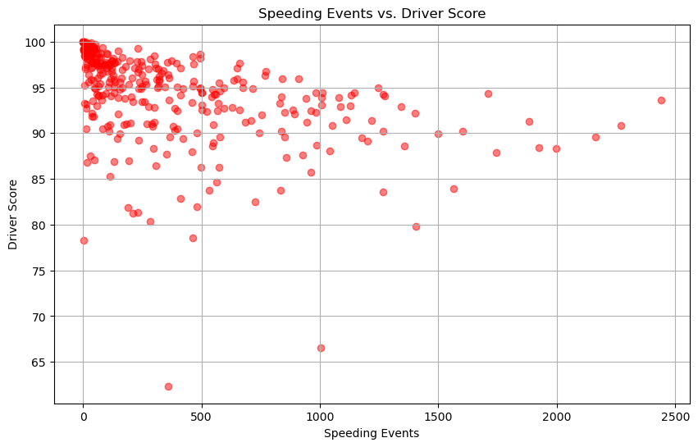
Exploring the correlation between the number of speeding events and the driver score can help determine if drivers with more speeding events have significantly lower scores. This can impact underwriting criteria and risk assessment.

Slide 22
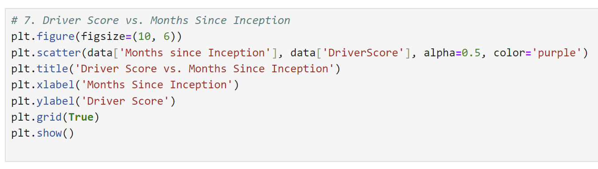
Driver Score vs. Months Since Inception

Slide 23
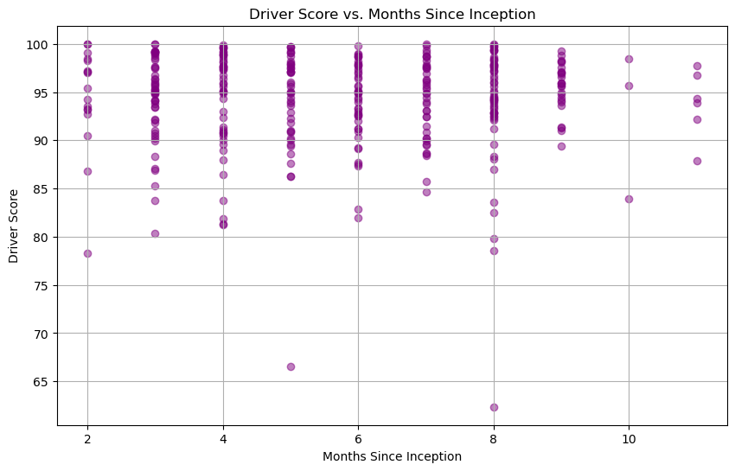
Examining the impact of the duration since policy inception on driver scores can help insurers understand if long-term policyholders demonstrate improved driving behavior. This can influence retention strategies and premium adjustments for long-term customers.

Slide 24
Conclusion
Our telematics analysis shows that most drivers exhibit average driving behavior, with only a few exhibiting extremely high or low scores, with younger drivers generally scoring lower. Premiums differ by gender, suggesting a need for fairer pricing models. Longer distances correlate with varying driver scores, highlighting the importance of safe driving practices.
High-risk events vary by gender, indicating benefits from gender-specific training. Speeding negatively impacts scores, stressing the need for stricter monitoring. Scores improve over time, showing the value of continuous feedback and incentives.

Slide 25
Recommendations
Implement driver education programs.
Introduce reward systems for high scores.
Provide regular performance feedback.
Adjust premium models for fairness.
Develop targeted coaching for low scorers.

Slide 26
Thank You
Sreekutty Thankappan

