Slide 1

Airline Passenger Satisfaction: A Data-Driven Approach
by SREELAKSHMI P G

Slide 2
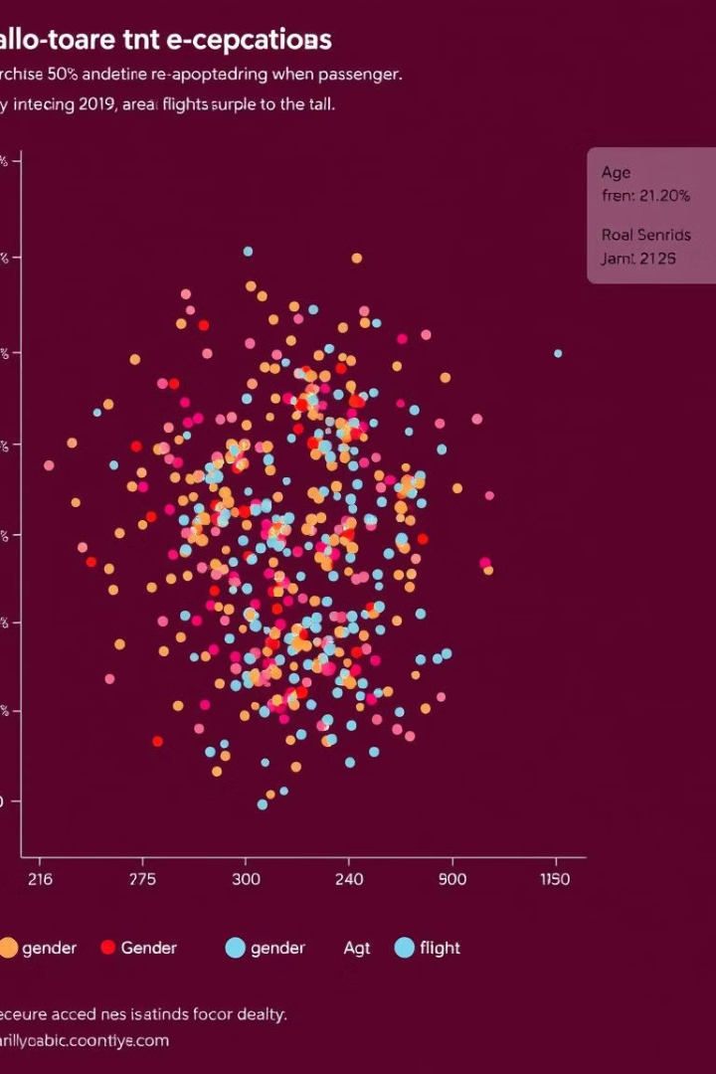
Dataset Overview
Rich Data
Diverse Features
The dataset encompasses 129,880 records with 23 features capturing crucial information.
Variables include demographics, flight details, and service ratings, offering a holistic view.

Slide 3
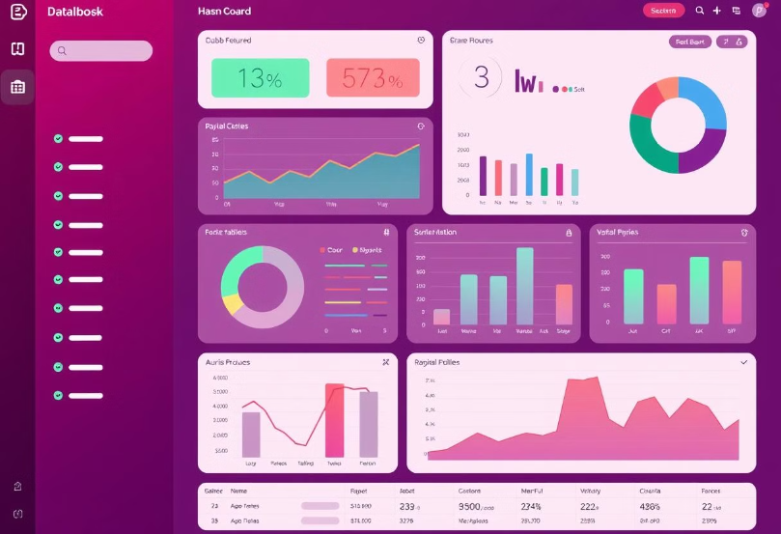
Analyzing Airline Passenger Satisfaction
Understanding the Data
Unveiling the factors that influence passenger satisfaction and providing insights for optimizing the customer journey.
Data-Driven Insights
Leveraging a comprehensive dataset to identify key trends, correlations, and patterns.

Slide 4
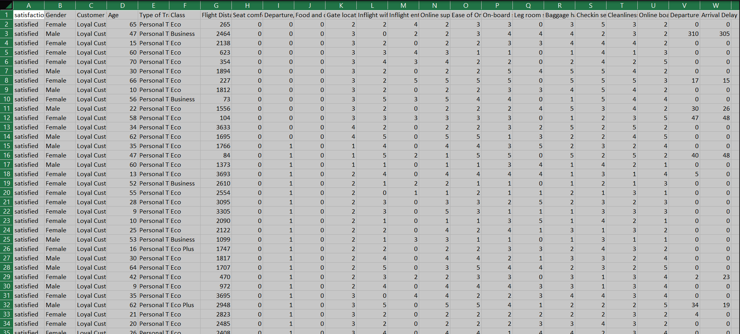
Key Features and Variables
Demographics
Flight Details
Age, gender, and frequent flyer status provide insights into customer segments.
Departure and arrival cities, flight duration, and class of travel reveal journey specifics.
Service Ratings
Ratings for seat comfort, food, entertainment, and customer service capture passenger experience.

Slide 5

Examining Flight Details
1
2
3
Flight Duration
Class of Travel
Route Complexity
Correlating flight duration with satisfaction highlights the impact of travel time.
Analyzing satisfaction based on cabin class unveils differences in service perception.
Assessing satisfaction related to connecting flights identifies challenges in multi-leg journeys.

Slide 6





Analyzing Service Ratings
Seat Comfort
Identifying the factors driving satisfaction with seating arrangements and amenities.
Food and Beverage
Analyzing the impact of food quality, selection, and service on overall satisfaction.
Entertainment
Investigating the role of in-flight entertainment options in enhancing the passenger experience.
Customer Service
Examining the impact of staff professionalism, responsiveness, and helpfulness on satisfaction.

Slide 7
Identifying Drivers of Satisfaction
Customer Service
1
A key driver of overall satisfaction, impacting all other aspects of the journey.
2
Seat Comfort
Contributing significantly to passenger well-being and comfort during the flight.
Flight Details
3
Factors like flight duration and class of travel influencing satisfaction.

Slide 8
Findings
Overall Satisfaction Levels:
54.73% of customers are satisfied, while 45.27% are dissatisfied. This indicates a slight majority of satisfied customers, but there is room for improvement.
Demographic Insights:
The customer count is nearly evenly split between males (64K) and females (66K).
The age group distribution shows the largest customer base in the 20-40 years age range.
Impact of Customer Type:
Loyal customers have significantly higher satisfaction levels (106.1K satisfied) compared to disloyal customers (41K satisfied).
Class of Service:
Business class passengers show the highest satisfaction levels (44K satisfied) compared to Eco and Eco Plus classes.
Dissatisfaction is more prominent in the Eco Plus class.

Slide 9
Service Performance:
Satisfaction and dissatisfaction with services such as cleanliness, in-flight Wi-Fi, food and drink, in-flight entertainment, and onboard service show variations, with room to enhance service quality for a better experience.
Delay Impacts:
There is a correlation between arrival and departure delays and customer dissatisfaction, with longer delays leading to higher dissatisfaction.

Slide 10
Recommendations for Service Enhancement
Invest in Training
1
Prioritize staff training to enhance customer service skills and professionalism.
Upgrade Amenities
2
Improve seat comfort, entertainment options, and food quality to elevate the experience.
Optimize Operations
3
Streamline processes and improve communication to enhance operational efficiency and reduce delays.

Slide 11
Conclusion
Our data-driven analysis reveals several key drivers of airline passenger satisfaction. Prioritizing customer service, enhancing seat comfort, and optimizing flight operations are crucial for improving the overall passenger experience. These insights provide actionable recommendations for airlines seeking to enhance their services and increase customer satisfaction.

Slide 12
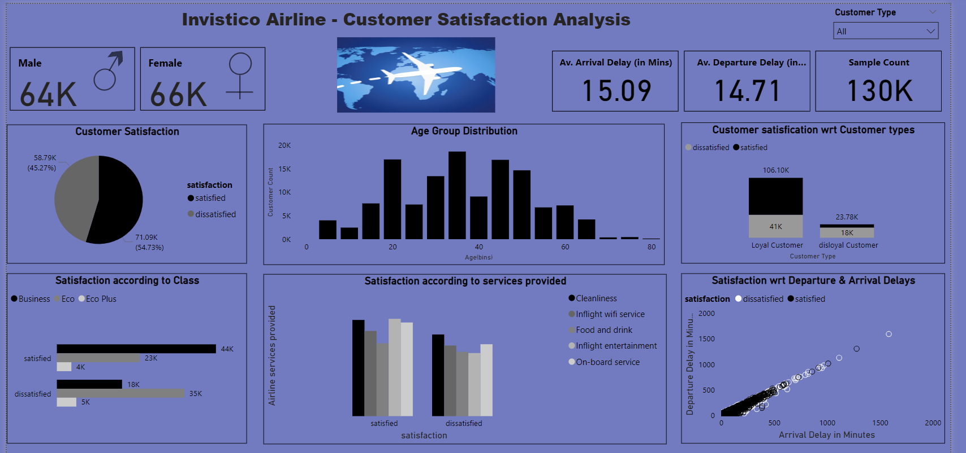
Dashboard Preview

Slide 13
Data Sources and Methodology
Data Sources
Methodology
The dataset utilized in this project has been sourced from a popular online platform known as Kaggle, which hosts a wide variety of datasets for data analysis and machine learning purposes.
We took a rigorous, data-driven approach to analyze the drivers of airline passenger satisfaction. This involved exploring the data, identifying key factors, and synthesizing actionable recommendations for airlines.
A Power BI dashboard was created to visualize the data.
Power BI is a Microsoft tool for creating interactive data visualizations and insights, helping organizations make data-driven decisions.

Slide 14
Thank You…

