Slide 1

REAL ESTATE
Sprint 1&2

Slide 2
FEATURES
Admin
Login
Profile
Dashboard
Comments
User-all, new, profile
Post-all post
Media-library, add new
property-add new
User
Register/Login
Homepage
Profile
Property management-contact form
Search property
Bookmark
For enquires
Change password

Slide 3
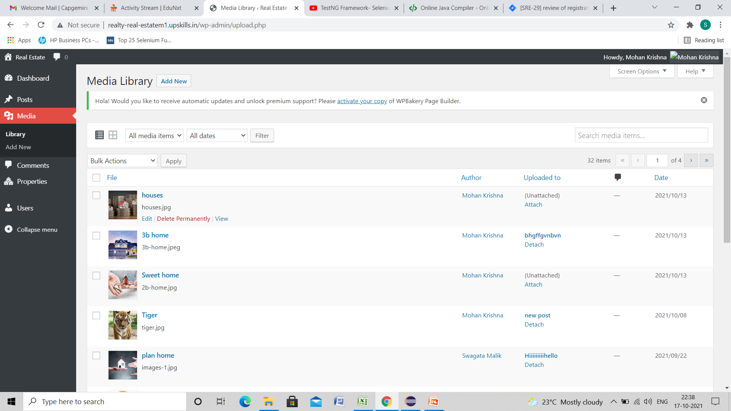
Real Estate website
Admin Media
-library and add new page

Slide 4
Sprint 1
Admin media category was assigned to me.
Stories and task for Admin media-library and add new media was assigned by scrum master in Jira.
Test cases for task for media library and adding media was created in excel.
Test design process-
Scenarios- categorised based on business risks
Test cases- positive and negative
Pre-conditions and specification for data creation
Test cases were reviewed and executed.
Issues which were found during the execution of test cases were noted down.
Bugs were created in Jira.

Slide 5
Jira – Workflow in Sprint 2
Story was created for automation of admin media library by scrum master.
Task for the story was created and assigned.
After completion of the task , it was uploaded in jira.
Defects were found and noted.
Issues were noted down.

Slide 6
Sprint 2
​Sanity test– Admin-media-library
​
Automation of media library in which edit, delete and search functionality was done using eclipse.​
Page and Test class was created in eclipse.
For search media, parameter was passed through data provider .
TestNG reports were generated. ​
​

Slide 7
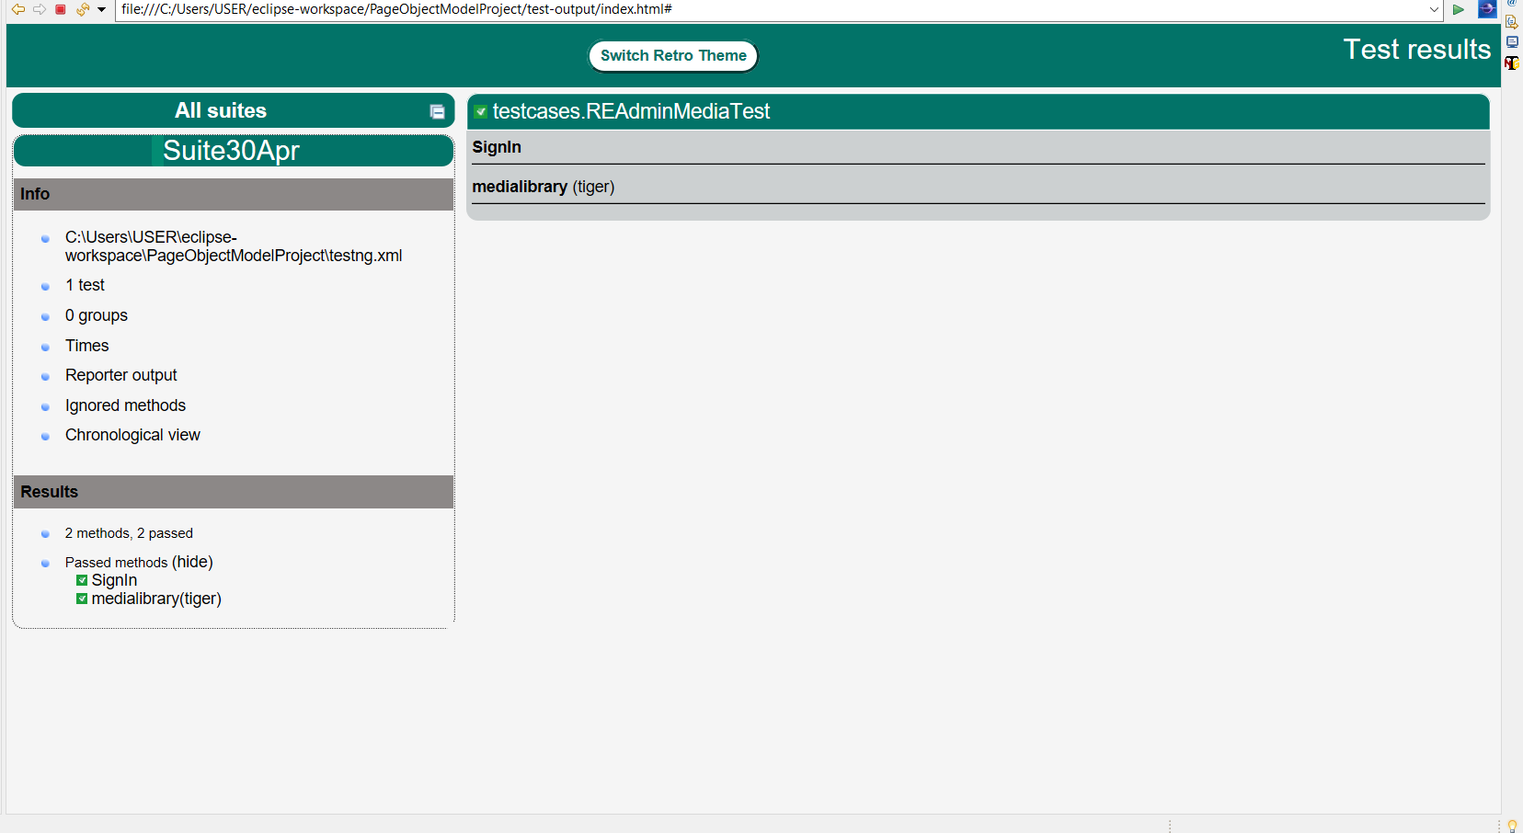
TestNG Report
TestNG report

Slide 8
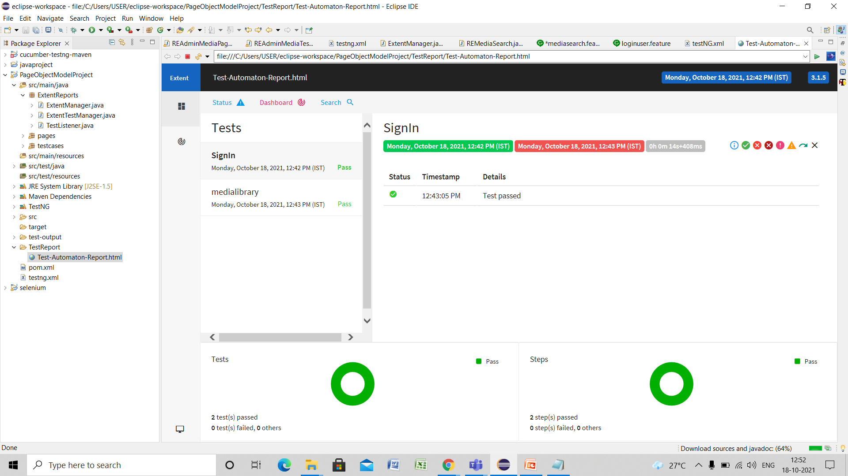
Extent Report

Slide 9
THANK YOU...

