Slide 1

REAL ESTATE
Sprint 1&2

Slide 2

Contents
Roles
Real Estate website
Features
Structure of website
Sprint 1 – Manual testing
Sprint 2 – Automation testing

Slide 3
Roles
Scrum master- Sreelakshmi Ram A
Team members-
Srishti Ghosh
Supriya Barthwal
Varshitha N
Swathi M
Swagata Malik
Soumya Shet
Sushmitha S
Taznaine

Slide 4
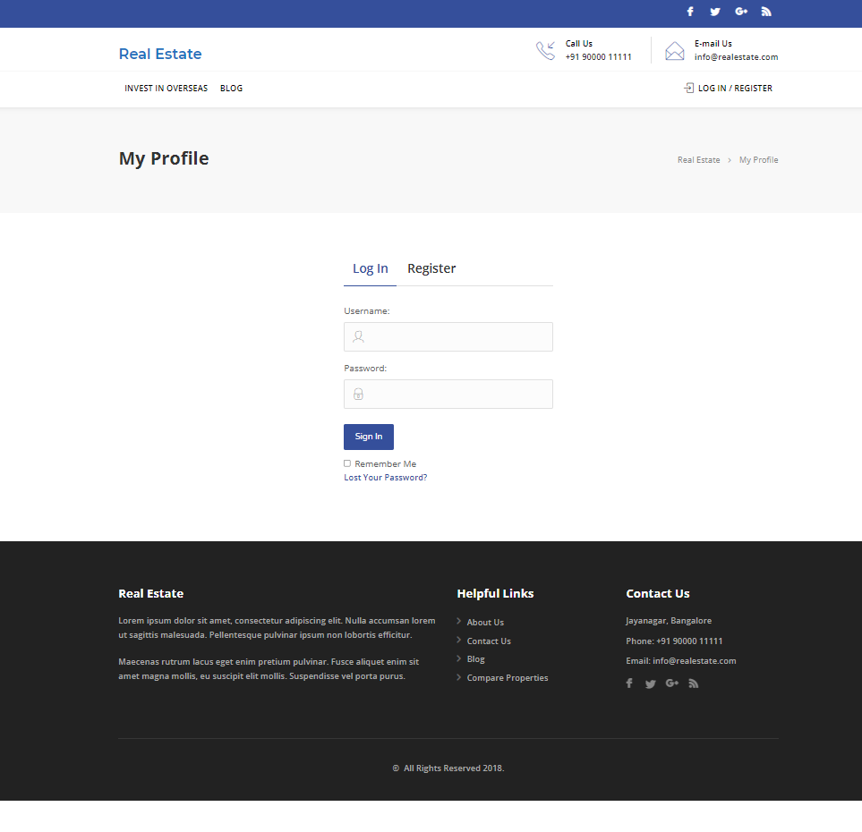
Real Estate website
Welcome to Real Estate

Slide 5
FEATURES
Admin
Login
Profile
Dashboard
Comments
user-all user, new user, profile
Post-all post, add new,
Categories, Tags
Media-library, add new
Property-add new, all property, Features, Regions, Property setting
User
Register/Login
Homepage
Profile
Property management-contact form
Search property
Bookmark
For enquires
Change password

Slide 6
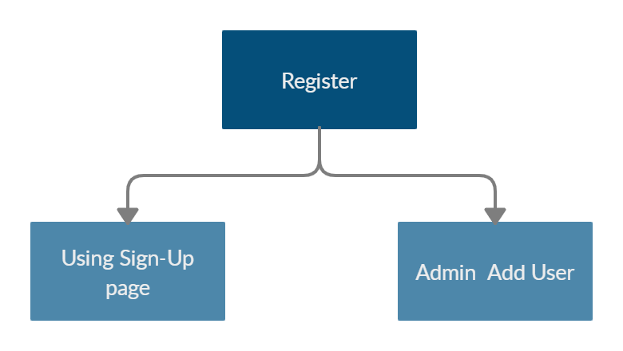
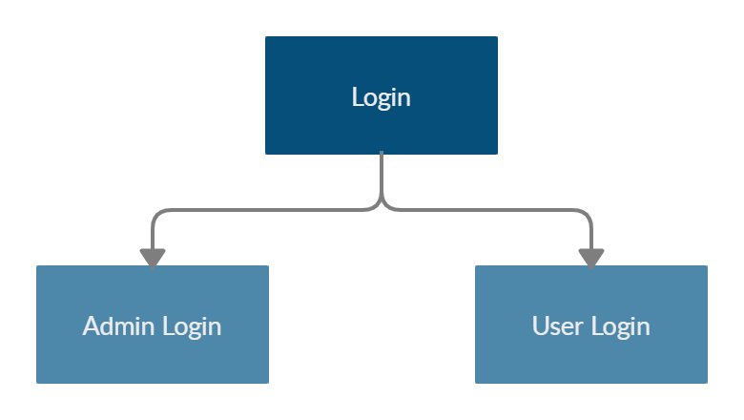
Register / Login

Slide 7
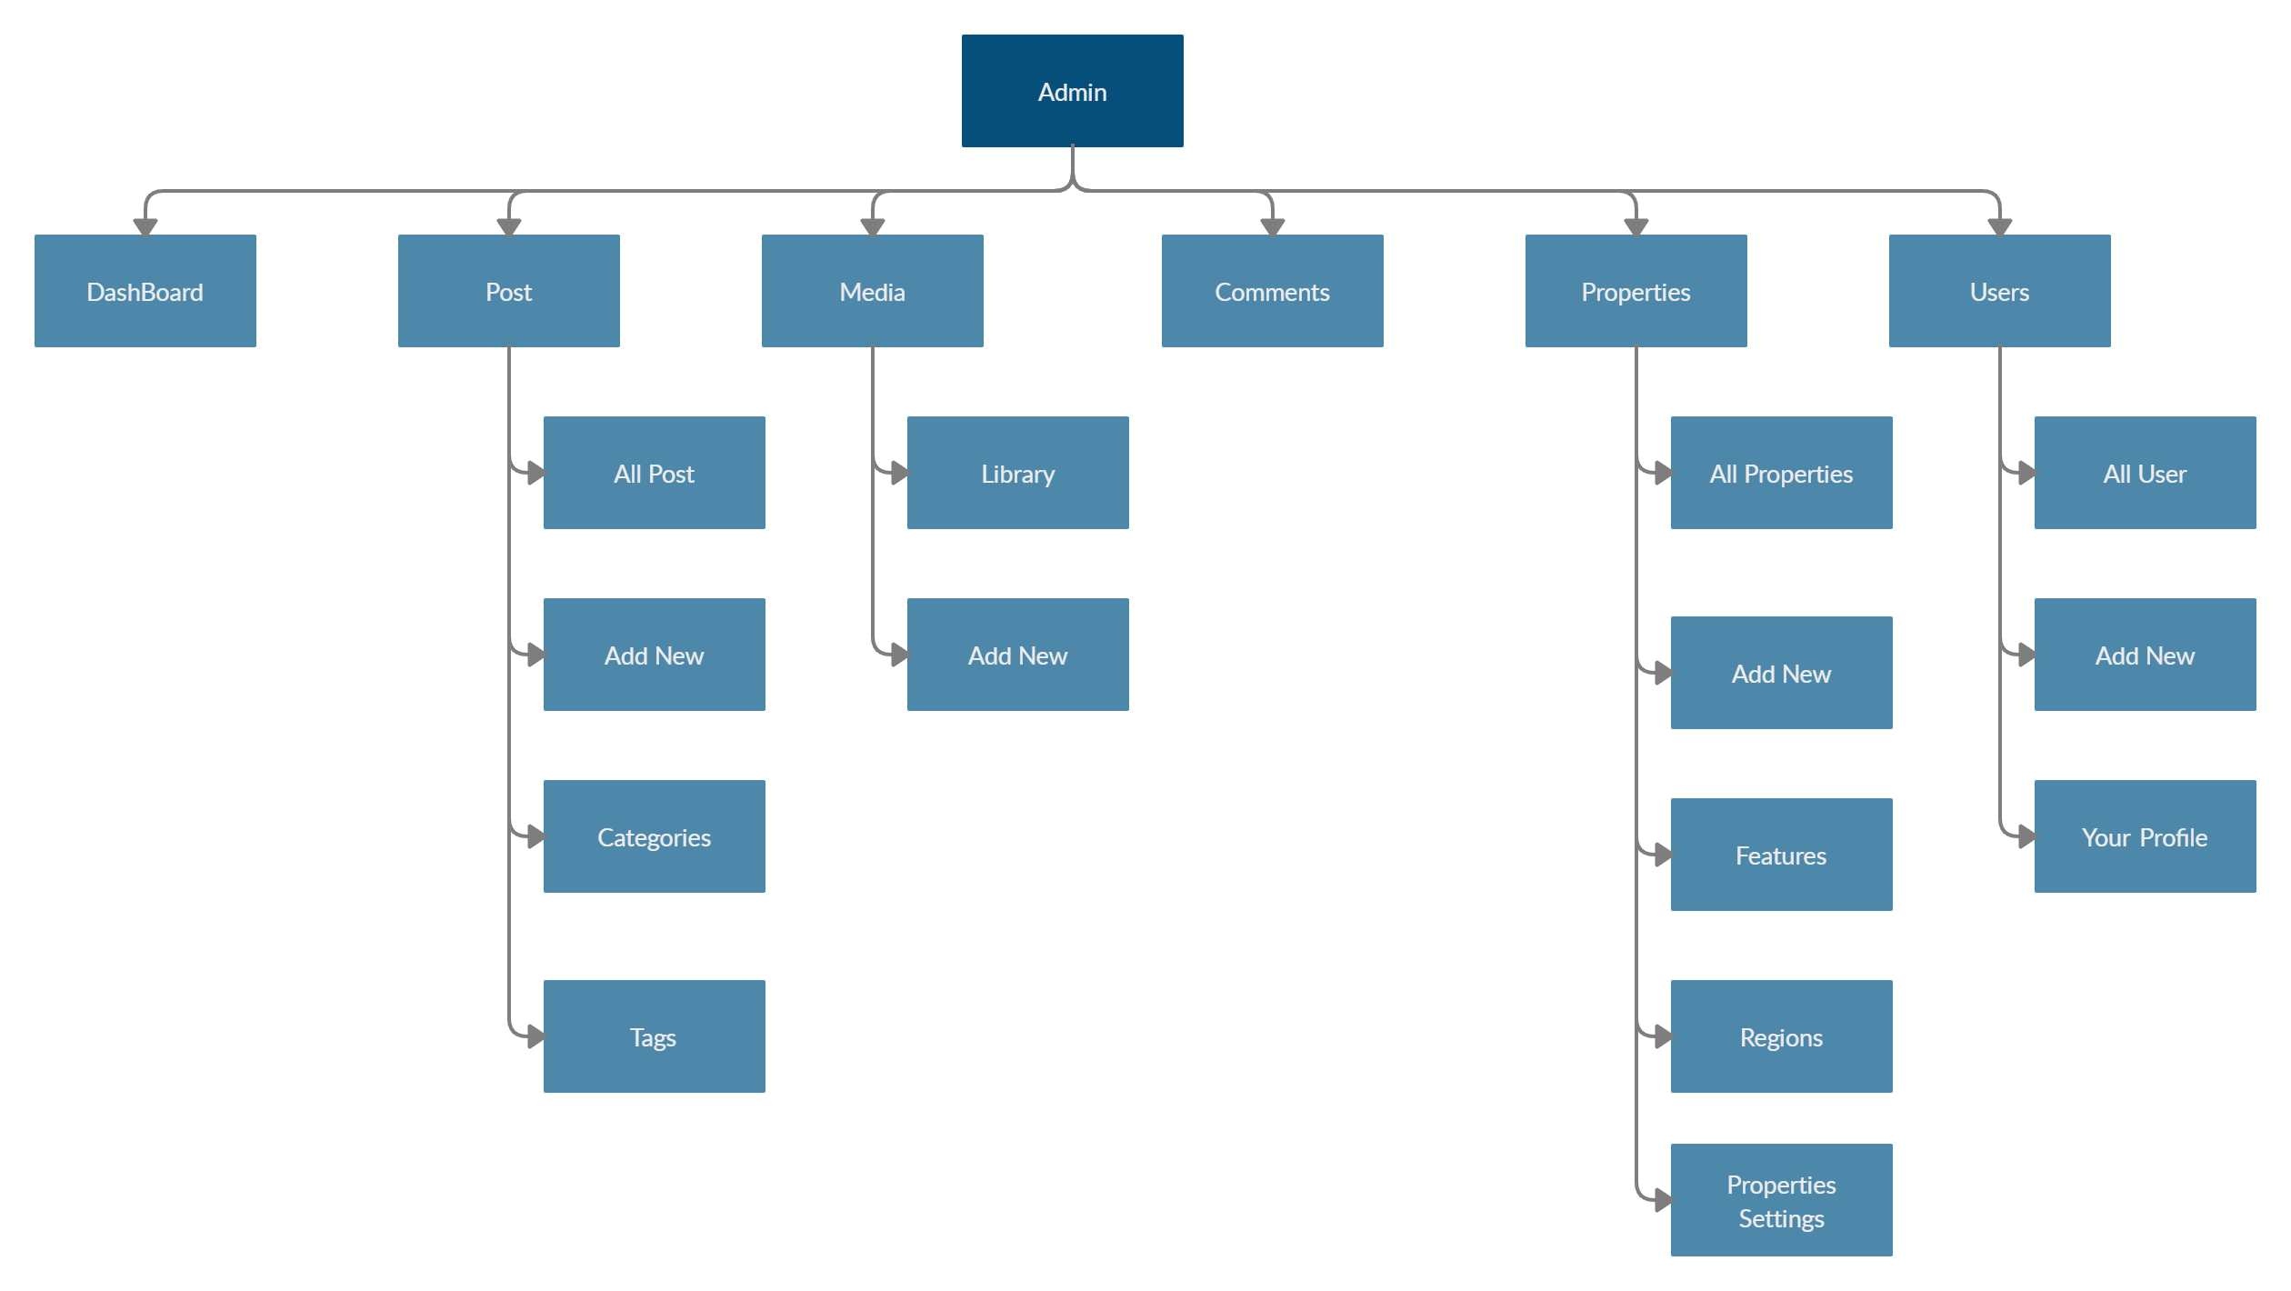
Admin

Slide 8
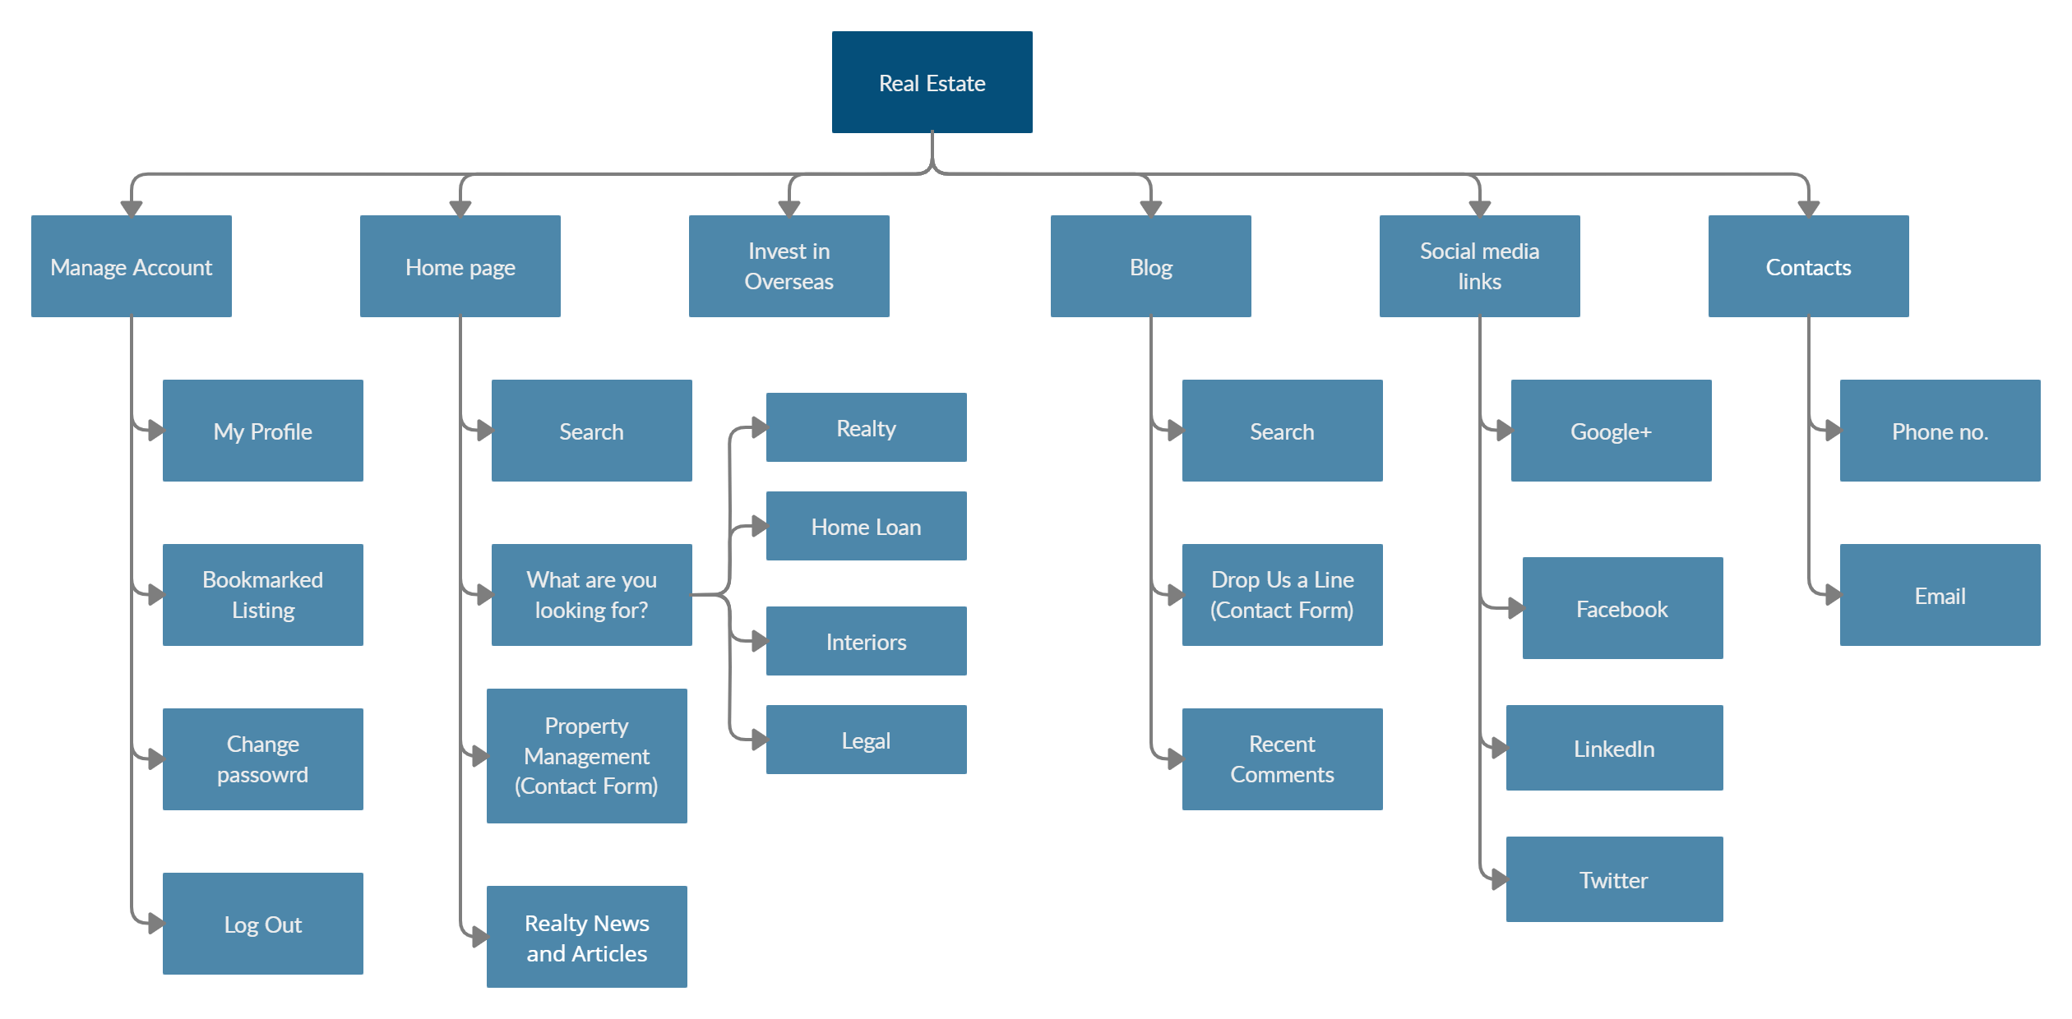
User

Slide 9
Manual testing - sprint 1
Activities
Planning-User stories in Jira
Work allocation- For test design to team members- Jira tasks
Test design process-
Scenarios- categorised based on business risks
Test cases- positive and negative based testcases
Pre-conditions and specification for data creation
Equivalence partitioning was done where ever required
Review process and baseline of testcases

Slide 10
Jira – Workflow in Sprint 1
15 Stories were created in Jira with respect to Admin side and user side
No of tasks & sub-tasks-16
No of bugs - 23
Review of each task was completed.
Execution of the testcase was submitted.
Defects were logged into the defect log with 23 defects.
Issue log was created with 41 issues.

Slide 11
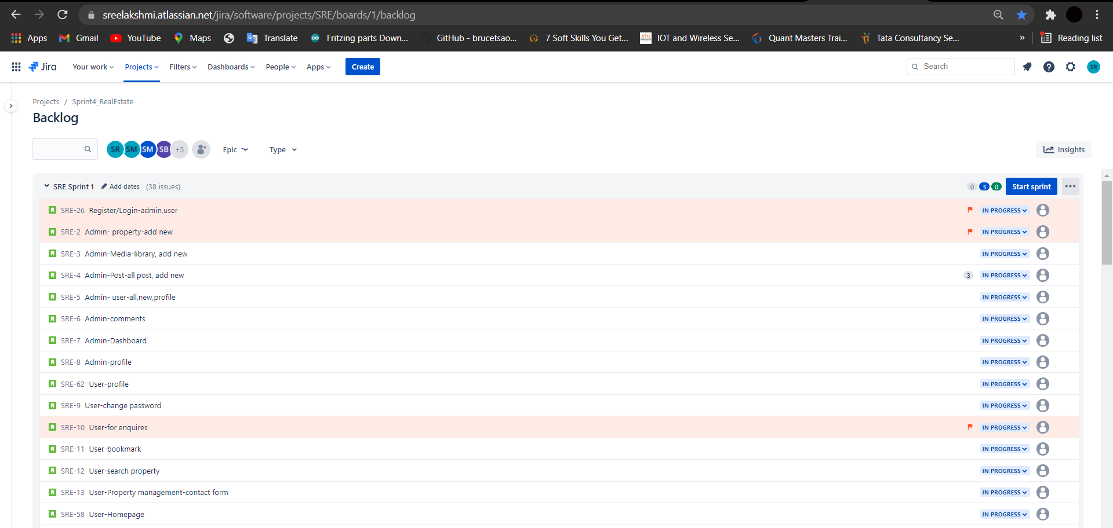
Jira – Workflow in Sprint 1

Slide 12
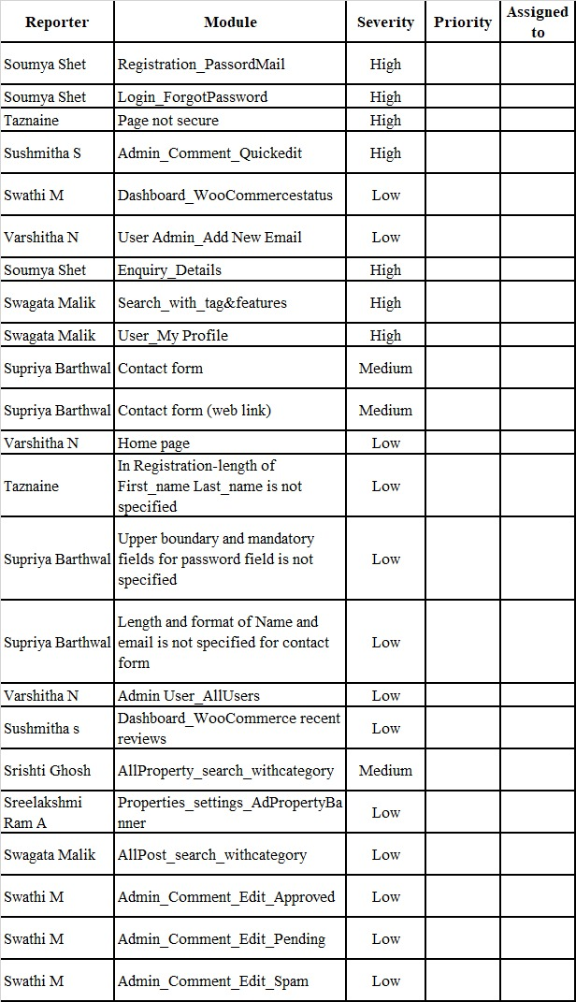
Test execution
Preparation of test data
Smoke test including pre-condition check
Start of Test execution
Defect logging –2 cycles
Follow ups
-Bug allocation to development team
-Updating of issue log
Figure : Defect log

Slide 13
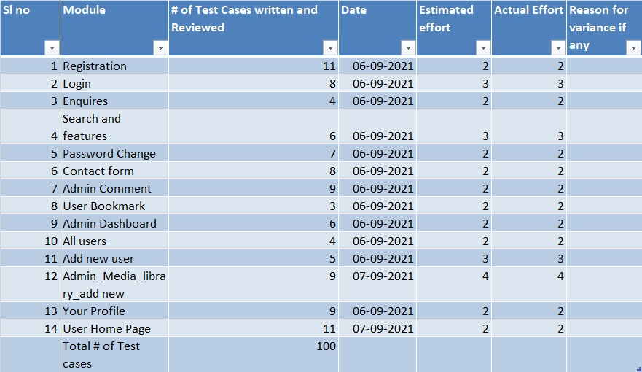
Test Metrics
Module wise number Of test cases written-100.
Category wise defect analysis based on priority, severity, status -41
Review of each task and submission of checklist.
Execution of the testcase was submitted.
Figure : Matrix table

Slide 14
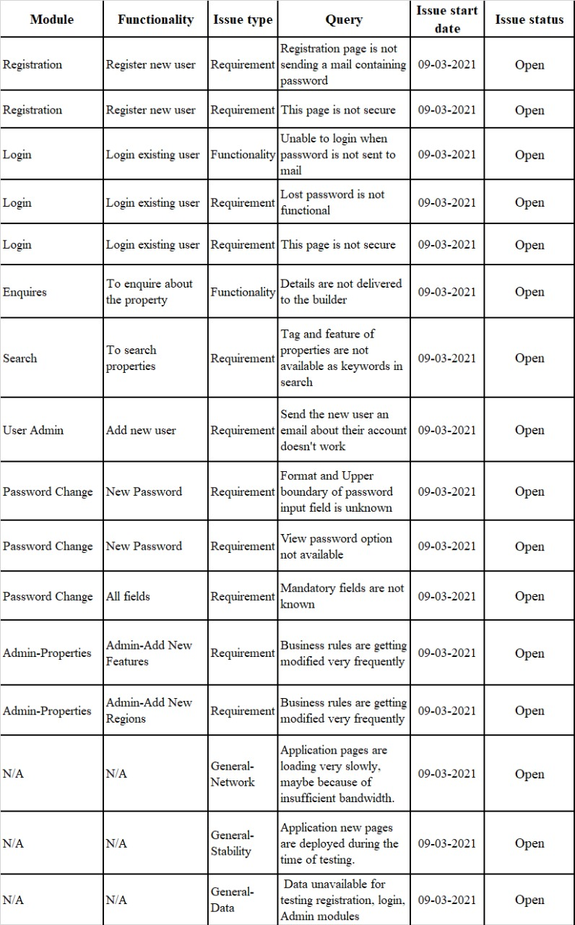
Post execution activities
Like to have features in application communicated to developers.
Ongoing issues discussed during the pre-production move of release 1.
Review of acceptance criteria.
Planning for regression test cases using manual/automation approach.
Figure : issue log

Slide 15
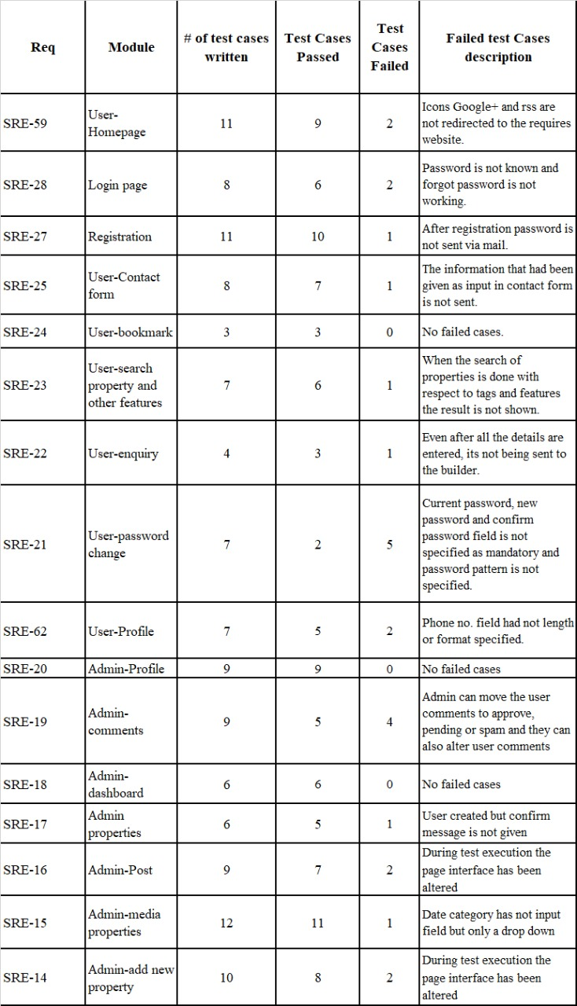
Test case Summary
Figure :Testcase summary

Slide 16
Automation testing - Sprint 2
Planning activities-selection of test cases for automation under
Smoke test
Sanity test
Regression test
Task allocation for automation test cases to automation testers
Techniques followed – Selenium IDE , Java ,Maven, TestNG, Page Object Model, frameworks selected for the automation.
Uploaded all the files on GitHub

Slide 17
Jira – Workflow in Sprint 2
15 Stories were created in Jira with respect to Admin side and user side
Sprint 1 -
No of tasks & sub-tasks-22
No of bugs – 14
Each task went through different automation testing which was segregated with respect to severity.
Defects were logged into the defect log with 14 defects.
Issue log was created with 16 issues.

Slide 18
Automation testing
ID No. | Automation Test | Test Case | Name
SRE-89 | Smoke Test | User-Homepage | Supriya Barthwal
SRE-91 |  | Admin-profile | Swagata Malik
SRE-92 |  | Admin-Dashboard | Sushmitha S
SRE-93 |  | Admin-comments | Swathi M
SRE-94 | Sanity Test | Admin-Post-all post, add new,delete,tags&categories,search | Srishti Ghosh​
SRE-95 |  | Admin-Media-library,search,delete | Soumya Shet
SRE-96 |  | User-Bookmark_remove-From profile | Swathi M
SRE-97 |  | User-profile | Swathi M
SRE-98 |  | Admin- all User | Supriya Barthwal
SRE-108 |  | Admin-profile | Taznaine
SRE-103 |  | User-comment | Taznaine
SRE-111 |  | User-Bookmark_save-From search | Sreelakshmi Ram.A
SRE-104 | Regression Test | Register-user | Sreelakshmi Ram.A
SRE-99 |  | Login-Admin | Sushmitha . S
SRE-105 |  | Login-User | Sreelakshmi Ram.A
SRE-106 |  | Register/Login page-Lost your Password? | Sreelakshmi Ram.A
SRE-100 |  | Admin- property-add new,all,delete,features&regions,search | Swagata Malik
SRE-101 |  | User-for enquires | Sreelakshmi Ram.A
SRE-102 |  | User-search property | Sreelakshmi Ram.A
SRE-107 |  | User-change password | Varshitha N
SRE-110 |  | User-Property management-contact form | Varshitha N
SRE-109 |  | Admin-Add user | Supriya Barthwal
Figure :Allocation of task with respect to automation testing

Slide 19
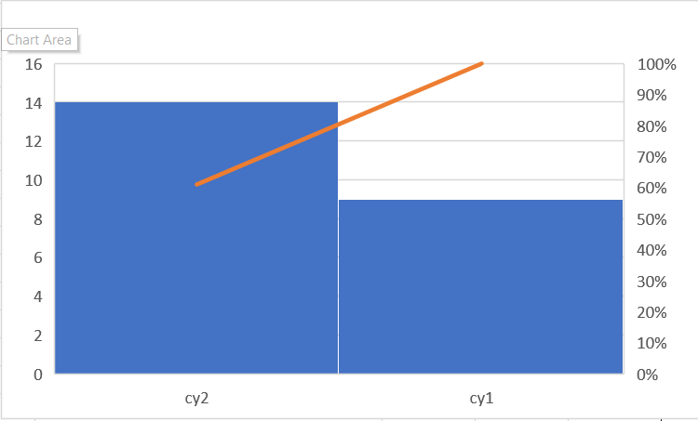
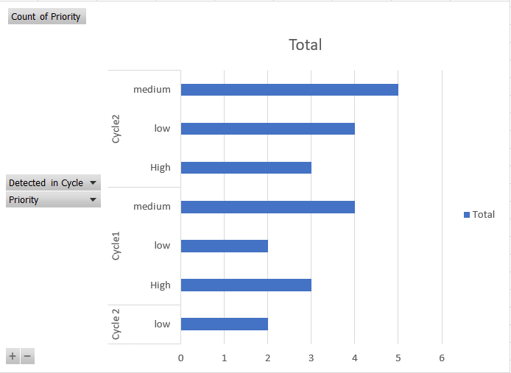
Charts and graphs
Sprint 1 - Pareto chart
Sprint 1 - Pivot table

Slide 20
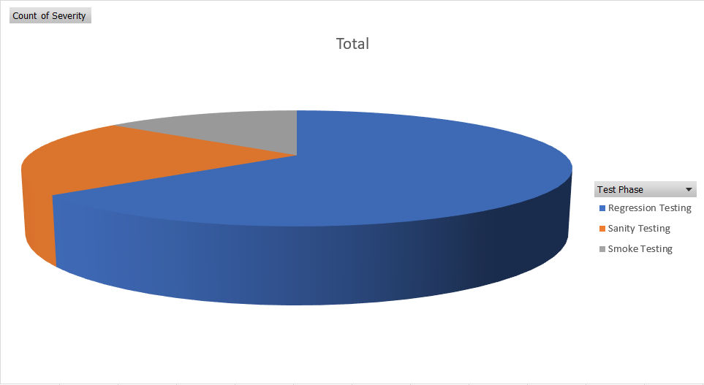
Charts and graphs
Sprint 2 - Pie chart

Slide 21
THANK YOU

