Slide 1

REAL ESTATE
Sprint 1&2
BY SWAGATA MALIK

Slide 2
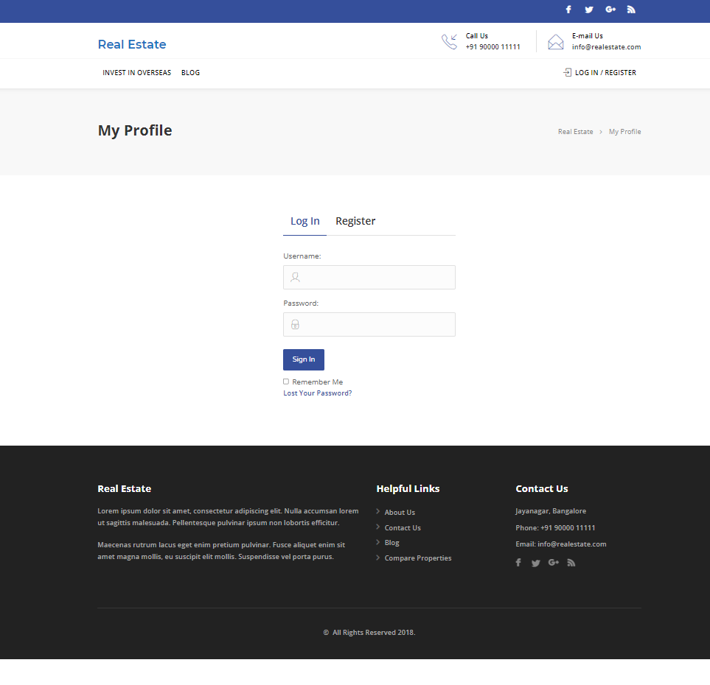
Real Estate website
Welcome to Real Estate

Slide 3
FEATURES
Admin
Login
Profile
Dashboard
Comments
user-all, new, profile
Post-all post
Media-library, add new
property-add new
User
Register/Login
Homepage
Profile
Property management-contact form
Search property
Bookmark
For enquires
Change password

Slide 4
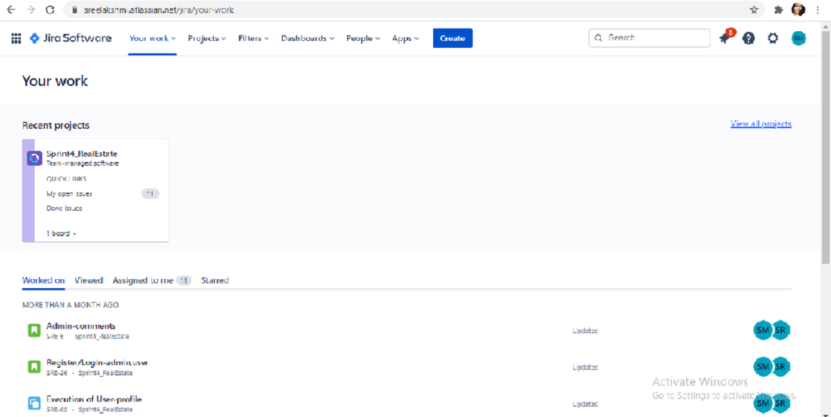
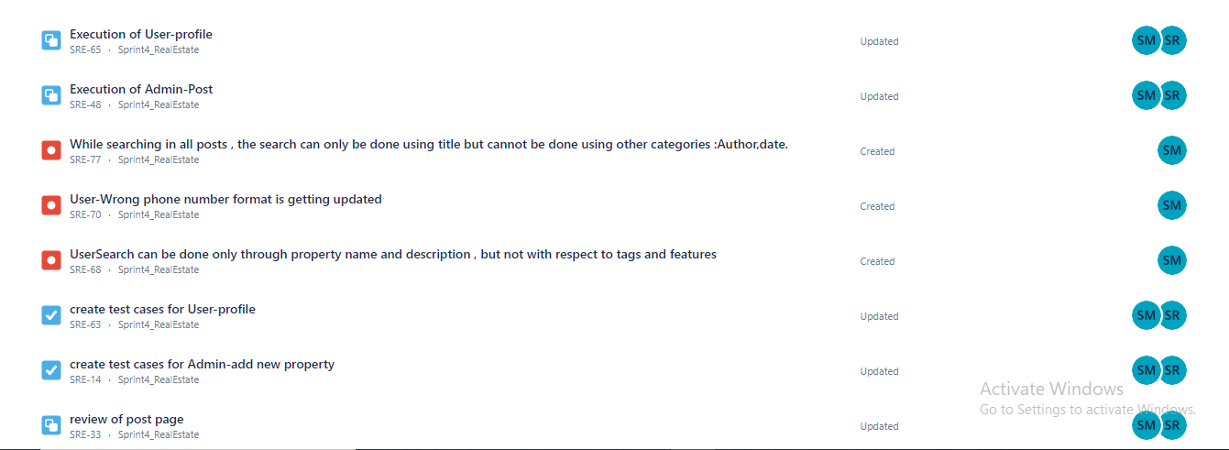
MY WORKS IN JIRA

Slide 5
Manual testing - sprint 1
Activities
Planning-User stories in Jira
Work allocation- For test design to team members- Jira tasks
Test design process-
Scenarios- categorised based on business risks
Test cases
Pre-conditions and specification for data creation
Test design techniques applied where ever necessary
Review process and baseline of testcases

Slide 6
Jira – Workflow in Sprint 1
2 Stories were created in Jira with respect to Admin side and user side
No of Issues- 7
No of bugs - 3
Review of each task was completed.
Execution of the testcase was submitted.
Total defects were logged into the defect log with 23 defects.
Issue log was created .

Slide 7
Sprint 1
User update profile and admin properties(all properties,add properties,add features,add regions,add property settings) were assigned by the scrum master.
Stories and tasks were created in Jira.
Test cases for were created in excel.
Test cases were reviewed and executed.
Defects and issues which were found during the execution of test cases and were noted down in defect log and issue log.
Bugs were created in Jira.

Slide 8
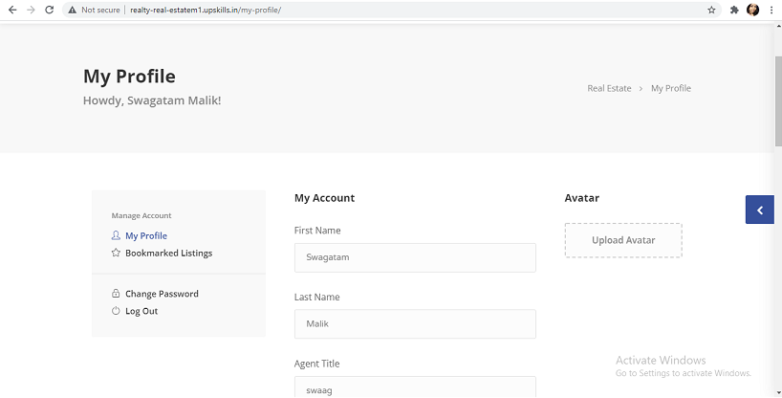
Real Estate website
User Update Profile

Slide 9
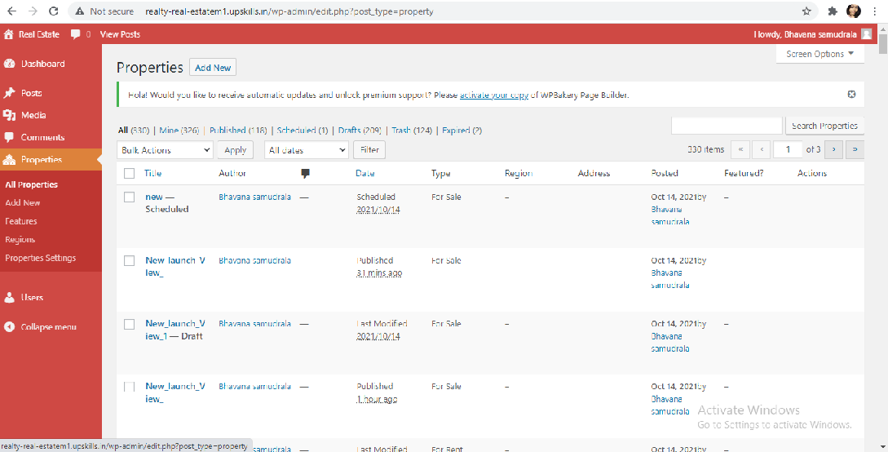
Real Estate website
Admin Properties

Slide 10
Test execution
Preparation of test data
Smoke test including pre-condition check
Start of Test execution
Defect logging if any –2 cycles
Follow ups
Bug allocation to development team
Updating of issue log

Slide 11
Post execution activities
Like to have features in application communicated to developers.
Ongoing issues discussed during the pre-production move of release 1.
Review of acceptance criteria.
Planning for regression test cases using manual/automation approach.

Slide 12
Automation testing - Sprint 2
Planning activities-selection of test cases for automation under
Smoke test
Sanity test
Regression test
Task allocation for automation test cases to automation testers
Techniques followed - Selenium , Java ,Maven, TestNG, Page Object Model, frameworks selected for the automation

Slide 13
Jira – Workflow in Sprint 2
1 Stories were created in Jira with respect to Admin side .
Sprint 2 –
No of Task- 2
No of Issues- 1
No of bugs –3
Each task went through different automation testing which was segregated with respect to severity.
Defects were logged into the defect log with 13 defects.
Issue log was created with 13 issues.

Slide 14
Sprint 2
ADMIN
1. Smoke Test - Admin profile
2. Regression Test - Property-all properties, search property, delete property , add new , add features , add region .
Automation of all functionalities of admin properties was done using eclipse.
Selenium , Java ,Maven, TestNG, Page Object Model, frameworks selected for the automation.
TestNG reports were generated.

Slide 15
ADMIN
Functionalities
PROPERTIY
ALL PROPERTIES
ADD FEATURES
ADD REGION
ADD NEW

Slide 16
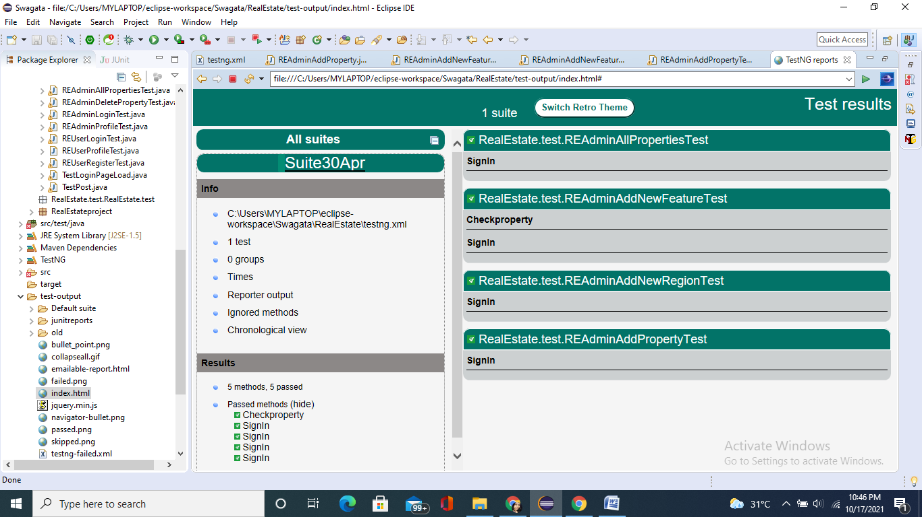
TESTNG REPORT

Slide 17
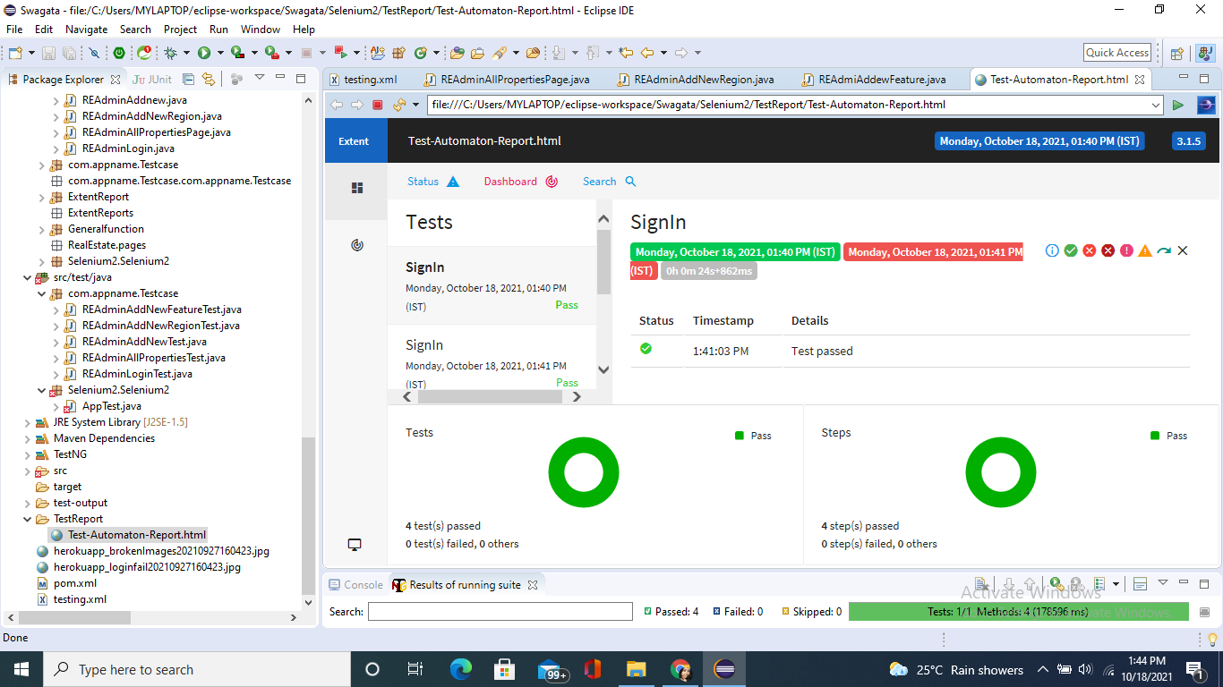
EXTENT REPORT

Slide 18
THANK YOU

