Slide 1

ATLIQ HARDWARE
Domain:
Consumer_Goods
G.Sreelakshmi

Slide 2
TABLE OF CONTENTS
Introduction
Agenda
Data Understanding
Adhoc Requests
Key Insights

Slide 3
INTRODUCTION
Atliq Hardware is one of the leading computer hardware producers in
India andwell expanded in other countries too.
Atliq Hardware has 74 customers in 27 countries worldwide. Along With
Asia Pacific(APAC)region ,they also operate in Europe(EU),
North America(NA),and Latin America (LATAM).
Atliq Hardware has three main Division of Products-Peripherals &
Accessories(P&A),Network & Storage (N&S),
And Personal Computer(PC)

Slide 4
AGENDA
Provide Insights to the management by solving Ad-hoc requests

Slide 5
DATA UNDERSTANDING
The dataset of fiscal year 2020 and 2021 is available.
Atliq hardware fiscal year starts from 1st September and ends on 31st August.
Atliq hardware database (Atliq hardware_db)has 6 main tables.
1.dim_customer:contains customer-related data
2.dim_product:contains product- related data
3.fact_gross_price : contains gross price information for each product
4.fact_manufacturing_cost : contains the cost incurred in the production of each product
5. fa ct_pre_invoice_deduction : contains pre-Invoice deduction information for each product
6.fact_sales_monthly : contains monthly sales data for each product

Slide 6
AD-HOC REQUESTS

Slide 7
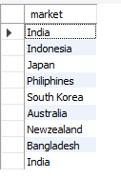

1.Provide the list of markets in which customer "Atliq Exclusive" operates its business in the APAC region.

Slide 8
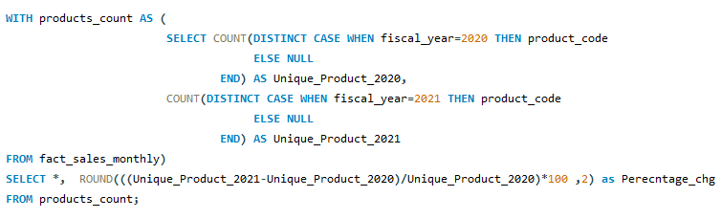

2. What is the percentage of unique product increase in 2021 vs. 2020?
The final output contains these fields,
unique_products_2020
unique_products_2021
percentage_chg

Slide 9

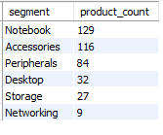
3. Provide a report with all the unique product counts for each segment and sort them in descending order of product counts. The final output contains 2 fields,
segment
product_count

Slide 10
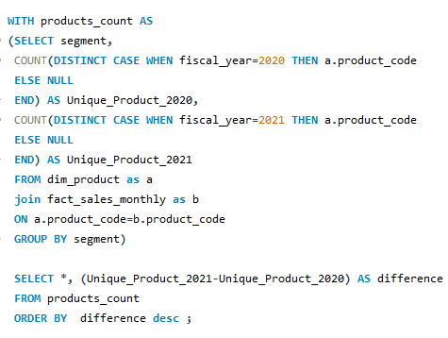
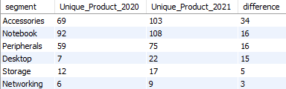
4. Follow-up: Which segment had the most increase in unique products in 2021 vs 2020?
The final output contains these fields,
Segment
product_count_2020
product_count_2021
difference

Slide 11
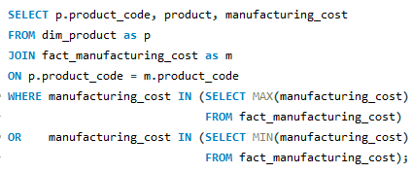

5. Get the products that have the highest and lowest manufacturing costs.
The final output should contain these fields,
product_code
Product
manufacturing_cost

Slide 12
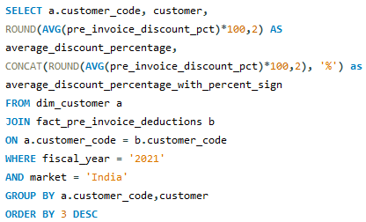
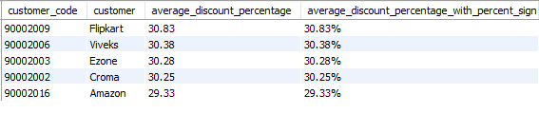
6. Generate a report which contains the top 5 customers who received an average high pre_invoice_discount_pct for the fiscal year 2021 and in the Indian market. The final output contains these fields,
customer_code
customer
average_discount_percentage.

Slide 13
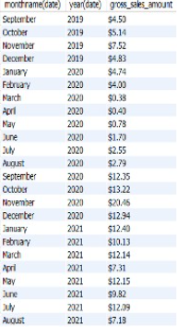
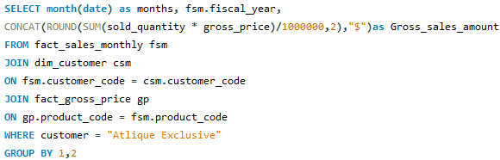
7. Get the complete report of the Gross sales amount for the customer “Atliq Exclusive” for each month. This analysis helps to get an idea of low and high-performing months and take strategic decisions. The final report contains these columns:
Month
Year
Gross sales Amount

Slide 14
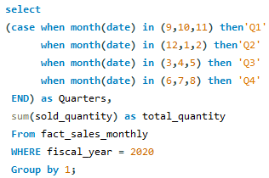

8. In which quarter of 2020, got the maximum total_sold_quantity? The final output contains these fields sorted by the total_sold_quantity,
Quarter
total_sold_quantity

Slide 15
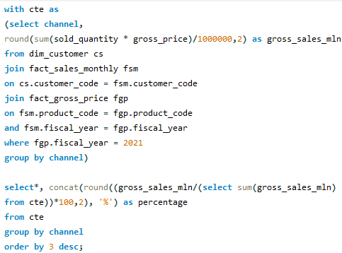

9. Which channel helped to bring more gross sales in the fiscal year 2021 and the percentage of contribution?
The final output contains these fields,
Channel
gross_sales_mln
percentage

Slide 16
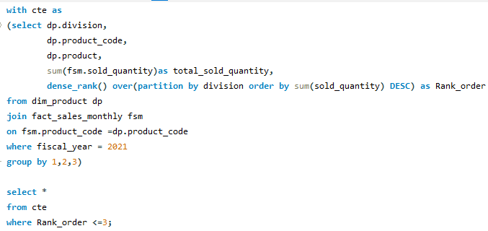
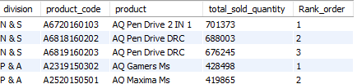
10. Get the Top 3 products in each division that have a high total_sold_quantity in the fiscal_year 2021? The final output contains these fields, division, product_code

Slide 17
THANK YOU

