Slide 1
BLUESTOCK FINTECH | CAPSTONE PROJECT
Mutual Fund
Analytics Platform
40
Fund Schemes
End-to-End Data Engineering, ETL Pipeline
& Interactive Dashboard
87K+
Data Rows
By:
Yarragunta Sreelatha Reddy
Bluestock Fintech MJ28(Intern)
Team: 215FMBF
4.5 Yrs
NAV History
Technologies: Python • SQL • Power BI / Tableau • Pandas • Matplotlib
June 2026

Slide 2
Problem Statement & Objectives
PROBLEMS
OBJECTIVES
Data Fragmentation
1
Build automated ETL pipeline from AMFI data
NAV, AUM, SIP data scattered across sources in different formats
2
Design normalised 5-table SQL star schema
No Benchmark Tracking
Investors can't tell if their fund beats the index
3
Perform comprehensive EDA on NAV & AUM
Performance Blind Spot
4
Compute Sharpe, Sortino, Alpha, Beta, VaR
No easy way to compare risk-adjusted returns across AMCs
5
Build 4-page interactive BI dashboard
Investor Behaviour Gap
Analyse investor transactions by demographics
Geographic & demographic insights missing for distributors
6
7
Compare fund returns vs Nifty 50 / 100
Slow Reporting
Static PDFs take days; no drill-down capability
8
Document and present the complete project

Slide 3
Data Sources & Datasets
10 datasets • 87,000+ rows • 4.5 years of history • All publicly available
01
fund_master.csv
02
nav_history.csv
40 rows
~46,000 rows
40 real schemes — AMFI codes, fund house, category, expense ratio
Daily NAV Jan 2022–May 2026, anchored to real mfapi.in values
03
aum_by_fund_house.csv
04
monthly_sip_inflows.csv
~90 rows
48 rows
Quarterly AUM for 10 fund houses 2022–2025 from AMFI reports
Real AMFI Monthly Note data — inflows, accounts, SIP AUM
05
category_inflows.csv
07
scheme_performance.csv
~144 rows
40 rows
Net inflows by fund category for FY 2024-25
1yr/3yr/5yr returns, Sharpe, Sortino, Alpha, Beta, Max Drawdown
08
investor_transactions.csv
10
benchmark_indices.csv
~32,000 rows
~8,000 rows
SIP + Lumpsum + Redemption transactions for 5,000 investors
Daily values for Nifty 50, Nifty 100, Nifty Midcap 150, BSE SmallCap

Slide 4
System Architecture & ETL Pipeline
1
2
3
4
5
EXTRACT
TRANSFORM
LOAD
ANALYSE
VISUALISE
Data Sources
Python / Pandas
SQLite Database
Jupyter Notebooks
Tableau
AMFI Daily NAV TXT • mfapi.in REST API • NSE/BSE Bhavcopy • Pre-packaged CSVs
Parse & clean • Forward-fill holidays • Compute daily returns • Validate AMFI codes
5-table star schema • dim_fund, dim_date, fact_nav, fact_transactions, fact_performance
EDA • Sharpe / Sortino / Alpha / Beta • VaR • Cohort analysis • Geo heatmap
4 report pages • Slicers • Drill-through • PDF export
Mirrors real-world fintech data pipelines used at Zerodha, Groww and Paytm Money

Slide 5
EDA Highlights — NAV & AUM Trends
Rs. 62.74L Cr
Rs. 31,002 Cr
26.12 Cr
Industry AUM Dec 2025
Record SIP Inflow Dec 2025
Total MF Folios

Slide 6
EDA Highlights — SIP & Investor Analytics
Investor Age Distribution
18–25
26–35
36–45
46–55
56+
12%
38%
29%
14%
7%

Slide 7
Fund Performance Metrics
CAGR (3yr)
Sharpe Ratio
Alpha
Formula:
Formula:
Formula:
(NAVₑₙ꜀ / NAVₛₜₐᵣₜ)^(1/3) − 1
(Rₚ − Rᶠ) / σₚ × √252
Fund Return − Benchmark Return
Top result:
Top result:
Top result:
Mirae Asset Large Cap: 18.4%
HDFC Top 100: 1.42
SBI Bluechip: +3.2%
Beta
Sortino
Max Drawdown
Formula:
Formula:
Formula:
OLS regression vs Nifty 100
(Rₚ − Rᶠ) / Downside σ
min(NAV / running_max − 1)
Top result:
Top result:
Top result:
Range: 0.78 – 1.21
ICICI Bluechip: 1.85
Worst: −21.3% (2022)
Fund Scorecard: 30% × 3yr Return Rank + 25% × Sharpe Rank + 20% × Alpha Rank + 15% × Expense Ratio (inv.) + 10% × Max DD (inv.)

Slide 8
Fund Scorecard & Benchmark Comparison
Fund Name | 3yr CAGR | Sharpe | Alpha | Max DD | Score
SBI Bluechip | 16.8% | 1.38 | +3.2% | -18.4% | 82
HDFC Top 100 | 17.2% | 1.42 | +2.9% | -19.1% | 84
Mirae Asset LC | 18.4% | 1.35 | +4.1% | -17.8% | 87
ICICI Bluechip | 15.9% | 1.28 | +2.5% | -20.3% | 78
Axis Bluechip | 14.2% | 1.19 | +1.8% | -22.1% | 72
Funds are ranked using a composite weighted score. Top performer: Mirae Asset Large Cap (Score: 87/100)

Slide 9
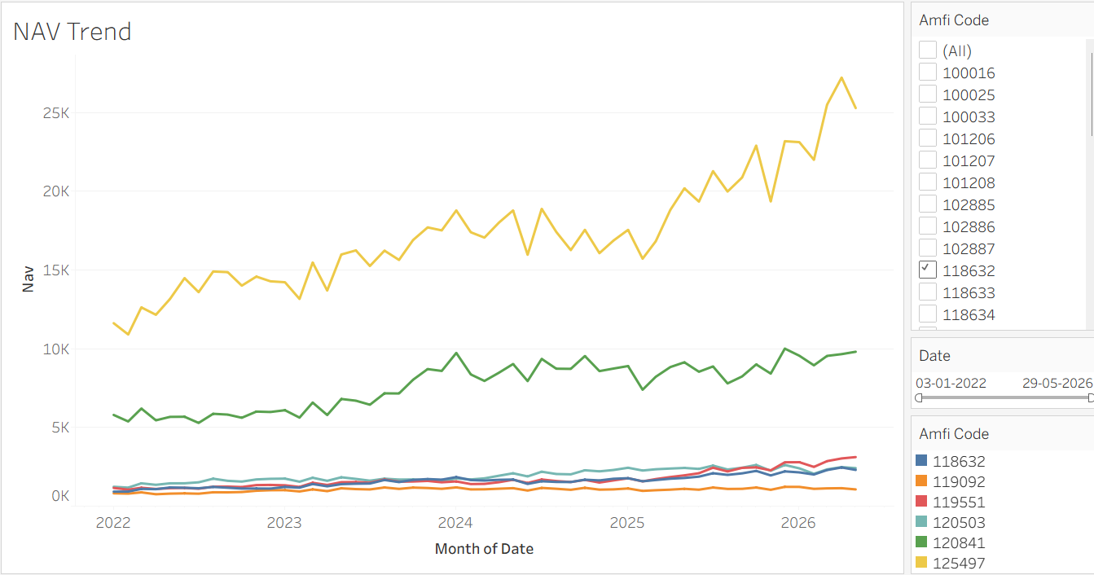
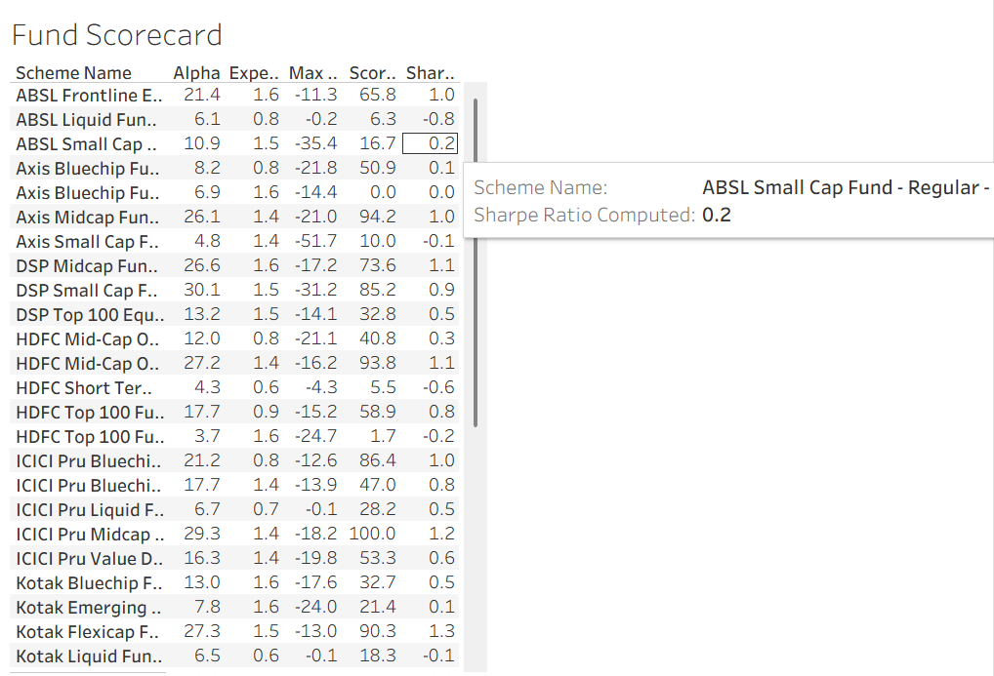
Dashboard Screenshots
Power BI / Tableau — 4 Interactive Pages
PAGE 1
PAGE 2
Fund Scorecard
NAV Trend
Score • Alpha • Sharpe • Max Drawdown
All 40 funds with sortable table
Slicers: Fund House, Category
6 selected funds • Jan 2022 – May 2026
Line chart with benchmark overlay
Slicer: Date Range, Fund
AUM: ₹62.74L Cr
SIP: ₹31K Cr
Folios: 26.12Cr
Note: Export each dashboard page as PNG from Power BI (File → Export → Export to PNG) and insert above

Slide 10
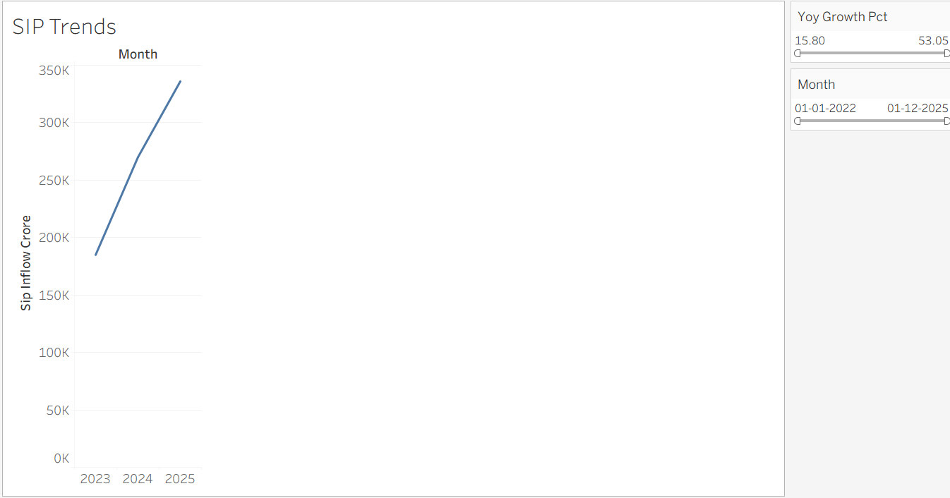
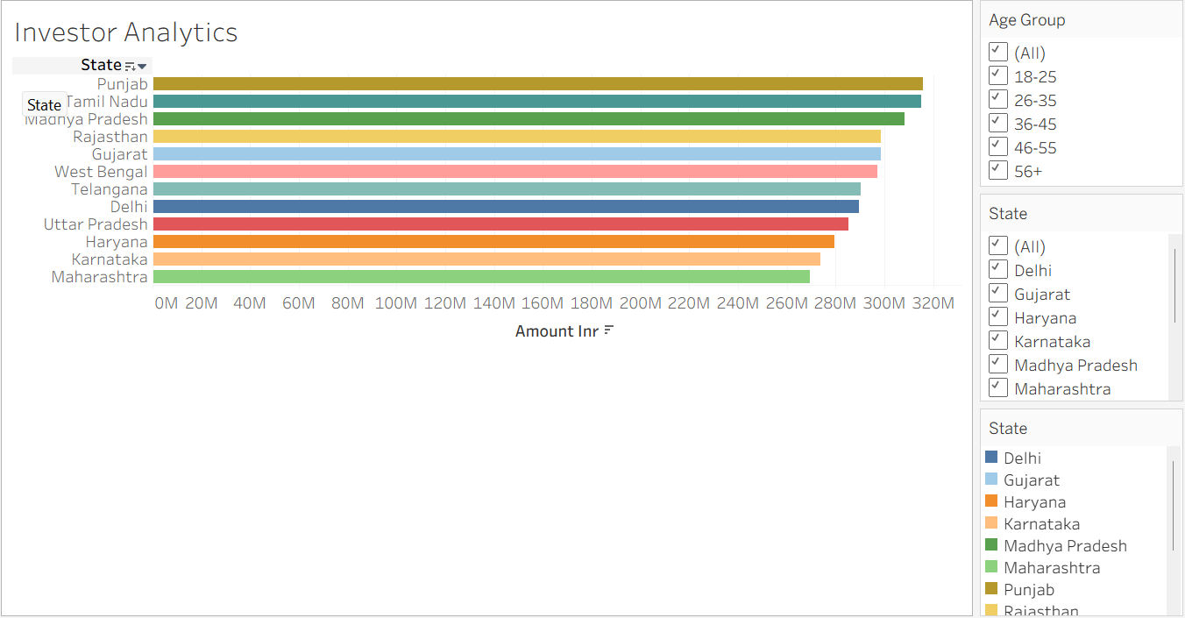
Dashboard Screenshots (continued)
PAGE 3
PAGE 4
Investor Analytics
SIP & Market Trends
Transaction amounts by state
12 Indian states • T30 vs B30 split
SIP vs Lumpsum vs Redemption donut
Age group vs avg SIP bar chart
Monthly SIP inflows 2022–2025
Dual-axis: SIP bar + Nifty 50 line
Category inflows heatmap
KPI: SIP account growth YoY
[

Slide 11
Key Findings & Insights
01
Industry Growth
02
Best Performer
Industry AUM hit ₹81 lakh crore in Dec 2025. SBI MF leads with ₹12.5L Cr — nearly 2× the nearest competitor. Monthly SIP inflows reached an all-time high of ₹31,002 Cr.
Mirae Asset Large Cap topped the composite scorecard (87/100) with 18.4% CAGR, Alpha of +4.1% vs Nifty 100, and lowest drawdown among large-cap peers.
03
Risk Metrics
04
Investor Behaviour
Funds with the highest Sharpe ratios (>1.3) delivered consistent alpha. Liquid funds showed near-zero drawdown and low beta, confirming their defensive role in portfolios.
26–35 age group drives 38% of all SIP transactions. Maharashtra and Delhi account for 42% of total transaction value. T30 cities contribute 78% of inflows.
05
SIP Momentum
06
Portfolio Concentration
Active SIP accounts grew from 4.1 Cr (Jan 2022) to 9.35 Cr (Dec 2025) — a 128% increase. Monthly new SIP registrations consistently exceeded 30 lakh from 2024 onwards.
Financial services (28%), IT (18%) and FMCG (12%) dominate equity fund holdings. Mid-cap funds show higher HHI concentration, contributing to elevated max drawdowns.

Slide 12
Thank You
Mutual Fund Analytics Platform — Bluestock Fintech Capstone
Deliverables Submitted
✓ ETL Pipeline Script (Python)
✓ SQLite Database + Schema
✓ EDA Notebook (15+ charts)
✓ Performance Analytics Notebook
✓ Interactive Dashboard (.pbix/.twbx)
✓ Advanced Analytics + VaR
✓ Final Report PDF + This Deck
Data Sources: AMFI India • mfapi.in • NSE/BSE • All data for educational purposes only
GitHub: github.com/Sreelatha2058/bluestock_mf_capstone

