Slide 1



Name of Project
Air Quality Prediction & Forecasting
Theme: Environmental Monitoring & Pollution Control
By Sreelekha Dasgupta

Slide 2

Learning Objectives
Gain hands-on experience in data preprocessing, including data cleaning, handling missing values, and feature engineering.
Develop skills in machine learning modeling for
Multi-class and binary classification of air quality categories.
Regression forecasting to predict future AQI values.
Learn to evaluate models using key metrics such as Accuracy, Confusion Matrix, R² Score, and MSE.
Enhance ability to visualize and interpret results through clear plots and trend analysis using Matplotlib and Seaborn.
Visualize results using Matplotlib & Seaborn (heatmaps, bar plots, line charts).
GOAL
Source :
www.freepik.com/

Slide 3
Tools and Technology used
Programming Language: Python
Libraries & Framework:
Data Handling: Pandas, NumPy
Visualization: Matplotlib, Seaborn
Machine Learning: Scikit-learn (Logistic Regression, Random Forest, SVM)
Deep Learning: TensorFlow/Keras (Neural Networks)
Forecasting: Random Forest Regressor with lag features
Development Environment: Google Colab (GPU/TPU acceleration, easy dataset mounting via Google Drive).
Version Control: GitHub for project tracking & collaboration.
Data Source: Kaggle Air Quality Dataset (CSV)

Slide 4
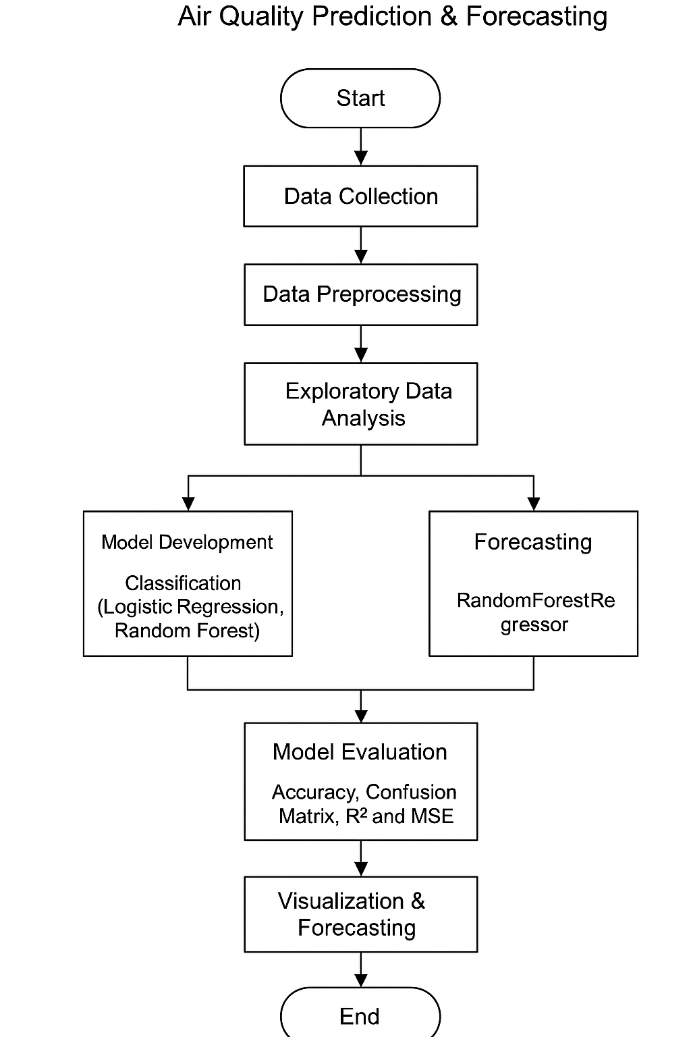
Methodology
Data Collection : Acquired air quality dataset (CSV) from Kaggle. The link of the dataset is: https://www.kaggle.com/datasets/shrutibhargava94/india-air-quality-data
Data Preprocessing
Data cleaning, handling missing values, encoding, and feature engineering.
Created lag features for forecasting.
Handle missing values:
3. Exploratory Data Analysis (EDA):
Visualized trends and correlations using Matplotlib and Seaborn.
Identified key pollutants influencing AQI.
.
Flowchart Air Quality Prediction & Forecasting

Slide 5
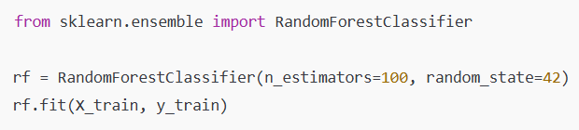
Methodology
4. Model Development
Classification Models: Logistic Regression, Random Forest, SVM for AQI category prediction.
Regression Model: RandomForestRegressor for 30-day AQI forecasting.
5. Model Evaluation
Evaluated using Accuracy, Confusion Matrix, R² Score, Mean Squared Error (MSE).
6. Visualization & Reporting
Plotted forecast trends and category distribution.
Documented and version-controlled code using GitHub.

Slide 6
.
Problem Statement:
Air pollution poses a serious threat to public health and the environment. With rising urbanization and industrial activities, it has become essential to monitor and predict air quality levels accurately. Manual observation methods are often delayed, making it difficult to take timely action.
This project aims to build a machine learning-based system that can:
Classify air quality into standard categories (e.g., Good, Moderate, Poor, etc.)
Predict whether the air is Safe or Unsafe for human exposure
Forecast future Air Quality Index (AQI) values based on historical data
By automating air quality analysis and forecasting, this solution supports proactive decision-making for health advisories and environmental policy.

Slide 7
Solution:
To address the problem of air quality monitoring and forecasting, we developed a data-driven machine learning pipeline that performs:
1. Air Quality Classification - Built models (Logistic Regression, Random Forest, SVM, Neural Network) to classify air quality into standard categories: Good, Moderate, Poor, Very Poor, Hazardous.
2. Air Safety Prediction - Converted AQI categories into binary labels (Safe / Unsafe). - Trained binary classifiers to identify potential health risk zones.
3. AQI Forecasting (Next 30 Days) - Used historical AQI trends and lag-based features. - Applied Random Forest Regressor to forecast future AQI values.
4. Visualization & Reporting - Plotted model comparisons, AQI category distributions, and forecast trends. - Delivered insights in an interpretable format for policy-makers and the public. 5. Achieved >99% accuracy in classification and reliable AQI forecasting.

Slide 8
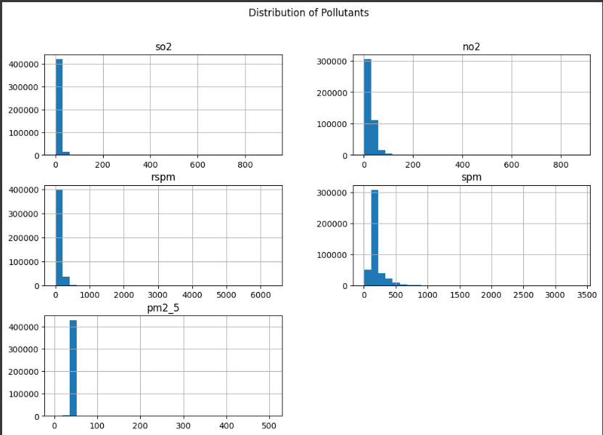
Screenshot of Output:
The histograms show the frequency distribution of pollutants (SO₂, NO₂, RSPM, SPM, PM2.5).
Most values are concentrated at lower ranges, while a few extreme values act as outliers.
This indicates that high pollution levels occur less frequently, but they significantly affect AQI.

Slide 9
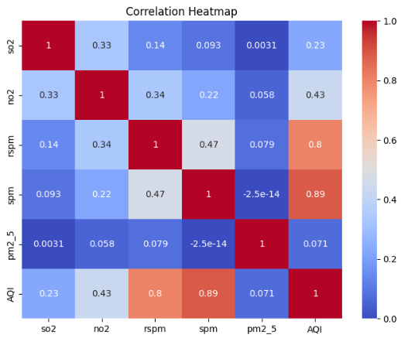
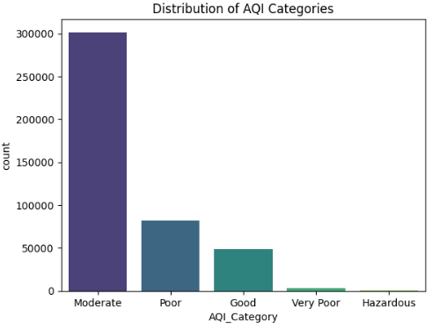
Screenshot of Output:
Pollutant distribution histograms
Dataset correlation heatmap

Slide 10
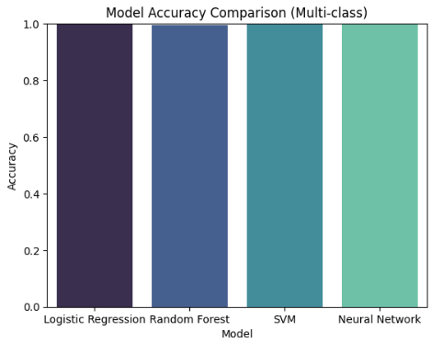
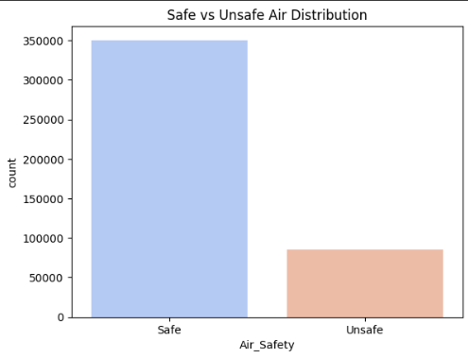
Screenshot of Output:

Slide 11
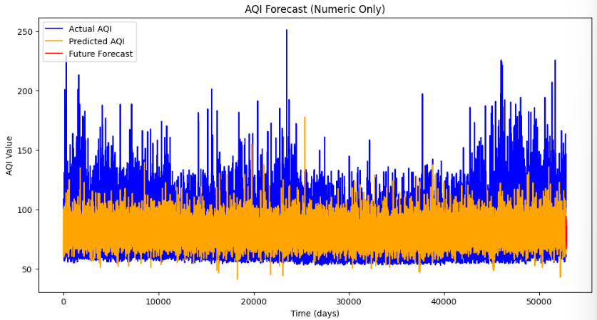
Screenshot of Output:

Slide 12
Conclusion:
This project successfully demonstrates the application of machine learning techniques in the domain of environmental analytics, specifically for air quality prediction and forecasting. Through a comprehensive approach involving data preprocessing, classification, regression, and forecasting,
Key achievements include:
Developed multiple classification models (Logistic Regression, Random Forest, SVM, and Neural Network) to categorize air quality into five standard AQI categories with high accuracy (up to 99.9%).
Designed a binary classification model to distinguish between Safe and Unsafe air quality, enabling quick public health advisories.
Implemented a time series forecasting model using Random Forest Regressor with lag-based feature engineering to accurately predict AQI values for the upcoming 30 days.
Visualized critical insights through histograms, correlation heatmaps, category distributions, and forecast trend lines for easier interpretation and communication.
Demonstrated effective use of Python libraries (Pandas, scikit-learn, TensorFlow, Seaborn, etc.) in a collaborative environment using Google Colab and GitHub.
Overall, the project contributes a practical and intelligent solution for air quality monitoring and forecasting, with potential real-world applications in smart cities, environmental agencies, and public health systems.
GitHub link: - https://github.com/Sreelekha08Dasgupta/Air_Quality_Prediction.git

Slide 13
Thank you

