Slide 1
TEXT TO IMAGE USING STACK-GAN
PRESENTED BY: SREE LEKHA S
REGISTER NO: 711721243105
DEPARTMENT: ARTIFICIAL INTELLIGENCE AND DATA SCIENCE
3/21/2024 Annual Review

Slide 2
PROJECT TITLE TEXT TO IMAGE USING STACK-GAN
3/21/2024 Annual Review

Slide 3


AGENDA 1. Problem statement 2. Project overview 3. Who are the end users? 4. Solution and its value proposition 5. The wow in my solution 6. Modelling 7. Result 8. Conclusion
3/21/2024 Annual Review

Slide 4

PROBLEM STATEMENT The objective of this project is to develop a cutting-edge text-to-image model utilizing Stack-GAN, capable of producing top-tier images from textual prompts. The existing challenge lies in the inadequacy of current text-to-image models to generate images that are both realistic and diverse. Often, the generated images lack intricate details or exhibit oversimplified features. This limitation poses a significant obstacle in various domains like product design, advertising, and entertainment, where the quality and diversity of images play a crucial role in achieving success.
3/21/2024 Annual Review

Slide 5
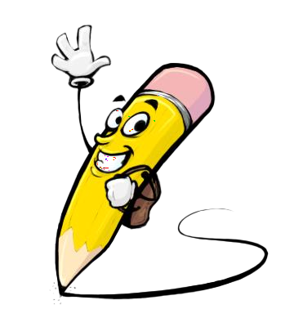
PROJECT OVERVIEW The project focuses on creating a text-to-image model using the Stack-GAN architecture to generate high-quality images from textual descriptions. The current challenge lies in the inability of existing models to produce realistic and diverse images, hindering applications such as product design, advertising, and entertainment. By enhancing semantic understanding and improving diversity and realism, this project aims to overcome these limitations. Through innovative training strategies and architectural modifications, the proposed model seeks to generate images that accurately reflect the input text, thereby addressing the pressing need for advanced text-to-image synthesis techniques.
3/21/2024 Annual Review

Slide 6

WHO ARE THE END USERS?
Product designers
Advertising agencies
Graphic design firms
Interior Designer
Entertainment Companies
3/21/2024 Annual Review

Slide 7

SOLUTION AND ITS VALUE PROPOSITION
Solution:
The proposed solutions encompass advanced semantic understanding through natural language processing techniques, leveraging the Stack-GAN architecture's multi-stage approach for hierarchical image generation, integrating feedback mechanisms for iterative image refinement, and employing transfer learning and fine-tuning for domain-specific adaptation. By enhancing semantic comprehension, the model ensures faithful translation of textual descriptions into high-quality images, catering to diverse industries like product design and advertising. Multi-stage generation facilitates the creation of realistic and diverse images, while feedback mechanisms enable customization to meet specific quality standards or user preferences.
Value Proposition:
Advanced Semantic Understanding
Multi-Stage Image Generation
Feedback Mechanisms for Image Refinement
3/21/2024 Annual Review

Slide 8

THE WOW IN MY SOLUTION
The "wow" factor in our project lies in seamlessly fusing cutting-edge technologies and creative innovation to push text-to-image synthesis boundaries. Integrating advanced semantic understanding, multi-stage image generation, and innovative feedback mechanisms, our model transcends limitations to produce breathtakingly realistic visual representations. What sets our project apart is its adaptability, enabled by transfer learning and fine-tuning techniques, ensuring tailored solutions for diverse industries. Each output is meticulously crafted to embody the desired aesthetic, delivering an unparalleled wow factor that captivates audiences.
3/21/2024 Annual Review

Slide 9
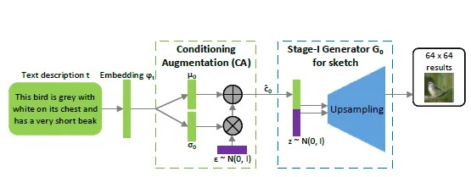
MODELLING
Data Collection:
Gather dataset of paired text descriptions and images from wildlife photography domain.
Ensure diversity of animal species and detailed textual descriptions.
Curate data from wildlife photography archives or online repositories.
2.Preprocessing:
Tokenize and encode textual descriptions for numerical representation.
Resize and normalize images to a fixed size for consistency.
Apply data augmentation techniques to enhance dataset diversity.
3.Model Architecture Design:
Implement Stack-GAN framework with Stage-I and Stage-II generators.
Stage-I generator generates low-resolution image from text embeddings.
Stage-II generator refines image using low-resolution output and text embeddings.
3/21/2024 Annual Review

Slide 10
4.Training:
Optimize parameters of generators and discriminator using adversarial training.
Iterate through dataset multiple times to adjust model parameters.
Employ techniques like gradient descent to minimize loss.
5.Evaluation:
Assess image quality, diversity, and fidelity to text descriptions.
Utilize separate validation dataset for evaluation experiments.
Consider qualitative assessment by human evaluators for subjective feedback.
6.Fine-tuning and Optimization:
Fine-tune model parameters based on evaluation results.
Explore hyperparameter tuning techniques for improved performance.
Optimize training process for efficiency and convergence speed.
7.Deployment:
Integrate trained model into production environment.
Develop user-friendly interface for inputting text descriptions and viewing generated images.
Monitor model performance in real-world usage and iterate as needed for continuous improvement.
3/21/2024 Annual Review

Slide 11
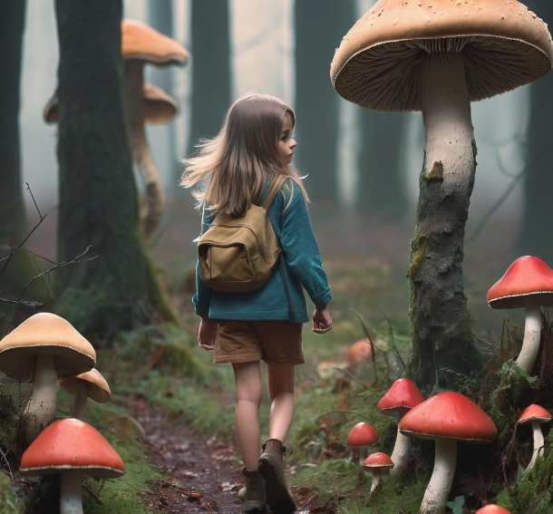
RESULT
Text
A Girl walking beside Mushrooms
3/21/2024 Annual Review

Slide 12
CONCLUSION
In conclusion, the project endeavors to revolutionize text-to-image synthesis through the implementation of the Stack-GAN architecture, tailored specifically for the domain of wildlife photography. By leveraging advanced semantic understanding, multi-stage image generation, and innovative training techniques, we aim to generate high-quality, diverse images that faithfully represent textual descriptions of various animal species. Through meticulous data collection, preprocessing, and model architecture design, we have laid the foundation for a robust and versatile solution capable of delivering visually compelling results. Moving forward, continuous evaluation, fine-tuning, and optimization will be key to refining our model and ensuring its effectiveness in real-world applications. Ultimately, the project seeks to push the boundaries of creativity and technology, offering a transformative tool for visual content creation in the wildlife photography domain and beyond.

