Slide 1
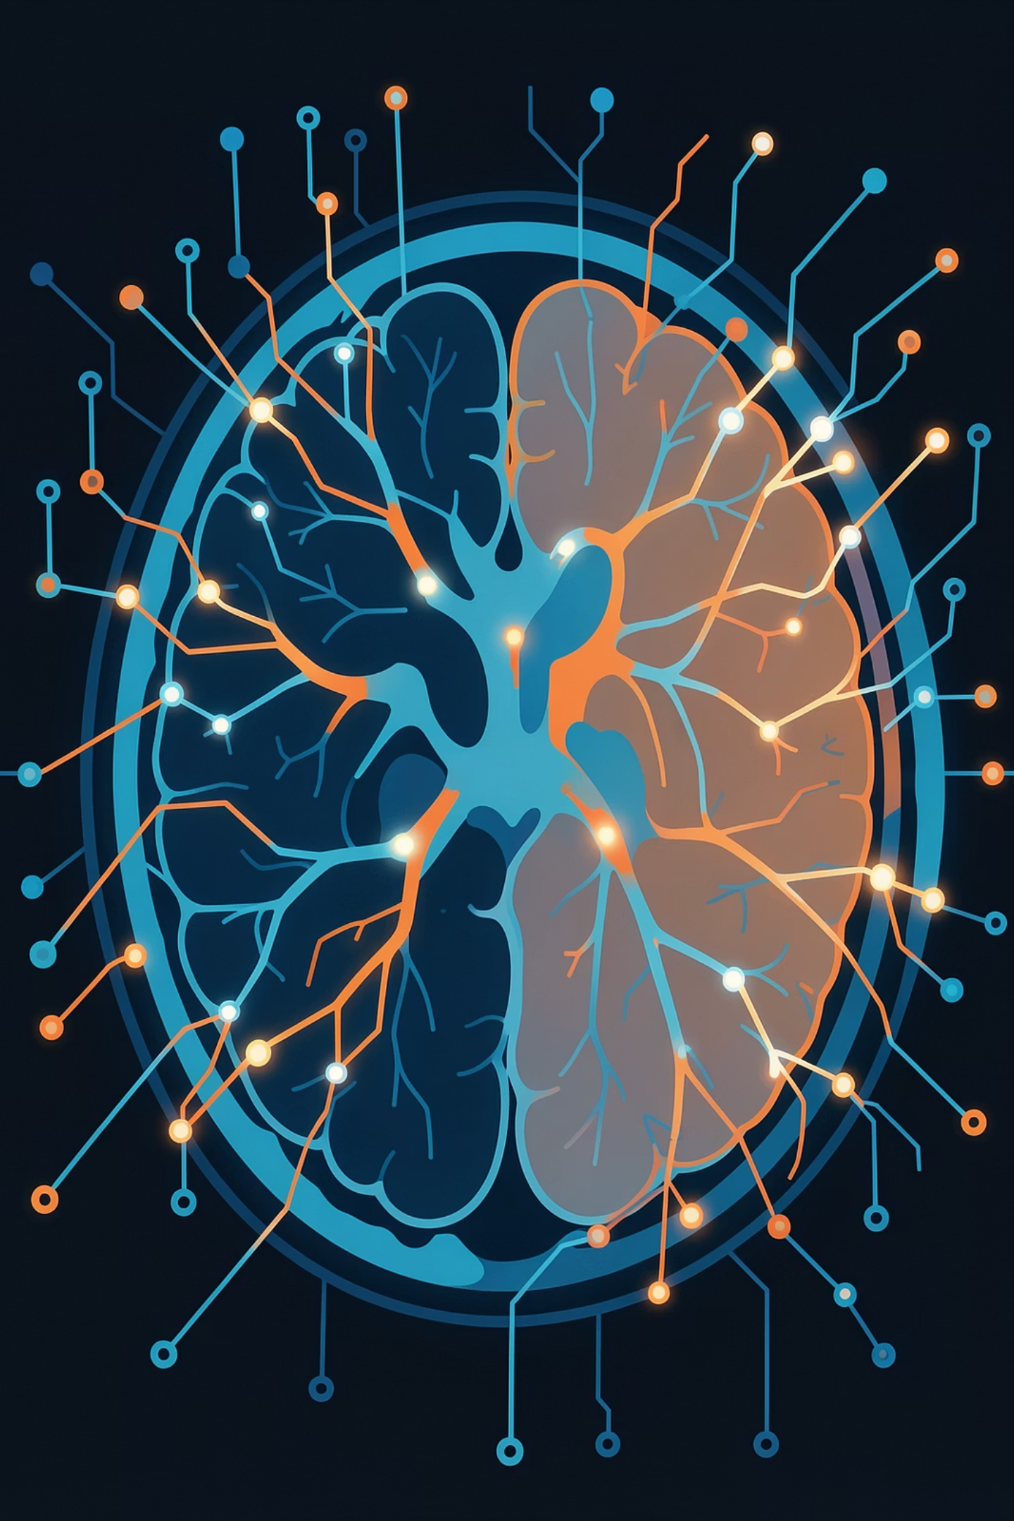

Brain Tumor Detection using DenseNet121
A Deep Learning-based system that classifies brain MRI images into four categories using Transfer Learning, CNNs, and Attention Mechanisms.
Glioma Tumor
Aggressive brain tumor originating in glial cells
Meningioma Tumor
Tumor arising from the meninges surrounding the brain
Pituitary Tumor
Abnormal growth in the pituitary gland
No Tumor
Healthy MRI scan with no detected abnormality
Core Techniques Combined
Tech Stack
Transfer Learning with DenseNet121 (pretrained on ImageNet)
Convolutional Neural Networks (CNN)
Self-Attention Block Integration
Batch Normalization & Regularization
Quantization Approaches
Python, TensorFlow, Keras
NumPy, OpenCV, Matplotlib
Seaborn, Scikit-learn
Jupyter Notebook
Author: Sreelekshmi S N — Licensed under MIT

Slide 2
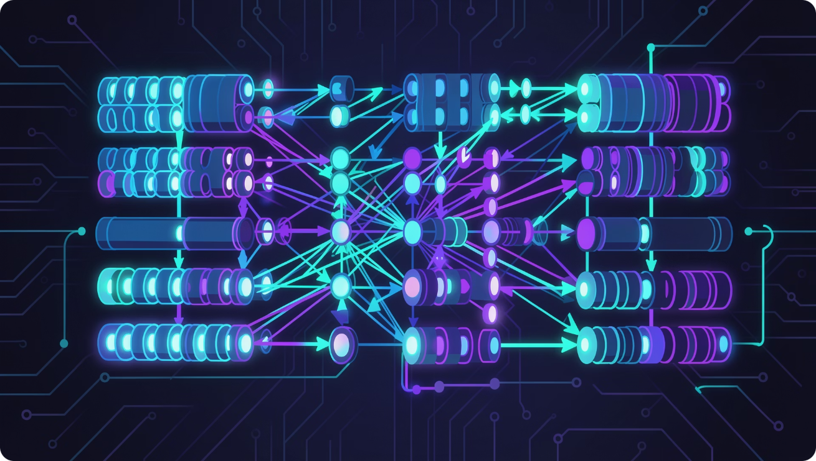

Architecture, Evaluation & Results
Deep Learning Components
DenseNet121
Base model for deep feature extraction via transfer learning
Self-Attention Block
Focuses on critical regions within MRI scans
Quantization
Reduces computational complexity and optimizes the model
Dropout & Weight Regularization
Prevents overfitting and improves generalization
Evaluation Metrics & Outputs
Accuracy & Loss Graphs
Confusion Matrix
Training & validation accuracy/loss curves visualize convergence and detect overfitting
Class-wise prediction performance evaluated across all four tumor categories
Prediction + Confidence
Classification Report
Model outputs predicted tumor type with confidence score (e.g., Glioma: 0.95)
Includes Precision, Recall, Validation Accuracy, and full Classification Report
Quick Start
Future Improvements
01
Real-time Brain MRI Detection
Web Application & Mobile App Deployment
Grad-CAM Visualization
Medical Report Generation
Edge Device Optimization
Clone repo & create conda environment (Python 3.10)
02
Install dependencies: TensorFlow 2.10, OpenCV, NumPy, etc.
Strong classification performance achieved on MRI datasets using DenseNet121 + advanced optimization techniques.
03
Run brain_tumor_detection.ipynb in Jupyter Notebook
04
Model saved as Models/brain_tumor_model_V2.keras

