Slide 1

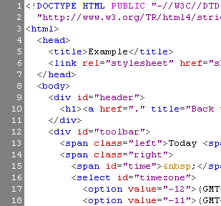

HTML
Prof.N.Nalini
AP(Sr),
SCOPE,
VIT

Slide 2
Programming Languages - set of instructions/code which tells a computer what it needs to do
To make software or drivers
Scripting Languages -to perform some certain task.
used to create a website.
Markup Languages - prepare the structure/design of a page
used to design a website

Slide 3
Content
Web Page
HTML Structure
Basic Tags
Hyperlinks
Images
Lists
Tables
Frames
Forms

Slide 4



How the Web Works?
WWW use classical client / server architecture
HTTP is text-based request-response protocol
HTTP
Page request
HTTP
Server response
Server running Web Server Software (IIS, Apache, etc.)
Client running a Web Browser

Slide 5
What is a Web Page?
Web pages are text files containing HTML
HTML – Hyper Text Markup Language
A notation for describing
document structure (semantic markup)
formatting (presentation markup)
The markup tags provide information about the page content structure
HTML is only about structure, not appearance

Slide 6
HTML Structure
HTML is comprised of “elements” and “tags”
Begins with <html> and ends with </html>
Elements (tags) are nested one inside another:
Tags have attributes:
HTML describes structure using two main sections: <head> and <body>
<html> <head></head> <body></body> </html>
<img src="logo.jpg" alt="logo" />

Slide 7
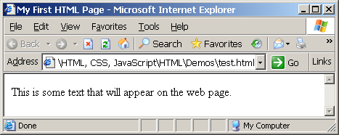
First HTML Page
test.html
<!DOCTYPE HTML>
<html>
<head>
<title>My First HTML Page</title>
</head>
<body>
<p>This is some text...</p>
</body>
</html>

Slide 8
First HTML Page: Tags
<html>
<head>
<title>My First HTML Page</title>
</head>
<body>
<p>This is some text...</p>
</body>
</html>
Opening tag
Closing tag
An HTML element consists of an opening tag, a closing tag and the content inside.

Slide 9
First HTML Page: Header
HTML header
<html>
<head>
<title>My First HTML Page</title>
</head>
<body>
<p>This is some text...</p>
</body>
</html>

Slide 10
First HTML Page: Body
<html>
<head>
<title>My First HTML Page</title>
</head>
<body>
<p>This is some text...</p>
</body>
</html>
HTML body

Slide 11
Some Simple Tags
Hyperlink Tags
Image Tags
Text formatting tags
<a href="http://www.vit.ac.in/"
title=“VIT">VIT University</a>
<img src="logo.gif" alt="logo" />
This text is <em>emphasized.</em>
<br />new line<br />
This one is <strong>more emphasized.</strong>

Slide 12
Tags Attributes
Tags can have attributes
Attributes specify properties and behavior
Example:
Few attributes can apply to every element:
id, style, class, title
The id is unique in the document
Content of title attribute is displayed as hint when the element is hovered with the mouse
Attribute alt with value "logo"
<img src="logo.gif" alt="logo" />

Slide 13
The <head> Section
Contains information that doesn’t show directly on the viewable page
Starts after the <!doctype> declaration
Begins with <head> and ends with </head>
Contains mandatory single <title> tag
Can contain some other tags, e.g.
<meta>
<script>
<style>
<!–- comments -->

Slide 14
<head> Section: <title> tag
Title should be placed between <head> and </head> tags
Used to specify a title in the window title bar
Search engines and people rely on titles
<title>VIT University – Fall Semester 2016-17 </title>

Slide 15
<head> Section: <meta>
Meta tags additionally describe the content contained within the page
<meta name="description" content="HTML tutorial" />
<meta name="keywords" content="html, web design, styles" />
<meta name="author" content="Chris Brewer" />
<meta http-equiv="refresh" content="5; url=http://www.telerik.com" />

Slide 16
<head> Section: <script>
The <script> element is used to embed scripts into an HTML document
Script are executed in the client's Web browser
Scripts can live in the <head> and in the <body> sections
Supported client-side scripting languages:
JavaScript
VBScript
JScript

Slide 17
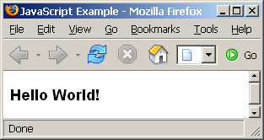
The <script> Tag – Example
scripts-example.html
<html>
<head>
<title>JavaScript Example</title>
<script type="text/javascript">
function sayHello() {
document.write("<p>Hello World!<\/p>");
}
</script>
</head>
<body>
<script type=
"text/javascript">
sayHello();
</script>
</body>
</html>

Slide 18
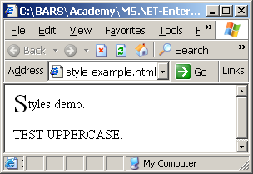
<head> Section: <style>
The <style> element embeds formatting information (CSS styles) into an HTML page
style-example.html
<html>
<head>
<style type="text/css">
p { font-size: 12pt; line-height: 12pt; }
p:first-letter { font-size: 200%; }
span { text-transform: uppercase; }
</style>
</head>
<body>
<p>Styles demo.<br />
<span>Test uppercase</span>.
</p>
</body>
</html>

Slide 19
Comments: <!-- --> Tag
Comments can exist anywhere between the <html></html> tags
Comments start with <!-- and end with -->
<!–- Logo (a JPG file) -->
<img src="logo.jpg" alt=“Logo”>
<!–- Hyperlink to the web site -->
<a href="http://www.vit.ac.in/">VIT UNIVERSITY</a>
<!–- Show the news table -->
<table class="newstable">
...

Slide 20
<body> Section: Introduction
The <body> section describes the viewable portion of the page
Starts after the <head> </head> section
Begins with <body> and ends with </body>
<html>
<head><title>Test page</title></head>
<body>
<!-- This is the Web page body -->
</body>
</html>

Slide 21
Headings and Paragraphs
Heading Tags (h1 – h6)
Paragraph Tags
Sections: div and span
<h1>Heading 1</h1>
<h2>Sub heading 2</h2>
<h3>Sub heading 3</h3>
<p>This is my first paragraph</p>
<p>This is my second paragraph</p>
<div style="background: skyblue;">
This is a div</div>

Slide 22
Headings and Paragraphs – Example
headings.html
<html>
<head><title>Headings and paragraphs</title></head>
<body>
<h1>Heading 1</h1>
<h2>Sub heading 2</h2>
<h3>Sub heading 3</h3>
<p>This is my first paragraph</p>
<p>This is my second paragraph</p>
<div style="background:skyblue">
This is a div</div>
</body>
</html>

Slide 23
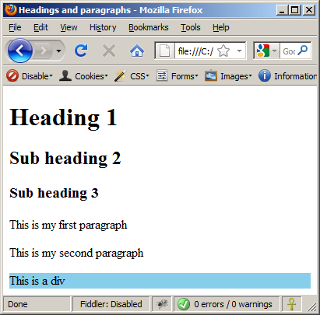
Headings and Paragraphs – Example (2)
headings.html
<!DOCTYPE HTML>
<html>
<head><title>Headings and paragraphs</title></head>
<body>
<h1>Heading 1</h1>
<h2>Sub heading 2</h2>
<h3>Sub heading 3</h3>
<p>This is my first paragraph</p>
<p>This is my second paragraph</p>
<div style="background:skyblue">
This is a div</div>
</body>
</html>

Slide 24
Text Formatting
Character Tags
A tag that you apply to an individual character is referred to as a character tag. There are two types of character tags, physical and logical.

Slide 25
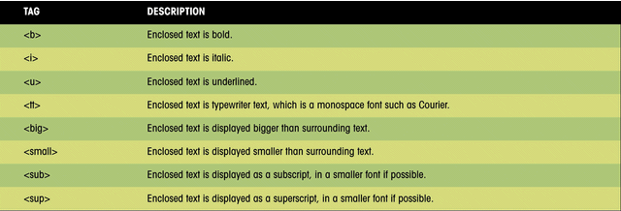
Common Physical Character Tags
Physical Tags
Physical tags are used to indicate exactly how specific characters are to be formatted.
This figure shows examples of how these tags can be displayed in a browser.

Slide 26
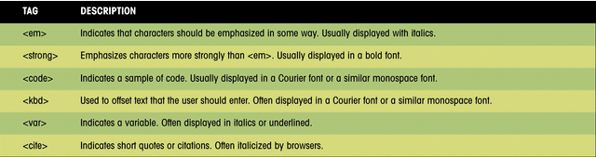
Common Logical Character Tags
Logical Tags
Logical tags are used to indicate to the visually impaired that there is some emphasizes on the text. Each browser has its own technique as to how to indicate to its viewer that the text between the tags are different.
This figure lists some common logical character tags.

Slide 27
Text Formatting
Text formatting tags modify the text between the opening tag and the closing tag
Ex. <b>Hello</b> makes “Hello” bold
<b></b> | bold
<i></i> | italicized
<u></u> | underlined
<sup></sup> | Sample^{superscript}
<sub></sub> | Sample_{subscript}
<strong></strong> | strong
<em></em> | emphasized
<pre></pre> | Preformatted text
<blockquote></blockquote> | Quoted text block
<del></del> | Deleted text – strike through
27

Slide 28
Hyperlinks: <a> Tag
Link to a document called form.html on the same server in the same directory:
Link to a document called parent.html on the same server in the parent directory:
Link to a document called cat.html on the same server in the subdirectory stuff:
<a href="form.html">Fill Our Form</a>
<a href="../parent.html">Parent</a>
<a href=“files/cat.html">Catalog</a>

Slide 29
Hyperlinks: <a> Tag (2)
Link to an external Web site:
Always use a full URL, including "http://", not just "www.vit.ac.ing"
Using the target="_blank" attribute opens the link in a new window
Link to an e-mail address:
<a href="http://www.vit.ac.in" target="_blank">VIT</a>
<a href="nalini@vit.ac.in?subject=Bug+Report">
Please report bugs here (by e-mail only)</a>

Slide 30
Hyperlinks: <a> Tag (3)
Link to a document called apply-now.html
On the same server, in same directory
Using an image as a link button:
Link to a document called index.html
On the same server, in the subdirectory english of the parent directory:
<a href="apply-now.html"><img
src="apply-now-button.jpg" /></a>
<a href="../english/index.html">Switch to English version</a>

Slide 31
Hyperlinks and Sections
Link to another location in the same document:
Link to a specific location in another document:
<a href="#section1">Go to Introduction</a>
...
<h2 id="section1">Introduction</h2>
<a href="chapter3.html#section3.1.1">Go to Section 3.1.1</a>
<!–- In chapter3.html -->
...
<div id="section3.1.1">
<h3>3.1.1. Technical Background</h3>
</div>

Slide 32
Hyperlinks – Example
hyperlinks.html
<a href="form.html">Fill Our Form</a> <br />
<a href="../parent.html">Parent</a> <br />
<a href="stuff/cat.html">Catalog</a> <br />
<a href="http://www.vit.ac.in" target="_blank">VIT</a> <br />
<a href="mailto:nalini@vit.ac.in?subject=Bug Report">Please report bugs here (by e-mail only)</a>
<br />
<a href="apply-now.html"><img src="apply-now-button.jpg” /></a> <br />
<a href="../english/index.html">Switch to English version</a> <br />

Slide 33
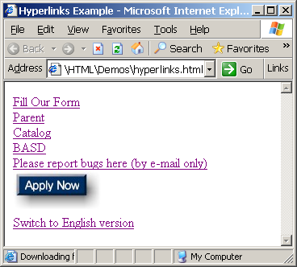
Hyperlinks – Example (2)
hyperlinks.html
<a href="form.html">Fill Our Form</a> <br />
<a href="../parent.html">Parent</a> <br />
<a href="stuff/cat.html">Catalog</a> <br />
<a href="http://www.devbg.org" target="_blank">BASD</a> <br />
<a href="mailto:bugs@example.com?subject=Bug Report">Please report bugs here (by e-mail only)</a>
<br />
<a href="apply-now.html"><img src="apply-now-button.jpg” /></a> <br />
<a href="../english/index.html">Switch to English version</a> <br />

Slide 34
Links to the Same Document – Example
links-to-same-document.html
<h1>Table of Contents</h1>
<p><a href="#section1">Introduction</a><br />
<a href="#section2">Some background</A><br />
<a href="#section2.1">Project History</a><br />
...the rest of the table of contents...
<!-- The document text follows here -->
<h2 id="section1">Introduction</h2>
... Section 1 follows here ...
<h2 id="section2">Some background</h2>
... Section 2 follows here ...
<h3 id="section2.1">Project History</h3>
... Section 2.1 follows here ...

Slide 35
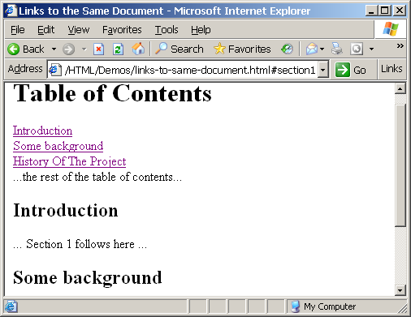
Links to the Same Document – Example (2)
links-to-same-document.html
<h1>Table of Contents</h1>
<p><a href="#section1">Introduction</a><br />
<a href="#section2">Some background</A><br />
<a href="#section2.1">Project History</a><br />
...the rest of the table of contents...
<!-- The document text follows here -->
<h2 id="section1">Introduction</h2>
... Section 1 follows here ...
<h2 id="section2">Some background</h2>
... Section 2 follows here ...
<h3 id="section2.1">Project History</h3>
... Section 2.1 follows here ...

Slide 36
Images: <img> tag
Inserting an image with <img> tag:
Image attributes:
Example:
<img src="/img/basd-logo.png">
src | Location of image file (relative or absolute)
alt | Substitute text for display (e.g. in text mode)
height | Number of pixels of the height
width | Number of pixels of the width
border | Size of border, 0 for no border
<img src="./php.png" alt="PHP Logo" />
36

Slide 37
Miscellaneous Tags
<hr />: Draws a horizontal rule (line):
<center></center>: Deprecated!
<font></font>: Deprecated!
<hr size="5" width="70%" />
<center>Hello World!</center>
<font size="3" color="blue">Font3</font>
<font size="+4" color="blue">Font+4</font>

Slide 38
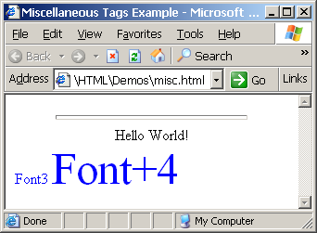
Miscellaneous Tags – Example
misc.html
<html>
<head>
<title>Miscellaneous Tags Example</title>
</head>
<body>
<hr size="5" width="70%" />
<center>Hello World!</center>
<font size="3" color="blue">Font3</font>
<font size="+4" color="blue">Font+4</font>
</body>
</html>

Slide 39
Ordered Lists: <ol> Tag
Create an Ordered List using <ol></ol>:
Attribute values for type are 1, A, a, I, or i
<ol type="1">
<li>Apple</li>
<li>Orange</li>
<li>Grapefruit</li>
</ol>
Apple
Orange
Grapefruit
Apple
Orange
Grapefruit
Apple
Orange
Grapefruit
Apple
Orange
Grapefruit
Apple
Orange
Grapefruit

Slide 40
Unordered Lists: <ul> Tag
Create an Unordered List using <ul></ul>:
Attribute values for type are:
disc, circle or square
<ul type="disk">
<li>Apple</li>
<li>Orange</li>
<li>Grapefruit</li>
</ul>
Apple
Orange
Pear
Apple
Orange
Pear
Apple
Orange
Pear

Slide 41
Definition lists: <dl> tag
Create definition lists using <dl>
Pairs of text and associated definition; text is in <dt> tag, definition in <dd> tag
Renders without bullets
Definition is indented
<dl>
<dt>HTML</dt>
<dd>A markup language …</dd>
<dt>CSS</dt>
<dd>Language used to …</dd>
</dl>

Slide 42
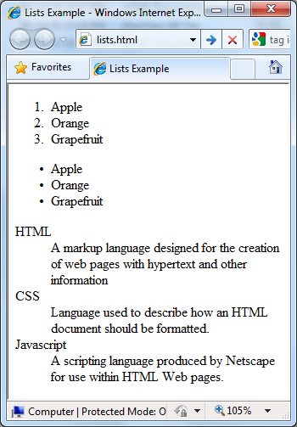
Lists – Example
lists.html
<ol type="1">
<li>Apple</li>
<li>Orange</li>
<li>Grapefruit</li>
</ol>
<ul type="disc">
<li>Apple</li>
<li>Orange</li>
<li>Grapefruit</li>
</ul>
<dl>
<dt>HTML</dt>
<dd>A markup lang…</dd>
</dl>

Slide 43
HTML Special Characters
Symbol Name
HTML Entity
Symbol
Copyright Sign
&copy;
©
Registered Trademark Sign
&reg;
®
Trademark Sign
&trade;
™
Less Than
&lt;
<
Greater Than
&gt;
>
Ampersand
&amp;
&
Non-breaking Space
&nbsp;
Em Dash
&mdash;
—
Quotation Mark
&quot;
"
Euro
&#8364;
€
British Pound
&pound;
£
Japanese Yen
&yen;
¥
43

Slide 44
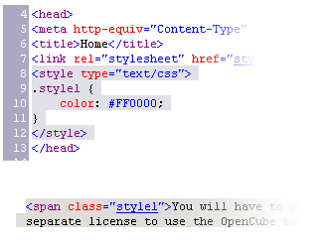

Using <DIV> and <SPAN> Block and Inline Elements

Slide 45
Block and Inline Elements
Block elements add a line break before and after them
<div> is a block element
Other block elements are <table>, <hr>, headings, lists, <p> and etc.
Inline elements don’t break the text before and after them
<span> is an inline element
Most HTML elements are inline, e.g. <a>

Slide 46
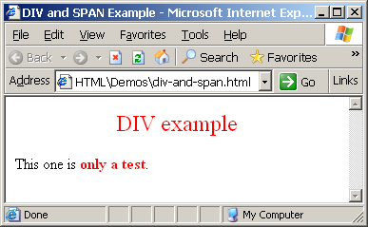
The <div> Tag
<div> creates logical divisions within a page
Block style element
Used with CSS
Example:
div-and-span.html
<div style="font-size:24px; color:red">DIV example</div>
<p>This one is <span style="color:red; font-weight:bold">only a test</span>.</p>

Slide 47
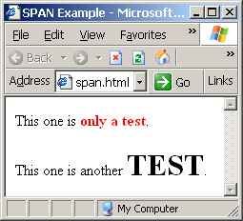
The <span> Tag
Inline style element
Useful for modifying a specific portion of text
Don't create a separate area (paragraph) in the document
Very useful with CSS
span.html
<p>This one is <span style="color:red; font-weight:bold">only a test</span>.</p>
<p>This one is another <span style="font-size:32px; font-weight:bold">TEST</span>.</p>

Slide 48
Image Map

Slide 49
To create an image map:
Image maps are images with clickable areas (sometimes referred to as "hotspots") that usually link to another page.
First, you need an image. Create an image using the usual method.
Use the HTML img tag to link to this image. In the img tag, use with the usemap attribute to define which image map to use.
Use the HTML map tag to create a map with a name. Inside this tag, you will specify where the clickable areas are with the HTML area tag

Slide 50
Shapes, Coords
Types of Shapes
Rect → used for squares and ordered shapes.
Circle → used for circles.
Poly → used for unordered shapes.
Number of coordenations for each shape:
Rect →4 numbers for two corners
Circle →3 numbers for the center & R
Poly → depends on the number of corners of the shape( 2 numbers for each corner)

Slide 51
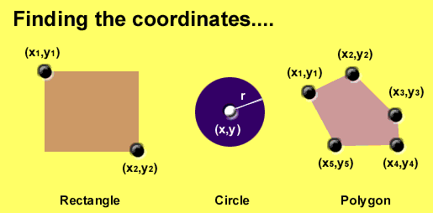
Area Shapes Used

Slide 52
<img src="planets.gif" width="145" height="126" alt="Planets" usemap="#planetmap" />
<map name="planetmap">
<area shape="rect" coords="0,0,82,126" alt="Sun" href="sun.html" />
<area shape="circle" coords="90,58,3" alt="Mercury" href="mercur.html" />
<area shape="circle" coords="124,58,8" alt="Venus" href="venus.html" />
</map>

Slide 53
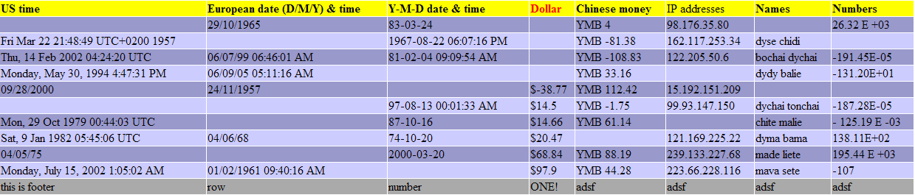
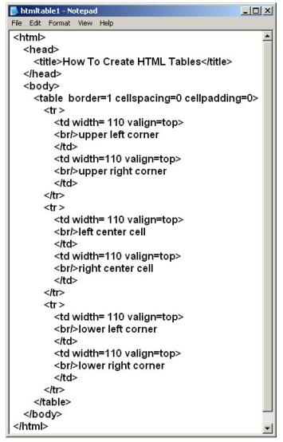
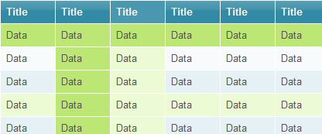
HTML Tables

Slide 54
HTML Tables
Tables represent tabular data
A table consists of one or several rows
Each row has one or more columns
Tables comprised of several core tags: <table></table>: begin / end the table <tr></tr>: create a table row <td></td>: create tabular data (cell)
Tables should not be used for layout. Use CSS floats and positioning styles instead

Slide 55
HTML Tables (2)
Start and end of a table
Start and end of a row
Start and end of a cell in a row
<table> ... </table>
<tr> ... </tr>
<td> ... </td>

Slide 56
Tables Attributes
BGColor: Some browsers support background colors in a table.
Width: you can specify the table width as an absolute number of pixels or a percentage of the document width. You can set the width for the table cells as well.
Border: You can choose a numerical value for the border width, which specifies the border in pixels.
CellSpacing: Cell Spacing represents the space between cells and is specified in pixels.
CellPadding: Cell Padding is the space between the cell border and the cell contents and is specified in pixels.
Align: tables can have left, right, or center alignment.
Background: Background Image, will be titled in IE3.0 and above.

Slide 57
Cell Spacing and Padding
Tables have two important attributes:
cellspacing
Defines the empty space between cells
cellpadding
Defines the empty space around the cell content
cell
cell
cell
cell
cell
cell
cell
cell

Slide 58
Simple HTML Tables – Example
<table cellspacing="0" cellpadding="5">
<tr>
<td><img src="ppt.gif"></td>
<td><a href="lecture1.ppt">Lecture 1</a></td>
</tr>
<tr>
<td><img src="ppt.gif"></td>
<td><a href="lecture2.ppt">Lecture 2</a></td>
</tr>
<tr>
<td><img src="zip.gif"></td>
<td><a href="lecture2-demos.zip">
Lecture 2 - Demos</a></td>
</tr>
</table>

Slide 59
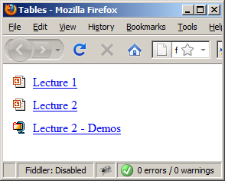
Simple HTML Tables – Example (2)
<table cellspacing="0" cellpadding="5">
<tr>
<td><img src="ppt.gif"></td>
<td><a href="lecture1.ppt">Lecture 1</a></td>
</tr>
<tr>
<td><img src="ppt.gif"></td>
<td><a href="lecture2.ppt">Lecture 2</a></td>
</tr>
<tr>
<td><img src="zip.gif"></td>
<td><a href="lecture2-demos.zip">
Lecture 2 - Demos</a></td>
</tr>
</table>

Slide 60
Complete HTML Tables
Table rows split into three semantic sections: header, body and footer
<thead> denotes table header and contains <th> elements, instead of <td> elements
<tbody> denotes collection of table rows that contain the very data
<tfoot> denotes table footer but comes BEFORE the <tbody> tag
<colgroup> and <col> define columns (most often used to set column widths)

Slide 61
Complete HTML Table: Example
<table>
<colgroup>
<col style="width:100px" /><col />
</colgroup>
<thead>
<tr><th>Column 1</th><th>Column 2</th></tr>
</thead>
<tfoot>
<tr><td>Footer 1</td><td>Footer 2</td></tr>
</tfoot>
<tbody>
<tr><td>Cell 1.1</td><td>Cell 1.2</td></tr>
<tr><td>Cell 2.1</td><td>Cell 2.2</td></tr>
</tbody>
</table>
columns
header
th
footer
Last comes the body (data)

Slide 62
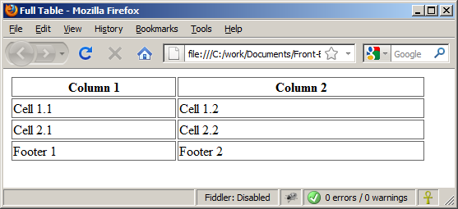
Complete HTML Table: Example (2)
By default, header text is bold and centered.
table-full.html
<table>
<colgroup>
<col style="width:200px" /><col />
</colgroup>
<thead>
<tr><th>Column 1</th><th>Column 2</th></tr>
</thead>
<tfoot>
<tr><td>Footer 1</td><td>Footer 2</td></tr>
</tfoot>
<tbody>
<tr><td>Cell 1.1</td><td>Cell 1.2</td></tr>
<tr><td>Cell 2.1</td><td>Cell 2.2</td></tr>
</tbody>
</table>
Although the footer is before the data in the code, it is displayed last

Slide 63
Cell Spacing and Padding – Example
table-cells.html
<html>
<head><title>Table Cells</title></head>
<body>
<table cellspacing="15" cellpadding="0">
<tr><td>First</td>
<td>Second</td></tr>
</table>
<br/>
<table cellspacing="0" cellpadding="10">
<tr><td>First</td><td>Second</td></tr>
</table>
</body>
</html>

Slide 64
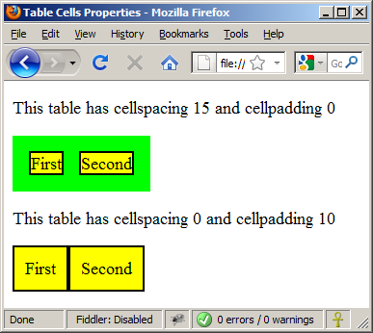
Cell Spacing and Padding – Example (2)
table-cells.html
<html>
<head><title>Table Cells</title></head>
<body>
<table cellspacing="15" cellpadding="0">
<tr><td>First</td>
<td>Second</td></tr>
</table>
<br/>
<table cellspacing="0" cellpadding="10">
<tr><td>First</td><td>Second</td></tr>
</table>
</body>
</html>

Slide 65
Column and Row Span
Table cells have two important attributes:
colspan
Defines how many columns the cell occupies
rowspan
Defines how many rows the cell occupies
colspan="1"
colspan="1"
rowspan="2"
rowspan="1"
cell[1,1]
cell[1,2]
cell[1,1]
cell[1,2]
cell[2,1]
cell[2,1]
colspan="2"
rowspan="1"

Slide 66
Column and Row Span – Example
table-colspan-rowspan.html
<table cellspacing="0">
<tr class="1"><td>Cell[1,1]</td>
<td colspan="2">Cell[2,1]</td></tr>
<tr class=“2"><td>Cell[1,2]</td>
<td rowspan="2">Cell[2,2]</td>
<td>Cell[3,2]</td></tr>
<tr class=“3"><td>Cell[1,3]</td>
<td>Cell[2,3]</td></tr>
</table>

Slide 67
Column and Row Span – Example (2)
table-colspan-rowspan.html
<table cellspacing="0">
<tr class="1"><td>Cell[1,1]</td>
<td colspan="2">Cell[2,1]</td></tr>
<tr class=“2"><td>Cell[1,2]</td>
<td rowspan="2">Cell[2,2]</td>
<td>Cell[3,2]</td></tr>
<tr class=“3"><td>Cell[1,3]</td>
<td>Cell[2,3]</td></tr>
</table>
Cell[1,1]
Cell[2,1]
Cell[1,2]
Cell[2,2]
Cell[3,2]
Cell[1,3]
Cell[2,3]

Slide 68
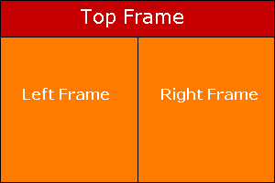
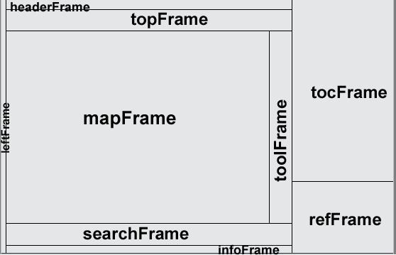
HTML Frames
<frameset>, <frame> and <iframe>

Slide 69
HTML Frames
Frames provide a way to show multiple HTML documents in a single Web page
The page can be split into separate views (frames) horizontally and vertically
Frames were popular in the early ages of HTML development, but now their usage is rejected
Frames are not supported by all user agents (browsers, search engines, etc.)
A <noframes> element is used to provide content for non-compatible agents.

Slide 70
HTML Frames – Demo
frames.html
<html>
<head><title>Frames Example</title></head>
<frameset cols="180px,*,150px">
<frame src="left.html" />
<frame src="middle.html" />
<frame src="right.html" />
</frameset>
</html>
Note the target attribute applied to the <a> elements in the left frame.

Slide 71
Inline Frames: <iframe>
Inline frames provide a way to show one website inside another website:
iframe-demo.html
<iframe name="iframeGoogle" width="600" height="400" src="http://www.google.com" frameborder="yes" scrolling="yes"></iframe>

Slide 72
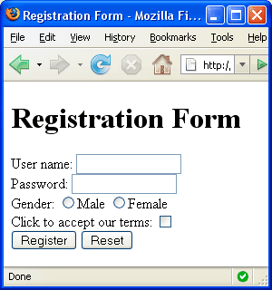


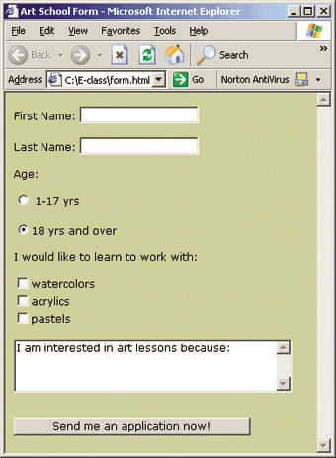
HTML Forms
Entering User Data from a Web Page

Slide 73
Forms
<form> is another kind of HTML tag
Forms are the primary method for gathering data from site visitors
HTML forms are used to create GUIs on Web pages
Usually the purpose is to ask the user for information
The information is then sent back to the server
A form is an area that can contain form elements
The syntax is: <form attributes> ...form elements... </form>
Form elements include: buttons, checkboxes, text fields, radio buttons, drop-down menus, etc
Other kinds of HTML tags can be mixed in with the form elements
A form usually contains a Submit button to send the information in he form elements to the server

Slide 74
The <form> tag
The <form arguments> ... </form> tag encloses form elements
The arguments to form tell what to do with the user input
method="get"
Form data is sent as a URL with ?form_data info appended to the end
Can be used only if data is all ASCII and not more than 255 characters
Faster
method="post"
Form data is sent in the body of the URL request
Cannot be bookmarked by most browsers
Notes:
Visible
Performance
Length
Type
bookmarking

Slide 75
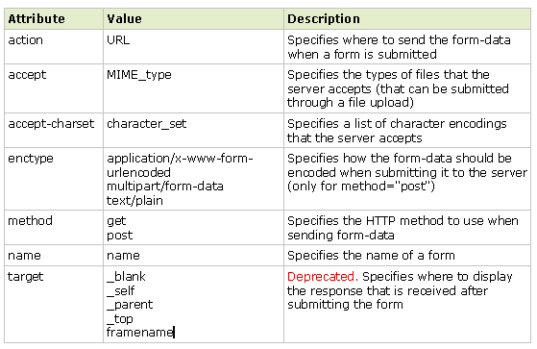
Form Attributes

Slide 76
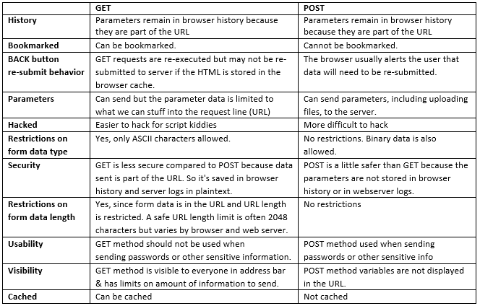
Get vs Post

Slide 77
The <input> tag
Form elements use the input tag, with a type="..." argument to tell which kind of element it is
type can be text, checkbox, radio, password, hidden, submit, reset, button, file, or image
Other common input tag arguments include:
name: the name of the element
value: the “value” of the element; used in different ways for different values of type
readonly: the value cannot be changed
disabled: the user can’t do anything with this element

Slide 78




Text input
A text field:
<input type="text" name="textfield" value="with an initial value">
A multi-line text field
<textarea name="textarea" cols="24" rows="2“ >Hello</textarea>
A password field:
<input type="password" name="textfield3" value="secret">
• Note that two of these use the input tag, but one uses textarea

Slide 79
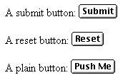
Buttons
A submit button: <input type="submit" name="Submit" value="Submit">
A reset button: <input type="reset" name="Submit2" value="Reset">
A plain button: <input type="button" name="Submit3" value="Push Me">
submit: send data
reset: restore all form elements to their initial state
button: take some action as specified by JavaScript
• Note that the type is input, not “button”

Slide 80
Checkboxes
A checkbox: <input type="checkbox" name="checkbox” value="checkbox" checked>
type: "checkbox"
name: used to reference this form element from JavaScript
value: value to be returned when element is checked
Note that there is no text associated with the checkbox—you have to supply text in the surrounding HTML

Slide 81

Radio buttons
Radio buttons:<br> <input type="radio" name="radiobutton" value="myValue1"> male<br> <input type="radio" name="radiobutton" value="myValue2" checked> female
If two or more radio buttons have the same name, the user can only select one of them at a time
This is how you make a radio button “group”
If you ask for the value of that name, you will get the value specified for the selected radio button
As with checkboxes, radio buttons do not contain any text

Slide 82

Drop-down menu or list
A menu or list: <select name="select"> <option value="red">red</option> <option value="green">green</option> <option value="BLUE">blue</option> </select>
Additional arguments:
size: the number of items visible in the list (default is "1")
multiple: if set to "true", any number of items may be selected (default is "false")

Slide 83

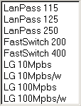
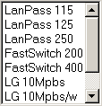
Selection Lists with Different Size Values
size = "1"
size = "4"
size = "7"
size = "9"

Slide 84
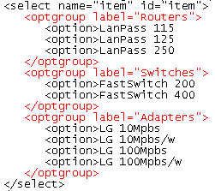
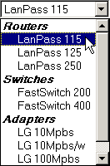
Option Groups
option group label
option group label
a single option group
a single option group

Slide 85
Hidden fields
<input type="hidden" name="hiddenField" value="nyah"> &lt;-- right there, don't you see it?
What good is this?
All input fields are sent back to the server, including hidden fields
This is a way to include information that the user doesn’t need to see
The value of a hidden field can be set programmatically (by JavaScript) before the form is submitted

Slide 86

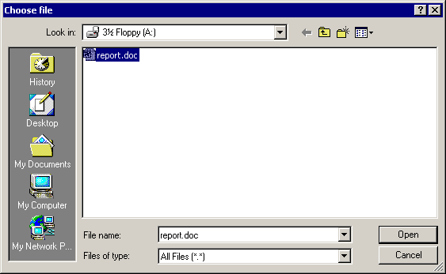

File Button
A file button is used to select files so that their contents can be submitted to the url specified in action attribute.
1. User clicks the Browse button
2. Selects a file from the Choose File dialog box
3. The filename and location are automatically placed in the text box

Slide 88
A complete example
<html> <head> <title>Get Identity</title> <meta http-equiv="Content-Type" content="text/html; charset=iso-8859-1"> </head> <body> <p><b>Who are you?</b></p> <form method="post" action=""> <p>Name: <input type="text" name="textfield"> </p> <p>Gender: <input type="radio" name="gender" value="m">Male <input type="radio" name="gender" value="f">Female</p> </form> </body> </html>

