Slide 1
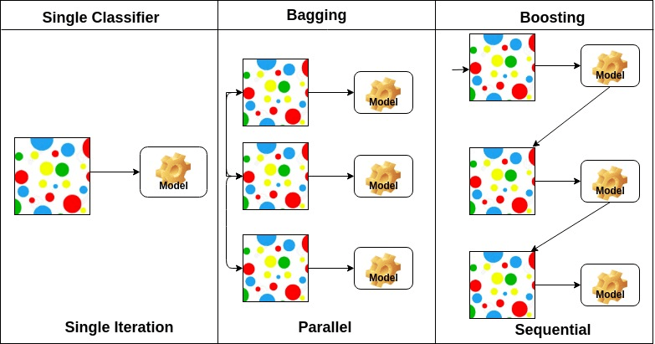

Slide 2
boosting
Boosting algorithms are a set of the low accurate classifier to create a highly accurate classifier.
Low accuracy classifier (or weak classifier) offers the accuracy better than the flipping of a coin.
Highly accurate classifier( or strong classifier) offer error rate close to 0. Boosting algorithm can track the model who failed the accurate prediction.
Boosting algorithms are less affected by the overfitting problem. The following three algorithms have gained massive popularity in data science competitions.
AdaBoost (Adaptive Boosting)
Gradient Tree Boosting
XGBoost

Slide 3
Initially, Adaboost selects a training subset randomly.
It iteratively trains the Adaboost machine learning model by selecting the training set based on the accurate prediction of the last training.
It assigns the higher weight to wrong classified observations so that in the next iteration these observations will get the high probability for classification.
Also, It assigns the weight to the trained classifier in each iteration according to the accuracy of the classifier. The more accurate classifier will get high weight.
This process iterate until the complete training data fits without any error or until reached to the specified maximum number of estimators.
To classify, perform a "vote" across all of the learning algorithms you built.
We don’t use trees instead we use stumps for our classification.

Slide 4
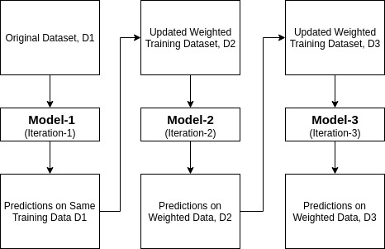

Slide 5
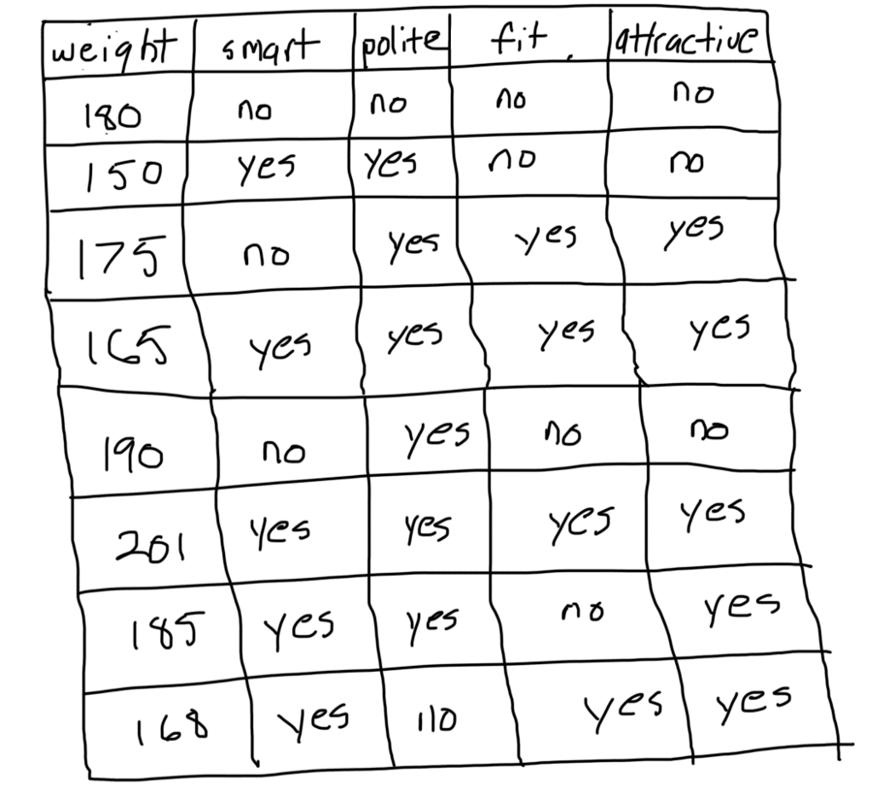

Slide 6
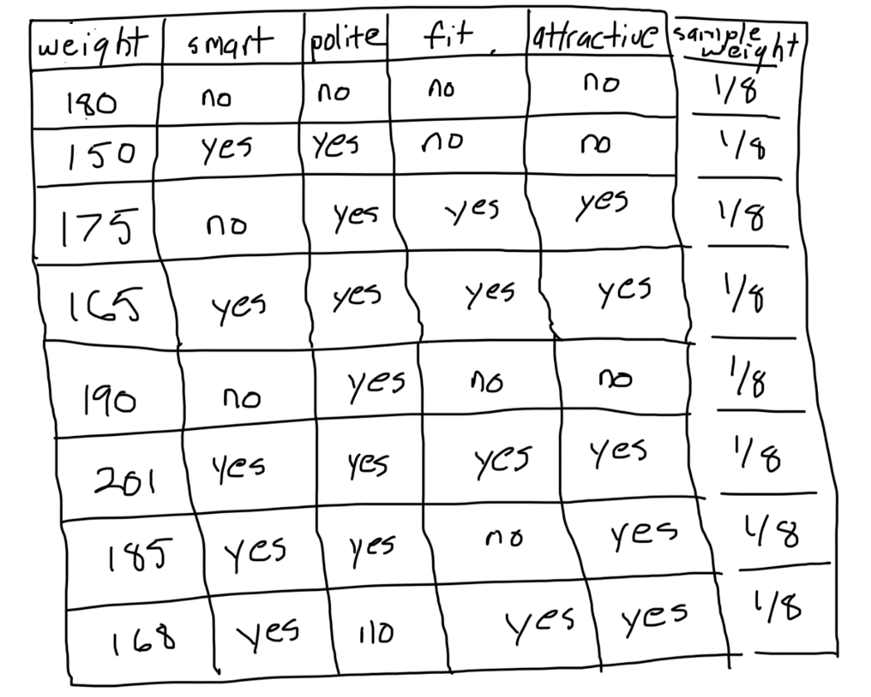

Slide 7
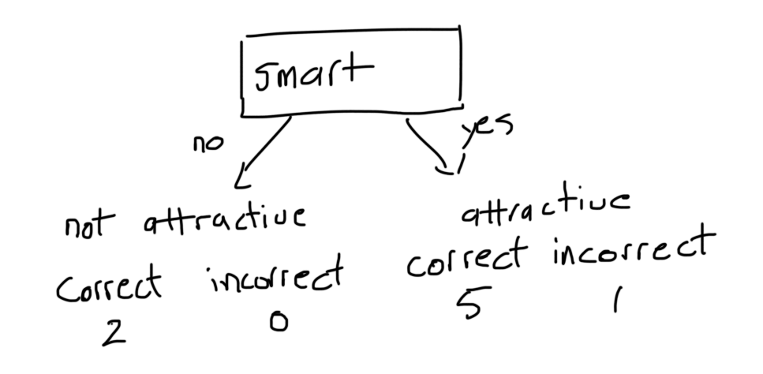

Slide 8
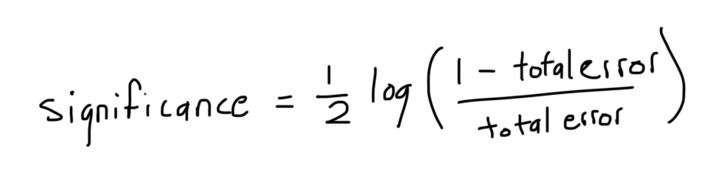
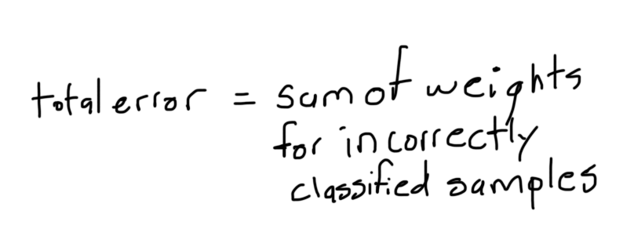

Slide 9
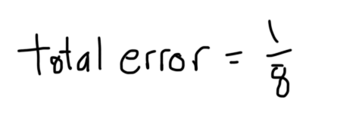
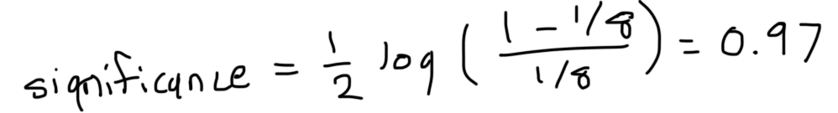

Slide 10
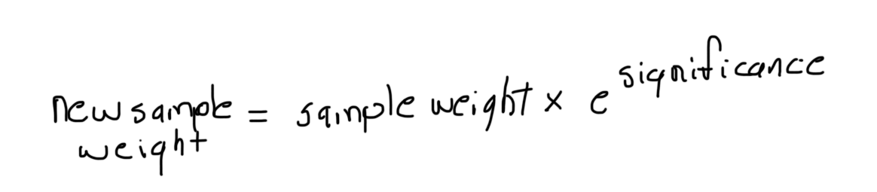
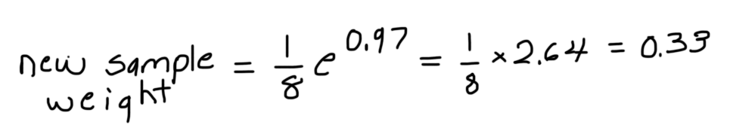

Slide 11
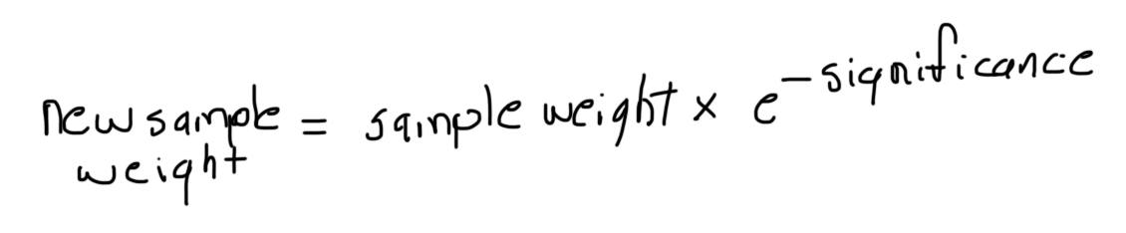
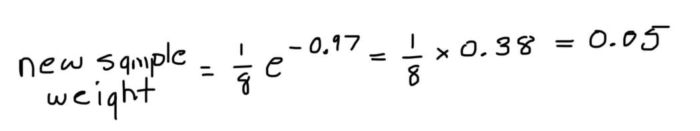

Slide 12
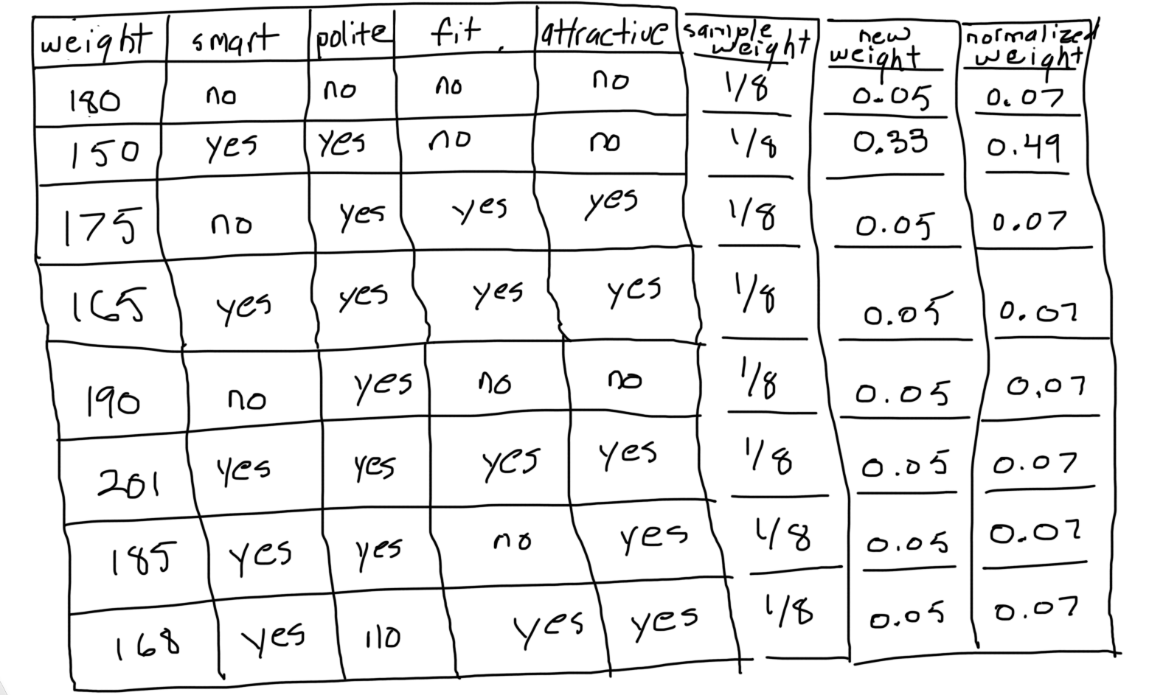

Slide 13
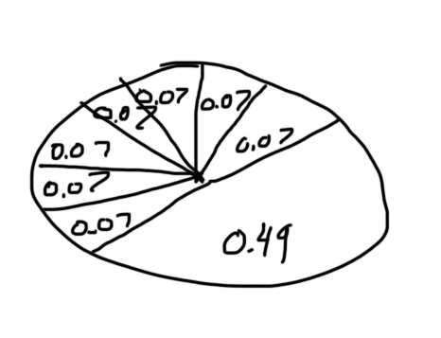

Slide 14
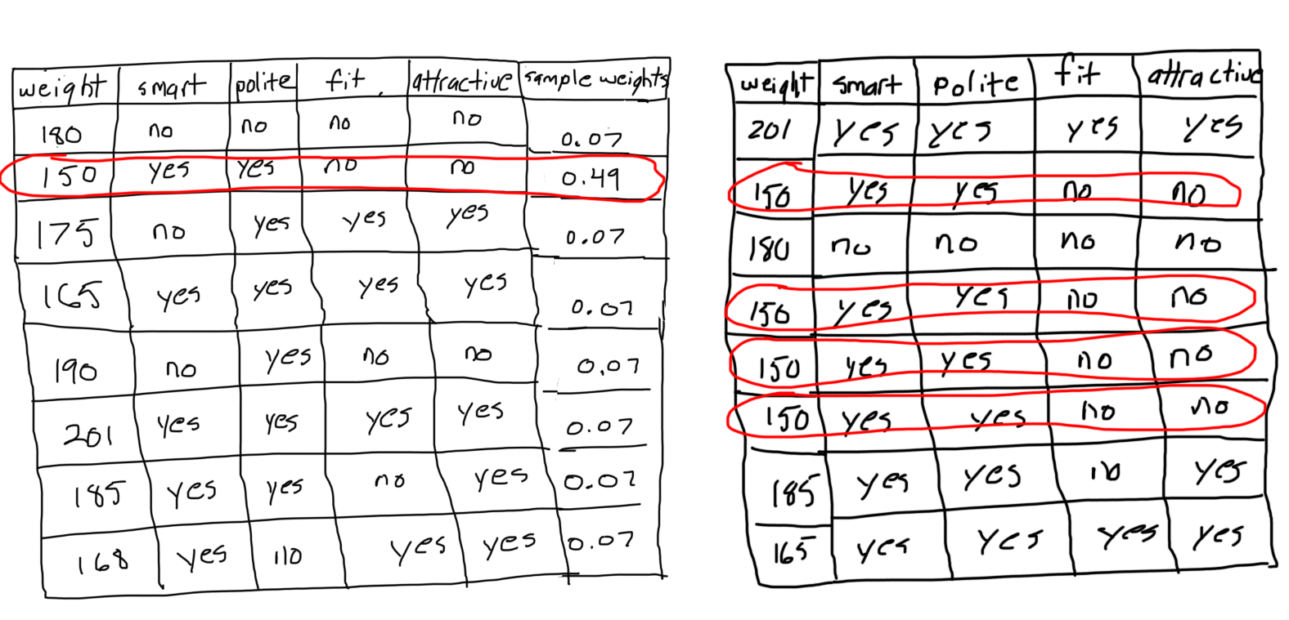

Slide 15
