Slide 1
Selenium training
JAVA CONCEPTS

Slide 2
Introduction to Java
Java is a programming language created by James Gosling from Sun Microsystems (Sun) in 1991.
The target of Java is to write a program once and then run this program on multiple operating systems.

Slide 3
Features of Java
Platform Independent
Portable
Object Oriented
Exception Handling
Automatic garbage collection

Slide 4
Objected Oriented Principles
Encapsulation
It is an object oriented principle in which an object supports Data binding and Data hiding.
Data binding is a process of binding the data with respect to an object memory address.
Data hiding is a process of hiding the data present in one object from another object

Slide 5
Example
Class Demo {
Int ival;
double dval; a2g45bfu7
public static void main (String[] args) {
Demo ref=new Demo();
ref.ival=10;
ref.dval=2.5;
Demo ref1=new Demo();
ref1.ival=20;
ref1.dval=3.5; gh665hejf2
System.out.println(ref.ival);
System.out.println(ref1.ival);
System.out.println(ref.dval);
System.out.println(ref1.dval);
} }
ival=10
dval=2.5
ival=20
dval=3.5

Slide 6
Inheritance
Inheritance is an objected oriented concept in which the class inherits states and behaviors of another class
To achieve inheritance the programmer must super class and sub class
The super class is a type of class which provides states & behaviors to another class
The sub class is a type of class in which the states & behaviors are provided by another class
To achieve super class and sub class relationship the programmer must use keyword Extends
The super class of all the classes in java is object class.

Slide 7
Types of inheritance
Single Inheritance
Multilevel Inheritance
Multiple Inheritance ( Not supported by classes)
Hierarchical Inheritance

Slide 8
Single inheritance
In single heritance it contains a single super class and single sub class where the super class provides all the states and behaviors to the sub class.
<<class>>
Object
<<class>>
Demo

Slide 9
Multi level inheritance
<<class>>
object
<<class>>
A
<<class>>
B

Slide 10
Multilevel inheritance
In Multilevel inheritance there are multiple levels of inheritances that is in multilevel inheritance every sub class behaves like a super class and a subclass
The subclass has states and behaviors of its super most classes.

Slide 11
Multiple inheritance
<<class>>
object
<<class>>
A
<<class>>
B
<<class>>
C

Slide 12
Multiple inheritance
In Multiple inheritance every sub class have multiple super class hence the subclass must have states and behaviors of all the super class.
Multiple inheritance cannot be achieved by java classes.
It can be achieved by java interface.

Slide 13
Hierarchical inheritance
In hierarchical inheritance a single super class has multiple sub classes hence all the sub classes has states and behaviors of all the super class.
<<class>>
object
<<class>>
A
<<class>>
C
<<class>>
B

Slide 14
Abstraction
Abstraction is selecting data from a larger pool to show only the relevant details to the object. It helps to reduce programming complexity and effort.
In Java, abstraction is accomplished using Abstract classes and interfaces. It is one of the most important concepts of OOPs.
Any class which is declared with keyword abstract is called an abstract class
An abstract class can contain abstract methods and concrete methods

Slide 15
Abstraction
An abstract method is a type of method which does not support any method body.
An object of the abstract class cannot be created.
The abstract class supports partial abstraction.
NOTE:
If a class inherits an abstract class then the subclass must provide implementation (method overriding) for all the abstract methods present inside the subclass.

Slide 16
Polymorphism
Polymorphism is an object oriented concept in which a reference holding an object has different behaviors at different stages of objects life cycle

Slide 17
Interface
An interface is a type definition block which is completely abstract.
An interface can be created by using the following syntax:
Interface interfacename {
Public static final variables
Public abstract instance methods
}
The root of interface indicates that any member inside the interface cannot contain any definition or body
An object of an interface cannot be created
An interface cannot contain concrete instance methods, static methods, constructors, blocks and instance variables.

Slide 18
Interface
An interface supports multiple inheritance
An interface supports complete abstraction because an interface can only abstract methods
An interface can inherit from another inherit using extends keyword
A class can inherit a interface by using implements keyword
NOTE:
If a class inherits an interface then the subclass of the interface must provide implementation for abstract methods present in the interface inside the subclass.

Slide 19
Access modifiers
Access modifiers are the keywords which specifies the visibility of class members.
Access modifiers can be classified into 4 types
public
Protected
Private
Default
Public:
If any member of a class is declared as public then that member can accessed within the class, within the same package and in different package

Slide 20
Access modifiers
Protected:
If any member of a class is declared as protected then that member can be accessed within the class, within the package, but classes present in different package can access the protected members only through inheritance.
Default:
If any member of a class declared as default then that member can be accessed within the class, within the package and cannot be accessed in different package.
It is also called as package level access modifier
Private:
If any member of a class is declared as private then that member can be accessed only within the class and cannot be accessed within the package and different package as well

Slide 21
String class
A string is a class present in java.lang package.
A string class is provided for the creation and manipulation of string objects.
The object of string is immutable in nature that is the content of the string object cannot be changed in the same memory address.
The string objects can be created in two ways
By using string literals
By using new keyword

Slide 22
String Immutable Nature
When a string object is Re-initialized it results in a creation of a new string object in random memory address and the previous object will undergoes de-reference (Garbage collection).
This indicates that the content of the strings cannot be changed in the same memory address hence string object is an immutable object.
Example:
String str = “Tester”; abc123
str=“Developer” nks235
Tester
Developer

Slide 23
String class methods
length()
charAt(int index)
contains(string str)
startsWith(string str)
endsWith(string str)
Substring(int start, int end)
Substring(int start)
Concat(string str)
toUppercase()
toLowercase()
tocharArray()

Slide 24
Exception handling
Exception :
An exception is an event which results in program termination in an abnormal manner.
When an exception occurs inside a program rest of the code after the exception statement will not get executed.
An exception can occur only during run-time and it cannot occur during compilation.
An exception requires to be handled by the programmer or by the JVM.

Slide 25
Exception handling
Exception handling is a process of handling the exception during the execution of the program.
When an exception is handled the program will terminate in a normal manner.
An exception can be handled by using exception handling mechanism or by the JVM.
Types of Exception:
Checked Exceptions
Unchecked Exceptions

Slide 26
Exception handling
Checked Exceptions:
It is checked by the compiler in order to avoid the exception from occurring during run time.
Example for checked exceptions are ClassNotFound exception, IO exception, FileNotFound exception.
Unchecked Exceptions:
Unchecked exceptions are the exceptions which cannot be handled by the compiler and this exceptions always occurs during runtime.
Example for unchecked exceptions are Arithmetic exception, Null pointer exception, Index out of bound exception

Slide 27
Exception handling mechanism
The exception handling mechanism consists of 3 blocks:
try block
catch block
finally block
try block:
try{
//Exception statement
}
Any statement which generates an exception must be written inside the try blocks.
A try block must not contain a combination of exception and non exception statements.

Slide 28
Exception handling mechanism
A try block must be followed with catch block or finally block.
An independent try block is not allowed.
Catch block:
Catch(Exception e){
//Debugging code;
}
A catch block is used to handle the exceptions generated inside the try block.
Catch block can contain debugging code associated with the exception in the try block
A catch block can be followed by another catch block or finally block.

Slide 29
Exception handling mechanism
Finally block:
A finally block will gets executed whether the exception occurs or doesn’t occur inside the try block
The finally block must contain clean up code.
The cleanup code is type of code associated with closing the system resources.
The finally block can also contain critical section of the code associated with the application.
finally{
//cleanup code
}

Slide 30
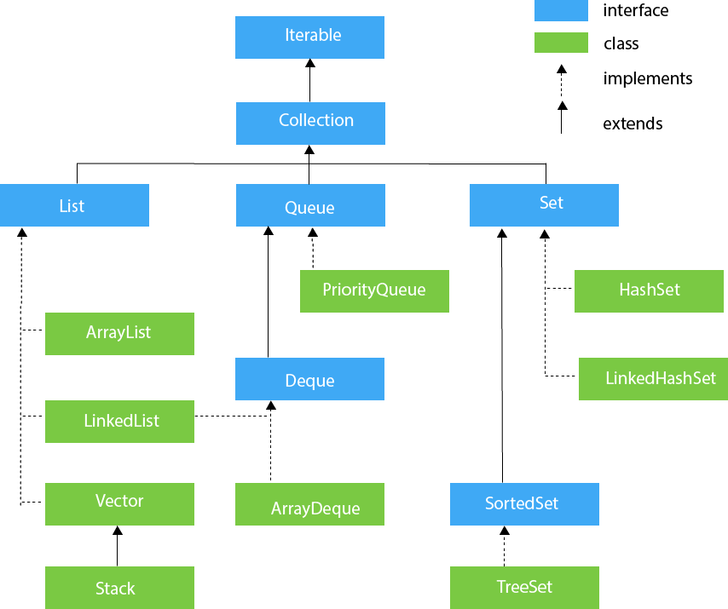
Collection framework

Slide 31
Collection framework
A collection framework is an API ( Application Programming Interface) which is used for storing collection of objects.
It cannot store primitive data types whereas it can store primitive data types in the form of an objects.
A collection framework contains following basic interfaces
Collection interface
Set interface
List interface
Queue interface
The collection framework provides support for storage, sorting and storage of data in the form of key and value pairs.

Slide 32
Advantages of collection framework
A collection framework can be used to store homogeneous and heterogeneous objects.
The collection framework is flexible in size with respect to collection classes
The collection framework provides special methods for processing the collection.

Slide 33
COLLECTION INTERFACE METHODS
size()
isEmpty()
add(object o)
contains(object o)
remove(int index)
add All(collection<E> co1)
retain All(collection<E> co1)
remove All (collection<E> co1)
contains All(collection<E> co1)
iterator()

Slide 34
ITERATOR INTERFACE
An Iterator interface is used to provide iterating support for classes of type List,Queue,set interface.
It can iterate only in forward direction.
An iterator interface contains following abstract methods.
hasNext()
next()
remove()

Slide 35
hasNext()
The hasNext() method is used to check whether the collection contains elements or not.
If the elements are existing then ‘true’ else ‘false’.
When the hasNext() method is called for the first time it creates a cursor to refer the first element in the collection.

Slide 36
Next() and remove()
next() method is used to fetch elements pointed by the cursor.
Once the element is fetched, it will move to the next element.
remove() is used for removing the elements pointed by the cursor.
It must be used along with next() method to remove the data from the collection.

Slide 37
Arraylist
It is a class present in java.util package.
It provides implementation for the abstract methods of List and Collection interface.
It has default capacity value of 10.
Internal capacity formula is
newcap=oldcap*1.5

Slide 38
Arraylist
It supports insertion order.
It supports Duplicate objects.
It supports Null values and duplicates of null values.
The real time use of ArrayList is retrieval of the data and searching the data.

Slide 39
Priority queue
Priority Queue is a class present in java util package.
It provides implementation of Queue interface and collection interface.
It uses lower priority based sorting to arrange the data inside the collection.
It doesn’t support insertion order.
It supports duplicate objects.
It doesn’t support null values if added generates a null pointer exception.
Constructor can be created as PriorityQueue();

Slide 40
Queue interface methods
poll():
This method is used to retrieve and remove the first element present in the priority queue.
If the poll() method is used as empty priority queue, then it returns the value null.
peek():
This method is used to retrieve the first element present in priority queue.
If the peek() method is used as empty priority queue, then it returns the value null.

Slide 41
remove():
This method is used to retrieve and remove the 1st element present in the priority queue.
If the remove() method is used on a empty priority queue then it generates exception called as NoSuchElementException.
element():
This method is used to retrieve the 1st element present in the priority queue.
If the element() method is used on a empty priority queue then it generates exception called as NoSuchElementException.

Slide 42
hashset
Hashset is a class present in java.util package.
It provides an implementation for set interface with respect to collection interface methods.
It doesn’t support insertion order.
It doesn’t support duplicate objects.
It supports null values but doesn’t supports duplicates of null values.
The default capacity is 16.
The internal capacity is calculated by
newcap=oldcap*0.75

Slide 43
Hashset Constructor can be created as Hashset();
In Real time application it must be used to store a Unique set or collection of data.
No duplication.

