Slide 1
SageServe MLOps Platform
Forecast-aware autoscaling for LLM inference, and the MLOps layer that makes its forecasts trustworthy.

Slide 2
What is SageServe
A serving system
Autoscaler for large language model inference across several GPU regions and models.
Forecast-aware
It predicts incoming token demand and adds capacity before the load arrives.
Optimization-driven
A global MILP decides how many instances each region and model should run.

Slide 3
How LLM inference works
Prefill
Reads the whole prompt in parallel. Compute-bound. Fills the KV cache.
IMAGE PLACEHOLDER
Diagram of prefill then decode on a GPU, with the KV cache between them
Decode
Generates one token per step. Memory-bandwidth-bound.

Slide 4
Why reactive autoscaling falls short
Bursty traffic
Demand is non-stationary and strongly diurnal.
Late reaction
Scaling after memory saturates means queues, slow first tokens and SLA misses.
Wasted GPUs
Sizing for the peak leaves expensive H100 / A100 GPUs idle.
IMAGE PLACEHOLDER
Chart sketch: demand curve with reactive capacity lagging behind it

Slide 5
The SageServe idea

Slide 6
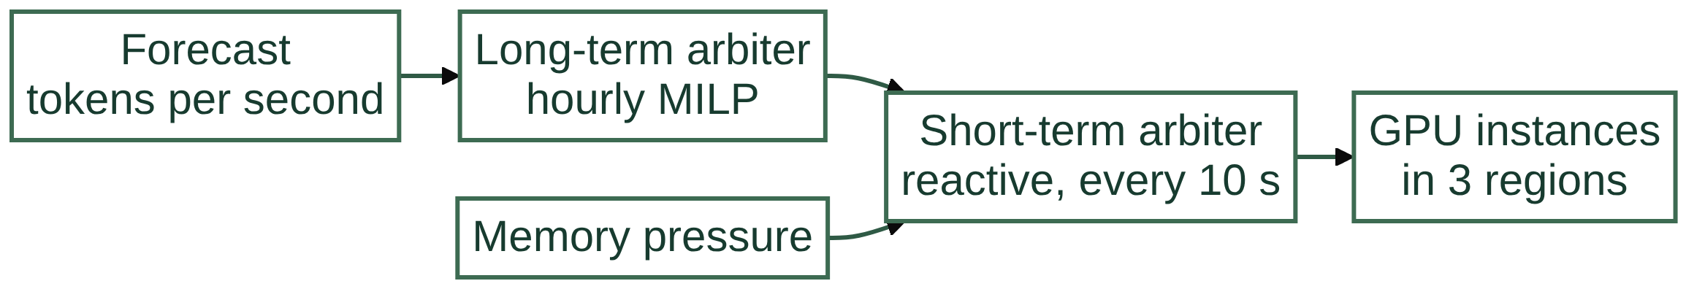
Where the forecast fits

Slide 7
The gap: who looks after the forecaster
The forecast is an ML model
Research simulators often assume perfect or ad-hoc offline forecasts.
Which data trained this forecast?
Is the model approved for production?
Can we reproduce this result?
Has the traffic drifted?
In production it needs care
Clean inputs, versions, approval, monitoring and repeatable runs.

Slide 8
What the MLOps platform adds
Data quality
Every trace is validated before use.
Versioning
Content hashes and a lineage ledger.
Model governance
Registry, model cards and promotion gates.
Monitoring
Latency, SLA and drift diagnostics.
Reproducibility
Containers with isolated environments.
Automation
CI/CD runs the whole chain.

Slide 9
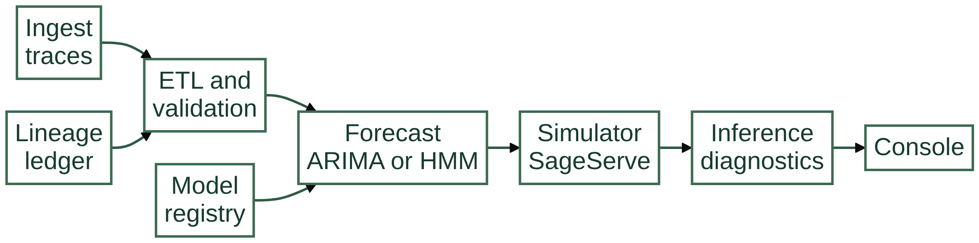
Platform architecture

Slide 10
Module 1: Workload ingestion
Purpose
Produces realistic LLM traffic that follows the patterns described in the SageServe paper, since real production traces are not available.
What it provides
Raw request traces in one strict 15-column format, identical byte for byte when the seed is the same.
What it does
Generates diurnal request arrivals for 3 regions and 4 models across three SLA tiers, either as a seeded file or as a live HTTP stream that can be replayed faster than real time.
Why it matters
Every later stage starts from controlled, repeatable input.

Slide 11
Ingestion: SLA tiers and trace schema
IW-F
TTFT under 1 s, utility 3. Daytime peak with an 8% weekend floor.
15 typed columns
request_id, batch_id, client_tenant, request_type, scenario, sla, utility, regions, model_type, workload_type, application_id, arrival_timestamp, batch_size, prompt_size, token_size.
IW-N
TTFT under 60 s, utility 2. Ramps up from Monday to Friday.
regions
3-digit priority string such as 012 or 201: primary region, then failover order.
NIW
Batch, 24 h turnaround, utility 1. Flat profile.

Slide 12
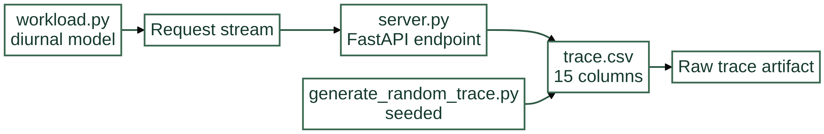
Ingestion flow

Slide 13
Module 2: ETL and data quality
Purpose
Makes sure no raw trace reaches a model without being checked.
What it provides
A validated trace with a manifest. If any check fails, the pipeline stops.
What it does
Standardizes types and formats, cleans the data, then validates it against a formal set of expectations covering schema, missing values, ranges and allowed categories.
Why it matters
Bad data is caught at the door, and a change in cleaning logic changes the version automatically.

Slide 14
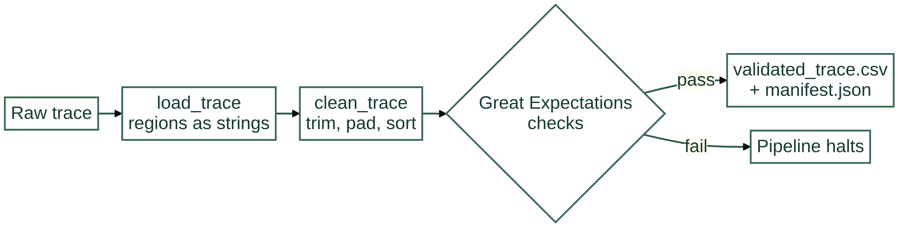
ETL flow

Slide 15
Module 3: Demand forecasting
Purpose
Predicts how many tokens each model will receive in each region, for the capacity planner.
What it provides
Forecast files per model and region, read by the simulator, behind one common interface for all models.
What it does
Turns the trace into per-minute demand, fits the active model (ARIMA or a Hidden Markov Model) and projects the next time horizon.
Why it matters
The registry decides which model runs, so models can be swapped without touching the pipeline.

Slide 16
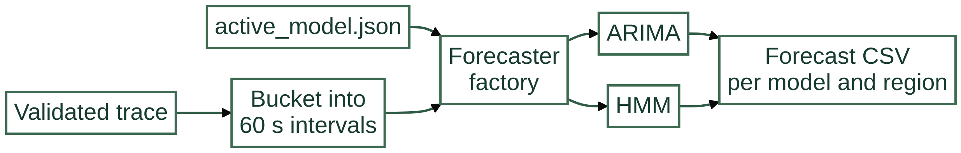
Forecasting flow

Slide 17
Module 4: Model registry and governance
Purpose
Acts as the single source of truth and gatekeeper for forecasting models.
What it provides
One atomic pointer to the production model, and a command line to register, document and promote.
What it does
Stores every model version with its settings, metrics and a model card, and checks documentation and performance before a model can reach Production.
Why it matters
Only documented, qualified models serve traffic, and the history stays auditable.

Slide 18
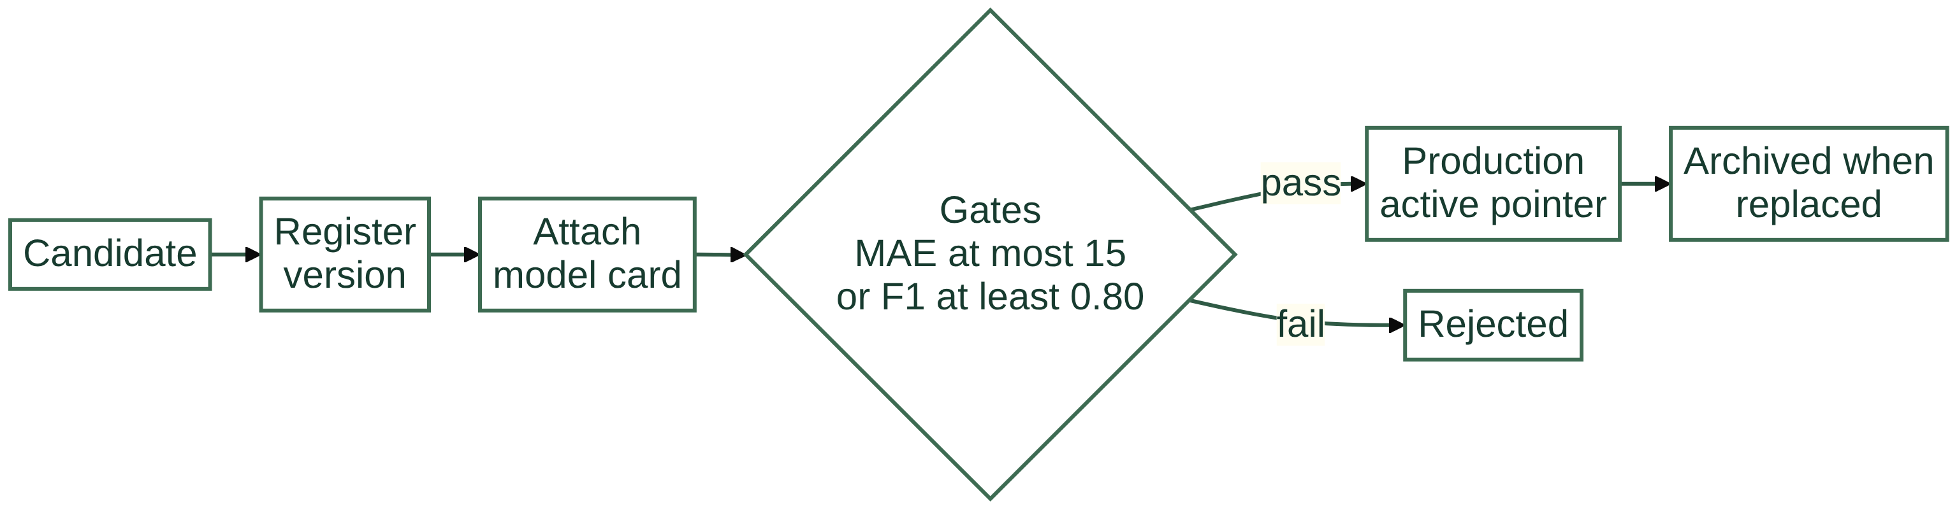
Registry lifecycle

Slide 19
Module 5: Pipeline, versioning and lineage
Purpose
Keeps runs deterministic, non-destructive and traceable.
What it provides
An append-only lineage ledger that traces any forecast back to its raw trace.
What it does
Runs ingest, ETL and forecast in order, gives each artifact a content-based version, skips work that already exists and records a manifest for each artifact.
Why it matters
Results can be reproduced and audited without heavy external infrastructure.

Slide 20
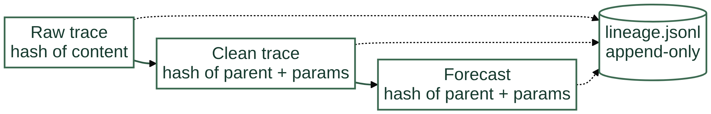
Lineage flow

Slide 21
Module 6: SageServe simulator
Purpose
Serves as the evaluation bed that shows what a forecast does to latency and cost.
What it provides
Logs of latency, instance counts and energy use for every run.
What it does
Replays traces through a multi-region GPU cluster, routes requests, models prefill and decode, and scales capacity in two layers: a reactive loop every 10 seconds and an hourly forecast-driven MILP.
Why it matters
It measures the effect of each forecasting model on SLA violations and instance-hours.

Slide 22
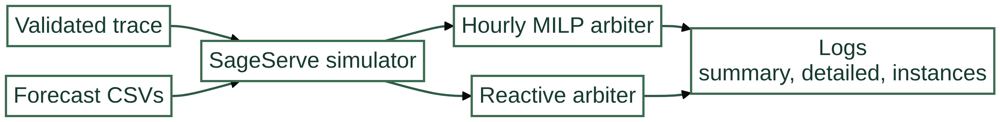
Simulator flow

Slide 23
Module 7: Inference and drift analysis
Purpose
Judges whether a simulation run was a success.
What it provides
Reports and latency CDF plots that compare configurations side by side.
What it does
Loads the logs and computes TTFT and TBT violation rates, combines them into a cohort score, injects workload drift and evaluates forecasts on unseen data.
Why it matters
It turns raw telemetry into a decision about which model and settings to use.

Slide 24
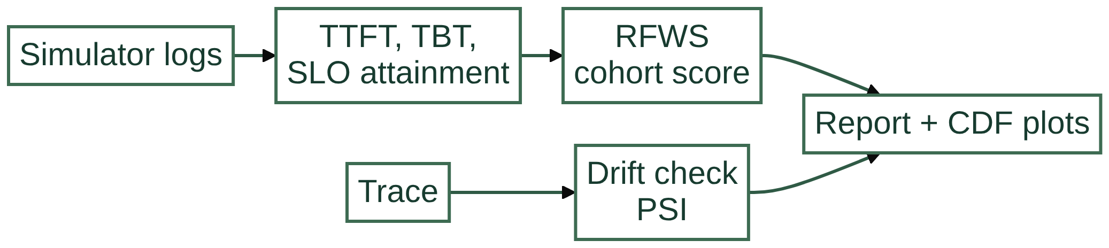
Inference flow

Slide 25
Module 8: Streamlit console
Purpose
Gives engineers and operators one place to control and inspect the platform.
What it provides
A status overview plus drift and allocation views.
What it does
Lets them generate or stream data, run ETL, view lineage, inspect and promote models, launch simulations and explore results.
Why it matters
The whole workflow is available without the command line.

Slide 26
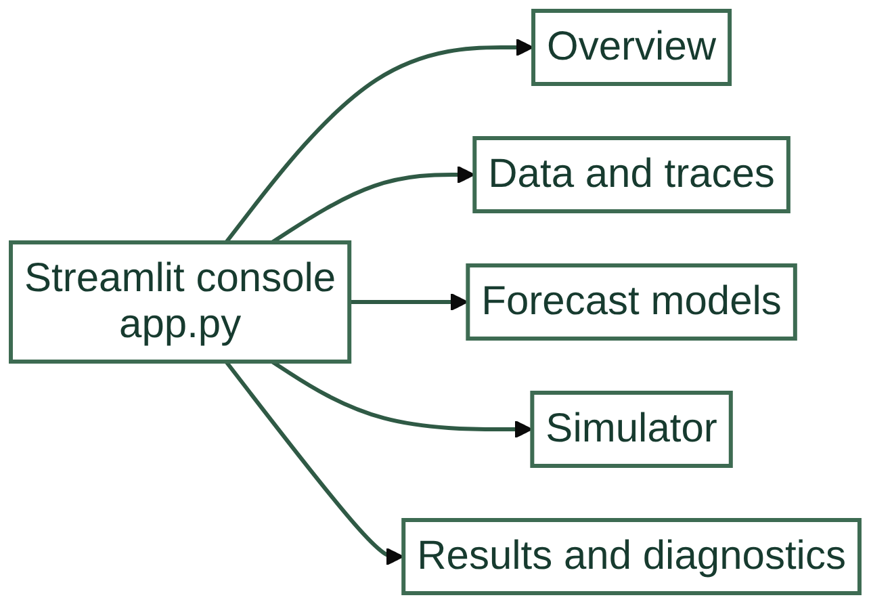
Console map

Slide 27
Module 9: Docker and environments
Purpose
Provides a reproducible runtime even though the tools need conflicting Python versions.
What it provides
The same setup on any machine, with the console on port 8501.
What it does
Builds three isolated environments in one image with uv, routes each command to the right one and runs a developer shell and the web console.
Why it matters
Dependencies never contaminate each other.

Slide 28
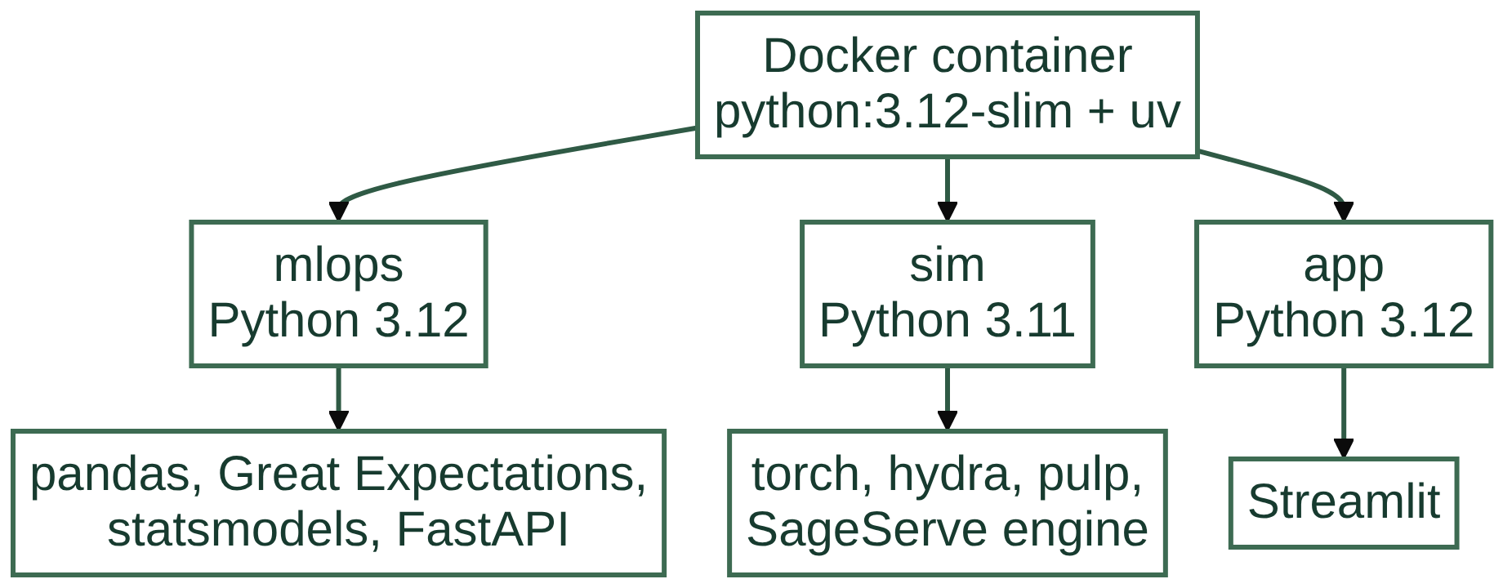
Container layout

Slide 29
Module 10: CI/CD pipeline
Purpose
Verifies that every change keeps the whole chain working.
What it provides
A pass or fail gate and a streaming_ci.csv report.
What it does
On each push or pull request it runs unit tests, then integration tests (register, promote, pipeline, lineage), then a full simulator and inference smoke test.
Why it matters
Breakage is caught before it reaches the main branch.

Slide 30
CI/CD flow

Slide 31
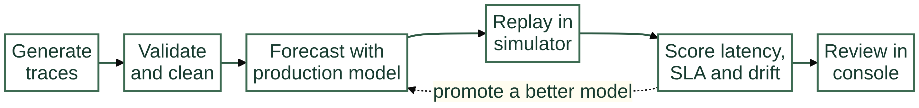
End-to-end lifecycle

Slide 32
Thank you
Questions?

