Slide 1
Sales and Customer Satisfaction Analysis
2023 Dataset Overview

Slide 2
Key Findings
• - Revenue increased by 103.84% from the first to the last month.
• - Units Sold decreased by 12.61% over time.
• - Customer Satisfaction improved slightly, with a -2.54% change.

Slide 3
Revenue and Units Sold Trends
>$19,253.67</$
Revenue Mean
>281.79 units</>
Units Sold Mean
$95,000.00
Revenue Max

Slide 4
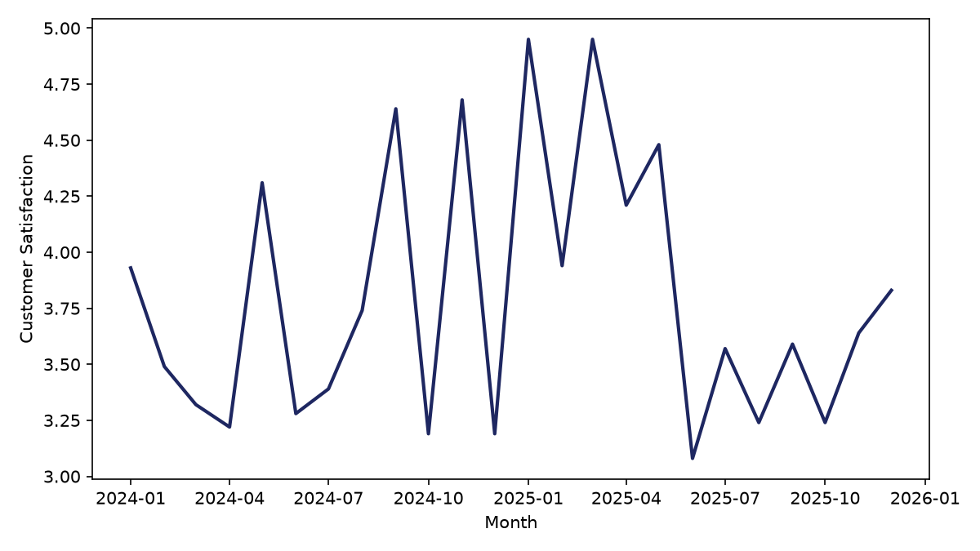
Customer Satisfaction Over Time

Slide 5
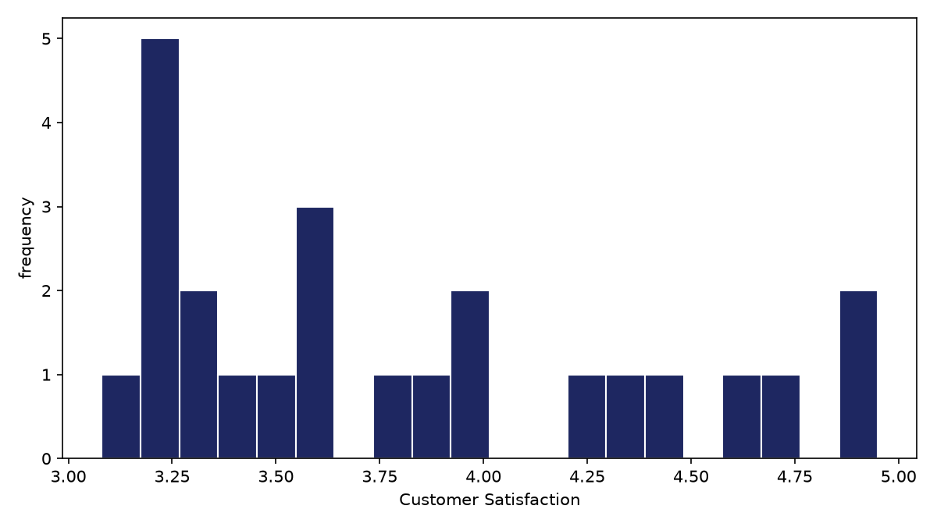
Revenue Distribution and Customer Satisfaction
• - Revenue distribution shows a right-skewed pattern.
• - Customer satisfaction is generally high, with most customers rating 4 or above.

Slide 6
Customer Satisfaction Distribution
>3.62</>
Median Customer Satisfaction
>4.95</>
Max Customer Satisfaction
<3.08</>
Min Customer Satisfaction
>0.60</>
Standard Deviation of Customer Satisfaction

Slide 7
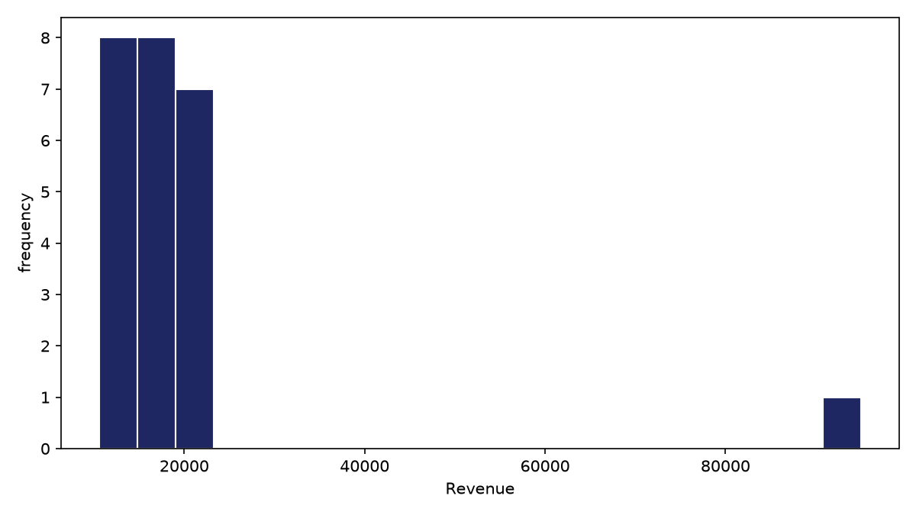
Revenue Distribution

Slide 8
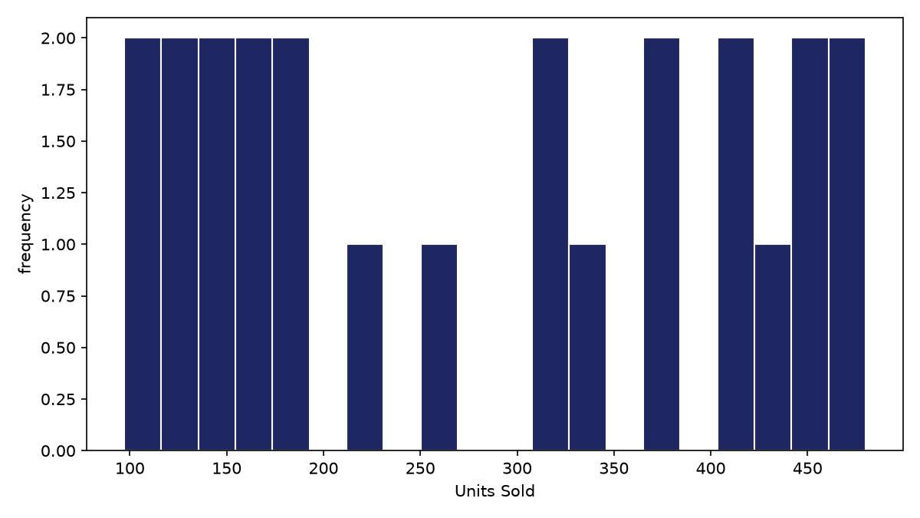
Units Sold Distribution and Region Breakdown
• - Units sold distribution is slightly left-skewed.
• - The West region has the highest number of customers, followed by North.

Slide 9
Summary and Recommendations

