Slide 1
SIGN LANGUAGE RECOGNITION
Presented By
S. Naveen
S. Siddhic Hyder Badhusha
S. R. Sreenivasan
Dept of CSE
Mepco Schlenk Engineering College, Sivakasi

Slide 2
introduction
Sign language is the common way of communication between normal people and people with hearing and speaking disability.
Gesture recognition becomes crucial for implementing Human computer interaction.
Sign language is difficult for the normal people to adapt.
The computerized digital image processing and many classification methods can be used to interpret the sign language.

Slide 3
MOTIVATION
But the people with hearing and speaking disabilities as facing so much problems to communicate with each other.
There is no effective medium for them to talk.

Slide 4
Problem statement
Speech and hearing impaired people use hand signs and gestures to communicate, Normal people face difficulty in understanding their language.
Beginners in sign language who are affected with this kind of disability also find it difficult to communicate with each other in their community.
Hence there is a need of a system which recognizes the different signs, gestures and conveys the information to the normal people.

Slide 5
BACKGROUND
Indian professionals find there is a lack of implementation of sign language and special schools for people with disability in hearing and speaking.
Surveys showed responses of misconception about Sign language.
There was a confusion of a standard sign language.
Linguistic studies on ISL started in 1978 in India.
Sign language recognition is to be implemented such that it doesn’t use special image acquiring devices.

Slide 6
constraints
The Sign language Prototype is a real-time vision based system whose purpose is to recognize the Sign Language.
Uses only one camera with a set of defined assumptions as follows,
The user must be within a defined perimeter area, in front of the camera.
The user must be within a defined distance range, due to camera limitations.
Hand pose is defined with a bare hand and not occluded by other objects
The system must be used indoor, since the selected camera does not work well under sun light conditions

Slide 7
workflow
The proposed system architecture has the following modules,
Data Acquisition
Pre-processing
Feature extraction
Sign language gesture classification
Mapping it with text

Slide 8
BLOCK DIAGRAM
Data
Acquisition
Pre- Processing
Feature
Extraction
Gesture
Classification
(CNN)
Data Source : From Kaggle datasets or real time data definitions

Slide 9
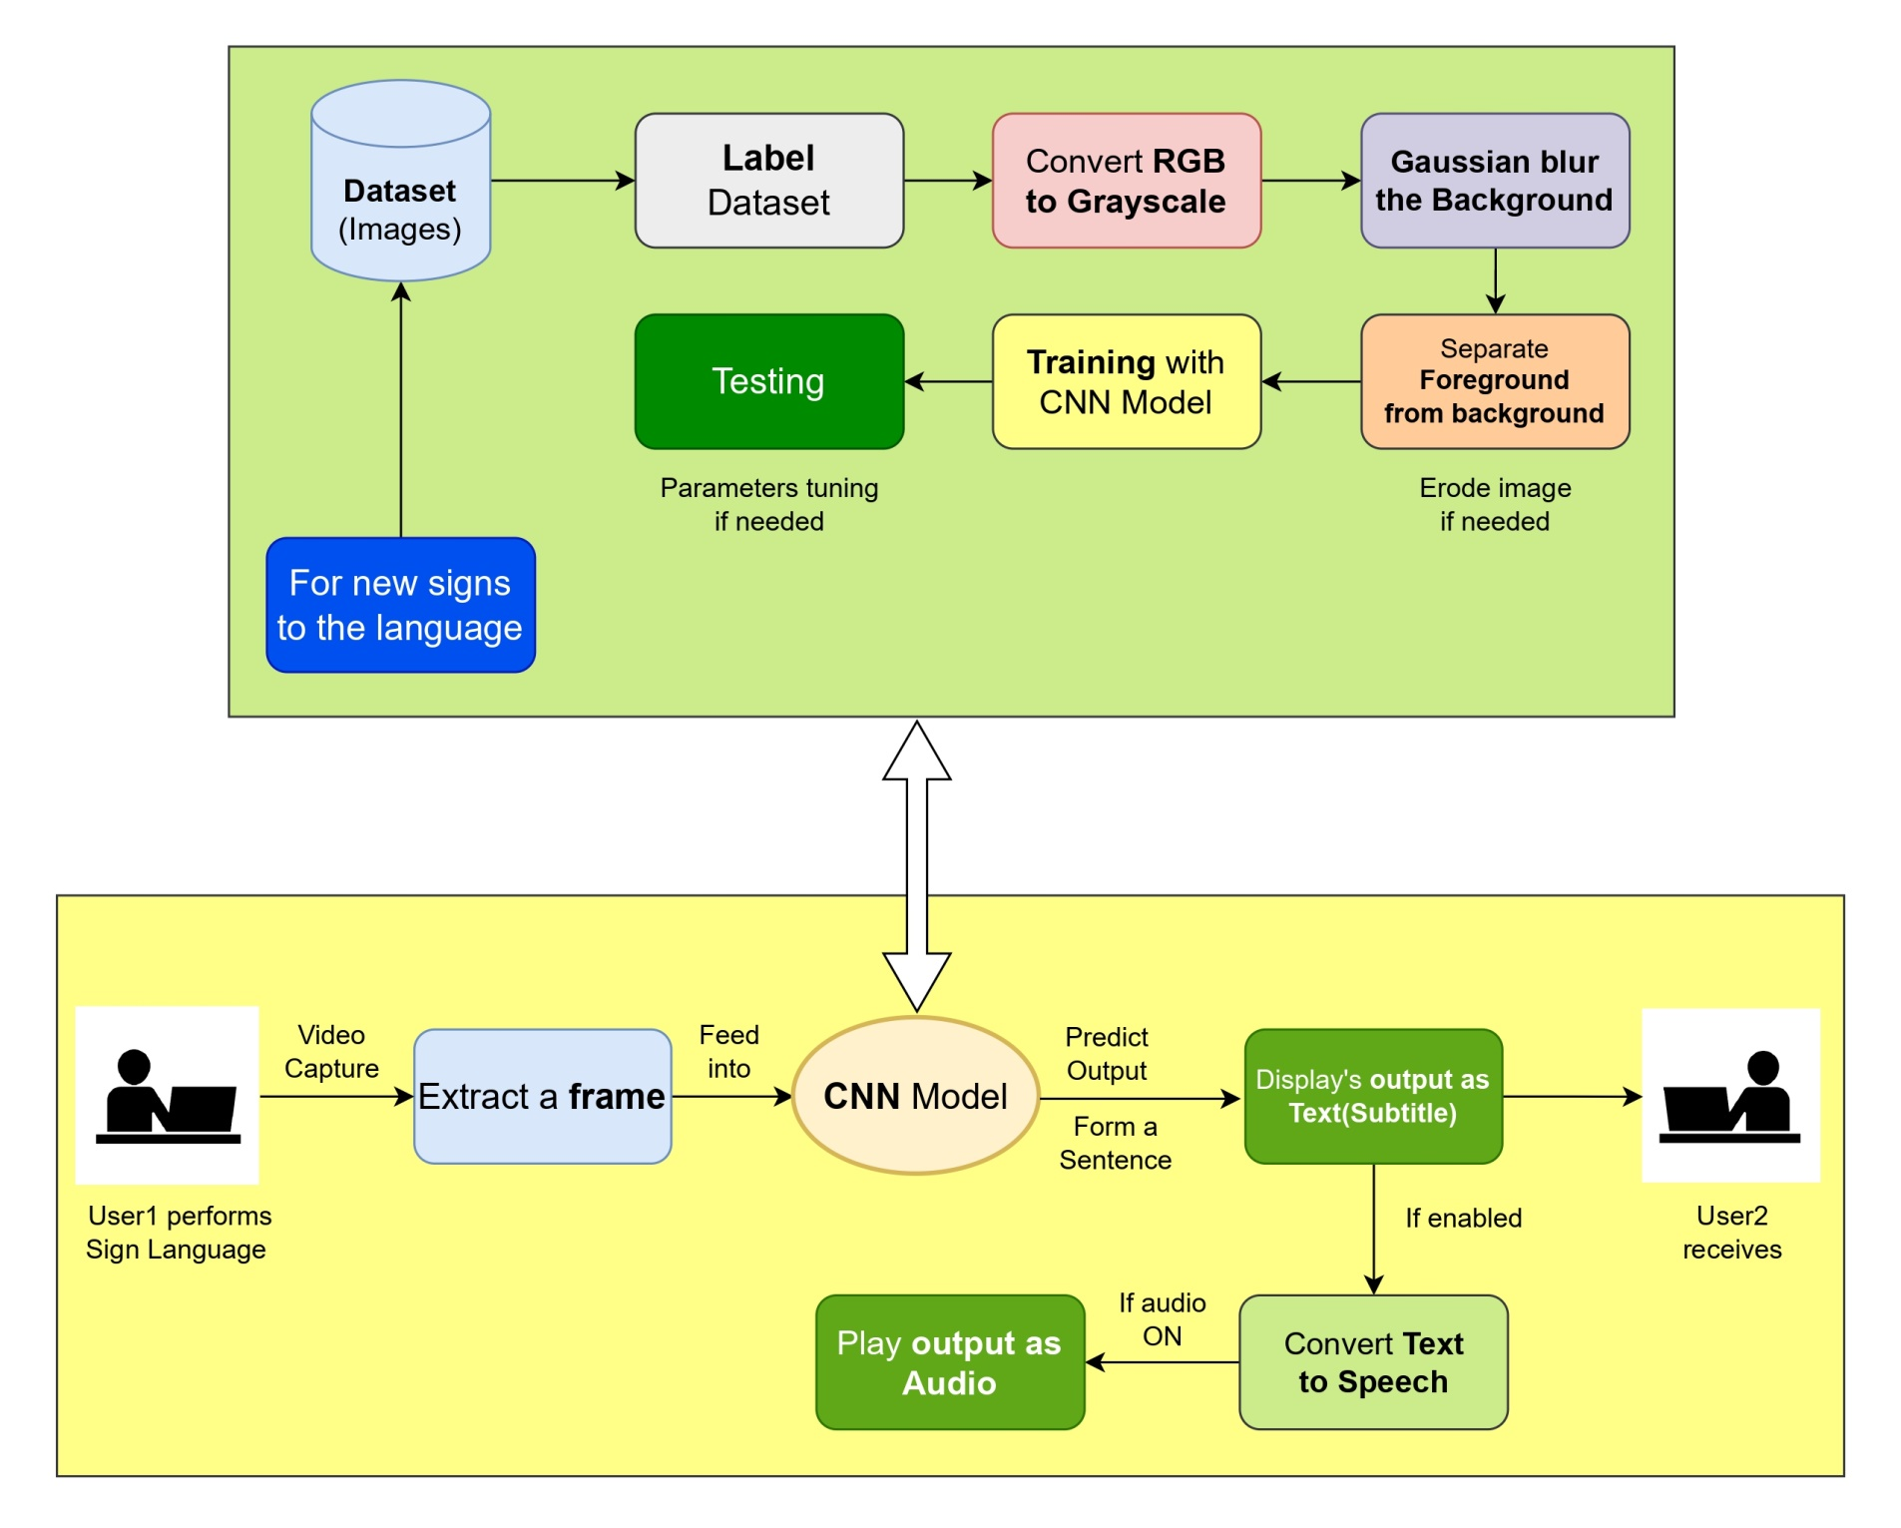
ARCHITECTURE DIAGRAM

Slide 10
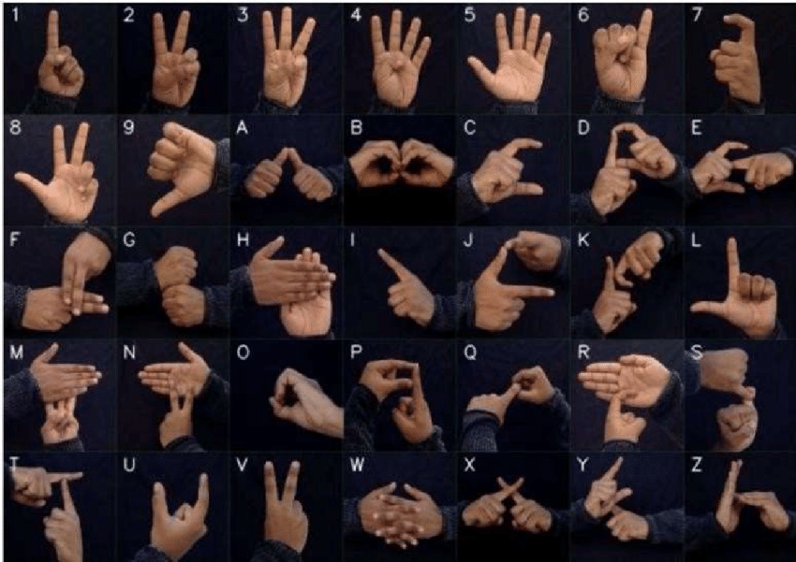
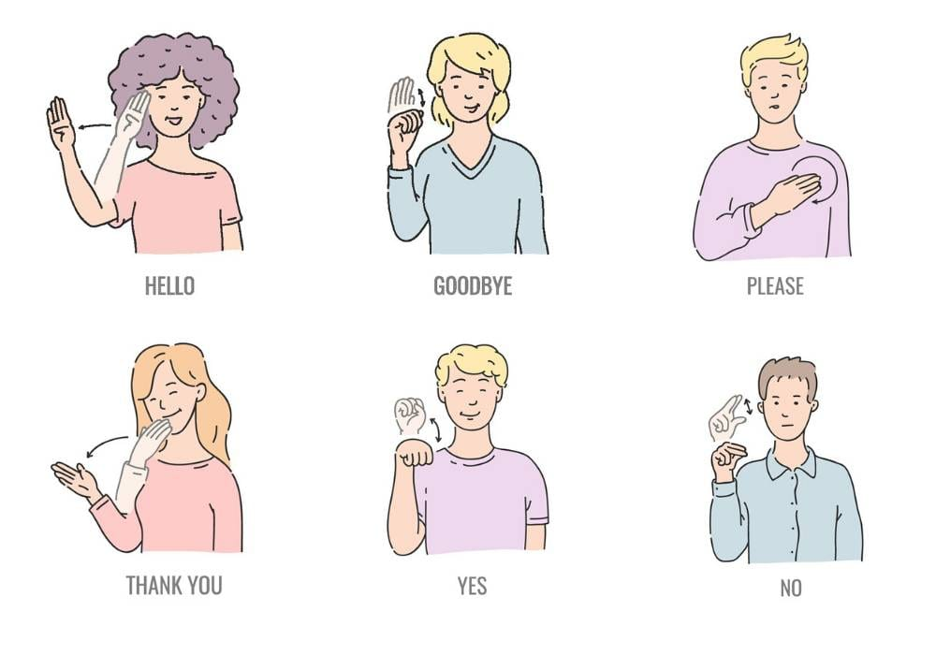
Data collection
Sign language is an independent language which is entirely different from spoken languages.
Researchers used general conversations for recognition of sign language.

Slide 11
Dataset generation
Open Computer Vision library used to produce the dataset.
Image was captured in RGB which is converted into grayscale
Gaussian blur filter was applied.

Slide 12
Gesture classification
2 layers of algorithm is used to predict the final symbol of the user
STEP 1 :
Apply gaussian blur filter and threshold to the frame taken with OpenCV to get the processed image after feature extraction.
Processed image is passed on to CNN model for prediction.
Space between the words are considered using the blank symbol.
STEP 2 :
We detect various sets of symbols which show similar results on getting detected.
We then classify between those sets using classifiers made for those sets only.

Slide 13
Challenge faces
Dealing with raw images.
Selection of filters
Difficulties related to accuracies

Slide 14
conclusion
A functional real time vision based Indian sign language recognition for people who have hearing and speaking disability.
We can improve the prediction by verifying and predicting the similar symbols.

Slide 15


