Slide 1

Student Feedback Analysis Insights from Survey Responses

Slide 2
INTRODUCTION explores student feedback to assess teaching effectiveness, course structure, and overall satisfaction. It highlights key strengths and areas for improvement based on both ratings and comments.

Slide 3
DATA CLEANING AND PREPOCESSING
Before analysis, the dataset was cleaned and standardized:
✅ Missing values were checked to ensure data completeness.
✅ Data types were verified to confirm correct formats (e.g., numeric ratings).
🔄 Ratings were normalized from a 1–10 scale to a 1–5 scale for consistency and better interpretation in visuals.
This preprocessing ensures accurate and meaningful analysis of the student feedback.

Slide 4
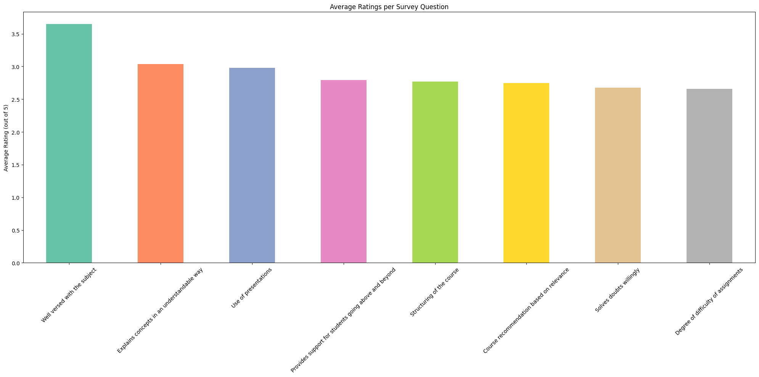
BAR CHART
This bar chart shows the average student ratings for each feedback question. It helps identify what students liked most and which areas need improvement.

Slide 5
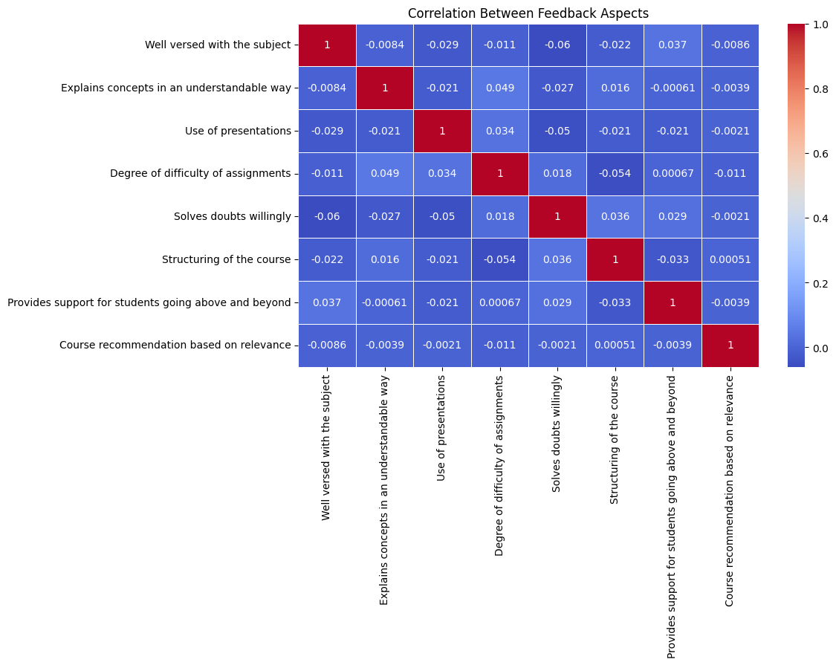
Heatmap
This heatmap shows the correlation between different feedback aspects. Stronger values (closer to 1 or –1) mean that students tend to rate those aspects similarly, revealing patterns in how course features are connected.

Slide 6
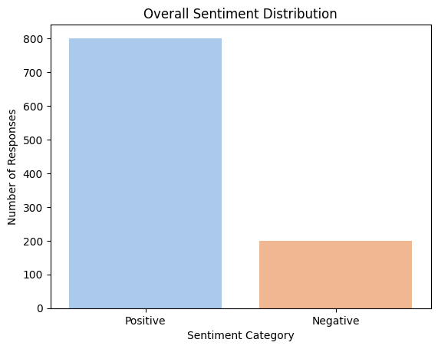
OVERALL SENTIMENT DISTRIBUTION
We used a small set of sample feedback
comments to analyze the overall sentiment using TextBlob. Each comment was classified as Positive, Negative, or Neutral based on its sentiment polarity score.
The bar chart shows how many comments fall into each sentiment category, giving a quick view of the general tone of the feedback.
This helps understand how students felt emotionally about the course, beyond just numerical ratings

Slide 7
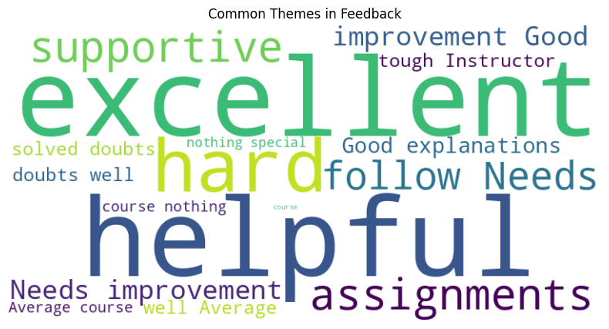
Common Themes in Feedback
This word cloud visualizes the most frequently
used words in student feedback comments. Larger words appear more often in the feedback, highlighting common topics or recurring sentiments.
This helps quickly identify what students talk about most—such as course, assignments, helpful, or supportive.

Slide 8
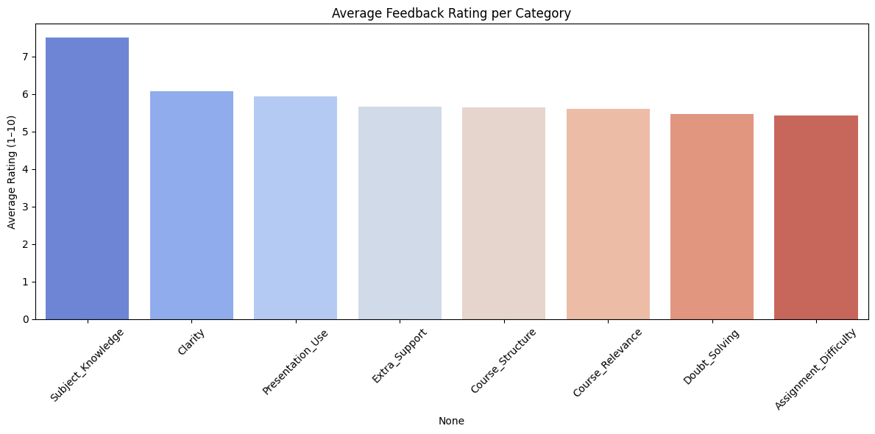
Average Feedback Rating per Category
This bar chart displays the average rating
for each feedback category based on student responses. It allows us to easily compare how different aspects—like teaching quality, support, or course structure—are rated.
Taller bars indicate well-performing areas, while shorter ones highlight areas that may need improvement.

Slide 9
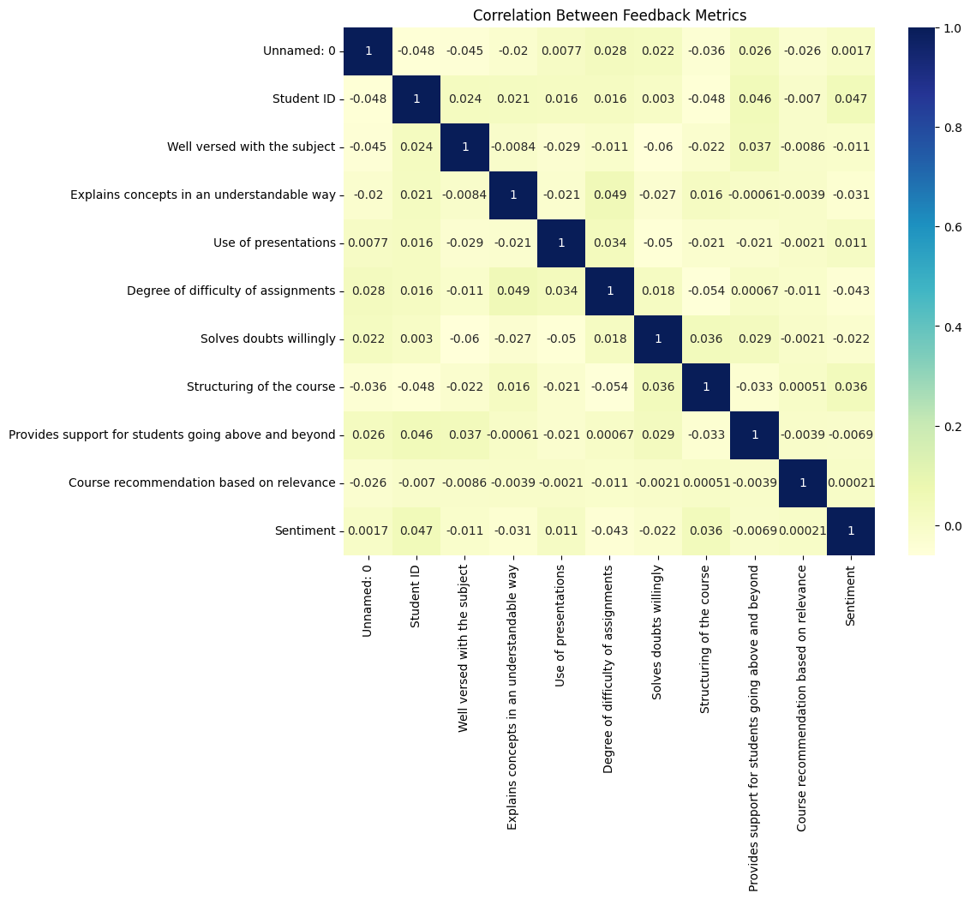
Correlation Between Feedback Metrics
This heatmap shows how different numeric
feedback metrics relate to each other. A high correlation (closer to 1) means students tend to rate those aspects similarly, while low or negative correlation suggests independent or opposite trends.
It helps identify which course features influence each other and can guide focused improvements.

Slide 10
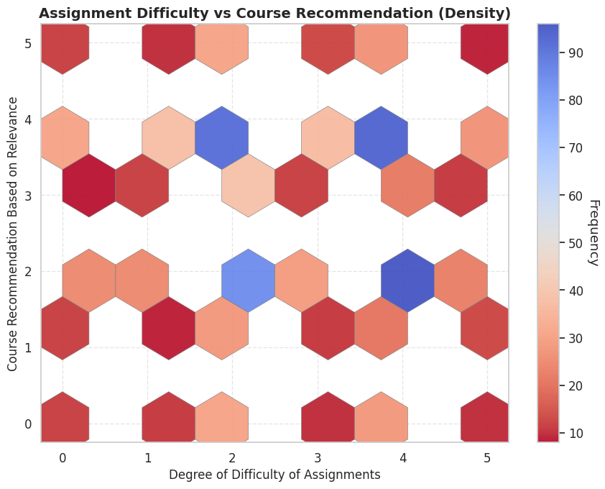
Assignment Difficulty vs Course Recommendation
This hexbin plot shows the density of
student responses comparing how difficult they found the assignments to how likely they were to recommend the course.
Darker hexagons represent areas with more responses.
It helps reveal trends:
If dense areas are toward high difficulty but low recommendation → students may be frustrated.
If students still recommend the course despite high difficulty → they may see value in the challenge.
This plot helps evaluate how assignment difficulty affects overall course satisfaction.

Slide 11
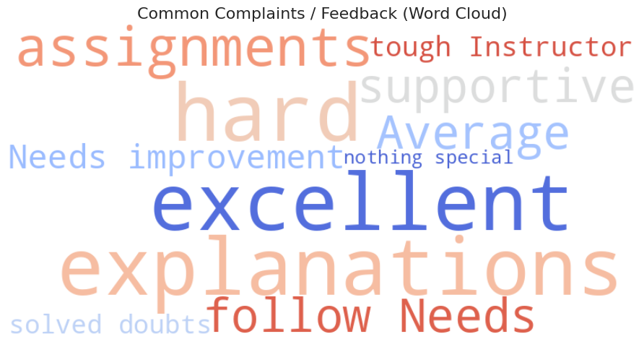
Common Complaints / Feedback (Word Cloud)
his word cloud highlights the most frequent
critical words used in student feedback. Generic and overly positive terms were filtered out using custom stopwords to focus on issues or concerns.
Larger words like tough, confusing, or assignments (if present) show what students often complained about, helping identify pain points that need attention.

Slide 12
thank you

