Slide 1
Predicting the price of used cars
Sreenivasa Etla

Slide 2

Business Objectives – Problem Statement
1
Maximize the Price for seller, Optimize the margin for agent, Model for car lease business
2
Based on car sales date ~ historical data & understanding the factors and the business
3
Build a ML Method to assess the complex dimensions that impact used car sales

Slide 3

Methodology : Approach to the solution
Business Understanding
& Data Understanding
Data Preparation
Modeling
Evaluation
Train & Test data
Rows (64238) ; Features (20), Primary Feature (Price)
Rows (21352) ; Features (19)
Missing Data – Train(12417), Test (4005)
Few features have no relevant data – offertype, sellertype, noofpictures
Data features are in inconsistent format
Age of the car is not provided and needs to be calculated(feature Engineering)

Slide 4
Solution Approach : Data
Business Understanding
& Data Understanding
Data Preparation
Modeling
Evaluation
Data Preparation: Some of the features removed from data sets like –
ModelOfTheVehicle,VehicleID,NameOfTheVehicle,SellerType,OfferType,NumberOfPictures,ZipCode,DateOfAdCreation,DateOfAdLastSeen
Feature Engineering :
Added “age of vehicle” – Difference between data collected date and registration date
Handling Missing value row :
TRAIN : given that the date set is big, the rows with NA have been removed.
TEST : missing value imputation using KNN
Standardised both data sets
Model building & analysis
Linear Regression & Step AIC
Decision Tree using RPART for regression
Random Forest

Slide 5
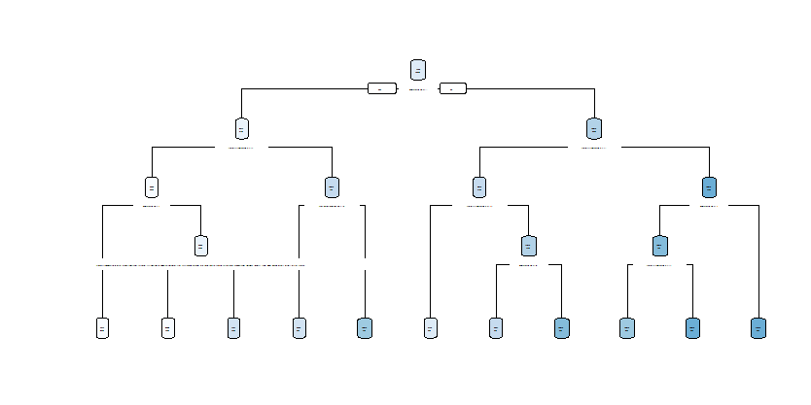
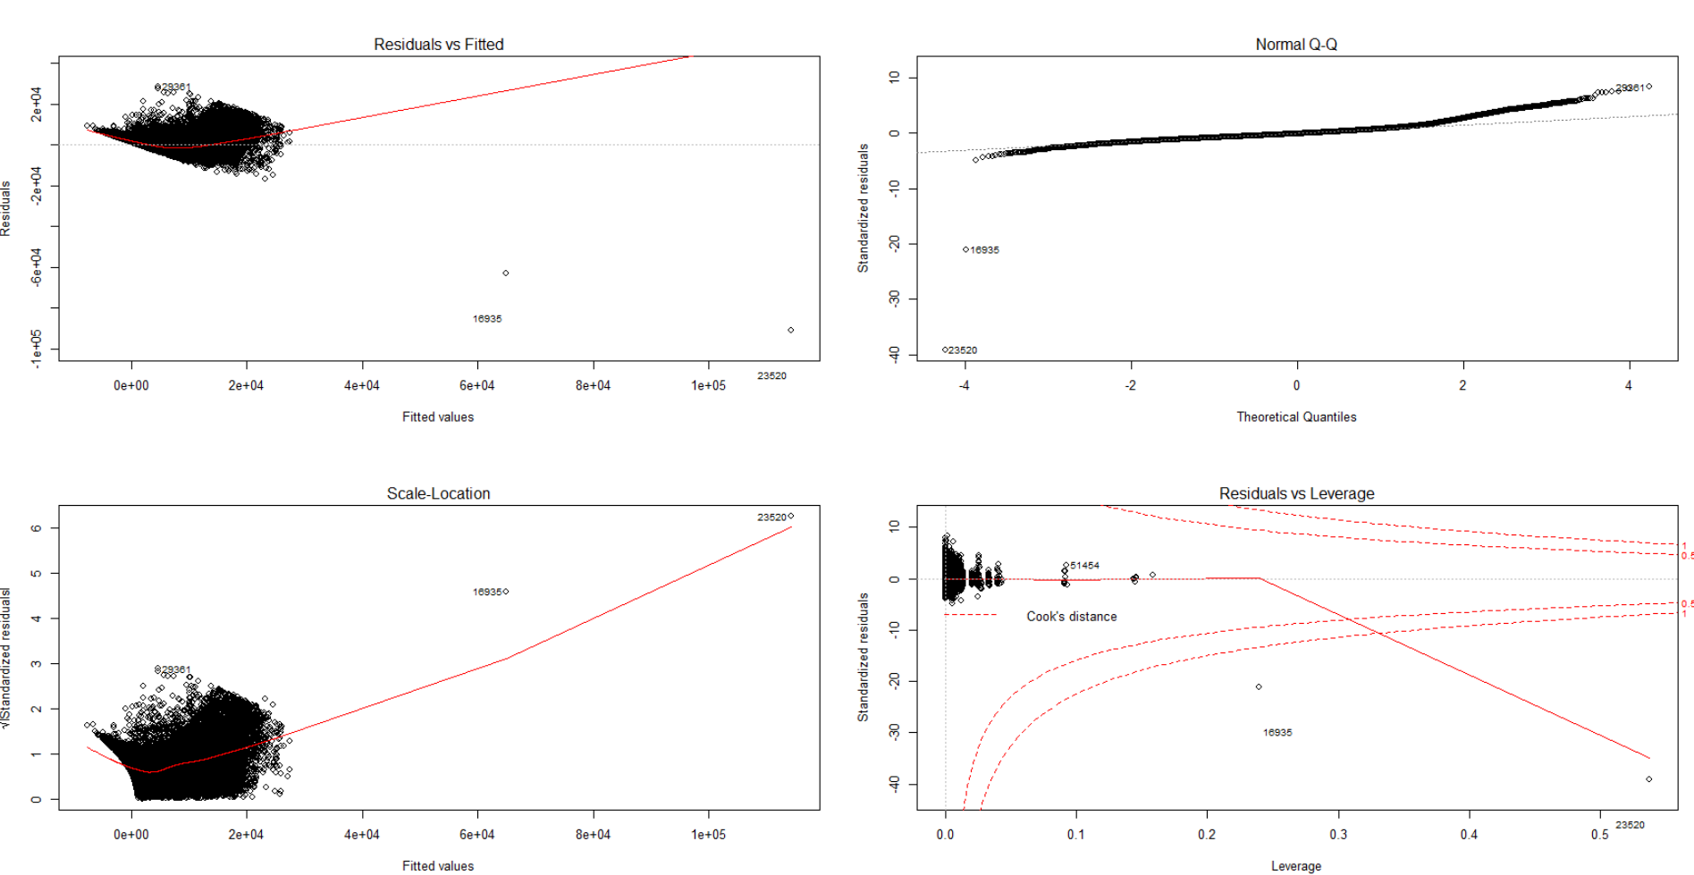
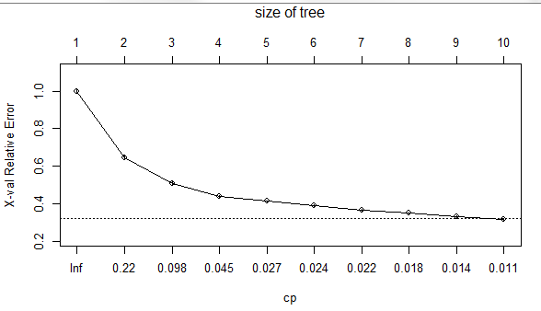
Solution Approach: Modeling
Business Understanding
& Data Understanding
Data Preparation
Modeling
Evaluation
Linear Regression & Step AIC
Decision Tree using RPART for regression
Random Forest
Decision Trees
Linear Regression

Slide 6
Evaluation & Results
# | Model | MAPE on TEST Data
1 | Linear Regression | 0.51
2 | Decision Tree Regression | 0.48
3 | Random Forest | 0.24 | Used to Predict on TEST 33.15%
Selected Random Forest for forecasting the price on test data – because better MAPE

Slide 7
THANK YOU

