Slide 1

Stock Price Prediction
Sreenivasa Etla

Slide 2

Presentation Outline
Business Objectives
Methodology & Approach
Evaluation/Results
Summary

Slide 3

Business Objectives
1
Financial Analytics company (Saankhya) wants to build a statistical algorithm for algorithmic trading
2
Based on historical performance of a financial asset over years the client would like to predict few key indicators
3
(1) percentage gain or loss on an investment
4
(2) Volatility of the asset

Slide 4
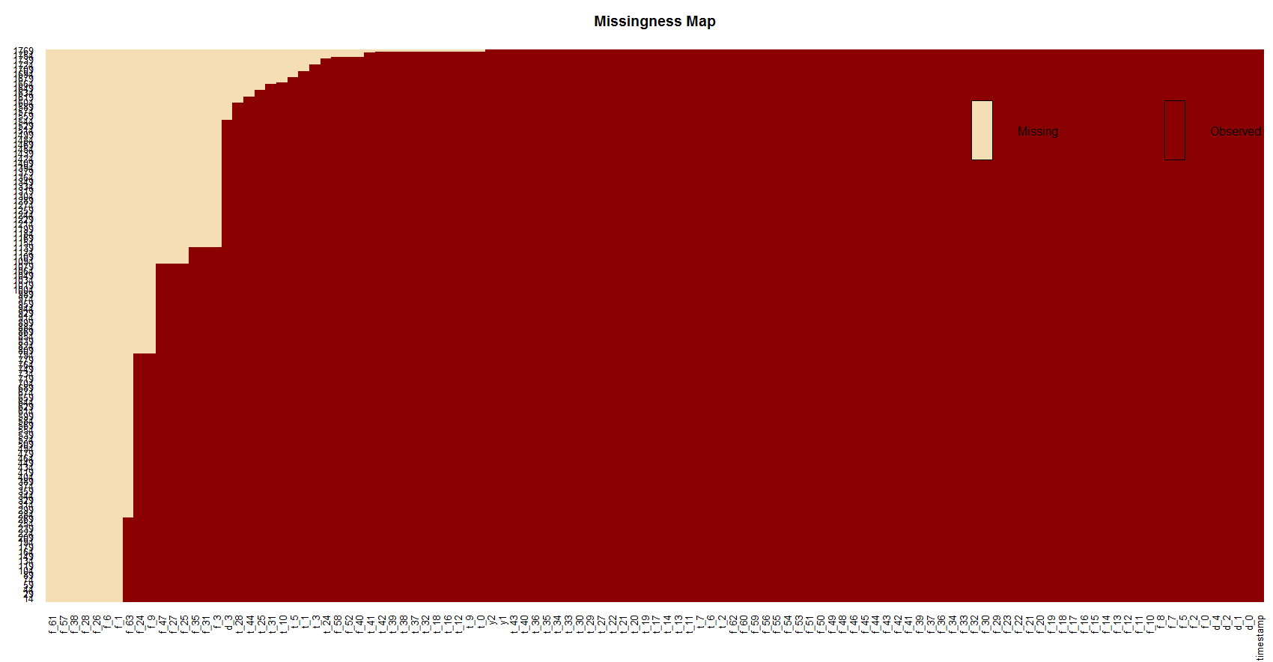
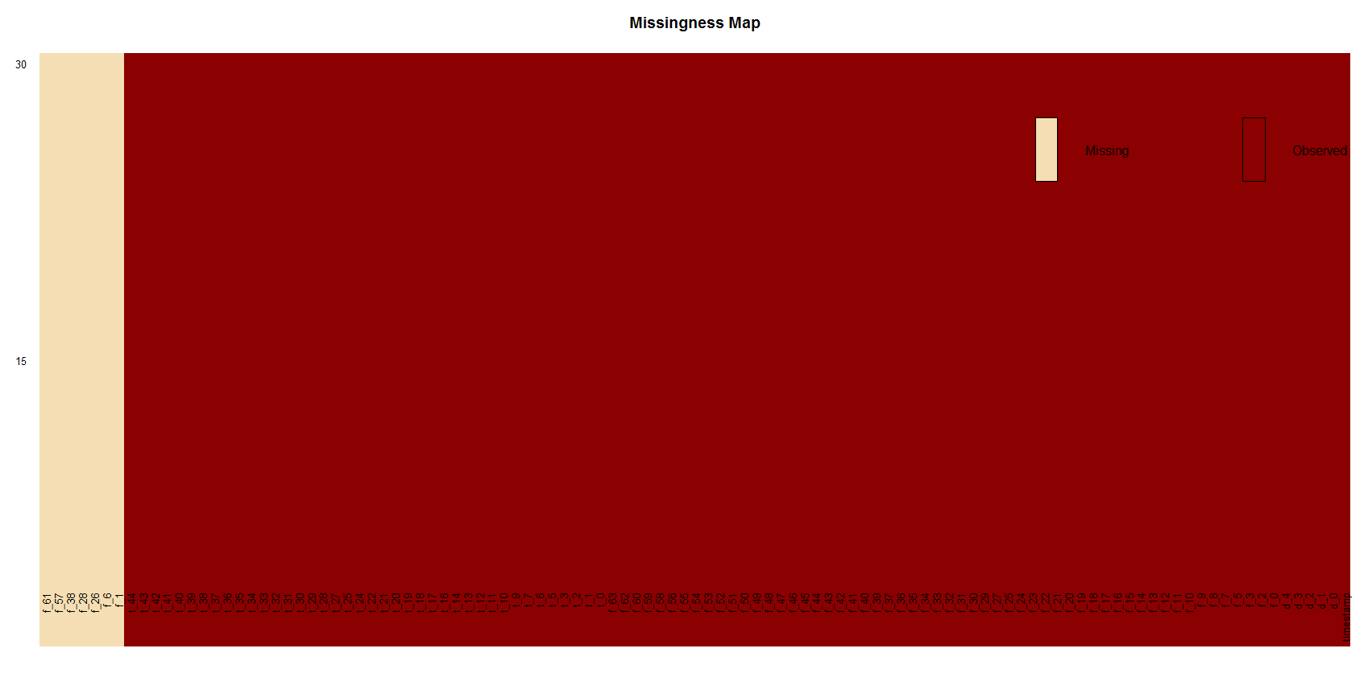
Methodology : Approach to the solution
Business Understanding
& Data Understanding
Data Preparation
Modeling
Evaluation
1
TRAIN DATA SET –
Rows (1769) ; Features (111), Primary Features (y1 & y2)
Observations on Data
Multiple NA columns in both sets
Excluding Null columns the remaining variables are all numeric
The split between Train and Test does not explain the variance in data
2
TEST DATA SET –
Rows (30) ; Features (109), Primary Features (none)
Null Data
TRAIN DATA
TEST DATA

Slide 5
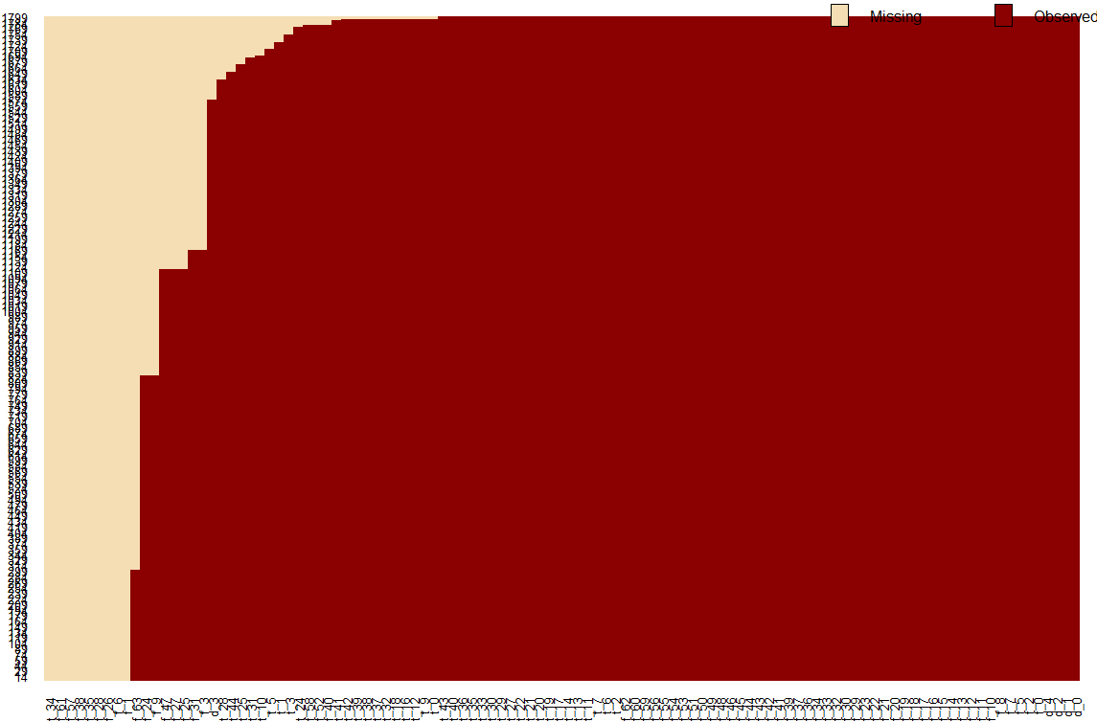
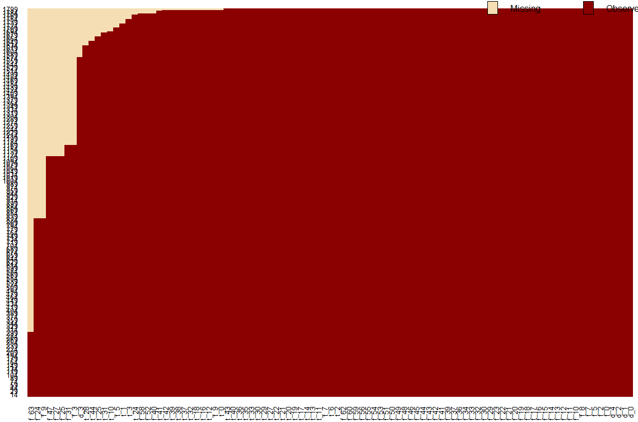
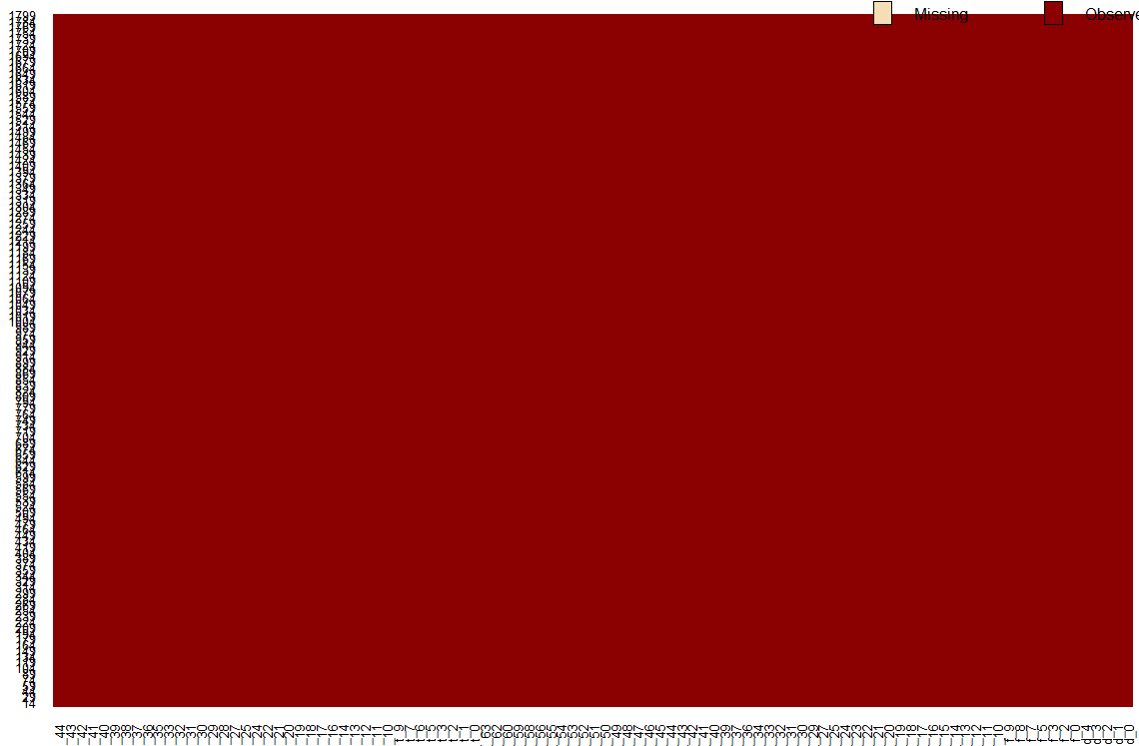
Methodology : Approach to the solution
Business Understanding
& Data Understanding
Data Preparation
Modeling
Evaluation
y1,y2 data frame
Append y1,y2 (cbind)
R 1769
C 111
R 1769
C 108
R 1769
C 101
Train
Remove
y1,y2,timestamp
Train1
R 1799
C 108
R 1799
C 108
R 1799
C 108
Train Data Final
Rbind
Train Test
combined
Standardized
Data
Data with no null columns
Data with no missing values
Remove
timestamp
standardize
Remove all columns with NA
Data
Missing values imputation
Test Data
Final
Test
Test1
R 30
C 109
R 30
C 108
R 30
C 99
Data with
Null columns
Null columns
removed
Missing values
imputed

Slide 6
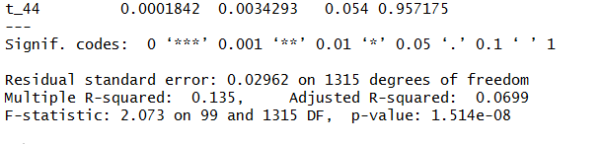
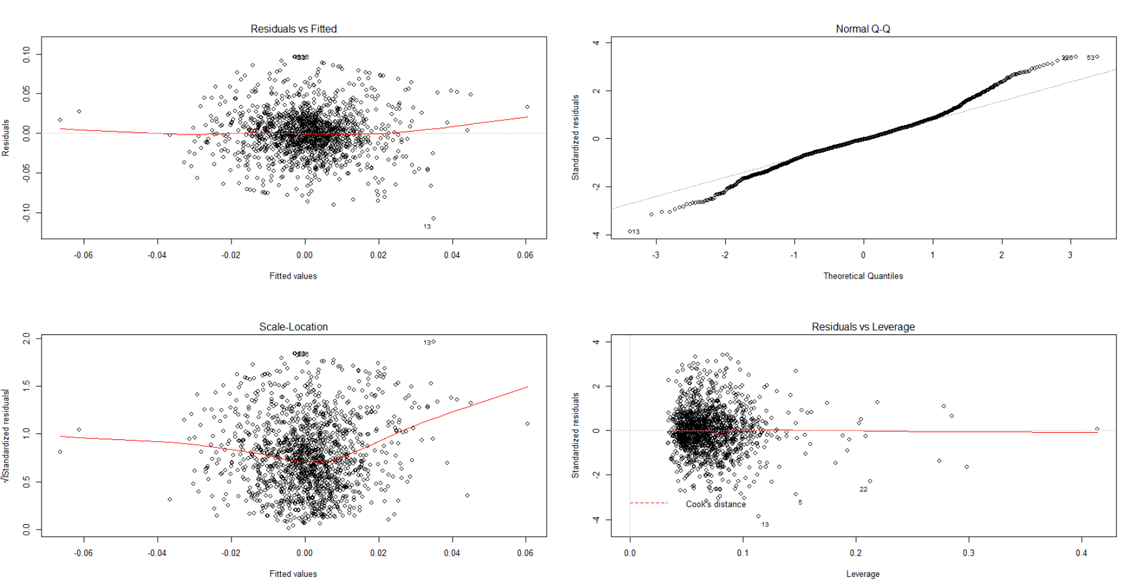
Modeling
1
Linear Regression
Business Understanding
& Data Understanding
Data Preparation
Modeling
Evaluation
Regression Summary
Residuals
Error Metrics

Slide 7
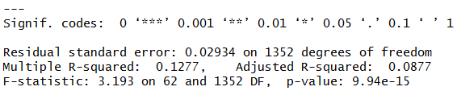
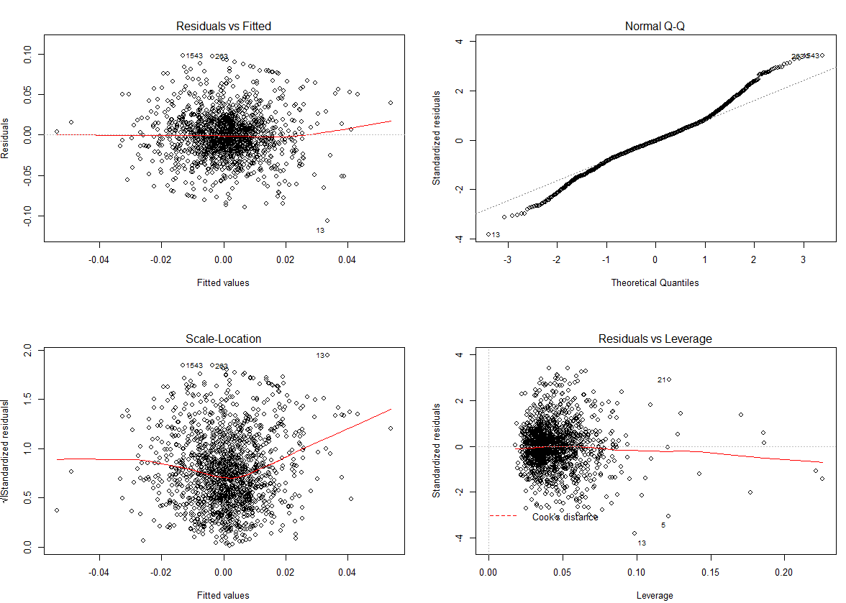
Modeling
2
Linear Regression : STEP AIC
Business Understanding
& Data Understanding
Data Preparation
Modeling
Evaluation
Regression Summary
Residuals
Error Metrics

Slide 8
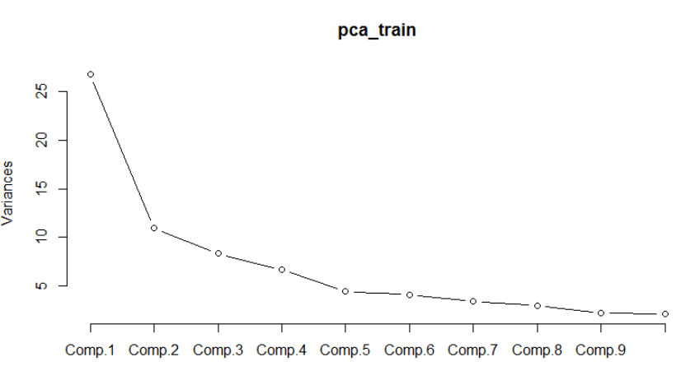

Modeling
3
Principal Comp Analysis (PCA)
Business Understanding
& Data Understanding
Data Preparation
Modeling
Evaluation
Regression Summary
Component Selection
Error Metrics

Slide 9
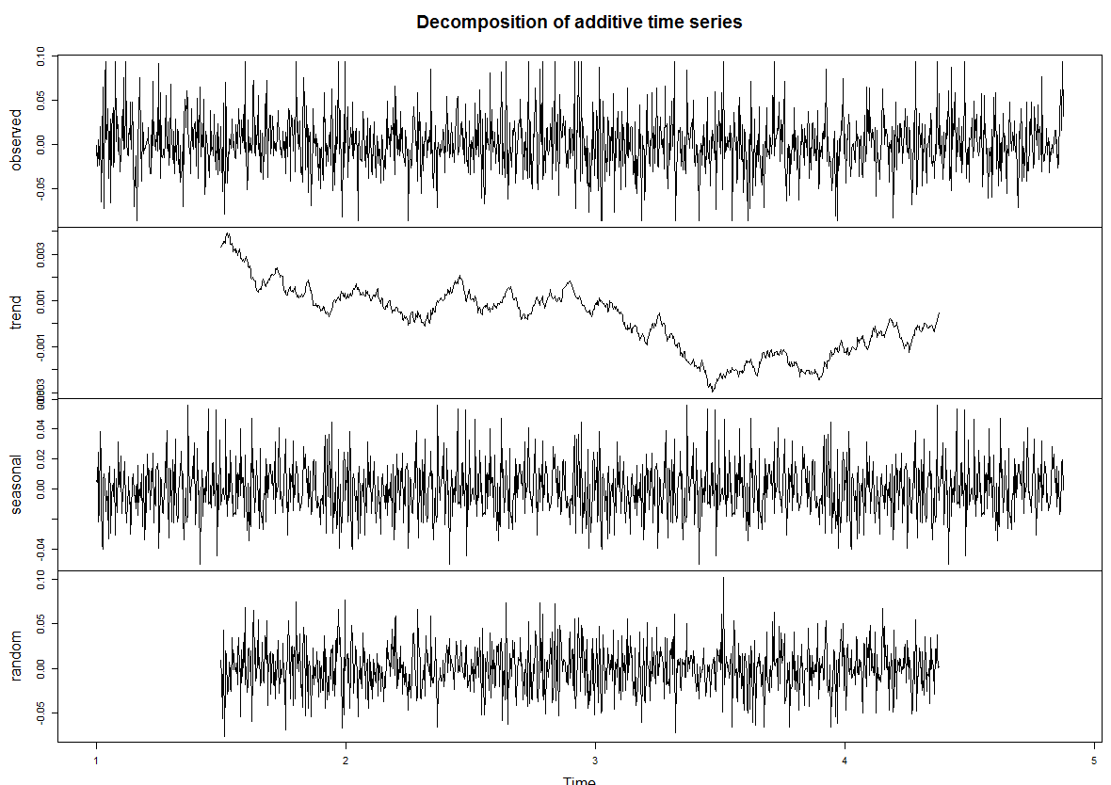
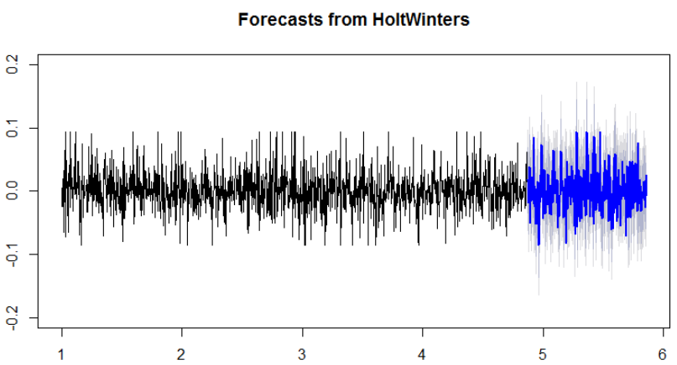
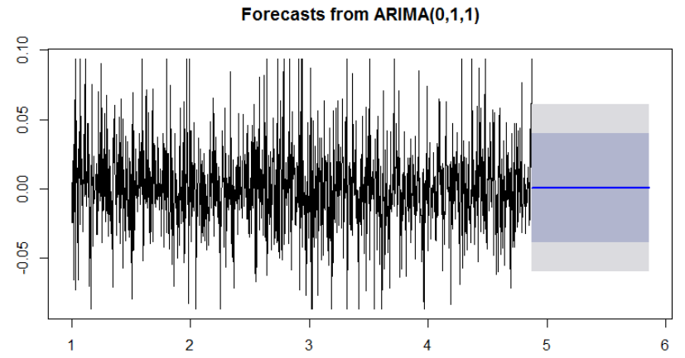
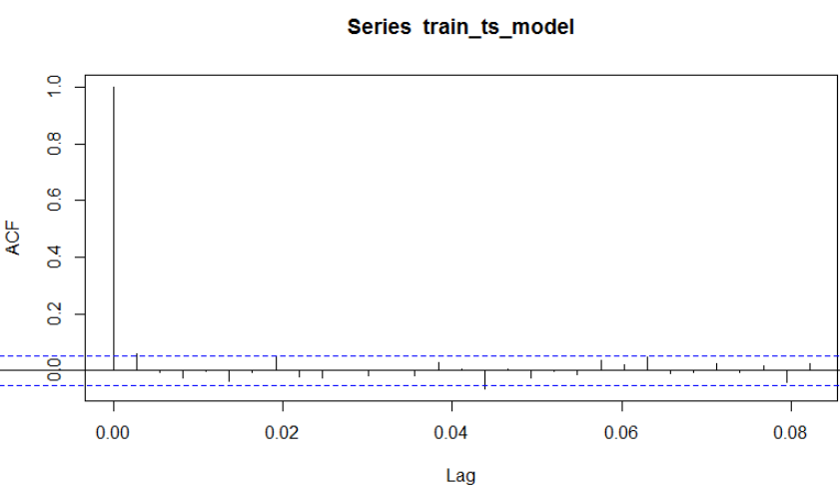
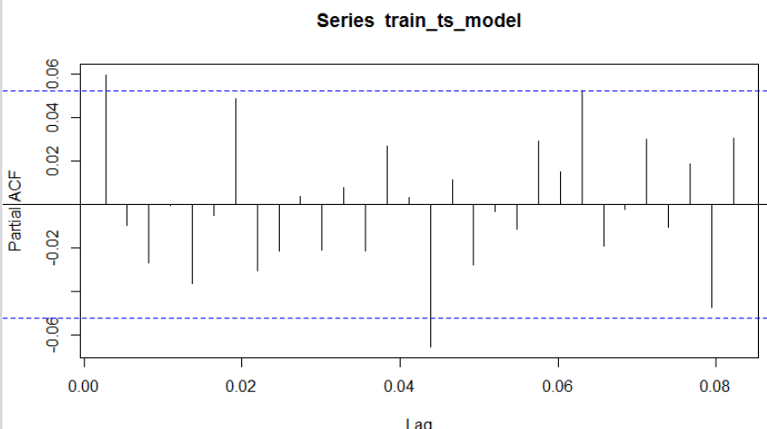
Modeling
4
Time Series Analysis
Business Understanding
& Data Understanding
Data Preparation
Modeling
Evaluation
Decomposed
Holtwinters Forecast (prediction) – with seasonality
Data Observations :
There is a trend component which is random.
seasonal component has a cycle ~ 30 days
The variance in the data is random
ACF
PACF
Conclusion : The model is predicting different forecasted values based on selection of trend or seasonality. The variation in the forecast is also very high.
Auto ARIMA Forecast

Slide 10
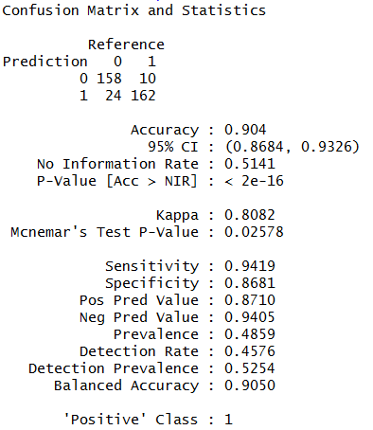
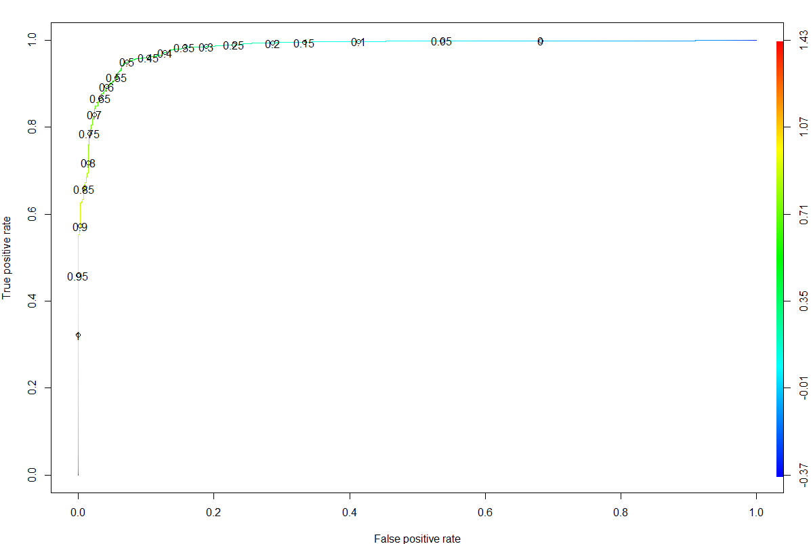
Modeling
5
Logistic regression
Business Understanding
& Data Understanding
Data Preparation
Modeling
Evaluation
Regression Summary
ROCR Plot
0.05

Slide 11
Evaluation & Results
 | R Squared | RMSE | MAPE | P-value
Model 1 – Linear Regression | 0.0699 | 0.0312148503 | 2.8676714325 | 1.514e-08
Model 2 – Linear AIC | 0.0877 | 0.0309669772 | 2.4308695932 | 9.94e-15
Model 3 – PCA | 0.0007159 | 0.3056
1
 | Accuracy | Sensitivity | Specificity | Pos Pred Value | Neg Pred Value | P-value
Logistic Regression | 0.904 | 0.9419 | 0.8681 | 0.8710 | 0.9405 | 2e-16
2
Selected Model 2 for forecasting the y1 values on test data – because better RMSE and higher R Sq values

Slide 12
Problem Understanding & Business Workshops
Data Extraction & receiving data
Data Pre-processing & Preparation (Test & Train data)
For Data Scientists
Model Building & Analysis
Analyse error metrics on TEST data
Finalized Models
Apply New Engineering Data
Optimize target values
For Engineers
Finalize input variable values
Implement in CAE simulation

Slide 13
Thank You
Notes:
In Slide Show mode, select the arrows to visit links.

