Slide 1
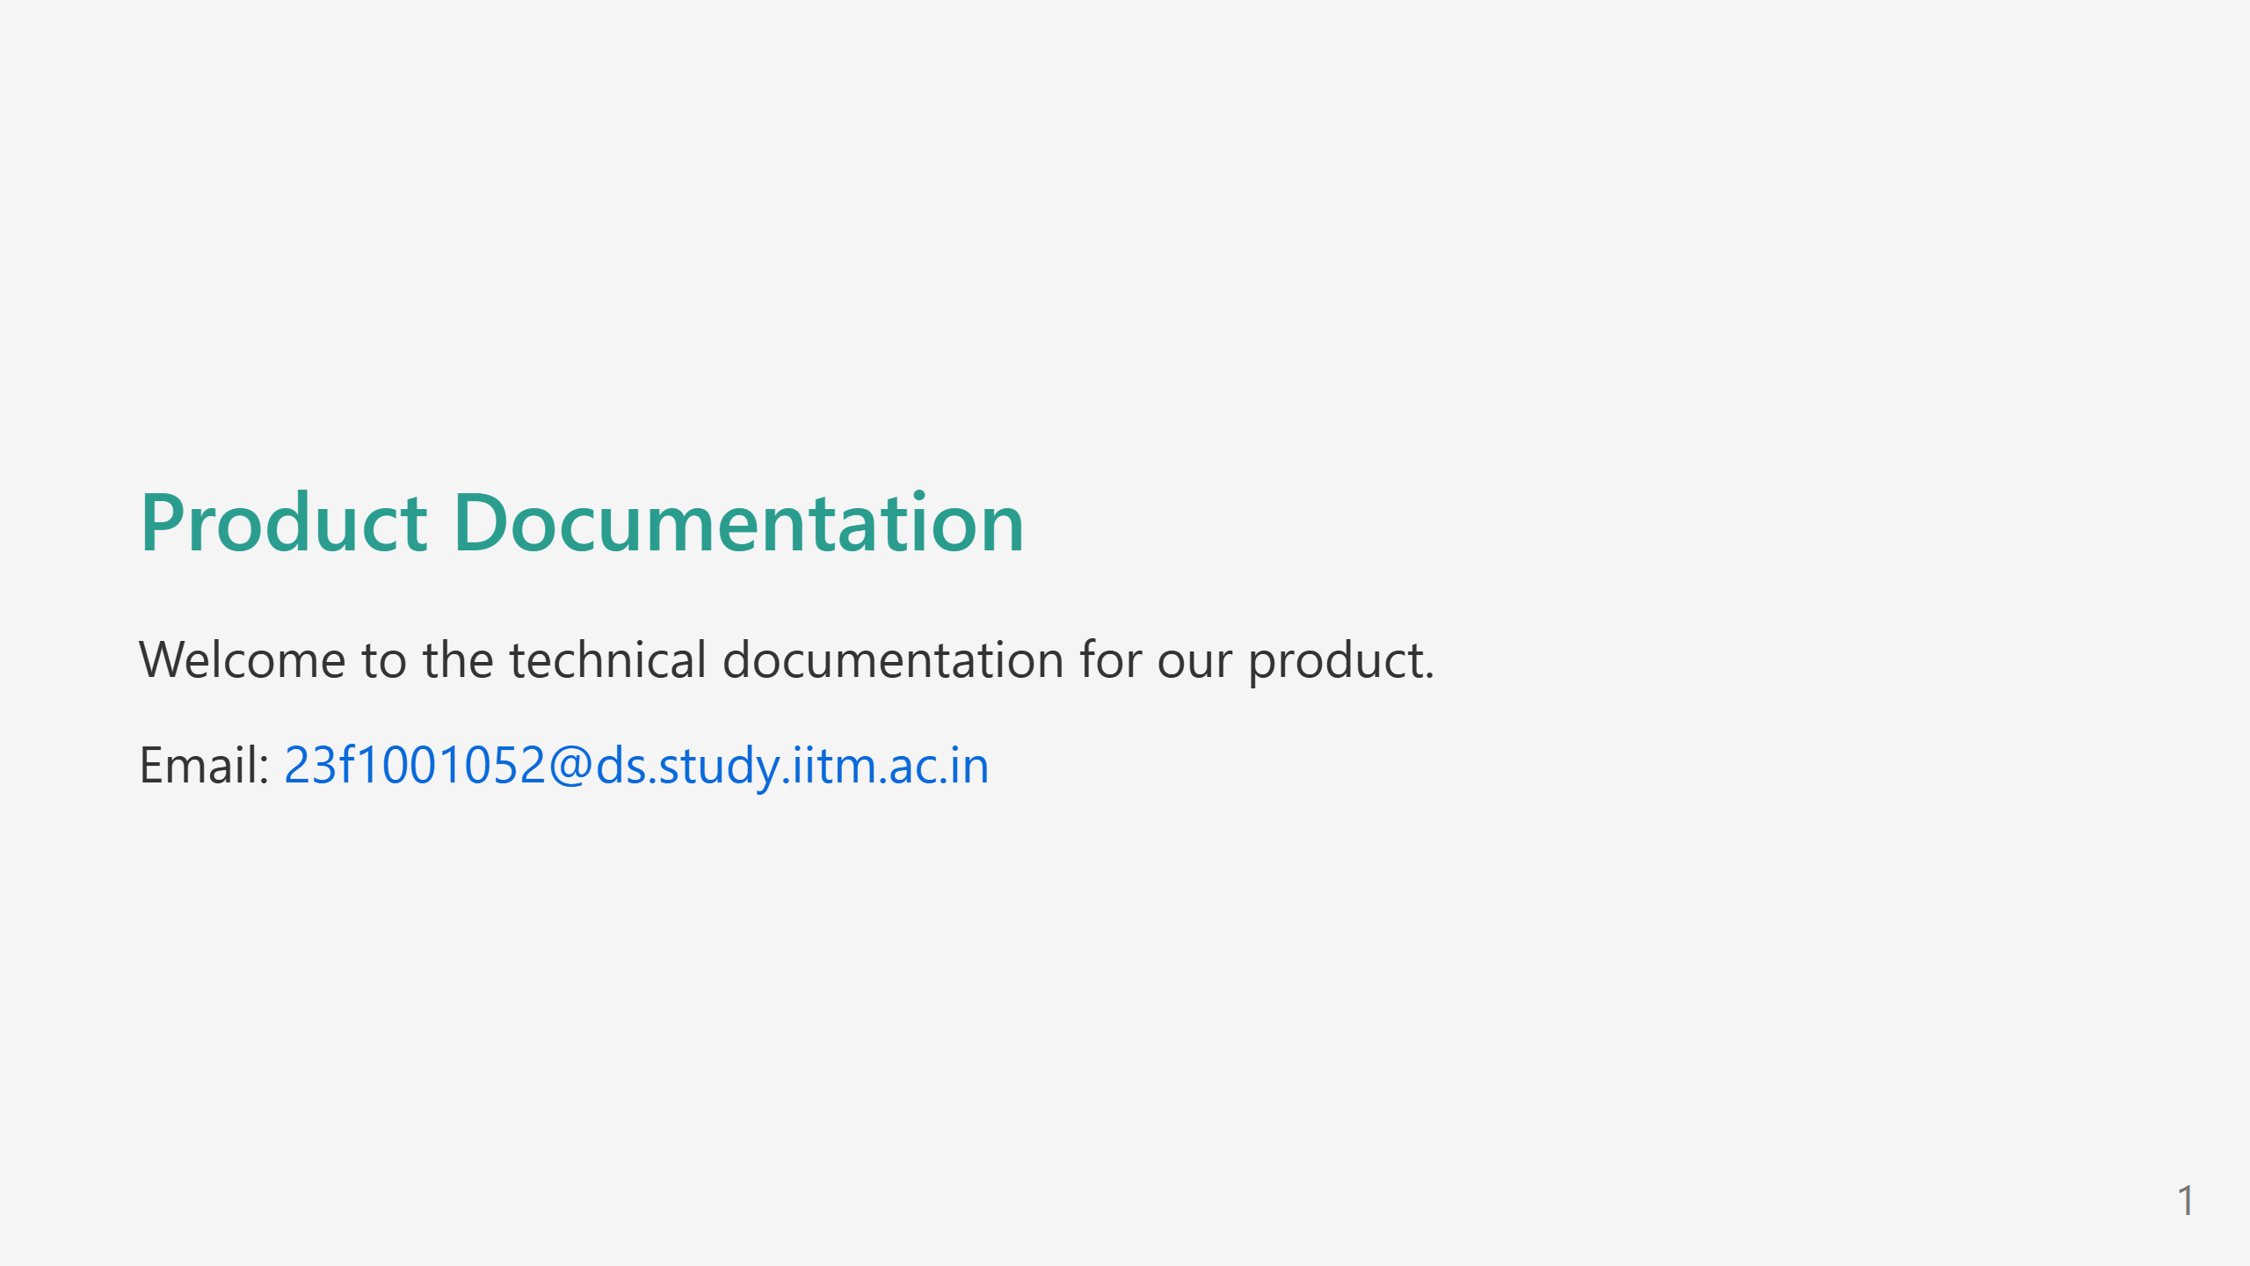
Notes:
Custom theme

Slide 2
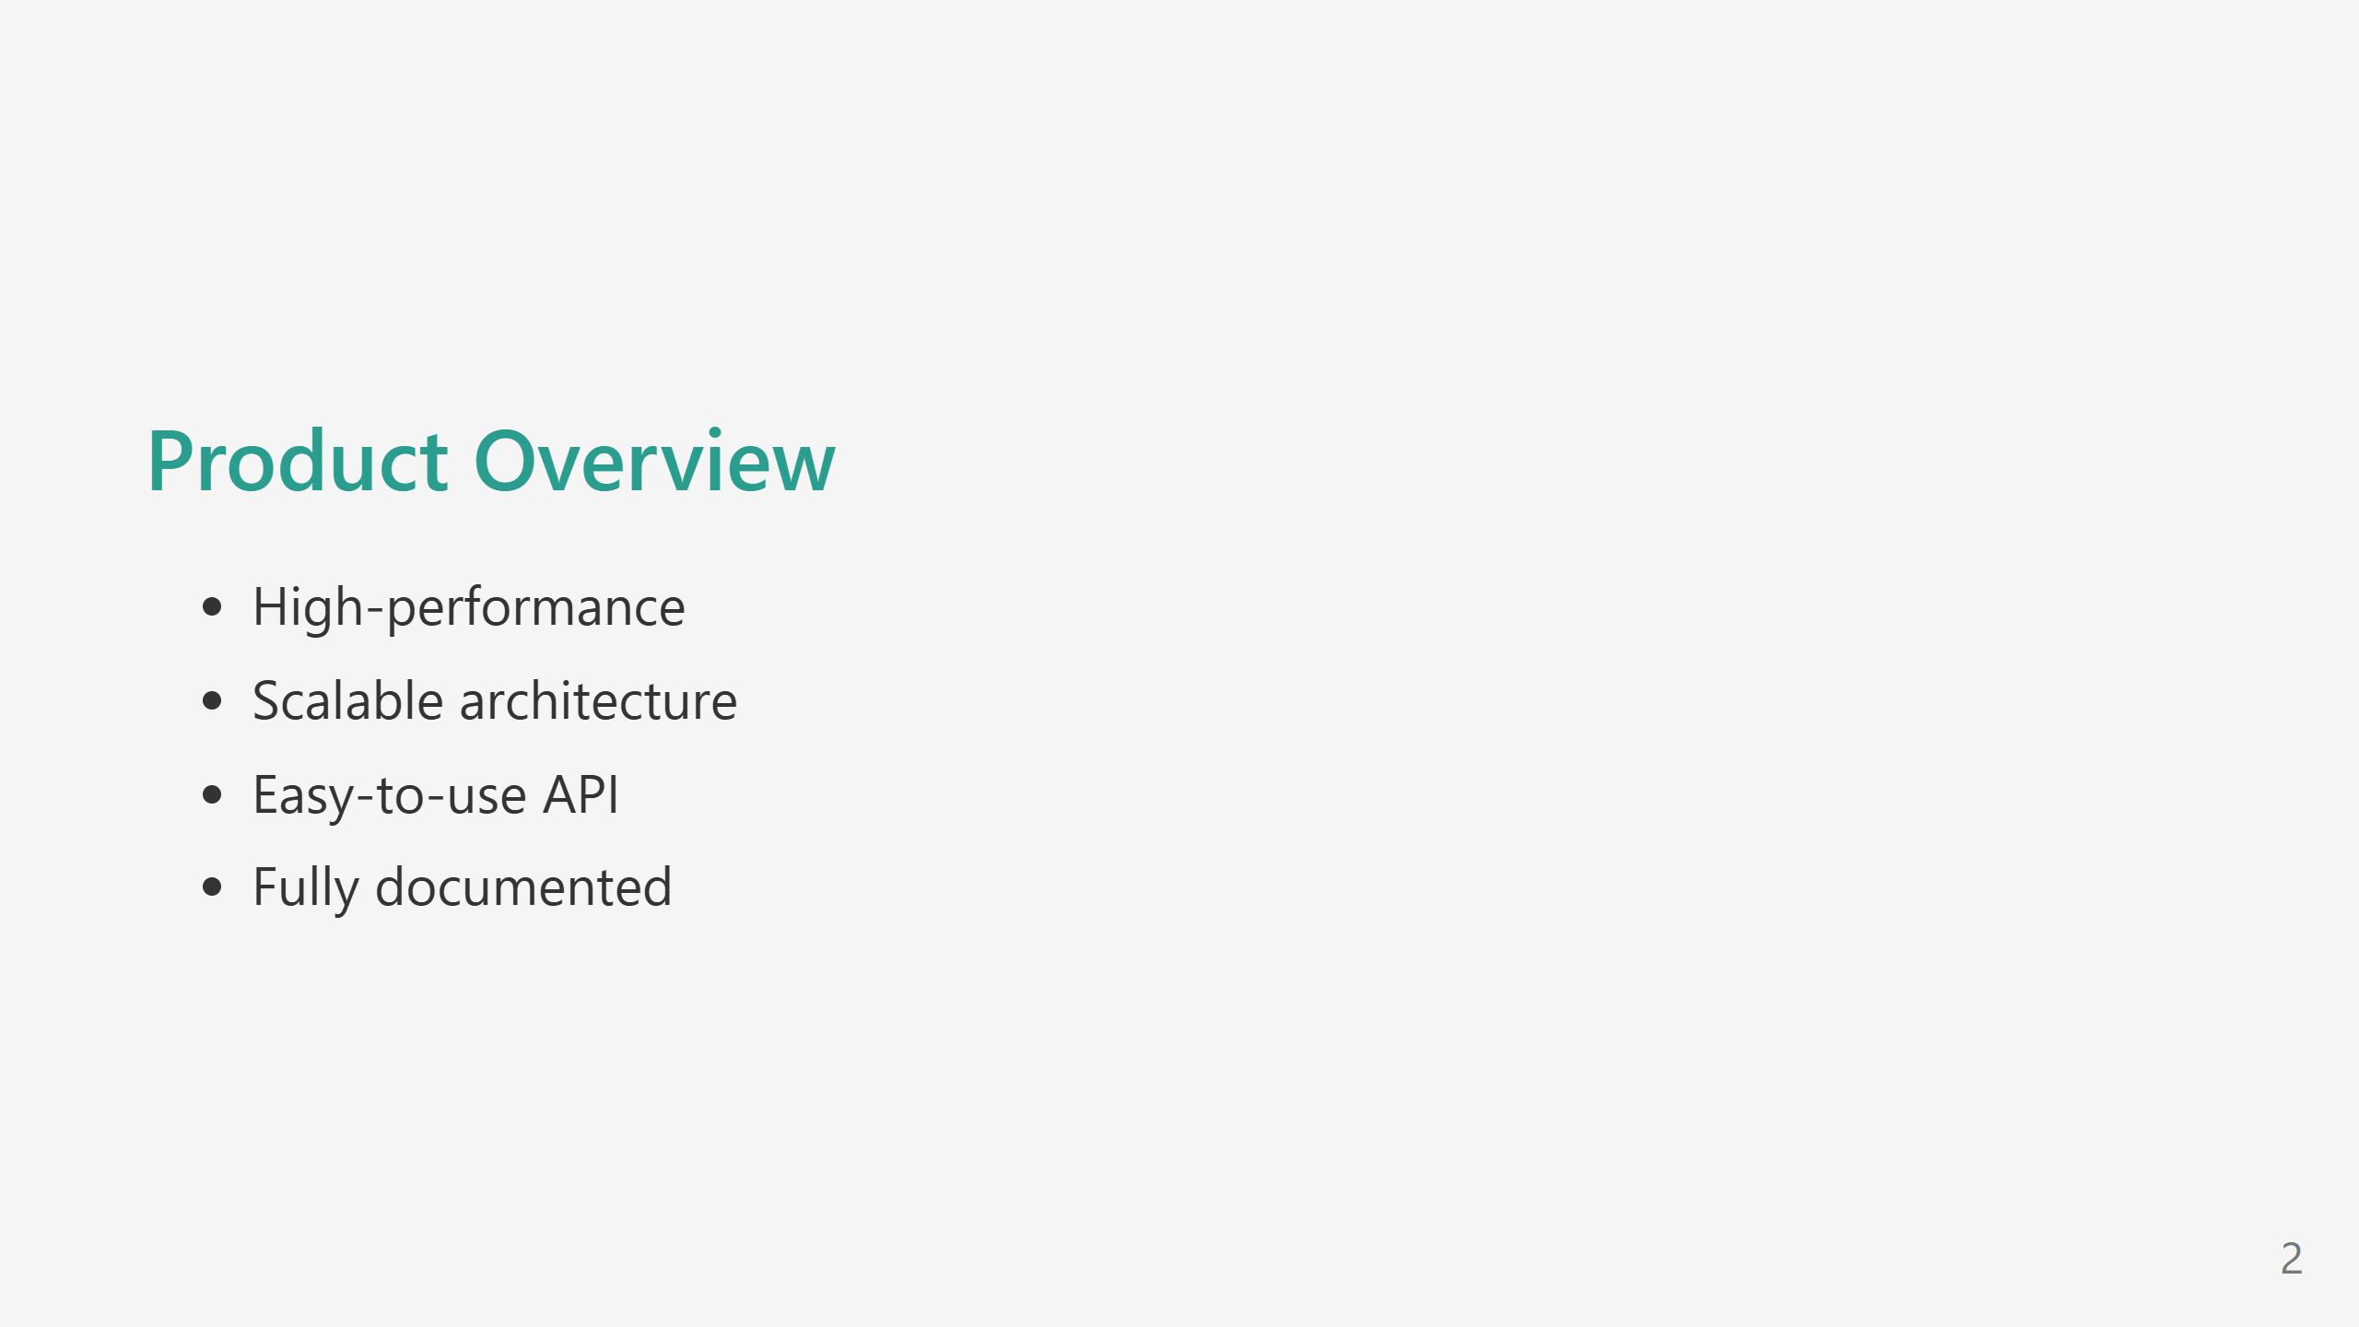
Notes:
Slide with background image

Slide 3
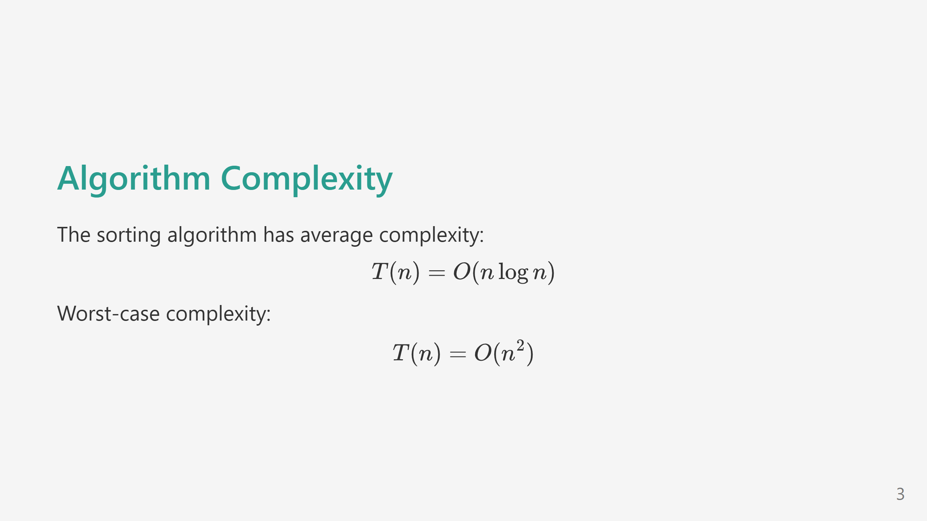
Notes:
Slide with math equation

Slide 4
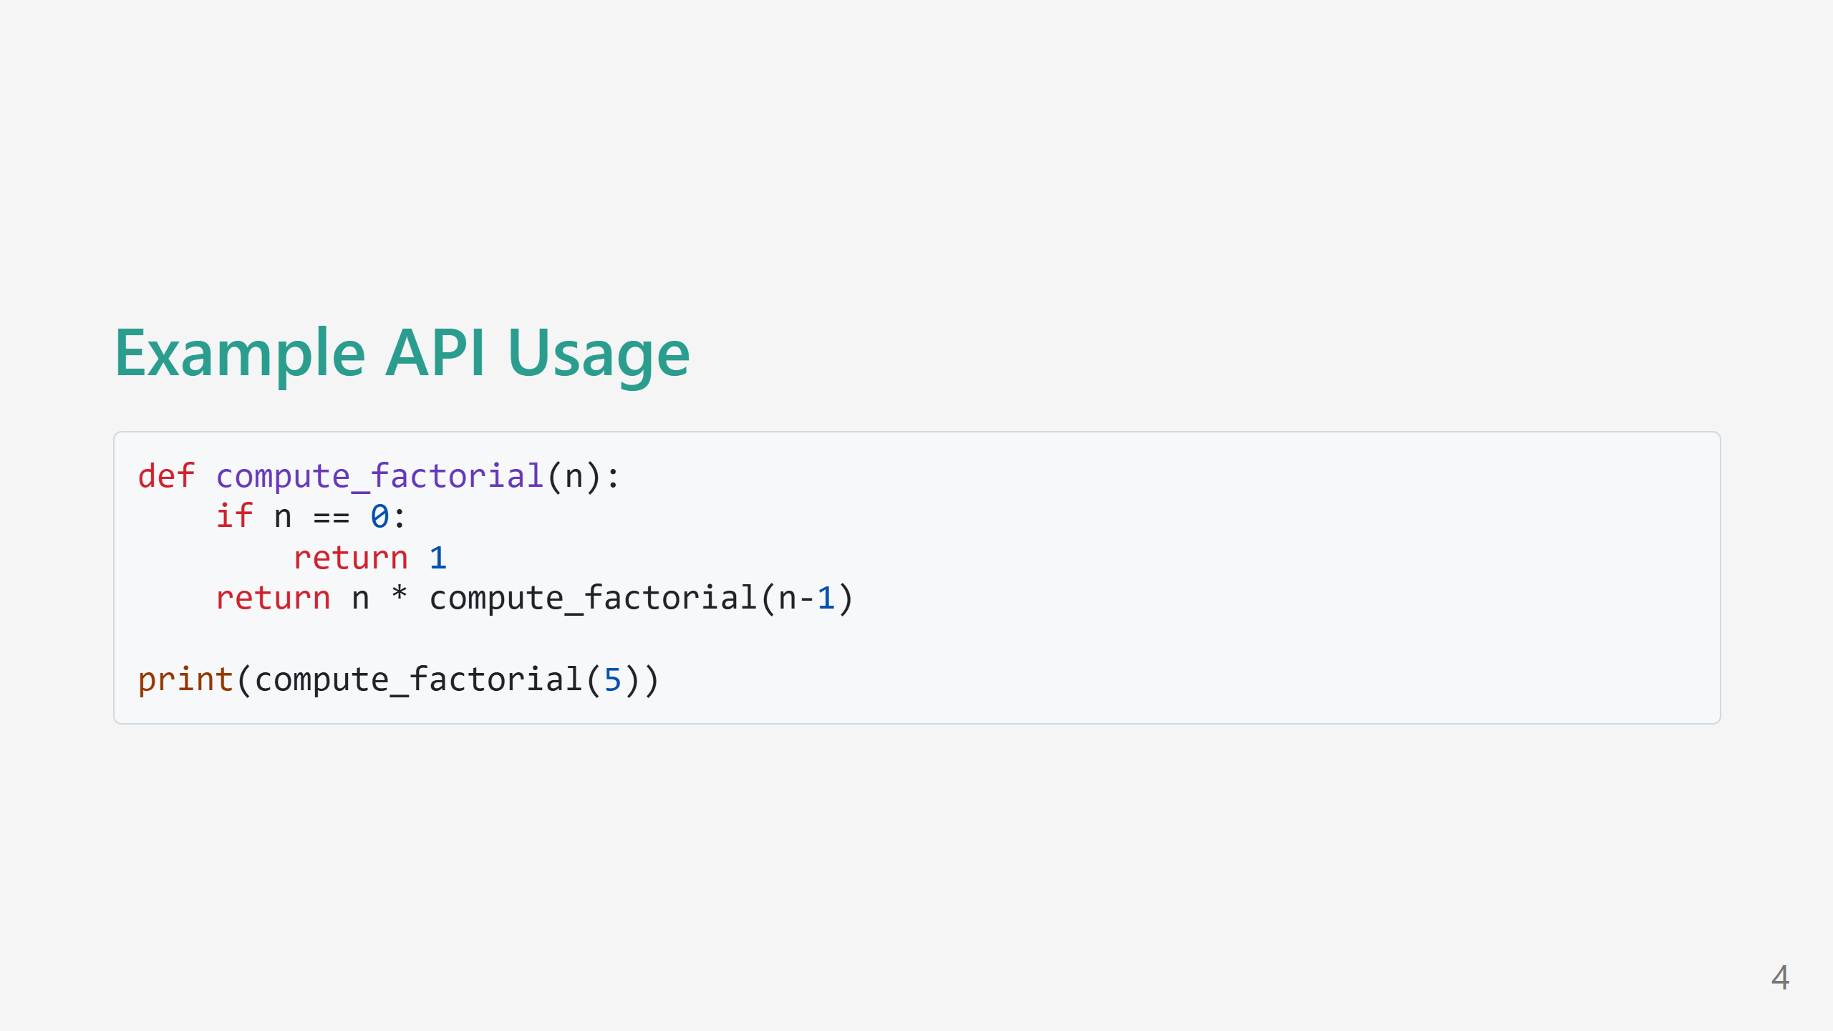
Notes:
Slide with code

