Slide 1

BATTERY MANAGEMENT SYSTEM FOR ELECTRICAL VEHICLES
Bhagavatula Sai Pranav (21BEE1043), Nomula Rishith (21BEE1096), Sreeniketh Dasam (21BEE1337)

Slide 2
Table of Contents
Objectives
Project Overview
Design specification for BMS
Circuit diagram for BMS
TP4056-Charging Module
Hardware Connections
Code flowchart
Serial monitor/dashboard output
Analysis and calibration of sensors
SoC estimation using ML algorithm
Conclusion
References

Slide 3
Objectives
To design and understand Battery Management Systems for EVs.
To Estimate the State of Charge (SOC) by measuring different battery parameters.
To predict the state of charge using machine learning models at low battery levels.
To demonstrate the BMS hardware prototype.

Slide 4
Project Overview
The objective of a Battery Management System (BMS) is to ensure the safe, efficient, and reliable operation of a battery.
Typically used in applications such as electric vehicles, renewable energy systems, or other energy storage solutions. Specifically, a BMS serves the following key objectives:
Safety Protection: Monitors the battery's state (voltage, temperature, current, etc.) to prevent unsafe conditions like overcharging, deep discharging, overheating, or short circuits.
State Monitoring: Tracks key battery parameters such as State of Charge (SoC) to ensure the system's proper functionality.
Energy Efficiency: Ensures that the battery operates optimally by regulating its usage and charging patterns.
Communication Interface: Provides data to external systems like the vehicle’s control unit or energy management system for enhanced control and monitoring.

Slide 5
Design Specification for BMS
Components and their operational rating
Name | Rating
ESP32 Microcontroller | -
DC current sensor [ACS712] | 10A
DC voltage Sensor[A180185] | 25V
Rechargeable Battery | 3.7V, 3000mAh
Resistors | 1kΩ, 10kΩ
DC motor | 5V
TP4056 Charging module | 4.12V, 1A
LM35 | -50˚C to 150˚C
Relay Module | 5V, 10A

Slide 6
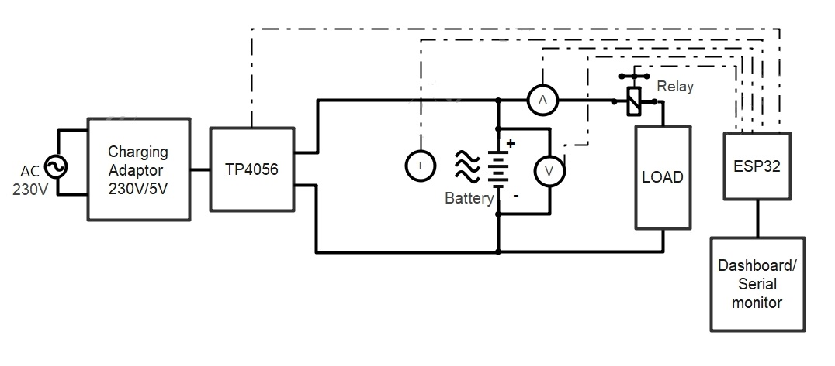
Circuit Diagram For BMS

Slide 7
TP4056-Charging Module
The TP4056 charging module is a lithium-ion battery charger module with a constant current/constant voltage (CC/CV) charging algorithm. It's designed to safely charge single-cell lithium-ion or lithium-polymer batteries.

Slide 8
TP4056-Charging Module
Working of the module:
Constant Current Mode (CC): When the battery voltage is low (below 4.2V), the module provides a constant current to charge the battery at the set rate (up to 1A). This ensures that the charging speed is optimal without stressing the battery.
Constant Voltage Mode (CV): Once the battery voltage approaches 4.2V, the module switches to constant voltage mode, maintaining a steady voltage while gradually reducing the current as the battery becomes fully charged.

Slide 9
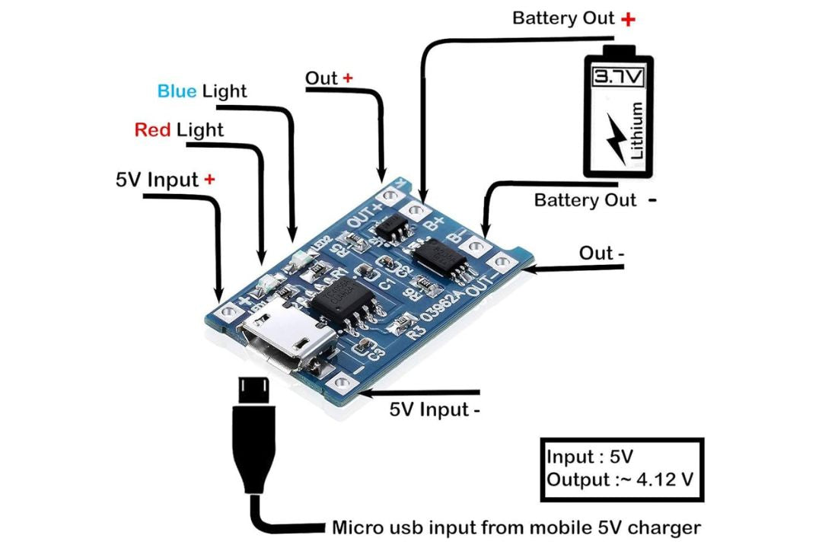
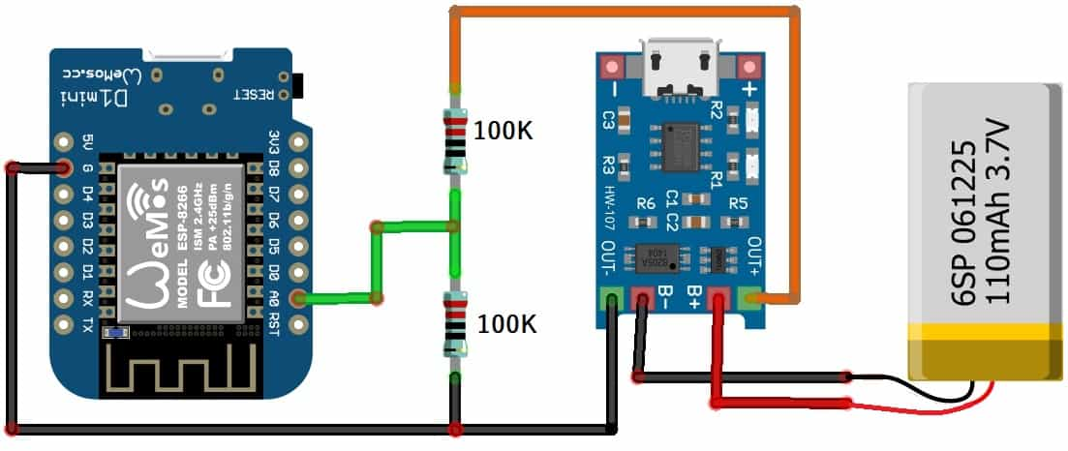
TP4056-Charging Module
Input voltage | 5V
Maximum charge current | 1000mA
Charging cut-off voltage | 4.2V±1%
Overcurrent Protection | 3A
Over-Discharge Protection | 2.5V

Slide 10
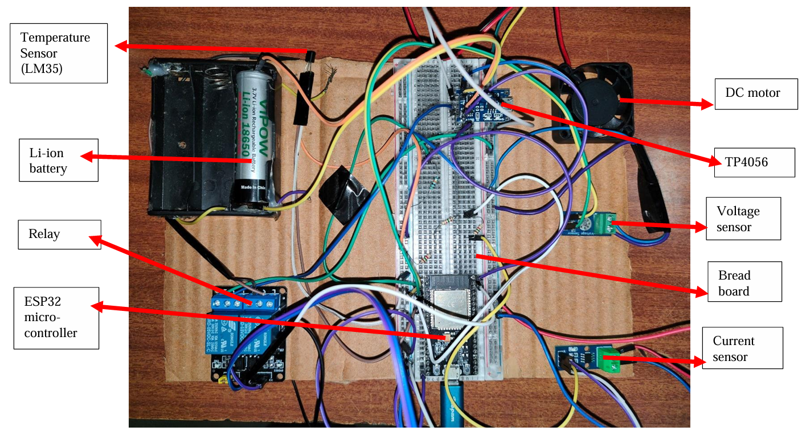
Hardware Connections

Slide 11
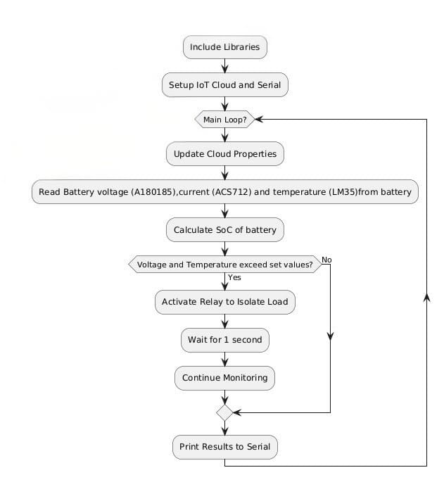
Code flowchart

Slide 12
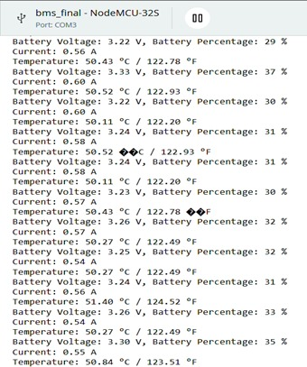
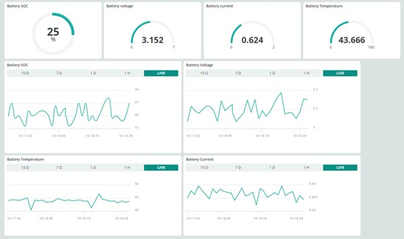
Serial monitor/dashboard output

Slide 13
Analysis & calibration of sensors
The main calculations in the project are classified as follows:
Voltage sensor calibration
Current sensor calibration
State of Charge

Slide 14
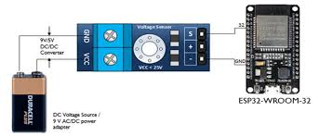
Voltage sensor

Slide 15

Voltage sensor calibration
Battery Voltage Measurement:
The voltage divider reduces the battery voltage to a level safe for the ESP32’s ADC input (0-3.3V).
Formula:
Where:
Vin​ = actual battery voltage (before the divider)
Vout​ = voltage at ADC input after the divider
R1= 7.5KΩ and R2= 30KΩ
Vin​ is approximately twice the value of Vout​, so the code multiplies the ADC reading by 2.
$$Vin​=Vout​×\left(\frac{​R1​+R2​​}{R2}\right)$$

Slide 16
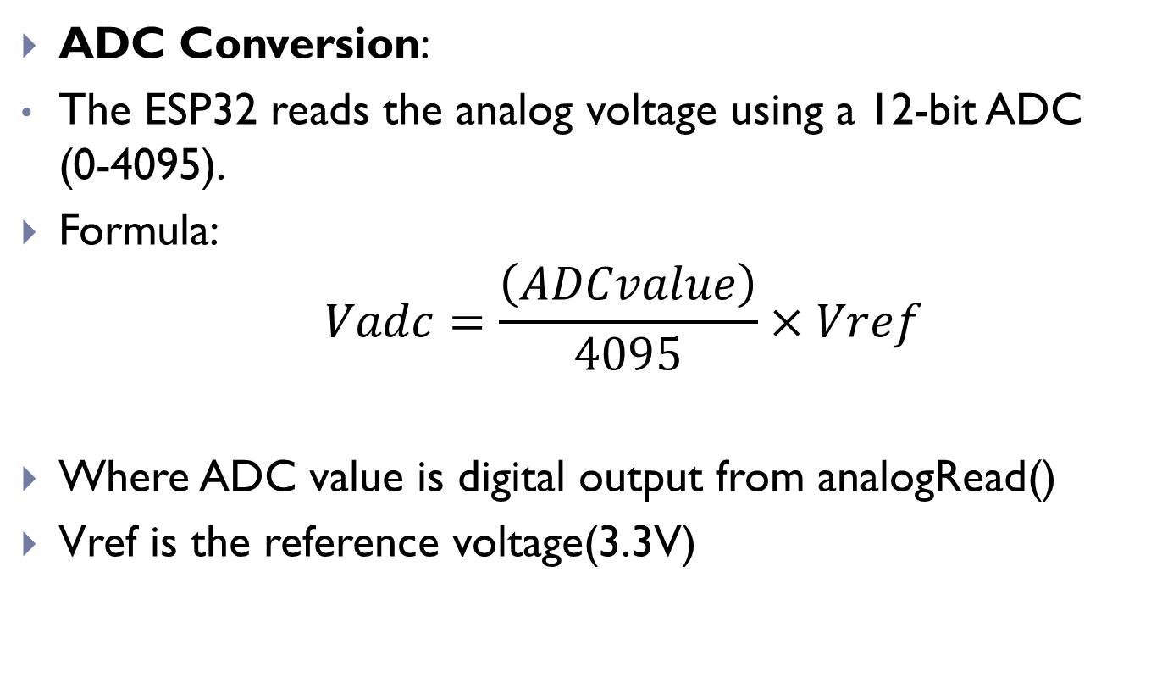
Voltage sensor
ADC Conversion:
The ESP32 reads the analog voltage using a 12-bit ADC (0-4095).
Formula:
$$Vadc=\frac{\left(ADCvalue​​\right)}{4095}×Vref​$$
Where ADC value is digital output from analogRead()
Vref is the reference voltage(3.3V)

Slide 17
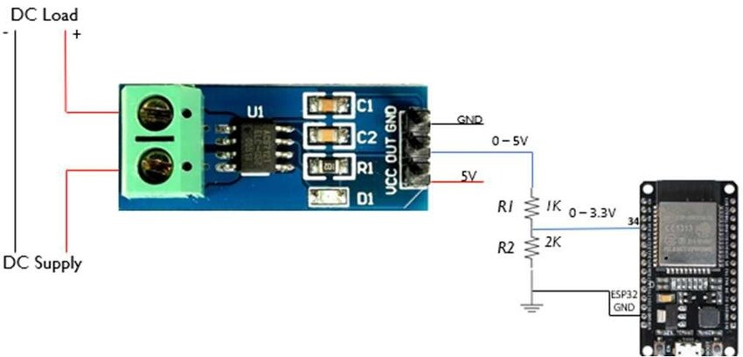
Current sensor

Slide 18
Current sensor
The ACS712 current sensor measures current. It outputs an analog voltage that corresponds to the current flowing through it. The output voltage at 0A is Vcc/2, and the sensor's sensitivity is typically 100mV per Amp (depending on the specific model).

Slide 19



Current sensor
Converting the ADC reading to voltage at R1= 1KΩ and R2= 2KΩ :
The actual sensor voltage V sensor , is calculated as:
The current is determined by subtracting the caliberation offset and dividing by the sensors sensitivity(100mV/A)
$$Vadc=\frac{\left(ADCvalue​​\right)}{4095}×Vref​$$
$$​$$
$$Vsensor​=\frac{​Vadc​×(R1​+R2​)​}{R2}$$
$$I=\frac{Vsensor​−calibrationOffset}{0.100}$$

Slide 20
LM35 Temperature sensor
Precise Temperature Measurement: The LM35 temperature sensor is used to accurately measure the temperature of the battery or surrounding environment in your BMS.
Integration with Microcontroller: The LM35 produces an analog output where the voltage increases by 10mV per °C rise in temperature. This analog signal is sent to ESP32, which converts it to a digital value using an ADC (Analog-to-Digital Converter).

Slide 21
Relay Module
Temperature Protection Mechanism: The relay module is activated when the battery temperature surpasses 60˚C, serving as a safeguard to isolate the battery from the load.
Preventive Isolation: The relay module prevents excessive heat buildup, which could lead to thermal runaway, over-voltage, or over-current conditions, thus preserving the integrity of the battery system.

Slide 22
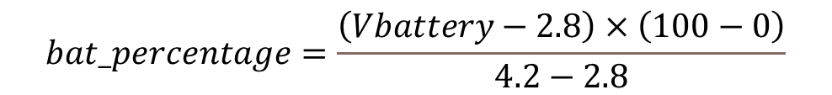
State of Charge
The State of Charge (SoC) of the battery represents the battery's remaining capacity as a percentage of the full charge. In this case, you're mapping the battery voltage (2.8V to 4.2V) to a percentage value (0% to 100%).
The function maps the battery voltage to a percentage range:
Voltage range:
4.2 V - represents fully charged battery
2.8V – represents a near-depleted battery
$$bat_percentage=\frac{\left(Vbattery​−2.8\right)×\left(100−0\right)}{4.2−2.8}$$

Slide 23
SOC estimation using ML algorithm
Model Selection and Approach: The XGBoost algorithm was chosen for predicting the State of Charge (SoC) due to its ability to handle non-linear patterns effectively and minimize overfitting through regularization. XGBoost performed well with the dataset, providing accurate SoC predictions and robust results.

Slide 24
SOC estimation using ML algorithm
Results: The model’s performance was evaluated using Mean Squared Error (MSE), Mean Absolute Error (MAE), and R² values. These metrics showed that XGBoost could handle the data complexity and deliver precise SoC estimates.

Slide 25
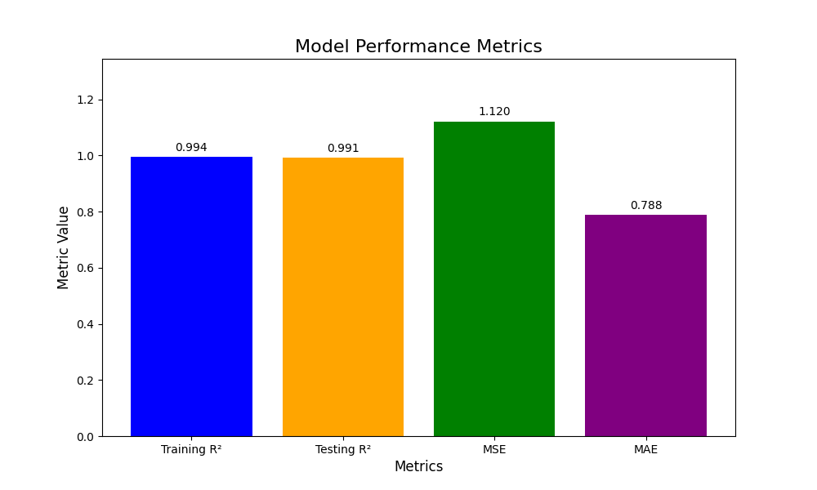
SOC estimation using ML algorithm

Slide 26
Conclusion
Battery Management System (BMS) enhances the efficiency, safety, and lifespan of battery-powered systems by continuously monitoring key parameters like voltage, current, and temperature.
Through real-time data analysis and machine learning, the BMS optimizes energy usage and dynamically safeguards against potential issues.
This approach not only minimizes energy waste but also supports the shift toward sustainable energy solutions, making it a critical component in modern electric vehicles and renewable energy storage.

Slide 27
References
Abd Wahab, M.H., Mohamad Anuar, I.N., Ambar, R., Baharum, A., Shanta, S., Sulaiman,M.S., et al. (2018) IoT-Based Battery Monitoring System for Electric Vehicle.International Journal of Engineering & Technology, 7, 505-510. https://doi.org/10.11591/ijeecs.v24.i3.pp1315-1322
Rao, S.S. and Rangaswamy, D. (2021) Power Quality Mitigation and Transient Analysis in AC/DC Hybrid Microgrid for Electric Vehicle Charging. Indonesian Journal of Electrical Engineering and Computer Science, 24, 1315-1322.
Le Gall, G., Montavont, N. and Papadopoulos, G.Z. (2022) IoT Network Management within the Electric Vehicle Battery Management System. Journal of Signal Processing Systems, 94, 27-44. https://doi.org/10.1007/s11265-021-01670-2
Dost, P., Spichartz, P. and Sourkounis, C. (2015) Charging Behaviour of Users Utilizing Battery Electric Vehicles and Extended Range Electric Vehicles within the Scope of a Field Test. 2015 International Conference on Renewable Energy Research and Applications (ICRERA), Palermo, 22-25 November 2015, 1162-1167.

Slide 28
Thank You

