Slide 1

Advanced Intrusion Detection and Prevention System
Presentation by Lalithadithya, Thasif Vali, Uddhav Narasimharao, and Sreenivasulu, BESTIU (2024-2025).

Slide 2

Abstract
Heuristic + ML: Combines to catch threats. Real-time: Sniffs packets, classifies, responds. Framework: Flask (UI) + Scapy (network analysis).
Random Forest: Trained on NSL-KDD dataset.
Key Features: Alerting, IP blocking, dashboard.

Slide 3
Problem Statement & Objectives
Problems Addressed
Inefficient static rules. High false positive rates. Lack of real-time action.
Objectives
Real-time threat detection. Automated IP blocking. ML-based anomaly detection.
User-friendly dashboard.

Slide 4

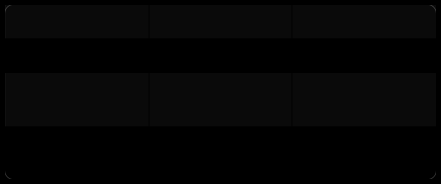
Literature Survey Highlights
Title
CNN-LSTM for IoT Graph Neural
Networks
Hybrid Signature &
Anomaly
Method
Deep Learning GNN
Accuracy
96% 97%
ML + Rules
+30% FP reduction
AI Trend: improves detection, reduces FPs, but increases resource usage.

Slide 5
System Architecture
Data Collection: Live packets. Preprocessing: Cleaning & Feature Extraction. ML Layer: Random Forest.
Detection & Prevention
Logging & Alerting Web Dashboard
Real-time monitoring and IP blocking integrated.

Slide 6
Methodology
Train Random Forest (NSL-KDD). Sniff packets (Scapy). Extract Features ³ Classify ³ Action.
Visualize, Log Attacks.
Update model periodically.

Slide 7
Dataset Overview
Primary Dataset
NSL-KDD. 41 features + 1 label. Attack types: DoS, Probe, U2R, R2L.
Extended Datasets
CIC-IDS2017: Botnets, XSS, SQLi UNSW-NB15: Worms, Exploits, Shellcode. Real-time & adversarial traffic.

Slide 8
Technologies Used
Python: Core Development. Flask: Web Dashboard. Scapy: Packet Analysis. Scikit-learn: ML Model (Random Forest). Pandas/NumPy: Data Handling. Matplotlib/Seaborn: Visualization.

Slide 9
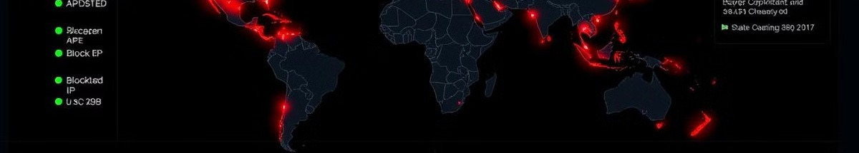
Output & Performance
Web Interface: Logs, IP Blocking, Alert Suppression. Detection Accuracy: High, low false positives. Detected Attacks: DoS, TCP scans, Recon.
Real-time: Alerts, dynamic firewall updates.

Slide 10
Conclusion & Future Work
Conclusion
Hybrid ML + Heuristics = efficient IDPS.
Real-time threat mitigation with automation.
Future Scope
Deep learning models (CNN, RNN). Integrate with SIEM (Splunk). Enterprise deployment.

Slide 11
Thank you!
We sincerely thank our Mentor, Project Co-Ordinator,DEAN sir and peers for their support and guidance throughout this journey
THIS PROJECT HAS BEEN A COLLABORATIVE EFFORT FILLED WITH LEARNING, INNOVATION, AND TEAMWORK.

