Slide 1
Term Project
Heart Stroke Prediction
Team Members (Group Vk18):
Sreenivas Kasulanati
Sneha Vangala
Adil Shaik

Slide 2
CONTENTS:
Overview of the project
Overview of the Datasets and Variables
Machine Learning Model Results
Evaluation Method and Conclusion
Future Scope
Conclusion
Links and References

Slide 3

Overview of the project
The Heart Stroke prediction system uses the power of machine learning models to anticipate and mitigate the risk of heart strokes.
This comprehensive approach involves:
Collecting and preprocessing patient data
Identifying crucial risk factors using models like Logistic Regression asnd Decision Trees
Training ensemble models such as Random Forests and XG-Boost.
The system's robustness is further enhanced through the application of a Hybrid Voting Classifier, combining predictions from various models.
Rigorous evaluation and optimization processes ensure reliable performance metrics.
Finally, the integrated system is deployed in healthcare settings, emphasizing continuous monitoring, interpretability, and ethical considerations to provide accurate and responsible predictions for identifying individuals at risk of heart strokes.

Slide 4
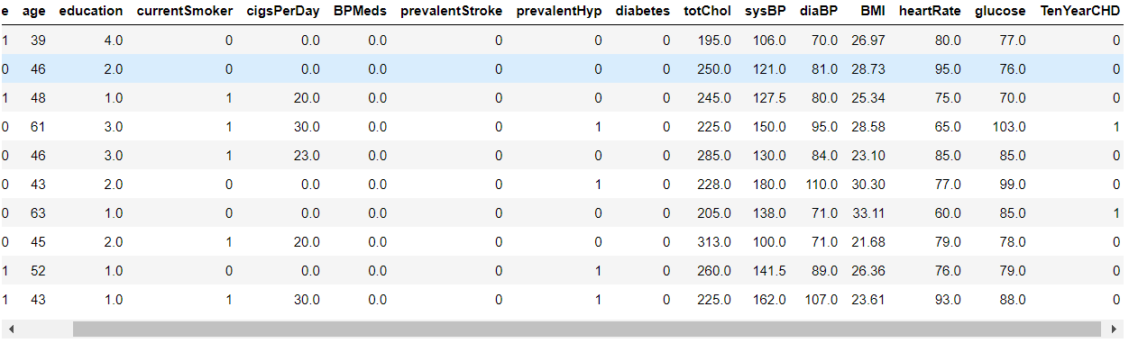
Overview of the Datasets and Variables
Patient sex (Gender) : Male - 0, Female - 1
Patient age (Numerical)
Patient education level (Numerical) : lowest lever – 0.0, Highest level – 4.0
Current Smoker : No - 0, Yes – 1
Cigs Per Day (Numerical) : Number of cigarettes consumed by the person.
BP Meds(If under Medication for BP) : No - 0, Yes – 1
Prevalent Stroke(Patient history of heart stroke ) : No - 0, Yes – 1
Prevalent Hyper(Patient history of hypertension) : No - 0, Yes - 1
Diabetes(Patient history of diabetes) : No - 0, Yes – 1
TotChol (Numerical) : Patient Cholestrol level
sysBP (Numerical) : Patient systolic blood pressure level
diaBP (Numerical) : Patient systolic blood pressure level
BMI (Numerical) : Patient body mass index value
heartRate (Numerical) : Patient heart rate value
glucose (Numerical) : Patient glucose level
Stroke(Patient stroke chance for Ten years - risk of coronary heart disease): No - 0, Yes - 1

Slide 5
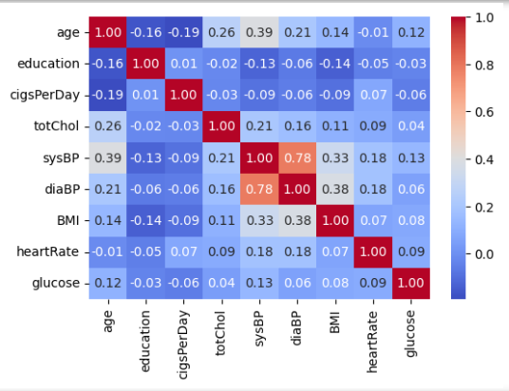
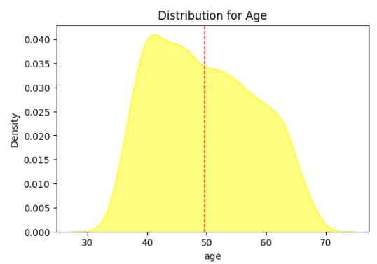
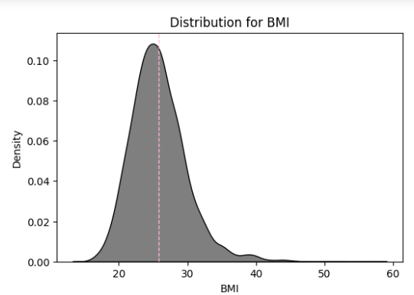
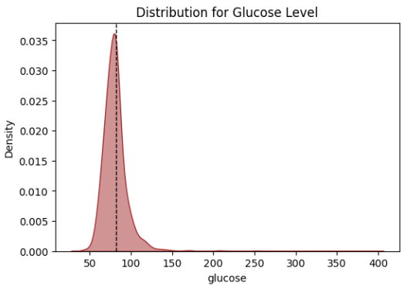
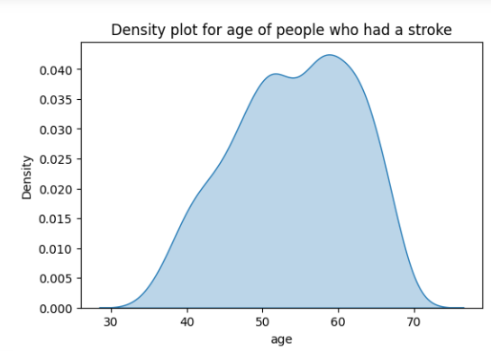
Data Visualization
Univariate Analysis:

Slide 6
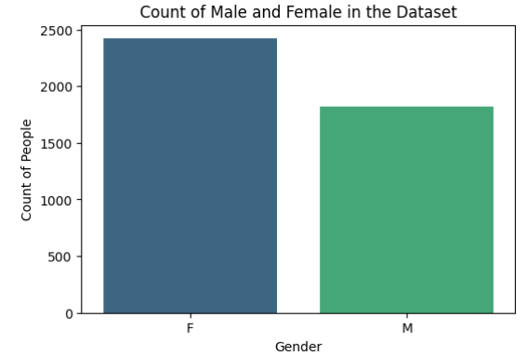
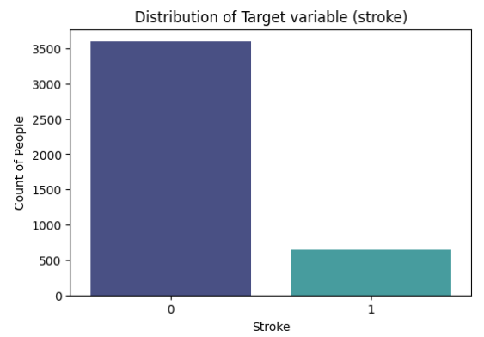
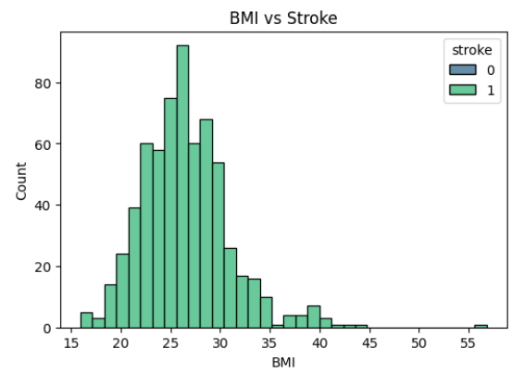
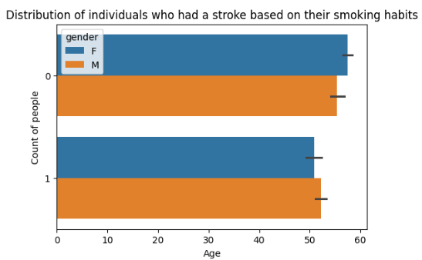
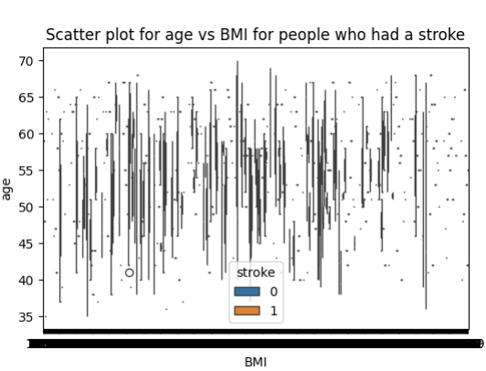
Bivariate Analysis:

Slide 7
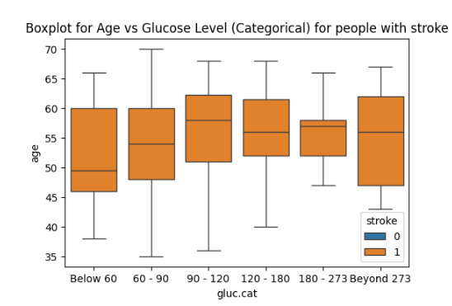
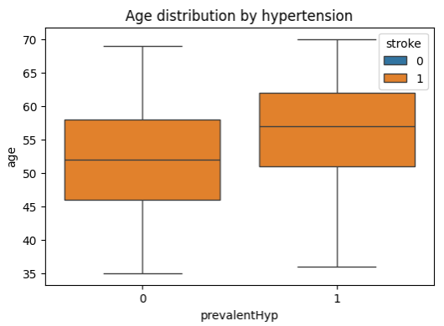
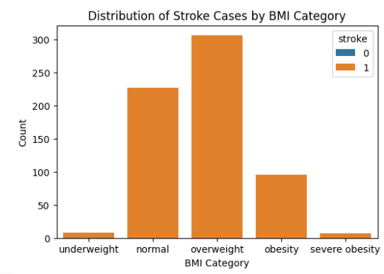
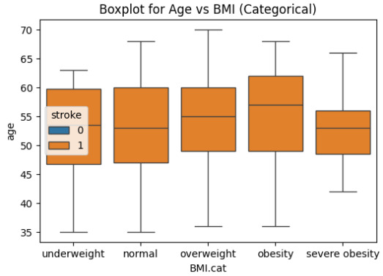
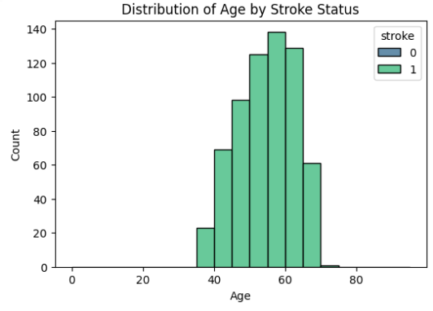
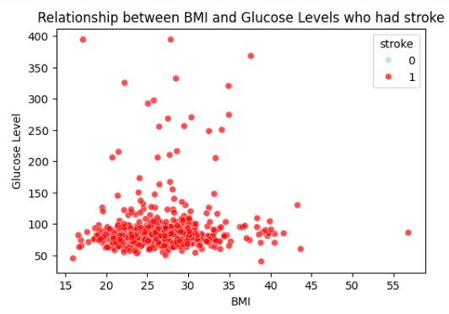
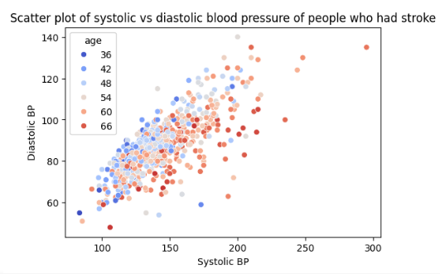

Slide 8
Machine Learning Models And Evaluation Techniques

Slide 9

Logistic Regression:
The logistic regression model achieved an 81.4% mean cross-validation accuracy during training, with low variability.
On the testing dataset, the accuracy was 83.25%, indicating good generalization to new data.
The close alignment between training and testing accuracies suggests the model is well-calibrated.

Slide 10
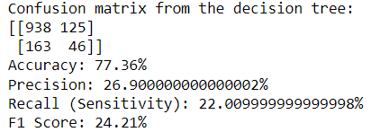
Decision Tree:
The Decision Tree did not give a good result.
The confusion matrix and metrics indicate the performance of a decision tree model for heart stroke prediction.
The model is about 77.36% accurate but has low precision (26.90%) and recall (22.01%), suggesting a high rate of false positives and misses in capturing actual positive instances.
The F1 Score, a balance of precision and recall, is also relatively low at 24.21%. These results suggest a need for further model refinement to improve overall predictive capability.

Slide 11

Random Forest
The Random Forest model was tuned using Grid Search, resulting in the best hyperparameters:
`max _ depth` of 20
`min _ samples _ split` of 2
`n _ estimators` of 100.
With these settings, the model achieved a testing accuracy of 84.12%.
This indicates improved performance compared to default settings.
The Random Forest model, configured with the best hyperparameters, shows strong performance with a training cross-validation accuracy of 89.5% and a testing accuracy of 84.12%.
The model's predictions are balanced between the two classes.
This suggests effective learning from the training data, good generalization to new data, and the absence of overfitting or underfitting.

Slide 12

XG-Boost Classifier
The XG-Boost Classifier achieved a mean cross-validation accuracy of 86.9% during training, with a small variability of +/- 4.4%.
On the testing dataset, the accuracy was 83.02%, indicating good generalization to new data.
The close alignment between training and testing accuracies suggests the model is well-calibrated.

Slide 13

Hybrid - Voting Classifier
The Hybrid Voting Classifier achieved an 88.4% mean cross-validation accuracy during training, with a standard deviation of +/- 4.6%.
On the testing dataset, it showed an accuracy of 83.57%, indicating effective generalization.
The output includes indices representing specific instances in the test dataset and details of a particular test instance with 18 features.
This suggests successful combination and performance of individual models in the hybrid approach

Slide 14
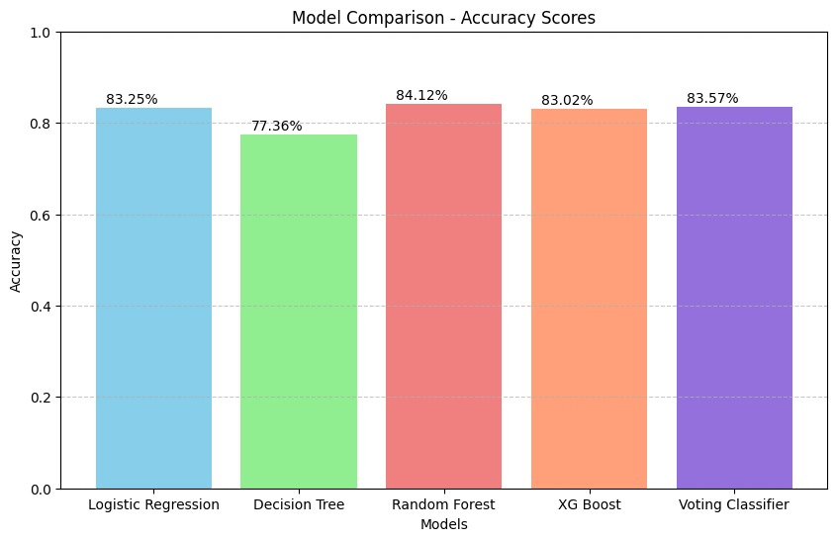
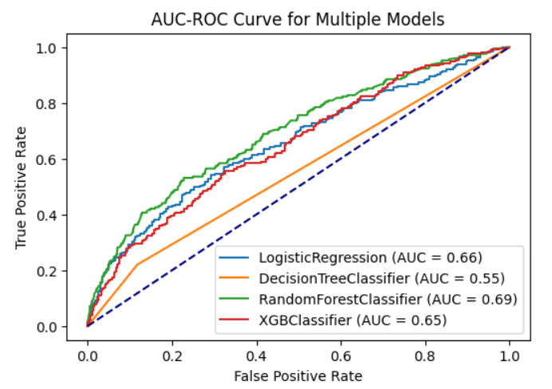
Comparison of 3 Models:
MODELS | ACCURACY
Decision Tree: | 0.7736
Random Forest - Grid Search: | 0.8412
Logistic Regression: | 0.8325
XG-Boost Classifier: | 0.8302
Hybrid - Voting Classifier: | 0.8357

Slide 15
Future Scope:
Model Enhancement: Continuously improve machine learning models and explore advanced algorithms for better accuracy.
User-Centric Development: Incorporate user feedback and iterate on the model based on real-world outcomes.
Comprehensive Health Metrics: Expand input features to include a broader range of health indicators for a more thorough risk assessment.
Mobile Accessibility: Develop a mobile app for wider accessibility and include features like health reminders.
Real-time Monitoring: Integrate wearables or IoT for real-time health data, providing more immediate and accurate predictions .
Privacy Measures and Collaborations: Strengthen data security, comply with privacy regulations, and explore collaborations with healthcare professionals and institutions.

Slide 16
Conclusion:
After an exhaustive exploration involving various models and diverse hyperparameter configurations, we have opted to proceed with the Random Forest algorithm.
Specifically, we found that setting the hyperparameters to (n _ estimators=100, random _ state=555, max _ depth=20, min _ samples _ split=2) yielded superior performance compared to other models with an accuracy value close to 85% (84.12)

Slide 17
Links and References
GITHUB LINK:
https://github.com/SreenivasKasulanati/AI_Project
DATA SOURCE LINK:
https://www.kaggle.com/datasets/dileep070/heart-disease-prediction-using-logistic-regression

