Slide 1
TECHNICAL REPORT
Distributed and Scalable Data Engineering (DSDE)-6007-02
FALL 2023

Slide 2
CONTENTS
1
Loan Eligibility Prediction………………………..1
Executive Summary ..................................2
Technical Report .......................................3
Highlights of Project..................................3
Using Python for building a Loan Prediction model and AWS for
deployment ................................................3
Submitted on: 4/30/2023..........................3 Abstract....................................................4
Methodology ............................................5
Results Section .........................................7
This is the final application web page that consume our model. ...................................................7
Conclusion ................................................7

Slide 3

Loan Eligibility Prediction
2
Executive Summary
This project aims to develop a predictive model for loan approval eligibility, leveraging machine learning algorithms to analyze historical applicant data and identify key factors influencing approval outcomes. The goal is to enhance decision-making efficiency, minimize risk, and optimize the loan approval process for improved accuracy and speed.
Team Members:
Sreenivas Kasulanati (Data Scientist)
Akhil Reddy Vangala (Data Engineer)
Navya Vemireddy (Data Visualization)
Sai Swaroopa Yalaguri (Data Modelling)
Questions?
Contact : skasu5@unh.newhaven.edu

Slide 4

Technical Report
3
Loan Eligibility Prediction
Highlights of Project
Using Python to build a Predictive model and AWS for deployment using Flask
Submitted on: 12/05/2023

Slide 5
4
Abstract
This data science project focuses on developing a predictive model for loan approval eligibility by leveraging machine learning algorithms and analyzing diverse sets of financial and personal data. The goal is to enhance accuracy in assessing applicants' creditworthiness, thereby optimizing the loan approval process and minimizing risks for financial institutions
Introductory Section
Here we are majorly focusing on building a Predictive model by using ML algorithms such as Logistic Regression, Decision Trees, KNN Classifier, Random Forest, XG Boost and deploying it by using AWS services for making the client comfortable in their business which will reduce human cause errors.
GitHub : https://github.com/SreenivasKasulanati/DE-Project/tree/main/Final_Project
Review of available research
The major resources that we are using are Python, AWS Lambda, AWS S3, AWS Redshift.
Python 3.10
Pandas - Pandas is a software library written for the Python programming language for data manipulation and analysis
Flask – Flask is a Python web framework utilized for developing and deploying our web application on AWS
Aws EC2 - EC2 instances offer scalable cloud computing for running virtual servers across a range of applications and services.

Slide 6
5
Methodology
Data Understanding
Dataset contains the following features
No of dependents
Education
Self employed
Income annum
Loan amount
Loan term
Cibil score
Residential assets value
Commercial assets value
Luxury assets value
Bank asset value
Loan status
Data Preparation
Remove leading spaces from column names and display the updated data frame.
Encoded categorical features using label encoder.
Scaled the numerical features using standard scaler.
The source of this Dataset is Kaggle.
Business Understanding
In a world where access to credit plays a pivotal role in shaping individuals' and businesses' futures, we recognize the challenges that have historically plagued the lending industry.
The complexities and inefficiencies of loan approval processes, high default rates, and imprecise risk assessments have created barriers that affect us all.

Slide 7
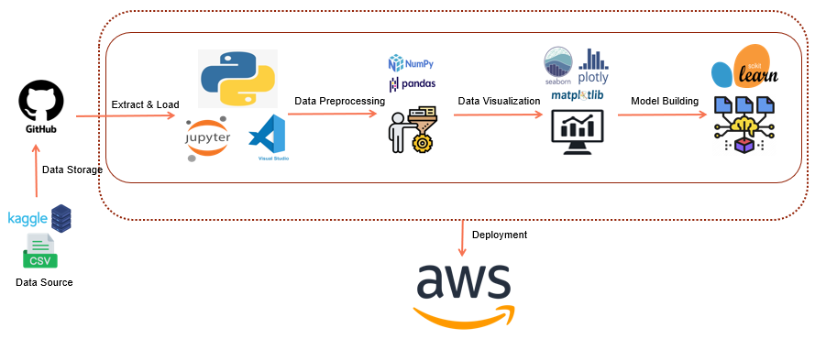
6
Problem
Receiving In the current lending landscape, the loan approval process is riddled with inefficiencies and risks that pose significant obstacles to both financial institutions and loan applicants.
Effects:
a. High Default Rates
Lengthy Approval Process
Inaccurate Risk Assessment
Solution
Our "Loan Eligibility Prediction" application offers a comprehensive solution using advanced machine learning, automation, and enhanced risk assessment.
Modelling of the Pipeline

Slide 8
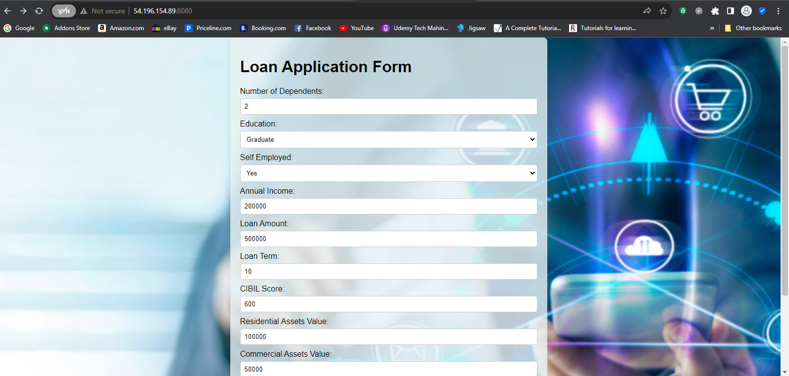
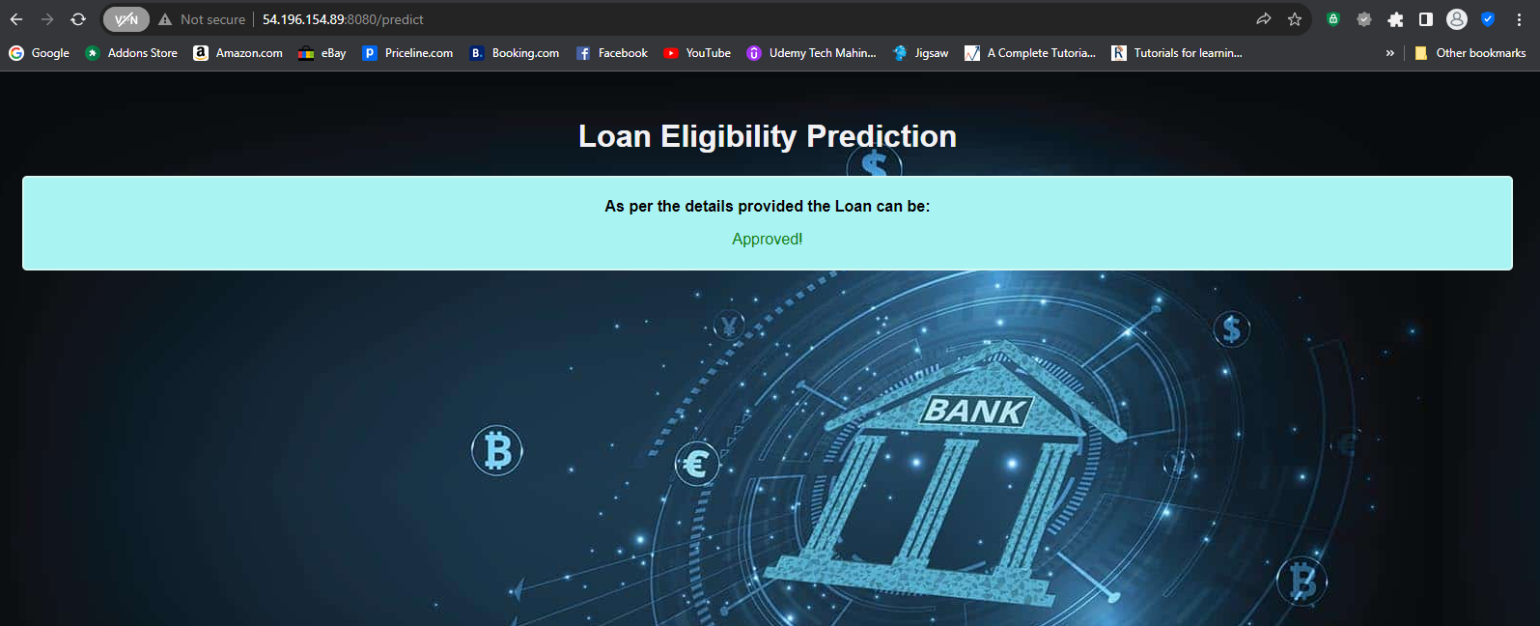
7
Results Section
This is the final web application that was deployed on AWS Server for the model consumption.
Conclusion
In this way we are creating the web application and providing it to the clients to check the loan eligibility of their customers which reduces the following issues.
Time consuming
Lack of resources
High Default Rates
Lengthy Approval Process
Inaccurate Risk Assessment

