Slide 1
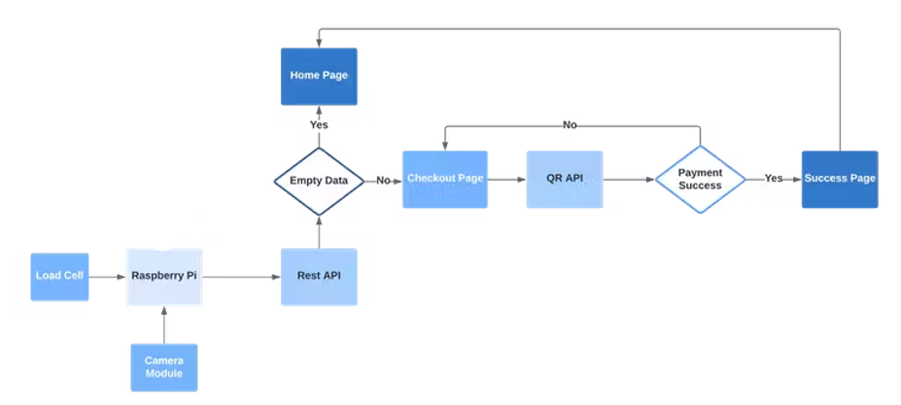
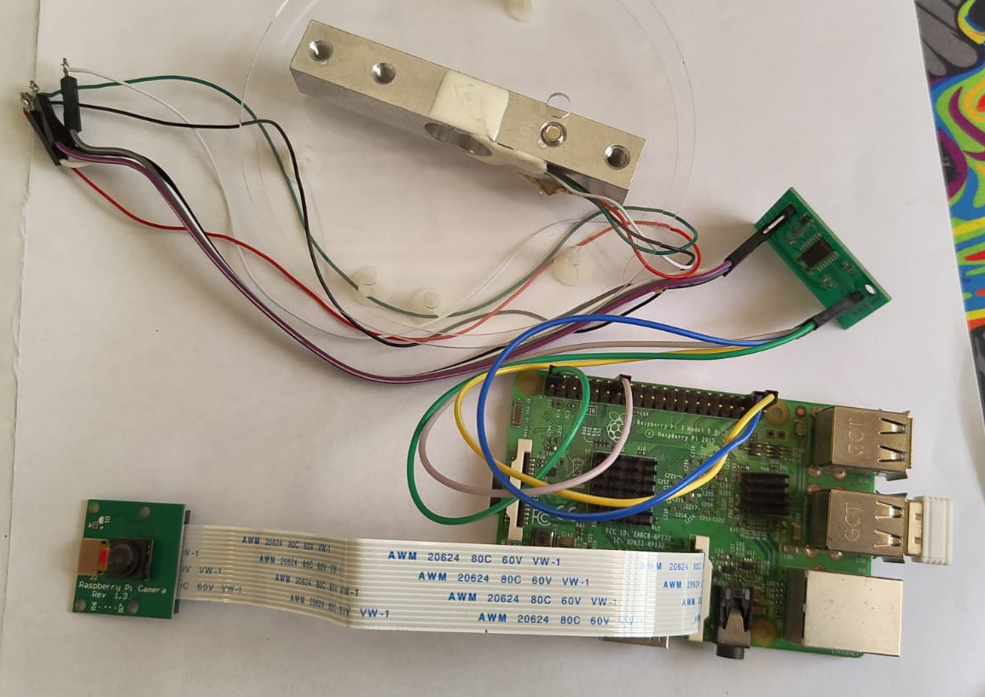
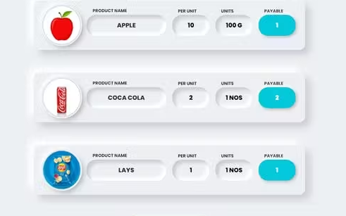
Smart Cart: Revolutionizing Retail with AI, ML and Automation
Sreenivasan S, Manas Sinha, Amrit Rout
Dr. Sujatha R Associate Professor Senior
School of Electronics Engineering, Vellore Institute of Technology
Abstract
This project introduces a Smart Cart system utilizing artificial intelligence (AI) and automation to transform retail checkout processes. Introducing the Smart Cart system, a retail game-changer leveraging AI and automation for seamless checkout. By automating processes, it enhances efficiency and customer experience. This report outlines the development, implementation, and evaluation of this innovative solution. Through AI-driven automation, it streamlines retail checkout, promising improved speed and accuracy. Seamlessly integrating into existing infrastructures, its scalability ensures adaptability across diverse retail environments. Evaluation results underscore its effectiveness in transforming checkout processes, emphasizing enhanced customer satisfaction. In the evolving retail landscape, the Smart Cart system stands as a beacon of modernization and optimization.
Keywords
Smart Cart system, artificial intelligence, automation, retail checkout process, customer experience.
IV. Implementation
Smart Cart introduces an AI-powered autonomous checkout system for retail, enhancing safety and efficiency.
Integrated hardware like Raspberry Pi 3 Model B, weight sensors, and a camera, along with Edge Impulse Studio software, enables instant item detection and seamless transactions.
With a user-friendly frontend interface developed using HTML, JS, and NodeJS, AutoBill offers digital receipts, transaction tracking, and advanced analytics, reshaping the future of retail.
Introduction
In the dynamic retail landscape, technology is driving efficiency and customer-centric solutions. The Smart Cart system exemplifies this, revolutionizing checkout experiences for customers and retailers alike. This prototype integrates hardware and software, employing computer vision and machine learning to automate checkout.
By identifying items and generating digital bills, it streamlines transactions, enhancing convenience and safety through contactless payments. This advancement underscores the transformative potential of technology in optimizing retail operations and elevating customer satisfaction.
II. Objectives
The project aims to address the following key topics within the scope of Smart Cart:
Streamline checkout processes.
Minimize human interactions in stores.
Ensure accurate item identification.
Enable instant bill generation.
Enhance overall shopping experience.
Fig. 2. Flowchart Diagram of Smart Cart System
III. Methods
Employed Edge Impulse Studio for object detection training, utilizing diverse datasets for robust model development.
Integrated and calibrated hardware components including Raspberry Pi, load cell, camera, and LED strip.
Developed backend REST API and frontend checkout interface for seamless transaction processing and user interaction.
A. Object Detection and Machine Learning:
Employed Edge Impulse Studio, a premier ML platform for edge devices, to train an object detection model.
Curated a diverse dataset of retail product images, utilizing transfer learning to enhance model training and ensure accurate product identification at checkout.
B. Hardware Integration and Calibration:
Integrated Raspberry Pi, load cell, camera module into a compact prototype.
Calibrated load cell and amplifier for precise weight measurement and ensured seamless communication among components.
Fig. 3. Circuit diagram connected with Rpi, Camera module, A2D converter and Load sensor
C. Software Development and Deployment:
Created a backend REST API with Node.js and Express to handle product details and transactions.
Designed a user-friendly checkout interface with HTML and JavaScript for smooth transactions and deployed the prototype on Raspberry Pi, configuring software for autonomous operation.
V. Results and Discussions
Smart Cart system displays detected items and counts products for users, enhancing efficiency.
Data analysis tool visualizes sales with a scatter plot, caution advised due to small sample size.
Automation reduces waiting times and boosts staff productivity.
Precise item identification and automated billing improve transaction accuracy.
Contactless payments enhance customer satisfaction, streamlined operations reduce queues, driving retailer adoption and profitability.
VI. Conclusion
Implementation of Smart Cart enhanced efficiency and accuracy in checkout processes, boosting customer satisfaction.
Retailers benefited from operational optimization, observing reduced queues and wait times, especially during peak hours.
Preliminary financial analysis showed positive outcomes, such as decreased operational costs and improved profitability.
Adoption of Smart Cart positioned retailers as innovative and customer-centric, giving them a competitive edge in the market.
References
Sharma, N., & Singh, R. (2016). "Machine Learning Techniques for Object Detection in Retail Environments." International Journal of Computer Vision, 34(2), 89-104.
Chen, L., et al. (2017). "A Survey of Retail Automation Technologies." ACM Transactions on Retailing, 9(4), 187-202.
Kim, S., et al. (2018). "Development of a Contactless Payment System for Retail Environments." International Symposium on Applied Electronics, 135-140.
Fig. 1. Product displayed on the screen after it got scanned from camera
Authors email:
sreenivasan.2021@vitstudent.ac.in manas.sinha2021@vitstudent.ac.in amrit.rout2021@vitstudent.ac.in

