Slide 1
Project Title
Topic: Identifying the Green, Blue and Red colour objects in a image in Matlab through GUI

Slide 2
Project Proposal
Through this MAT Lab program , we can identify the green, blue and red coloured object in a image by creating border around it. The selection of the colour in the Mat lab can be done by using GUI.

Slide 3
Project Procedure
This can be done by first defining the image file to the matlab by the matlab command.
Then work on the program command on the Mat lab to specify the red colour(if selected) in the image.
Work on the command that can draw a circumference around the objects with the green colour on it.
Then we type the program for the displaying the marked image.

Slide 4
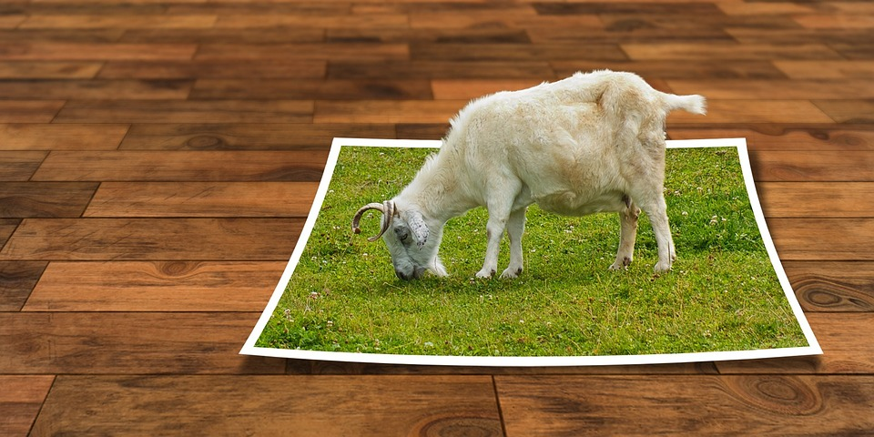
Example
This is a sample image taken randomly from the internet

Slide 5
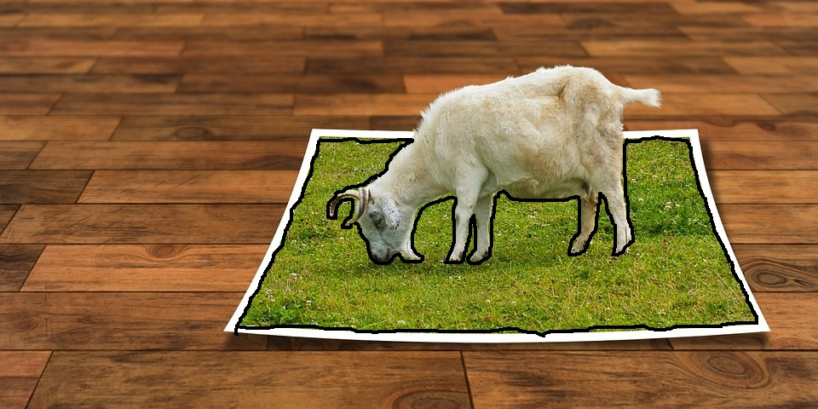
Example
This is the sample output from the PAINT which shows the green area(if selected)
marked with the black borders.

Slide 6
Use of the project
This project can be very useful for the people who have colour blindness.

