Slide 1



CAREER PREDICTION
A Machine Learning Based Career Guidance System

Slide 2

ABSTRACT
  This project proposes a Machine Learning based Career Prediction System.
  It analyzes skills, interests, certifications, and behavioral attributes.
  The system supports multiple career recommendations for better decision making.

Slide 3

SCOPE OF THE PROJECT
  Useful for students, career counselors, and educational institutions.
  Reduces human bias in career decision making.
  Can be extended for large-scale career guidance platforms.

Slide 4
WORKFLOW
Data Preprocessing
Feature Engineering
Model Training
Career Prediction and Recommendation
Model Evaluation

Slide 5
TECHNICAL REQUIREMENTS
Programming Language: Python
  Libraries: Pandas, NumPy, Scikit-learn
  Machine Learning Model: Random Forest Classifier
  Tools: Google Colab, Streamlit, VS Code
  Hardware: Minimum 4GB RAM, Standard CPU

Slide 6
MACHINE LEARNING MODELS

Slide 7
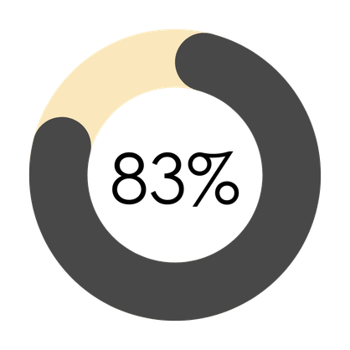
SUPPORT VECTOR MACHINE
  Achieved an accuracy of 83%
  Used for comparison and validation
  Required more tuning and computational effort

Slide 8

RANDOM FOREST CLASSIFIER
  Achieved an accuracy of 87%
  Provided the highest performance among all tested models
  Effectively handled mixed features such as skills, interests, and behavioral data

Slide 9

PROPOSED SYSTEM
Accepts student data such as skills, interests, and certifications.
  Uses automated preprocessing with ML pipeline architecture.
  Applies Random Forest model for career prediction.
  Provides top career recommendations instead of a single option.

Slide 10
FUTURE SCOPE
Integration with real-time academic databases.
  Addition of salary and job market trend analysis.
  Use of deep learning models for improved accuracy.
  Mobile and web application deployment.
  Personalized course and skill recommendations

Slide 11
CONCLUSION
  A Machine Learning based Career Prediction System was developed.
  Random Forest classifier provided effective career recommendations.
  The system supports informed and data-driven career decisions.

Slide 12
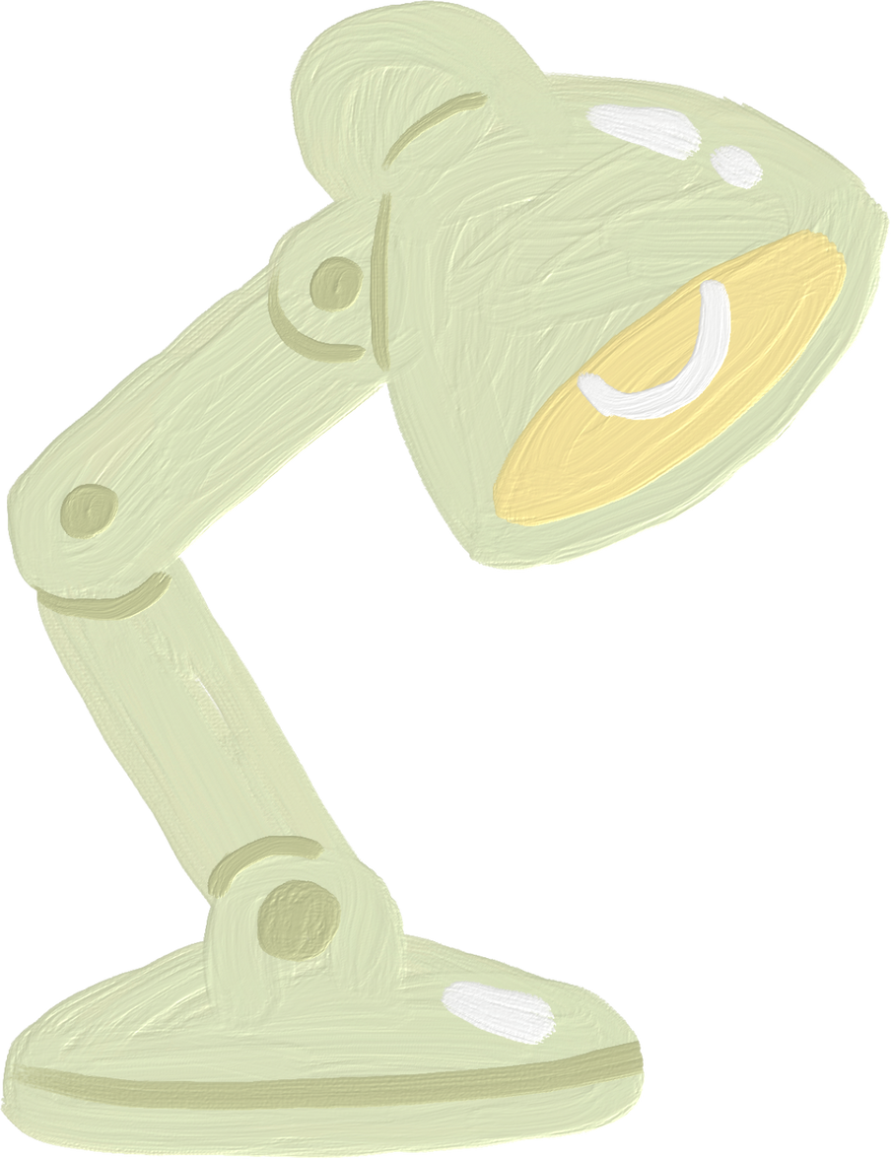
THANK YOU

