Slide 1
Blue tongue
Synonyms:-Sore mouth, sore muzzle, ovine catarrhal fever.
Blue tongue is an infectious, non contagious, insect-borne viral disease of sheep & other domestic& wild ruminants.
The outcome of infection range from inapparent in vast majority of infected animals to fatal in a proportion of infected sheep, goat, & other ruminants.
Blue tongue so called because it can cause a loss of oxygen & blue tinge to tongue.

Slide 2



Host affected:-
Sheep of all ages and breeds are highly susceptible.
But goats, cattle and wild ruminants suffer much milder symptoms.
They may act as carriers of the infection.

Slide 3
Etiology:-
Bluetongue virus is a members of Orbivirus genus under the family Reoviridae.
Within orbivirus genus,14 serogroups are differentiated on serological grounds.
World wide 24 serotypes of BTV have been identified.
Most serogroups appears to be immunologically distinct but there is considerable cross reaction between members of BT.

Slide 4
Blue tongue viruses are composed of three protein layers. The outer layer contain two protein VP2 and VP5.
VP2 is the major neutralizing antigen and determinant of serotype specificity.
It is also responsible for haemaglutinating and binding of BTV to mammalian cells.
The virus is resistance to lipid solvent which is typical of non enveloped virus.

Slide 5
The viruses are relatively acid-labile .
Freezing at -10⁰ to -20⁰ c is deleterious to the virus.
Acetic acid is an effective disinfectants.
Epidemiology:- Occurrence:
BT was first described in south Africa in the late 18th century.
Now this disease is world wide distributed.

Slide 6
BT occurs as clinical disease in Africa and middle east Indian subcontinent, china, USA and Mexico.
Ruminants species are susceptible to BTV But the expression of clinical diseases varies in different species.

Slide 7
Risk factor:
Climate:
Warmth and moisture require culicoides breeding.
Rainfall condition is suitable for infection.
Clam, warmth humid, weather are also prevalence for infection.
Host risk factor:
Indigenous sheep breeds are less susceptible in comparison to European Merino breed.

Slide 8
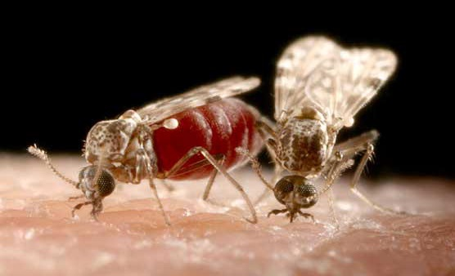
Transmission:
Transmission of Orbi virus is primarily by midges of the genus Culicoides species, which are biological vectors.
1400 species of culicoides are present, less than 20 are considered actual or possible vectors.
The virus can be transmitted sexually in infected semen.

Slide 9
Transmission:
Transmitted transplacentally from dam to offspring.
Transmission by embryo transfer
The disease has a seasonal occurrence.
Ticks are capable of mechanically or biologically transmission.
It is not transmitted by direct or indirect contact .

Slide 10
Transmission:
Risk of introduction: Blue tongue introduced to new regions by
can be
*Movement of infected animals.
*Wind born movement of insects.
*Insects on airplanes
*Semen from infected animals.

Slide 11
Clinical findings:
Clinical signs of disease in ruminants range from subclinical to an acute febrile response.
Acute febrile response characterized by
inflammation, congestion,
facial of the
edema,
hemorrhages and ulceration
mucous
membranes.
BT is clinically manifested as two syndromes.
Vascular damage of several organs (b)Reproductive syndrome.

Slide 12
Symptoms in sheep:
Incubation period is usually 7 to 10 days but viremia may appear as early as 3 to 4 days after infection.
The first sign of illness is a rise of temperature to 106⁰ -107⁰F.
Within 24 hours, excessive salivation and frothing at the mouth develop.
If forced to move, sheep may pant like a dog.

Slide 13
In severe cases the tongue become edematous and protrude from the mouth.
The mucous membrane of the mouth and tongue develop a bluish reddish coloration, and this blue coloration of the tongue give rise to name Blue tongue.
Hyperemia may extend to other parts of the body particularly the groin, axilla and perineum .

Slide 14
During the next 2 to 3 days. erosions and ulcerations may develop in the buccal
mucosa.
By 4 to 7 days in severe cases, extensive
ulcerations may be covered by gray necrotic tissue on the dental pad and dorsal surface of the tongue.
Sheep may become lame as a result of coronitis, which are often tender and varying degrees of lameness.

Slide 15
Severe muscle degeneration and dermatitis may cause wool breaks.
BTV infection of pregnant ewes in the first trimester can cause fetal death and resorption, abortion or birth of dummy lambs.

Slide 16
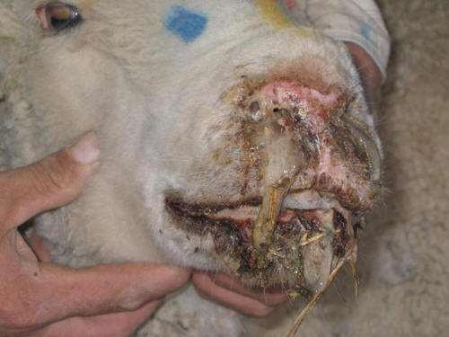
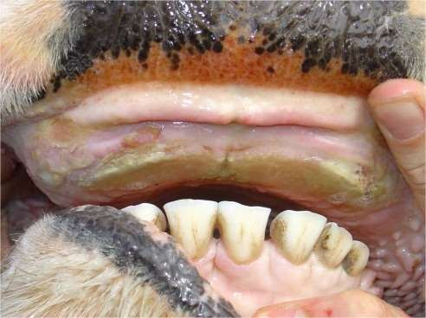
Fig: Frothy exudation from nose
Fig: Gray necrotic tissue on dental pad

Slide 17
Symptoms in cattle
A consistent fluctuation in rectal temperature
Reproductive failure in cattle.
Infected bulls become temporarily sterile.
Causing fetal death, resorption and abortion.
Teratogenic effects that result in dummy calves.
Symptoms in goats
Goats is typically an inapparent infection similar to that described for cattle.

Slide 18
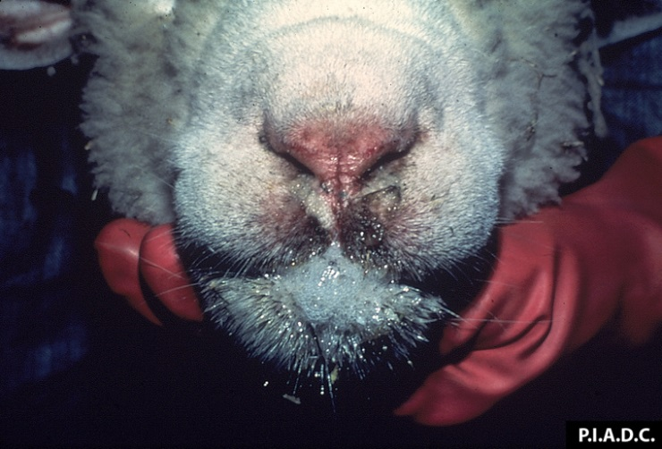
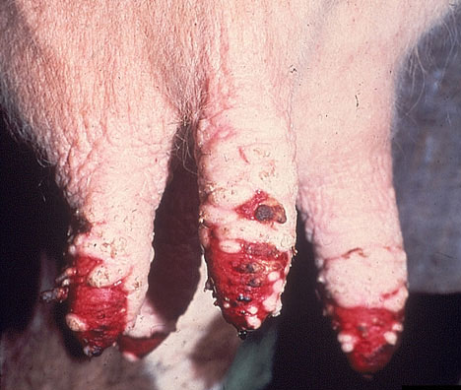

Slide 19
Morbidity and mortality:
In sheep,
Morbidity can reach 100%
Morality can vary from 0 to 50% .
Many animals will recover within a few days to 2 weeks.
In cattle,
Morbidity can approach 5%
Cattle typically recover within a few weeks.

Slide 20
Necropsy finding:
Lesions in the
oral cavity include focal
petechial hemorrhages that progress to gray necrotized debris over erosions and ulcerations on the lips, tongue and on the dental pad.
The buccal mucosa may be cyanotic.

Slide 21
The thoracic cavity may contain several litres of
plasma-like fluid.
In sheep, severe, common finding.
bilateral
pneumonia is a
Other findings may include:
Hemorrhages of the heart.
Swelling and necrosis of muscles.
Enlarged lymph nodes and
Swelling and congestion of the spleen and liver.

Slide 22
Diagnosis
Tentative diagnosis :
On the basis of history,
Merino breed are more susceptible than indigenous sheep.
Sheep are more susceptible than other ruminants.
On the basis of clinical signs,
Mucous membrane of tongue bluish reddish color.
Swelling of buccal mucosa.
and mouth
develop
Lameness as a result of coronitis.
The occurrence of disease prevalence of insect vectors.
coincides
with a

Slide 23
 On the basis of necropsy finding,
Buccal mucosa may be cyanotic.
Bronchial tree may be filled with froth.
Facial edema, edematous ears & dry, crusty exudate over nostrils.
 The flock history of recent wasting and pododermatitis(foot- rot).

Slide 24
Confirmatory diagnosis
Sample collection: From live animal:
Spleen
Bone marrow
Sterile heparinized blood
Aborted and congenitally infected newborn:
Heparinized blood,
spleen
lung,
brain &
serum.

Slide 25
Isolation and identification of virus from blood or tissues.
Serology:
Ager gel immuno diffusion technique
ELISA
Differential diagnosis:
Foot & mouth disease :
Vesicle formation which may coalesce with adjacent one.
Sheep pox:
Swollen and enlarged lymph node.
Development of ulcer, vesicle, papule, pustule.
Others are epizootic hemorrhagic disease, contagious ecthyma

Slide 26
Prevention and control:
Prevention is effected by quarantine, inoculation with live modified virus vaccine & control of midge vector by using insecticide.
Modified live (attenuated) virus vaccine have been used in several countries of the world such as South Africa.
The serotype incorporated into the vaccine must be the same as those causing infection in the field.

Slide 27
Attenuated viruses are prepared by serial passage of field virus in embryonated chicken eggs or cultured cells.
Following serial passage, virulence is attenuated and viruses replicate to lower titres in sheep.
Attenuated virus vaccines are teratogenic and should not be administered to pregnant sheep during the first half of pregnancy as this may cause fetal death and abnormalities.

