Slide 1
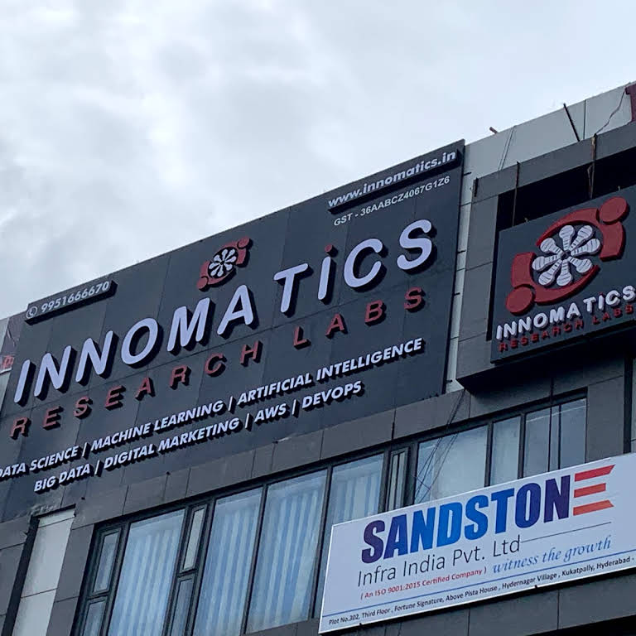
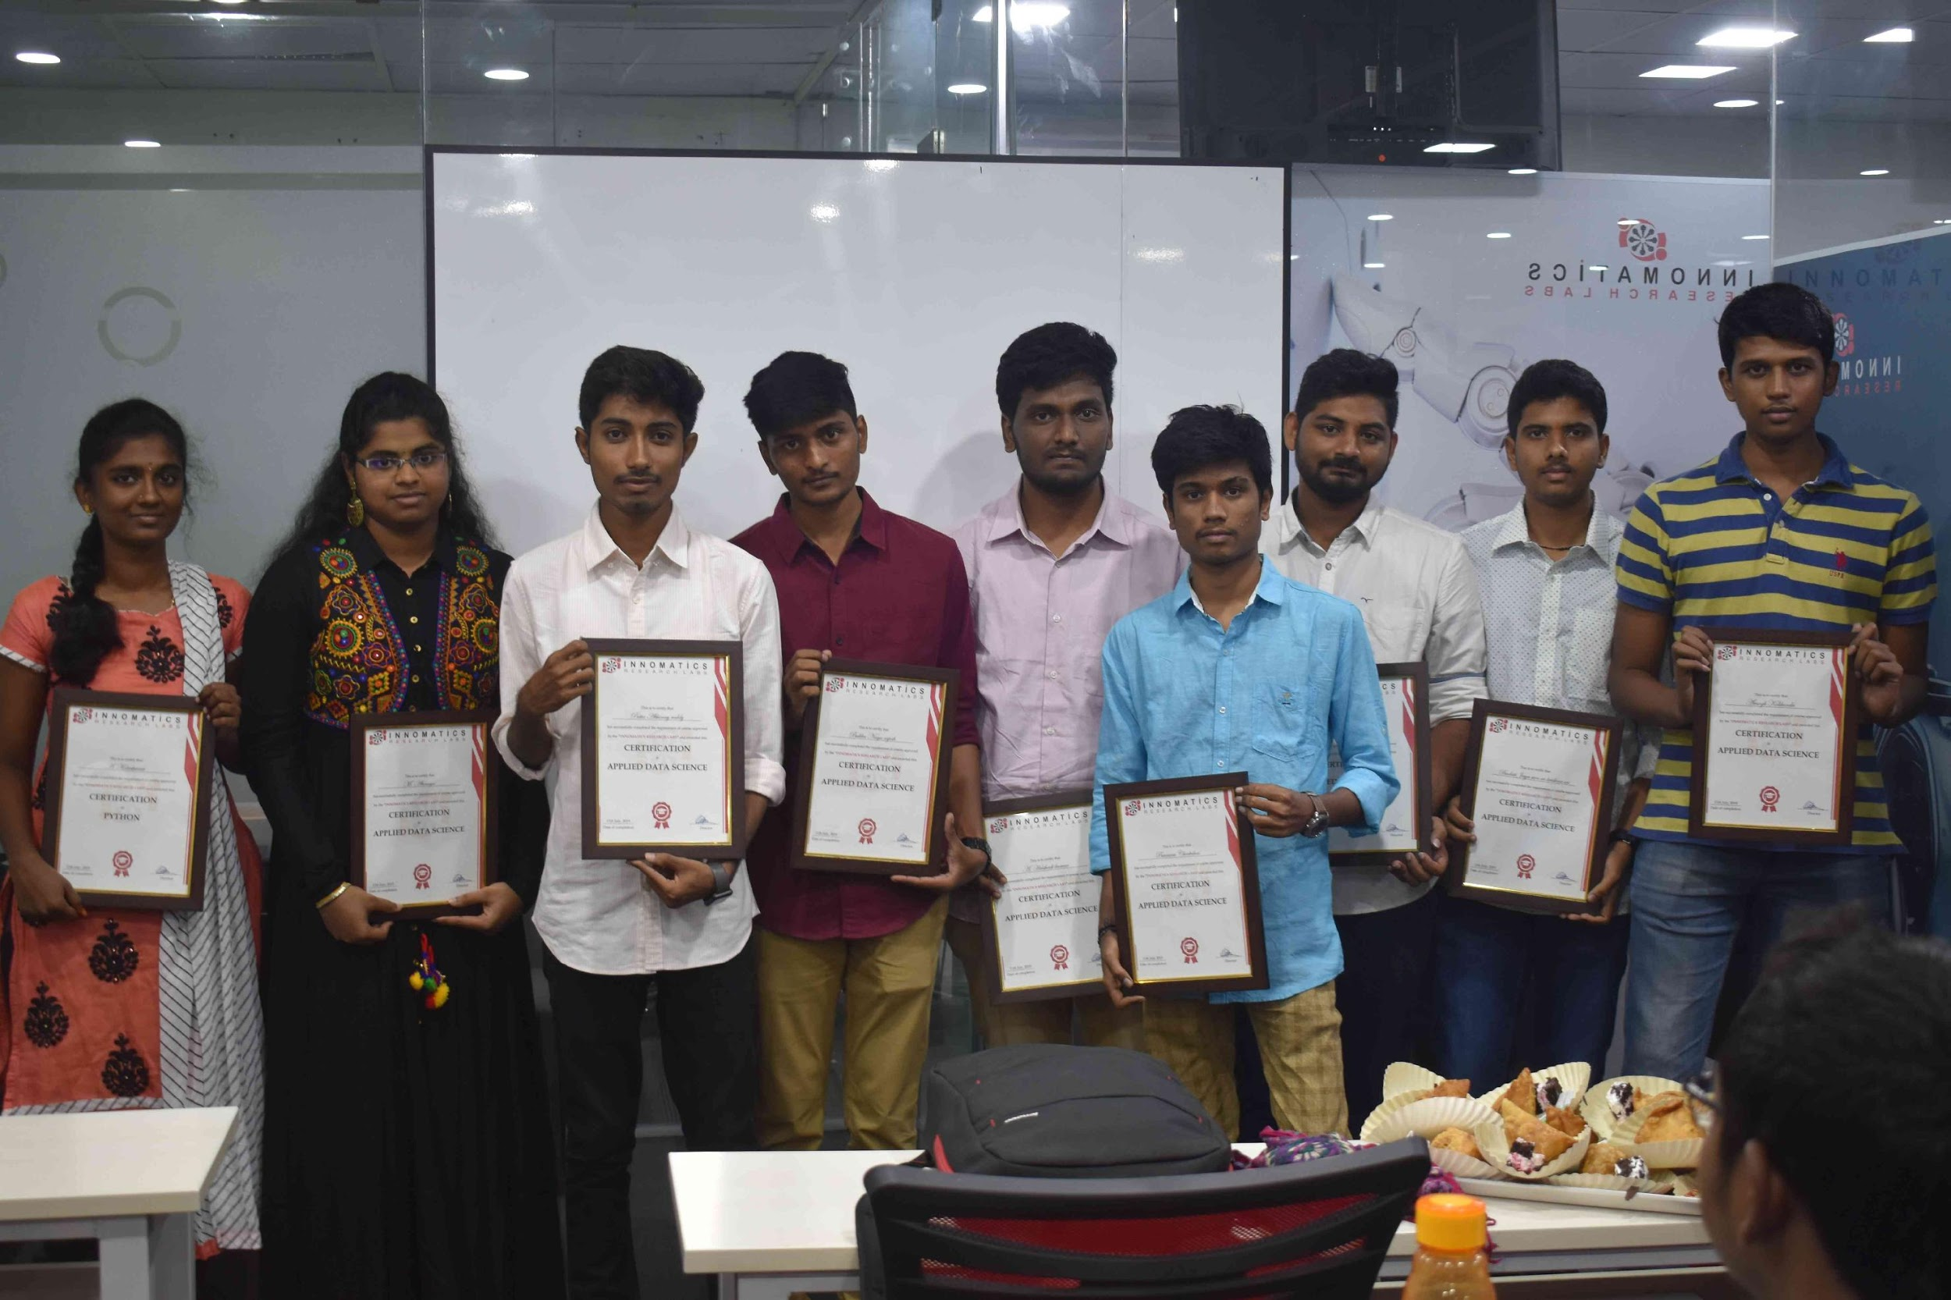
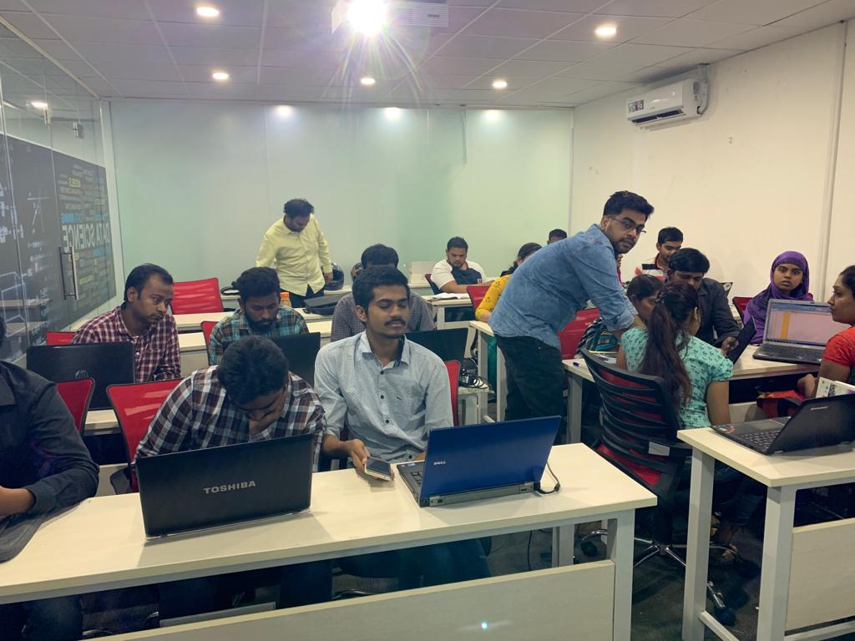

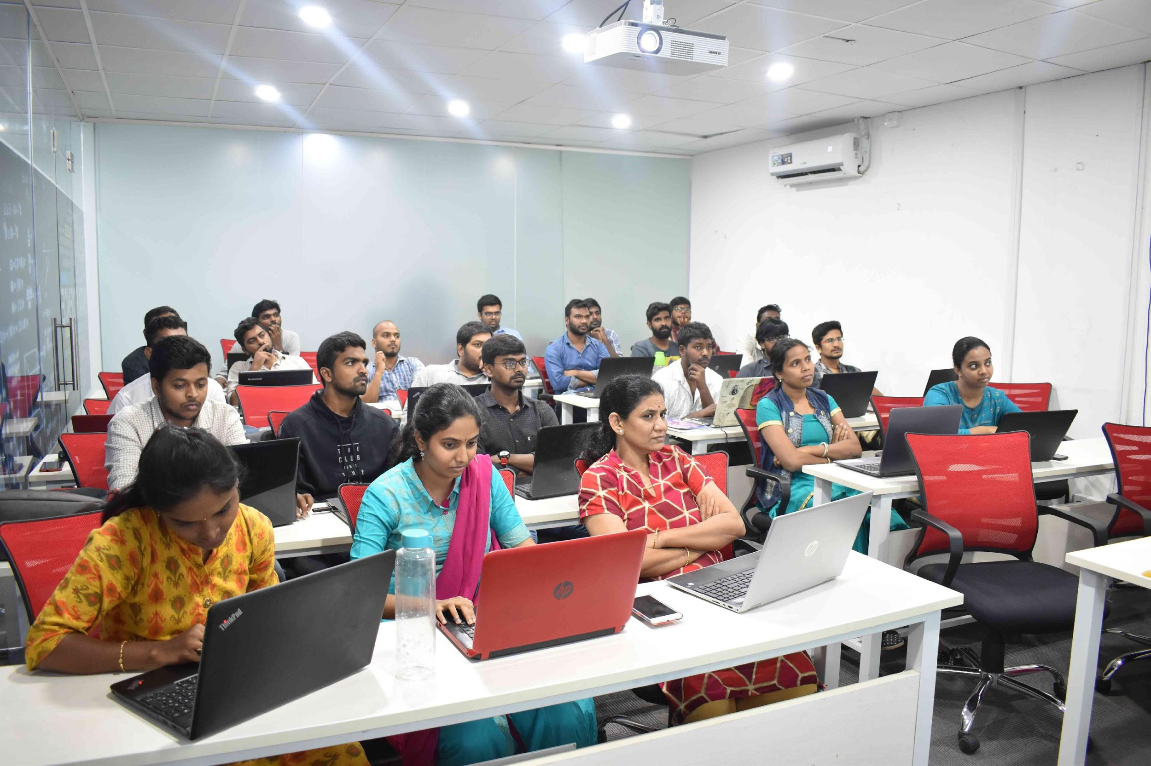
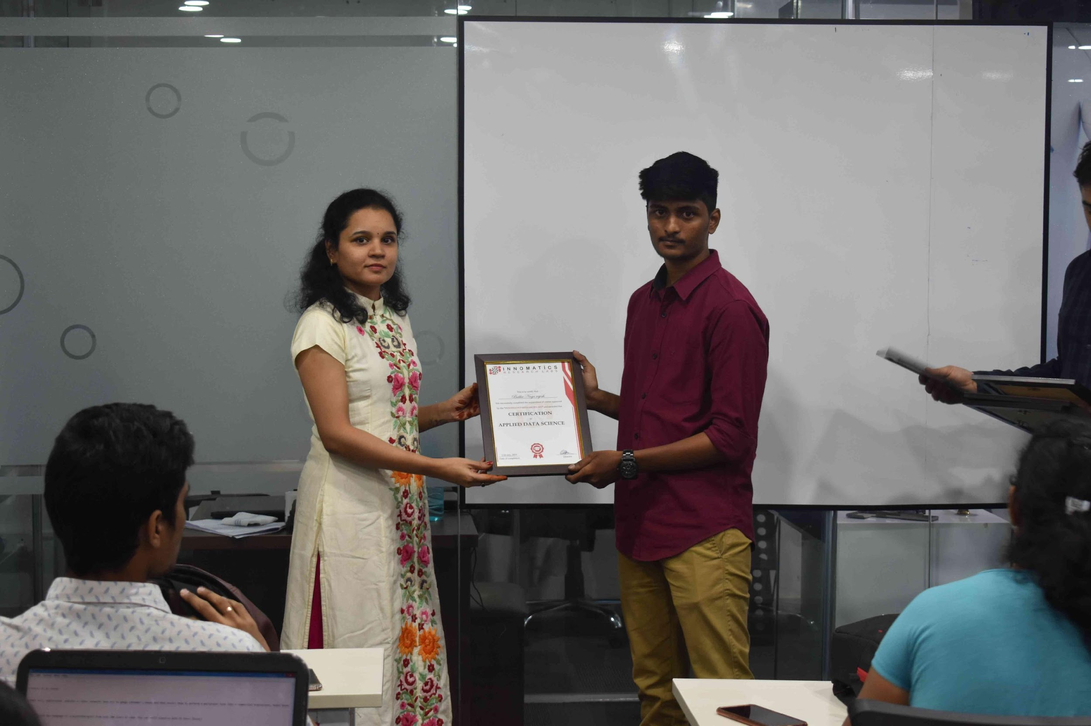
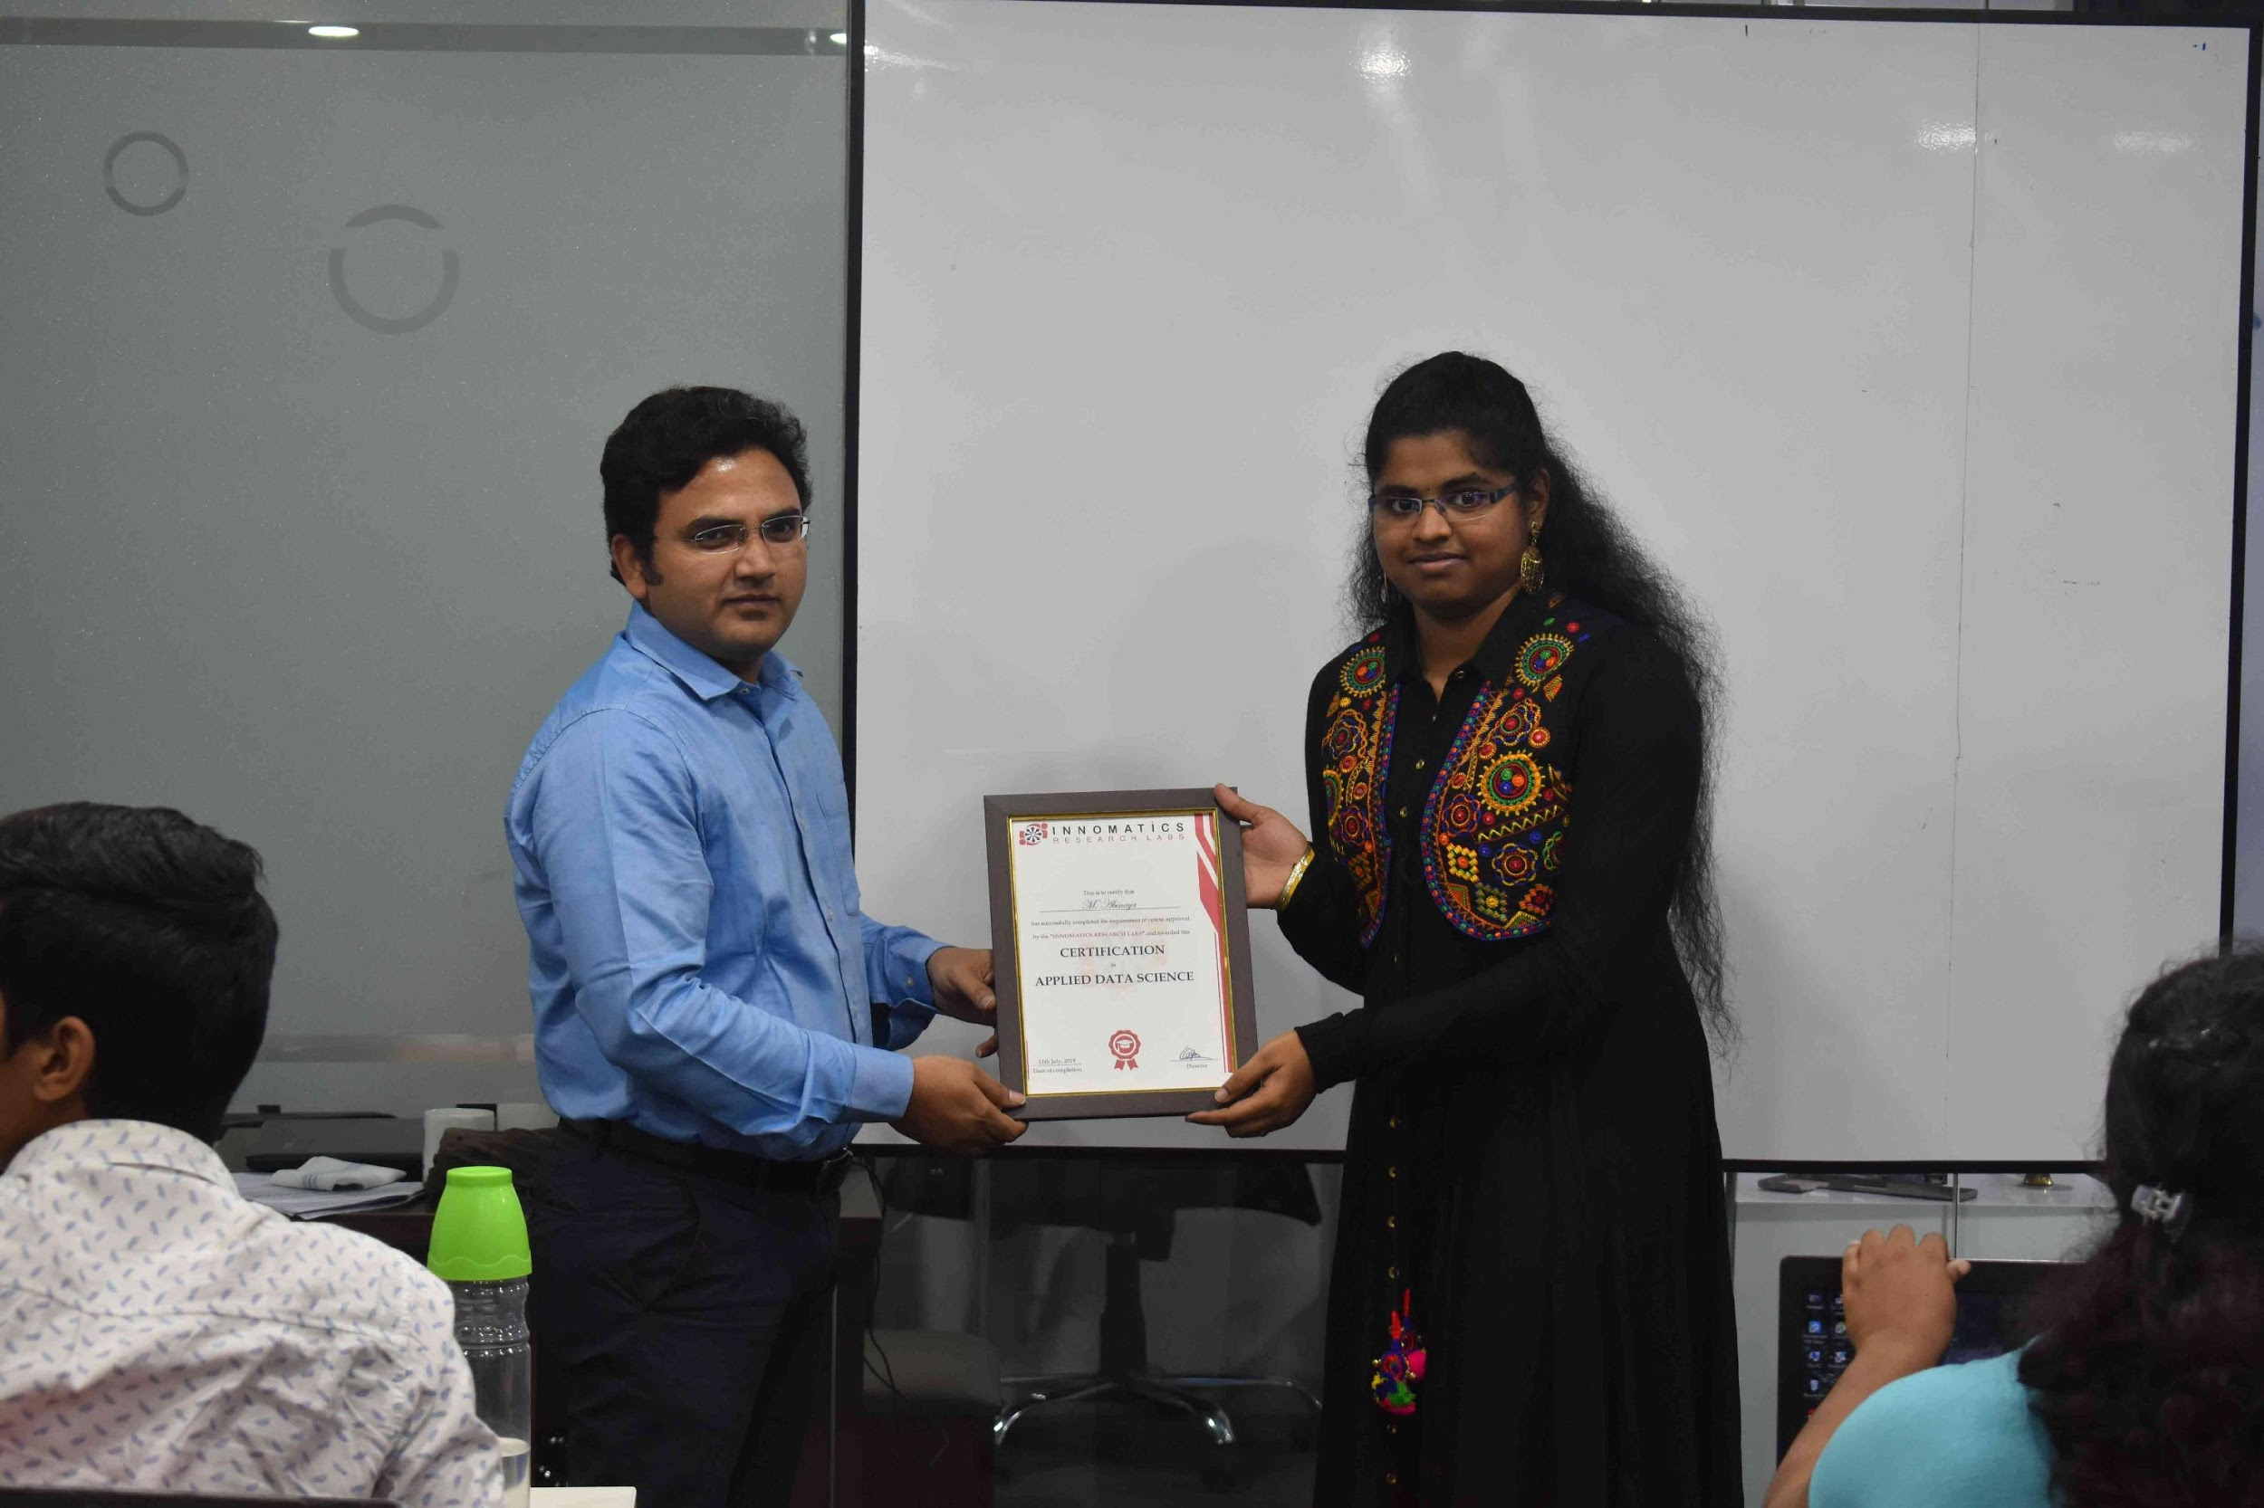

Slide 2
PROJECT ON
CODE REFACTORING AND BUG FIXING
BY
G V S SREERAM SARMA
IN1241203

Slide 3
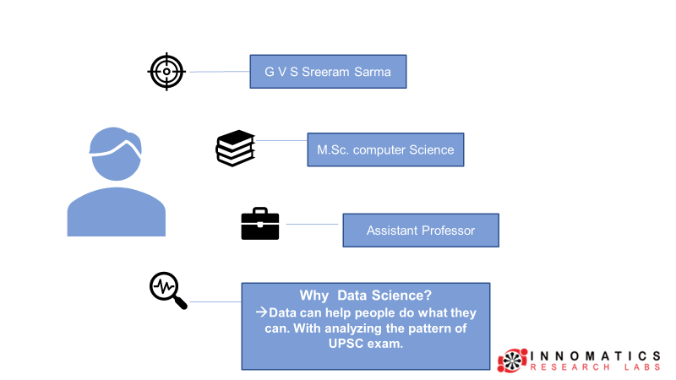
About me
Background ? (B-tech or M-tech)
Why you want to learn Data Science
Any work experience
What like you about Innomatics Research lab
Data Science Intern

Slide 4
OBJECTIVE OF THE PROJECT
To find the Bugs in the Note Making application AND.
To fix the Existing Code and Make the application to work intended.

Slide 5
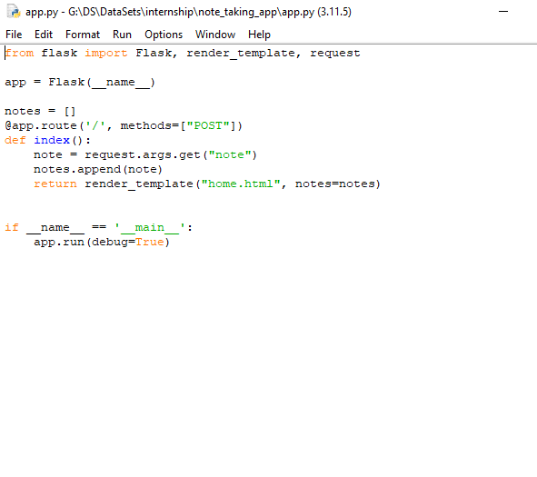
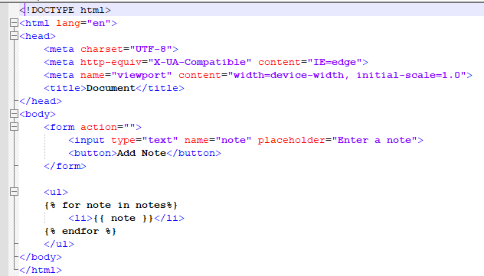
Initial Code:

Slide 6
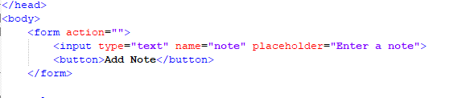
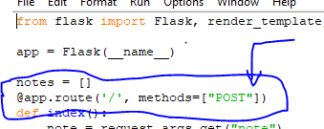
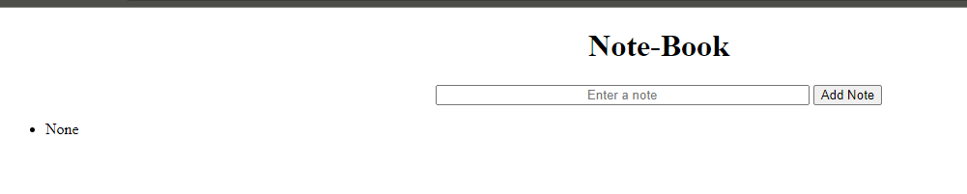
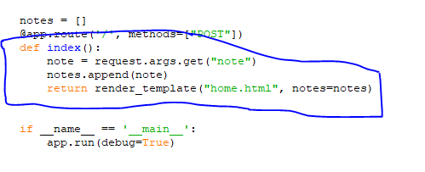
Identify Bugs
1.There are some missing parts in HTML file which defines the functionality of the form.
2.Here we can observe that “GET” method is missing
3. In Index() default “GET” method is executing and NONE is getting appended.

Slide 7

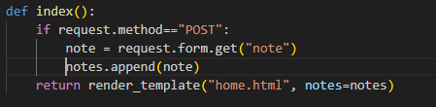
RESOLUTION:
1.We can fix this by adding”/” in action attribute
in the form ,”POST” in method name with type=“submit”
In button tag.
2.We can resolve the “Method not allowed” by providing
Request method “GET”.
3. The values must be appended only when
Method “POST” is requested.

Slide 8
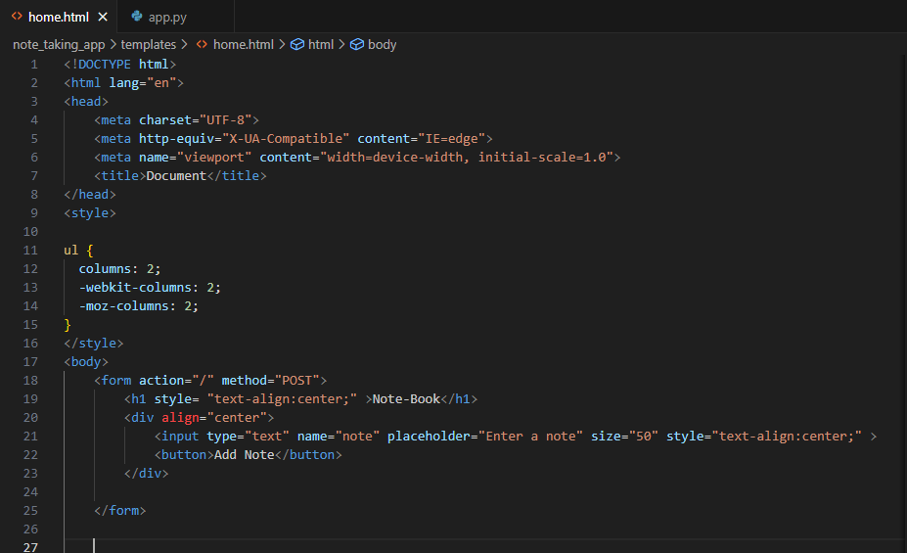
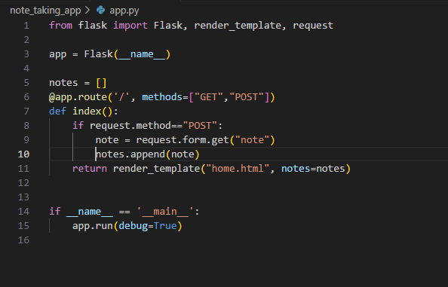
FIXED CODE

Slide 9

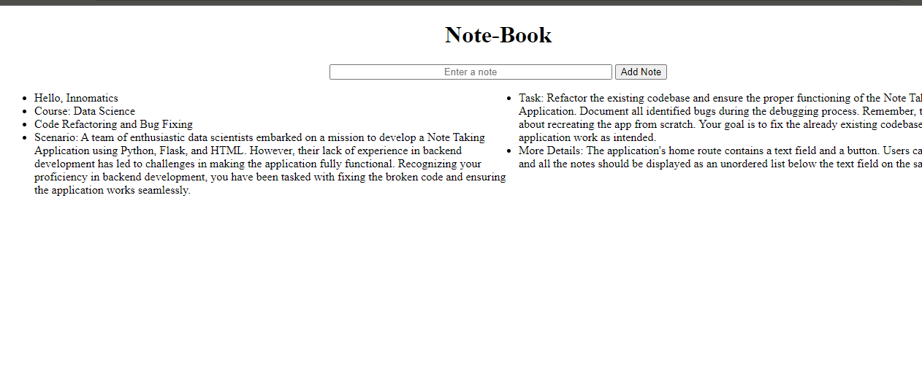
CONCLUSION:
The Note Making Application (“Note-Book”) was not working as expected.
By Identifying , Fixing Bugs and Refactoring the code.
Final OutCome:

Slide 10

THANK YOU

