Slide 1
Emotion Classification of Chinese Weibo Posts
Classical Machine Learning with a Leakage-Free Evaluation & Interactive Demo
UE24CS352A: Machine Learning Mini-Project
Student 1: Harsha R | SRN: PES1UG24AM115
Student 2: DARISI ANANTHA VENKATA SREERAM | SRN: PES1UG24AM076
Inspired by: Bai, He & Yuan (2021), Attitude Towards Vaccination Since Distribution in China

Slide 2
Problem Statement & Project Motivation
Core Problem
Project Objectives
Social media (Weibo) carries large volumes of public opinion and emotion, but posts are short, noisy and informal.
Task: classify a Chinese post into one of 7 emotion classes (IDs 0–6).
Chinese NLP challenges: no whitespace word boundaries, slang, emoticons, sarcasm.
Hidden risk: duplicated posts can make a model look far better than it really is.
Benchmark Naive Bayes, Logistic Regression and linear SVM on Chinese text.
Compare jieba words vs. character n-gram features.
Build a leakage-free evaluation: de-duplicate, split, bootstrap CIs, cross-validation.
Quantify how much the original evaluation was inflated.
Deliver a working web demo with calibrated probabilities.

Slide 3
Reference Paper & Our Scope
Reference Paper
What We Reproduce
What Differs (honest)
Bai, He & Yuan (2021): binary sentiment on Weibo posts about COVID-19 vaccination.
Models: NB, SVM, LR, bigram, LSTM.
Reported test accuracy ≈ 81.6–81.9%.
Monthly trend vs. vaccine doses.
Classical models and tokenisation comparison.
Validation-based model selection; single test evaluation.
Error analysis and an interactive demo.
Extra: duplicate-leakage audit.
Supplied data: 7 emotion classes, mixed topic, ≈5% COVID words.
No date column, so no trend analysis; we claim none.
No LSTM: no pre-trained/GPU resources; listed as future work.
Not a vaccine-sentiment model.

Slide 4
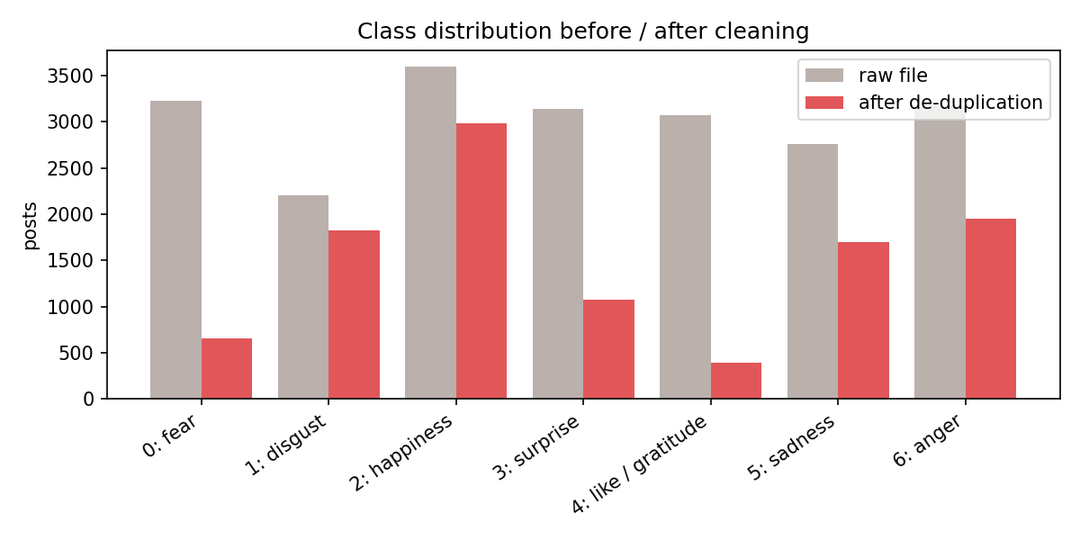
Dataset & Cleaning
Corpus & Partitioning
Weibo corpus: 21,173 posts, columns review/label, labels 0–6.
10,154 exact duplicates (48%); 86 texts with conflicting labels removed.
Result: 10,565 unique posts (50.1% removed).
Stratified split, seed 42: train 6,339 · val 2,113 · test 2,113; zero text overlap (unit-tested).
Label names are tentative: inferred from top n-grams (fear, disgust, happiness, surprise, like/gratitude, sadness, anger).
Class 4 collapses from 3,072 to 387 posts: most of it was copies, so class weights and macro-F1 are used.

Slide 5
Key Finding: Duplicate Leakage Inflated the Evaluation
56.7%
of test rows also in training
91.9% vs 60.9%
old model: leaked vs unseen rows
+9.8 pts
improvement on clean split
A random split of the raw file puts the same post in train and test. Honest evaluation requires de-duplication first.

Slide 6
Preprocessing & Feature Representations
Text Cleaning
Features (TF-IDF, sublinear)
NFKC normalisation; URLs and @mentions removed.
Repeated punctuation / characters collapsed.
Weibo emoticons ([good], [委屈]) are KEPT as EMO_x tokens: strong emotion cues the original code deleted.
Ablation: keeping emoticons gives +3.3 pts validation accuracy (0.699 vs 0.660).
jieba words, 1–2-grams (segmentation-dependent).
Character 1–3-grams: no segmentation, robust to slang, typos and emoticons.
Word + char union.
Result: char n-grams beat words by ≈6 macro-F1 points.

Slide 7
Models & Evaluation Protocol
Candidate Models (19)
Protocol (no test peeking)
Complement Naive Bayes (word TF-IDF).
Logistic Regression, C ∈ {1, 3, 10}.
Linear SVM, C ∈ {0.1, 0.3, 1}.
Each LR/SVM × {word, char, word+char}; balanced class weights.
Majority-class baseline for reference.
Fit all candidates on train; rank by validation macro-F1.
Re-fit winner with sigmoid-calibrated probabilities.
Score ONCE on test; 95% bootstrap CIs (1,000 resamples).
5-fold CV on train+val for stability.
Selected: Linear SVM, char 1–3-grams, C = 0.3.

Slide 8
Experimental Results: Validation Benchmarking
Classifier (best settings) | Val Acc % | Val macro-F1 %
Linear SVM char C=0.3 | 69.9 | 69.5
LogReg char C=3 | 69.0 | 68.8
Linear SVM word+char C=0.1 | 68.9 | 68.5
LogReg word+char C=1 | 68.2 | 68.1
Linear SVM word C=0.3 | 64.7 | 63.8
LogReg word C=3 | 64.3 | 63.7
Naive Bayes word | 63.4 | 61.0
Majority baseline | 28.3 | 6.3
Differences of ≈1 point between top candidates are within validation noise (2,113 posts).

Slide 9
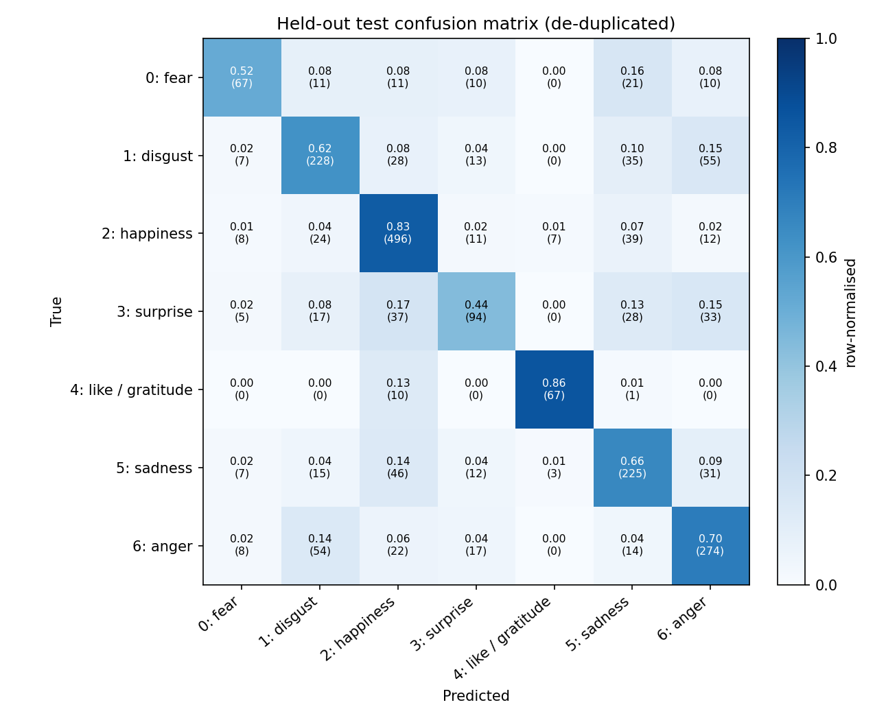
Test Set Evaluation & Confusion Matrix
Metric | Value
Accuracy | 68.7% (CI 66.8–70.6)
Macro-F1 | 0.672 (CI 0.650–0.693)
5-fold CV macro-F1 | 0.683 ± 0.016
Majority baseline | 28.3% accuracy
Best class F1 | like/gratitude 0.86
Worst class F1 | surprise 0.51
Insights
Selected on validation only; test scored once.
Honest ≈69%, 2.4× the majority baseline.

Slide 10
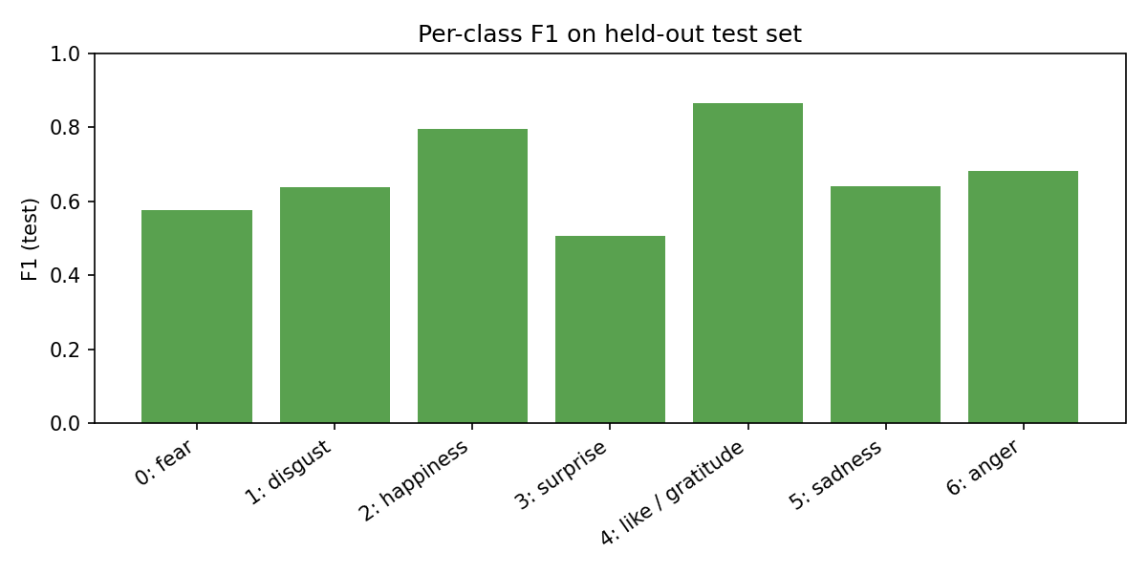
Error Analysis & Ablation
Where the model fails
disgust ↔ anger: 55 and 54 test posts (shared negative vocabulary).
sadness → happiness: 46 (laughter markers around sad text).
surprise: recall only 0.44; few distinctive words.
Confident errors are mostly very short posts (mean 24 chars) and sarcasm, e.g. 加油，武汉加油 (gratitude → happiness).
Ablation: emoticons
Kept: 69.9% acc / 0.695 macro-F1
Deleted (original): 66.0% / 0.660

Slide 11
Code Architecture & Live Demonstration
Repository
Live Demo Protocol
src/preprocess.py: cleaning, jieba, dedup key.
src/data.py: de-duplication, stratified split.
src/models.py: 19 candidate pipelines.
src/train.py / evaluate.py: search, test, CIs, plots.
src/leakage_audit.py: 2×2 inflation study.
app.py: Streamlit web demo · 11 pytest tests.
streamlit run app.py → http://localhost:8501
Click example buttons: probabilities for all 7 classes.
Batch tab: upload CSV, download predictions.
Honest-results tab: leakage table, confusion matrix.
CLI: python -m src.predict_demo --text "…"
Reproduce everything: python run_all.py (~3 min).

Slide 12
Conclusions & Limitations
Key Takeaways
Limitations & Future Work
Fixing the evaluation mattered most: 78.5% → 58.9% for the old approach once duplicates are removed.
Character n-grams + emoticons: 68.7% test accuracy (+9.8 pts).
Linear SVM ≈ Logistic Regression; both ≫ Naive Bayes.
Classical models are fast, interpretable, reproducible.
Label names tentative; mixed-topic corpus, not vaccine-specific.
No LSTM and no trend analysis (no dates in data).
Single split seed; ≈69% near ceiling for n-gram models.
Future: Chinese RoBERTa-wwm, dated vaccine dataset, neutral class.

Slide 13
Team Contributions & Q&A
Harsha R (PES1UG24AM115)
DARISI ANANTHA VENKATA SREERAM (PES1UG24AM076)
Text cleaning and emoticon handling.
De-duplication and stratified splitting.
Classical models and hyper-parameter search.
Streamlit and CLI demo.
Evaluation harness: bootstrap CIs, CV, ablation.
Leakage audit and error analysis.
Unit tests and documentation.
Anticipated Questions
Why did accuracy drop from the original 77.8%? The old score was inflated by duplicate posts leaking into the test set.
Why no LSTM / trend analysis? No dates in the data and no pre-trained models available; stated openly as limitations.

