Slide 1


SMART INDIA HACKATHON 2025
Real-Time Public Transport Tracking
Problem Statement ID –
Problem Statement Title-
Theme-
PS Category- Software
Team ID-
Team Name (Registered on portal)

Slide 2
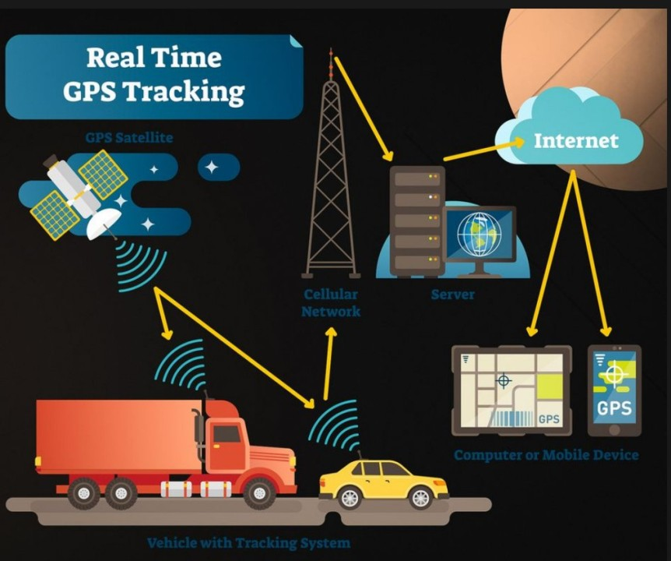
Your Team Name
Real-Time Public Transport Tracking
Proposed solution:
Our real-time tracking system offers multiple innovative features for users.
Real-time tracking of buses
Accurate Estimated Time of Arrival (ETA)
Optimized routes for efficiency
User-friendly mobile/web dashboard

Slide 3
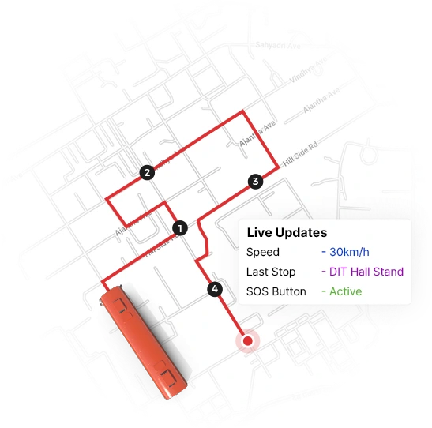
TECHNICAL APPROACH
Your Team Name
Backend Technology
Utilizing robust frameworks and languages like Node.js for efficient server-side processing and data management.
Frontend Framework
Implementing modern frameworks such as React for a dynamic user interface that enhances user experience.
Database Management
Leveraging cloud-based databases like MongoDB for scalable and secure data storage, ensuring real-time access.

Slide 4

FEASIBILITY AND VIABILITY
Your Team Name
Adoption in Other Cities
Integration with Smart City Initiatives
Expanding Solutions for Better Public Transport
Challenges and Risk
Mitigation
Challenges and Risk Mitigation
Internet Connectivity Issues
Managing Device Cost
Ensuring Scalability

Slide 5

IMPACT AND BENEFITS
Your Team Name
Impact
Better Commuter Experience – Passengers know exactly when buses/trains will arrive.
Less Waiting Time – Reduces uncertainty and stress at stops.
Traffic Management – Helps cities reduce congestion.
Transparency – Builds trust in public transport.
Benefits:
Enhanced Safety for Passengers
Improved Efficiency for Authorities
Positive Societal Impacts

Slide 6
RESEARCH AND REFERENCES
Your Team Name
Research:
References:
World Bank – Intelligent Transport Systems 🌐 https://www.worldbank.org/en/topic/transport/brief/intelligent-transport-systems
Node.js Documentation 🌐 https://nodejs.org/en/docs
React Documentation 🌐 https://react.dev/
MongoDB Documentation 🌐 https://www.mongodb.com/docs/
Smart Cities Mission – Government of India 🌐 https://smartcities.gov.in/
WRI – Benefits of Real-Time Public Transit Information 🌐 https://wrirosscities.org/news/real-time-information-public-transport
Real-time tracking reduces commuter waiting time and stress (WRI, 2018).
Frontend Dashboard:Public
GPS + mobile apps improve bus arrival prediction accuracy (IEEE study).
Smart city initiatives in India focus on integrating transport data for efficiency (Smart Cities Mission).
Cloud databases (like MongoDB) ensure scalable and real-time access for large cities.
Node.js + React stack commonly used for fast, reliable, real-time dashboards.

Slide 7
IMPORTANT INSTRUCTIONS
Please ensure below pointers are met while submitting the Idea PPT:
Kindly keep the maximum slides limit up to six (6). ( Including the title slide)
Try to avoid paragraphs and post your idea in points /diagrams / Infographics /pictures
Keep your explanation precise and easy to understand
Idea should be unique and novel.
You can only use provided template for making the PPT without changing the idea details pointers (mentioned in previous slides).
You need to save the file in PDF and upload the same on portal. No PPT, Word Doc or any other format will be supported.
Note - You can delete this slide (Important Pointers) when you upload the details of your idea on SIH portal.

