Slide 1


SMART INDIA HACKATHON 2025
TITLE PAGE
Problem Statement ID –SIH25004
Problem Statement Title-Image Based Breed Recognition for Cattle &Buffaloes of India
Theme-Agriculture,FoodTech & Rural Development
PS Category- Software/Hardware
Team ID-
Team Name(Registered on portal):AgriMitra-AI

Slide 2
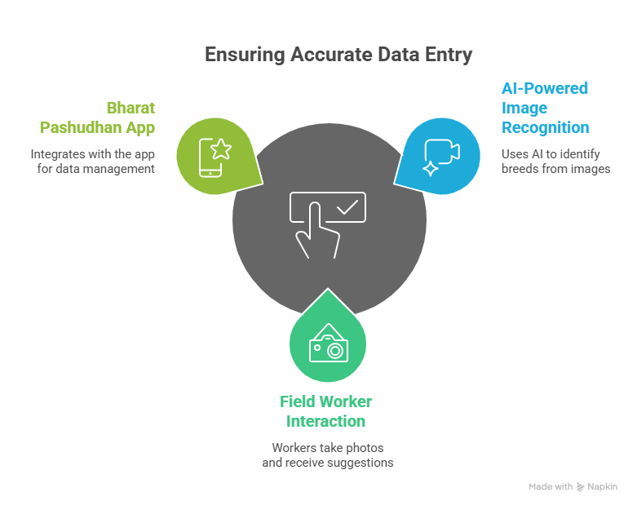
IDEA TITLE
AgriMitra-AI
Proposed Solution (Describe your Idea/Solution/Prototype)
AI-based image recognition tool for breed identification
Integrated with Bharat Pashudhan App (BPA)

Slide 3
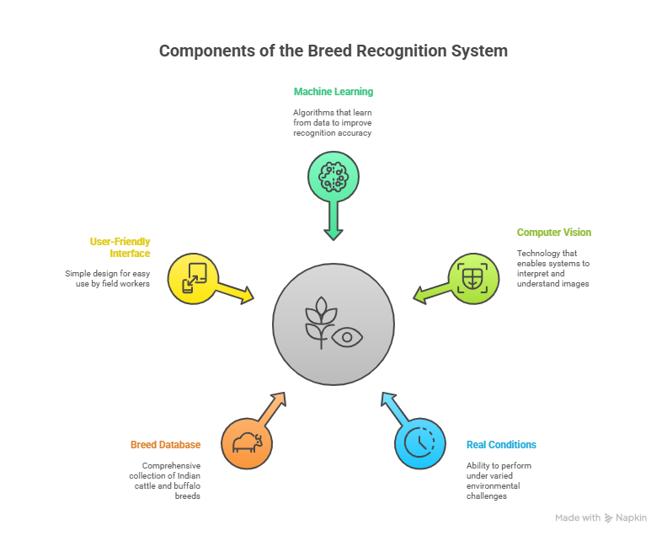
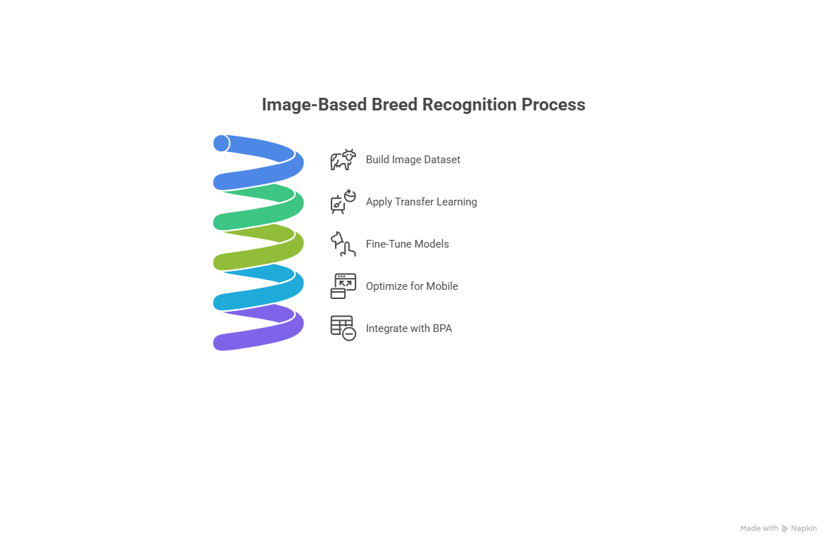
TECHNICAL APPROACH
AgriMitra-AI
Technologies: TensorFlow / PyTorch, Transfer Learning, Mobile App (Android), Flask/Django backend, TensorFlow Lite
Methodology:

Slide 4
FEASIBILITY AND VIABILITY
AgriMitra-AI
Feasibility:
AI models already proven in animal recognition tasks
Mobile devices can handle lightweight models
Dataset available from ICAR/NDDB + field collection
Challenges & Risks:
Need for continuous dataset updates
Poor image quality in field
Similar-looking breeds (crossbreds)
Strategies:
Use top-3 prediction suggestions
Augmentation & preprocessing for poor quality images
Human-in-the-loop validation (FLW confirmation)

Slide 5
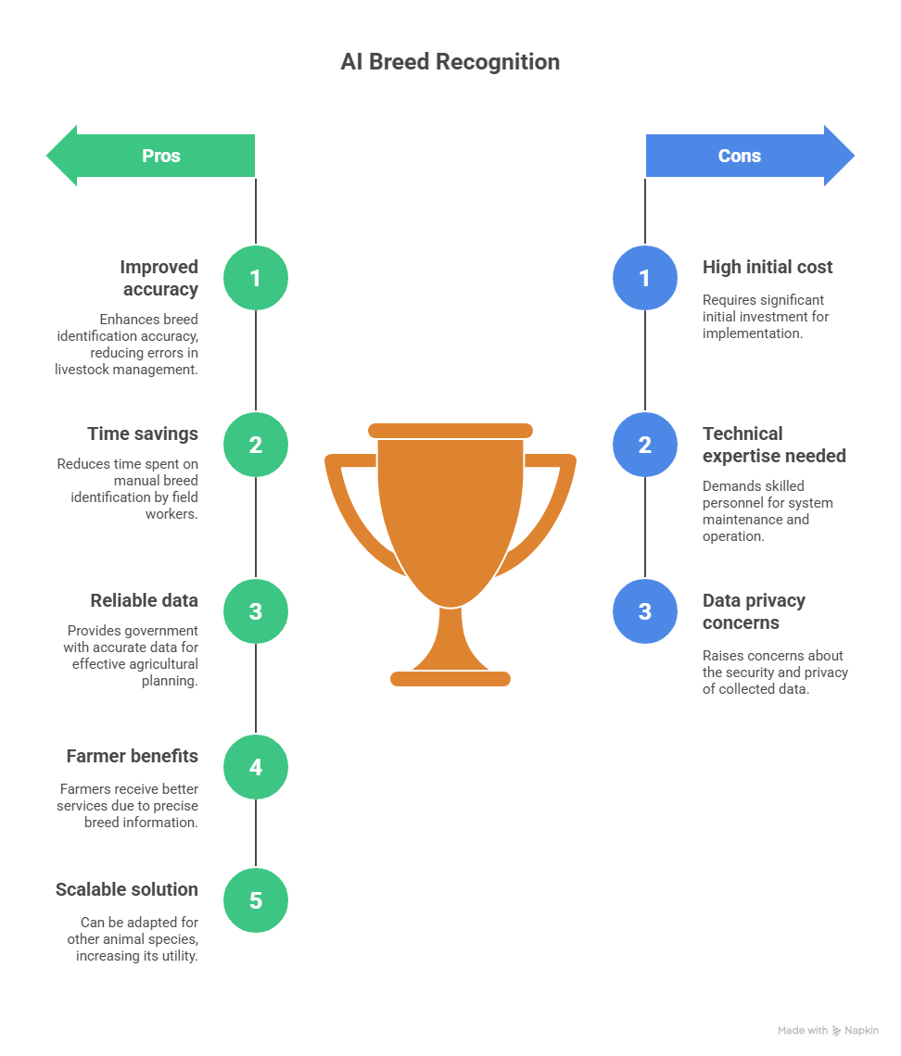
IMPACT AND BENEFITS
AgriMitra-AI

Slide 6
RESEARCH AND REFERENCES
AgriMitra-AI
Identification of Buffalo Breeds Using Self-Activated-Based Improved Convolutional Neural Networks.
https://doi.org/10.5194/aab-68-473-2025
Deep-learning-based buffalo identification through muzzle pattern images
https://doi.org/10.5194/aab-68-473-2025
Deployed frontend application:breed detection

