Slide 1

A Community Service Project on
Education For All:Say No To Dropouts
Submitted in Partial Fulfilment of the Requirements for the Award of the Degree of
BACHELOR OF TECHNOLOGY
IN
COMPUTER SCIENCE AND ENGINEERING(AI&ML)
Submitted By
Mulukuri Sreeram ( 23761A4236)
Supuri NarendraKumar (23761A4257)
Bontha Nitheesh Kumar (23761A4207)
Gandhi Seshagiri Rao ( 23761A4223)
Under the guidance of
Dr. sk. Razeena Begum
Associate Professor
Department of Computer Science and Engineering(AI&ML)
LAKIREDDY BALI REDDY COLLEGE OF ENGINEERING
(AUTONOMOUS)
Accredited by NAAC with ‘A’ Grade & NBA (Under Tier - I), ISO 9001:2015 Certified Institution Approved by AICTE, New Delhi and Affiliated to JNTUK, Kakinada L.B.
REDDY NAGAR, MYLAVARAM, NTR Dist, A.P.-521 230
June 2025

Slide 2

CERTIFICATE
This is to certify that the community service project entitled “Education For All:Say No To Droputs” isbeing submitted by Mulukuri Sreeram (23761A4236), Supuri NarendraKumar (23761A4257), Bontha Nitheesh Kumar (23761A4207), Gandhi Seshagiri Rao ( 23761A4223) in partial fulfilment for the award of B. Tech in Computer Science & Engineering(AI&ML) to the Jawaharlal Nehru Technological University Kakinada is a record of bonafide work carried out by him/her under our guidance. The results embodied in this project report have not been submitted to any other University or Institute for the award of any degree or diploma.
Period of CSP:
From: 15-05-25 To: 28-06-25
Name & Address ofthe Community / Habitation: Ibrahimpatanam
Date of Submission: / /2025
Project guide
Dr. Sk. Razeena Begum
Assosiate Professor
Head of the department Dr.S.Jayaprada
Professor & HOD CSE(AI&ML)

Slide 3
Student’s Declaration
I MULUKURI SREERAM student of B-Tech Program,Reg.No. 23761A4236 of the Department of CSE(AI & ML),LakiReddy Bali Reddy College of Engineering do here by declare that I have completed the mandatory community service from 15-05-2025 to 28-06- 2025 in Community Service Project under the Faculty Guideship of Dr.sk.Salma Asiya Begum Department of CSE(Artificial Intelligence And Machine Learning) in College.
Faculty Guide
Head of the Department
Princpal

Slide 4
Student’s Declaration
I SUPURI NARENDRA KUMAR student of B-Tech Program,Reg.No. 23761A4257 of the Department of CSE(AI & ML),LakiReddy Bali Reddy College of Engineering do here by declare that I have completed the mandatory community service from 15-05-2025 to 28-06- 2025 in Community Service Project under the Faculty Guideship of Dr.sk.Salma Asiya Begum Department of CSE(Artificial Intelligence And Machine Learning) in College.
Faculty Guide
Head of the Department
Princpal

Slide 5
Student’s Declaration
I BONTHA NITHEESH KUMAR student of B-Tech Program,Reg.No. 23761A4207 of the Department of CSE(AI & ML),LakiReddy Bali Reddy College of Engineering do here by declare that I have completed the mandatory community service from 15-05-2025 to 28-06- 2025 in Community Service Project under the Faculty Guideship of Dr.sk.Salma Asiya Begum Department of CSE(Artificial Intelligence And Machine Learning) in College.
Faculty Guide
Head of the Department
Princpal

Slide 6
Student’s Declaration
I GANDHI SESHAGIRI RAO student of B-Tech Program,Reg.No. 23761A4223 of the Department of CSE(AI & ML),LakiReddy Bali Reddy College of Engineering do here by declare that I have completed the mandatory community service from 15-05-2025 to 28-06- 2025 in Community Service Project under the Faculty Guideship of Dr.sk.Salma Asiya Begum Department of CSE(Artificial Intelligence And Machine Learning) in College.
Faculty Guide
Head of the Department
Princpal

Slide 7
Acknowledgement
The satisfaction that accompanies the successful completion of any task would be incomplete without the mention of people whose ceaseless cooperation made it possible, whose constant guidance and encouragement crown all efforts with success.
We are grateful to our Project Guide Mrs. SK. Razeena Begum, Assosiate Professor, Computer Science & Engineering(AI&ML) for the guidance, inspiration and constructive suggestions that helped us in the preparation of this project.
At the outset we thank our Head of the Department Dr. S. Jayaprada and our Honorable Principal Dr. K. Appa Rao for the moral support and the excellent facilities provided. We would also like to thank all the teaching and non-teaching staff members of the Computer Science department.
We wish to express our warm and grateful thanks to people who participated in the survey from the Ibrahimpatnam village (Ibhrahimpatanam mandal) for providing the answers in completing our Project successfully.
We thank all our friends who helped us sharing knowledge to complete the task in-time.
M.SREERAM (23761A4236),
S.NARENDRA KUMAR (23761A4257),
B.NITHEESH KUMAR (23761A4207),
G.SESHAGIRI RAO (23761A4223).

Slide 8
Abstract
Education and dropout rates are key indicators of the effectiveness and inclusiveness of educational systems, measuring the percentage of students who leave school before completing their level. High dropout rates often signal challenges such as inadequate infrastructure, insufficient resources, and systemic inequities. Factors like socioeconomic status and geographic location significantly influence these rates, with students from low-income families or rural areas being particularly at risk due to financial pressures and limited access to quality facilities.
To effectively address dropout rates, a multifaceted approach is necessary. Improving teaching quality is crucial for maintaining student interest and motivation. Financial support for families can ease economic burdens, while fostering an inclusive environment helps every student feel valued. Early intervention programs that identify at-risk students and provide support like tutoring and mentoring are essential in preventing dropouts. Additionally, flexible learning schedules and vocational training can accommodate diverse student needs.
Understanding the causes and consequences of high dropout rates is vital for policymakers and educators. These rates have long-term social and economic impacts, such as higher unemployment and lower earnings. Addressing dropout rates not only benefits individuals but also strengthens communities. Policymakers should focus on creating equitable educational opportunities to ensure that all students can complete their education and reach their full potential. Through comprehensive reforms and targeted interventions, educational systems can reduce dropout rates and improve overall outcomes.

Slide 9
CONTENTS
SNO | NAME OF THE CONTENT | PAGE NUMBER
1 | EXECUTIVE SUMMARY | 1 - 2
2 | OVERVIEW OF COMMUNITY | 3
3 | COMMUNITY SERVICE PART | 4
4 | ACTIVITY LOG | 5 - 16
5 | OUTCOMES DESCRIPTION & QUESTIONAIRE | 17 - 18
6 | PROBLEMS OF COMMUNITY | 19 - 21
7 | ACTION PLANS FOR PROBLEMS | 22 - 24
8 | DESCRIPTION | 25 - 26
9 | REPORT | 27 - 32
10 | RECOMMENDATIONS & EVALUTIONS | 33 - 47
11 | PHOTOS & DETAILS | 48 - 55
12 | MARKS STATEMENT | 58 - 62

Slide 10
CHAPTER1: EXECUTIVE SUMMARY
Executive Summary:
The Education and Dropout Rate report presents findings from an investigation into the educational landscape of Village Venkatayapalem. This study aims to understand the challenges faced by the community regarding education and dropout rates, providing insights to guide intervention strategies.
Community Description:
Village Venkatayapalem is a rural area with a population of approximately 1000 residents. Despite efforts to improve education, the village faces significant obstacles such as inadequate infrastructure, limited access to quality education, and socio-economic disparities. These factors contribute to high dropout rates and hinder academic progress.
Activities:
The study involved several activities to assess the education scenario and dropout rates in Village Venkatayapalem:
Conducting surveys and interviews with community members to identify factors influencing dropout rates and educational challenges.
Analyzing data from local schools and educational authorities to understand enrollment trends and dropout patterns.
Organizing focus group discussions to gather perspectives from teachers, parents, and students regarding barriers to education.
Learning Objectives:
To recognize the socio-economic factors impacting educational attainment and dropout rates in rural communities.
To develop strategies for improving access to quality education and reducing dropout rates through community engagement and advocacy.
To understand the importance of data-driven approaches in addressing educational disparities and

Slide 11
implementing targeted interventions.
Outcomes:
The study revealed several key findings:
High dropout rates among adolescents, particularly in secondary school levels, due to financial constraints, lack of parental support, and the need for child labor.
Limited access to educational resources and infrastructure, including inadequate school facilities and insufficient teaching staff.
Socio-economic disparities contribute to educational inequalities, with marginalized groups facing greater barriers to academic success.
Lack of awareness and emphasis on the importance of education among some community members, leading to low enrollment rates and high dropout rates.
Opportunities for intervention through targeted initiatives such as scholarship programs, vocational training, and community outreach efforts to promote the value of education and address dropout challenges.
Overall, the findings underscore the urgent need for comprehensive strategies to improve educational opportunities, address dropout rates, and empower the community towards academic success and socio-economic advancement in Village Venkatayapalem.

Slide 12
CHAPTER2: OVERVIEW OF THE COMMUNITY
The Community/Habitation in which the Community Service Project was undertaken is a small village located in a rural area. The community has a diverse population consisting of different ethnic and religious groups. The village has a long history, with evidence of human settlements dating back several centuries.
The community has a rich cultural heritage with various traditions and customs that are still practiced today. The village has a strong emphasis on family values, with the family being the central unit of the community. The community also places great importance on education and values hard work and self-sufficiency.
In terms of socio-economic conditions, the community faces several challenges. Most of the population are farmers, and agriculture is the main source of income for the community. However, the community faces challenges such as low productivity, lack of modern farming techniques, and limited access to markets.
The community also faces challenges in accessing basic services such as health care, education, and clean water. There is no primary/secondary school in the village, and residents have to travel nearby villages/towns for education. The villages school is poorly equipped, and many children drop out of school due to the lack of facilities and resources.
Despite these challenges, the community is resilient and resourceful. The community members work together to support each other and are committed to improving their living conditions. The Community Service Project provided an opportunity for the students to work with the community and support them in addressing some of their challenges.
Locality: Venkatayapalem Mandal: Nuzvid
District: Eluru
State: Andhra Pradesh Pin code: 521201

Slide 13
CHAPTER 3: COMMUNITY SERVICE PART
During the Education and Dropout Rate Project, students engaged in a series of impactful activities aimed at addressing critical education challenges within our community. These activities included:
Conducting a community needs assessment:
The students collaborated with community members and local leaders to assess the education needs of the community. They identified common education issues and challenges faced by the community, focusing on areas such as preventive education facilities, infrastructure and services.
Developing and implementing education-focused community projects:
Based on the needs assessment, the students developed and implemented education- focused community projects in collaboration with community members. These projects included establishing a mobile library,little classrooms and awareness campaigns.
Conducting workshops and training sessions:
The students conducted workshops and training sessions for community members on various education-related topics, such as awareness about importance of education and its benefits.
Through these activities, the students acquired various life skills, technical skills, and values. They learned the importance of community engagement, leadership, and teamwork in achieving project goals. They also gained technical skills in education needs assessment, project management, and community education promotion.
The project helped the students develop a sense of empathy and compassion for the community members. They learned to appreciate the challenges faced by the community. The project also instilled a sense of responsibility and commitment to education in community , which will be valuable in their future careers.
In conclusion, the Education and Dropout rate project provided the students with valuable life skills, technical skills, and values. The project had a positive impact on the community by addressing their education needs and supporting education initiatives. The project also highlighted the need for continued efforts to support communities in accessing basic education services and promoting sustainable education development.

Slide 14
ACTIVITY LOG FOR THE FIRST WEEK
Day & Date | Brief Description of The Daily Activity | Learning Outcome | Person In- Charge Signature
Day–1 | Introduction to the community and the project goals. | Cultural awareness, understanding community needs.
Day-2 | Meeting with community leaders to discuss project scope and timeline. | Communication skills, community engagement, details and conditions of community.
Day–3 | Meeting with parents and students to analyze problems. | Identifying dropout- related issues
Day–4 | Researching existing educational infrastructure in the community. | Data analysis, research on community schools.
Day–5 | Conducting a survey to assess community education needs. | Survey methodology, data collection and analysis.
Day–6 | Organizing survey data and identifying key educational issues. | Surveying community, detailed problem analysis.

Slide 15
WEEKLY REPORT
WEEK–1(From Dt ………....... to Dt ........................ )
Objective of the Activity Done: Analysis of Education Challenges in the
Community.
Detailed Report: During the first week of the survey, we conducted a
needs assessment to understand the educational challenges faced by the
community. we interviewed 25 households and collected their responses using a
structured questionnaire. Additionally, we held meetings with local educators,
parents, and community leaders to gain insights into the current educational
landscape. By the end of the week, we analyzed the survey data to identify the
primary challenges contributing to dropout rates within the community.
Most respondents highlighted significant issues related to education facilities of
and accessibility. Both students and parents expressed concerns about the lack
nearby schools, forcing many children to travel long distances or forego
education altogether. This transportation barrier emerged as a major obstacle to
regular school attendance and academic success. By the end of the first week,
these are the major problems identified by our team in the community.
Key findings from the first week's analysis include:
1. Access to Education Facilities: Many students face challenges due to the lack of accessible educational facilities within the community. Long travel distances impact attendance and engagement.
2. Quality of Education: Concerns were raised regarding the quality of education provided. There is a need for improved teaching standards, resources, and curriculum relevance.
3. Financial Constraints: Economic factors pose significant barriers to education. Families struggle to afford school fees, uniforms, and learning materials.

Slide 16
ACTIVITY LOG FOR THE SECOND WEEK
Day & Date | Brief Description of The Daily Activity | Learning Outcome | Person In- Charge Signature
Day–1 | Meeting with educators and school administrators to discuss project goals and potential partnerships. | Professional networking, collaboration, understanding educational facilities.
Day-2 | Researching potential funding sources for educational initiatives. | Grant writing, fundraising skills, understanding funding from government and private sources.
Day–3 | Planning and organizing an educational fair. | Community outreach, understanding community education issues.
Day–4 | Recruiting volunteers for the educational fair. | Leadership skills, team management, organizing educational events.
Day–5 | Preparing materials and supplies for the educational fair. | Time management, resource allocation, handling logistical challenges.
Day–6 | Distributing educational resources and supplies to students and families. | Helping the community with basic educational needs.

Slide 17
WEEKLY REPORT
WEEK–2 (From Dt ………..…… to Dt ................................ )
Objective of the Activity Done: Raising awareness about the importance of education
and reducing dropout rates.
Detailed Report: During the second week of the survey, we focused on creating
an awareness campaign about the importance of education and strategies to
reduce dropout rates. We designed posters and pamphlets with information about
the benefits of education and tips for parents to support their children's learning.
We spoke to the village and community officials to organize an educational fair.
The officials responded positively and helped us organize the fair, where we
provided information about educational resources and distributed learning materials
to students. We also held discussions with community members to gather feedback
on the materials and services provided. We asked about other challenges they faced
in accessing education and how we could help address these issues. This interaction
helped us understand the community's needs better and plan more effective
interventions. This is the main report that we have done in the community
and how we interacted with the people in the community.
Key activities and outcomes from the second week include:
Awareness campaign: Designed and distributed educational posters and pamphlets highlighting the importance of education and strategies to support student success.
Educational fair organization: Collaborated with local officials to set up an educational fair, providing information about educational resources and distributing learning materials and supplies to students.
Community engagement: Held discussions with community members to collect feedback on the materials and services provided. We also asked about other educational challenges they faced and how we could further assist the community.

Slide 18
ACTIVITY LOG FOR THE THIRD WEEK
Day & Date | Brief Description of The Daily Activity | Learning Outcome | Person In- Charge Signature
Day–1 | Conducting the community education fair and gathering details about what educational challenges are major issues. | Coordination and public speaking, analyzing educational problems.
Day-2 | Analyzing data from the education fair and information from school officials. | Data analysis, problem- solving.
Day–3 | Meeting with educators to discuss identified educational problems. | Collaboration, critical thinking
Day–4 | Planning with school officials to organize an educational survey in the community. | survey design, problem-solving skills
Day–5 | Recruiting volunteers for the educational survey. | Recruitment strategies, leadership skills.
Day–6 | Meeting with community leaders to explain the educational challenges identified. | Effective communication, advocacy skills

Slide 19
WEEKLY REPORT
WEEK–3(From Dt………..…..to Dt.................................. )
Objective of the Activity Done: Meeting with village officials and conveying
the educational problems of the people to officials.
Detailed Report: During the third week, we worked on developing a plan to
improve the educational infrastructure and support systems in the community.
We spoke to the village officials to discuss the establishment of additional
educational facilities and resources. We invited some officials to participate in
our survey and observe the challenges faced by students and their families
firsthand. We conducted research on the resources needed to improve the
educational outcomes in the community, including textbooks, school supplies,
and after-school tutoring programs. We also gathered information about the
specific needs of the students and estimated the costs of the required resources.
Additionally, we met with local education authorities to present the report we
had prepared, urging them to address these issues promptly and provide better
educational facilities and support to the community.
Key activities and outcomes from the third week include:
Planning for Educational Improvement: Developed a comprehensive plan for enhancing educational facilities and support systems, including the necessary resources and equipment.
Engaging with Officials: Spoke to village officials about the educational challenges faced by the community and the need for additional resources and facilities. We encouraged them to participate in our survey.
Resource and Equipment Research: Conducted detailed research on the resources and equipment needed to improve educational outcomes, focusing on the specific needs of the community's students.
Advocacy and Fundraising: Met with local education authorities to present our findings and advocate for address the educational challenges. We requested funding to support the necessary improvements and resources for the community.

Slide 20
ACTIVITY LOG FOR THE FOURTH WEEK
Day & Date | Brief Description of The Daily Activity | Learning Outcome | Person In- Charge Signature
Day–1 | Conducting the educational workshop and informing the officials how it works. | Public speaking ability and capability to educate people.
Day-2 | Evaluating the effectiveness of the educational workshop. | Evaluation skills and problem analysis.
Day–3 | Meeting with community officials to discuss the outcomes of the educational workshop. | Community engagement and understanding educational challenges.
Day–4 | Researching potential partnerships and resources for implementing educational interventions. | Research skills and resource allocation.
Day–5 | Planning about organizing an after-school tutoring program that helps the community. | Community engagement and project planning.
Day–6 | Discussing the progress and outcomes of ongoing projects and determining if problems have been resolved. | Analysis of the work done so far.

Slide 21
WEEKLY REPORT
WEEK–4(From Dt………..…..to Dt.................................. )
Objective of the Activity Done: Requesting the officials to arrange an
educational improvement event in the community.
Detailed Report: During the fourth week, we met with the community officials
to explain the educational challenges being faced by the community. We
requested the establishment of additional educational facilities and sought funds
for various educational improvement projects. We organized an event to raise
awareness among officials about the problems faced by students and the
community, emphasizing the need for prompt action and support. In addition to
meeting with officials, we held a session with potential donors to discuss the
educational issues within the community. We explained the challenges, the
expectations of the community, and how these problems could be solved with
their support. To further engage the community, we planned an educational fair
to promote the importance of education and encourage community involvement
address these issues. This is the detailed report of the fourth week of our project.
Key activities and outcomes from the fourth week include:
1. Meeting with Community Officials: Activity: Discussed the educational challenges faced by the community, requested the establishment and funding of additional educational facilities. Outcome: Increased awareness among officials about the community's educational challenges, with indications of support for the educational projects.
2. Organizing an Awareness Event: Activity: Highlighted educational challenges and proposed solutions, educated officials on strategies to reduce dropout rates and improve educational outcomes. Outcome: Enhanced understanding of the urgent need for improved educational facilities and support, with positive engagement from officials.

Slide 22
ACTIVITY LOG FOR THE FIFTH WEEK
Day & Date | Brief Description of The Daily Activity | Learning Outcome | Person In- Charge Signature
Day–1 | Recruiting volunteers to assist students facing educational challenges. | Recruitment strategies, team management, and supporting students
Day-2 | Planning and designing a program to support more students in the community. | Planning skills, leadership skills, and commitment to education
Day–3 | Preparing a survey document to identify students who need the most support. | Survey preparation, data collection, and analysis
Day–4 | Initiating support for students with basic educational needs, such as supplies and tutoring. | Providing essential educational resources and support
Day–5 | Meeting with community officials to secure funds for educational support programs. | Leadership capabilities, fundraising skills
Day–6 | Distributing essential educational resources to students in need. | Fulfilling the educational requirements of students

Slide 23
WEEKLY REPORT
WEEK–5 (From Dt………..…. .to Dt ............................. )
Objective of the Activity Done: Fulfilling the educational requirements of the community.
Detailed Report: During the fifth week, we continued our fundraising efforts to
secure the necessary funds to meet the basic educational needs of the
community. We developed a plan to support students who are at risk of
dropping out and used the funds to purchase essential educational supplies su
-ch as textbooks, notebooks, and stationery. We gathered volunteers to assist
in distributing these supplies to students in need. We also conducted a needs
assessment to determine the staffing requirements for potential after-school
tutoring programs and other educational support initiatives. We engaged with
community members to understand what additional educational facilities and
resources they expect from these programs. Our goal is to establish a strong
educational support system through collaborative efforts and partnerships
with local stakeholders. This is the detailed report of our activities in week 5.
Key activities and outcomes from the fifth week include:
1. Fundraising Efforts: Activity: Continued fundraising to meet the educational needs of the community. Outcome: Secured additional funds to support essential educational supplies and resources.
2. Developing an Educational Support Plan: Activity: Developed a plan to assist students at risk of dropping out using the funds raised. Outcome: Purchased essential educational items such as textbooks, notebooks, and stationery; mobilized volunteers for distribution.
3. Needs Assessment for Educational Programs: Activity: Conducted a needs assessment to determine staffing and resource requirements for after-school tutoring programs and other educational support. Outcome: Identified key educational needs and expectations from the community, laying the groundwork for effective educational support systems.

Slide 24
ACTIVITY LOG FOR THE SIXTH WEEK
Day & Date | Brief Description of The Daily Activity | Learning Outcome | Person In- Charge Signature
Day–1 | Analyzing whether the dropout problem is improving in the community. | Problem analysis, evaluating progress.
Day-2 | Conducting a detailed survey and planning for an educational awareness walk. | Surveying skills, community engagement.
Day–3 | Recruiting participants from the community and appointing them as volunteers to support education. | Outreach skills, recruitment strategies.
Day–4 | Conducting the educational awareness walk and learning about changes in the community over six weeks. | Event coordination, problem analysis.
Day–5 | Evaluating the impact of the educational awareness walk on the community's attitudes towards education. | Evaluation skills, critical thinking.
Day–6 | Submitting the report gathered by us to officials to seek a permanent solution to educational challenges. | Advocacy, effective communication.

Slide 25
WEEKLY REPORT
WEEK–6 (From Dt………..…..to Dt................................. )
Objective of the Activity Done: Analysis of the whole report.
Detailed Report: During the sixth and final week, we presented our findings and in
recommendations to the community leaders and educators in the community.
We conducted the final evaluation of the project to assess its impact on reducing
dropout rates and improving educational outcomes. We created a
comprehensive report summarizing our activities and providing
recommendations for future educational initiatives in the community. We
conducted a follow-up survey to determine whether any changes had occurred
during the previous five weeks. We assessed any development or improvement
the educational conditions within the community. Additionally, we appointed
some permanent volunteers to continue supporting the community’s educational
needs. We met with the community officials and leaders to submit our report
and requested the establishment of a permanent educational support center in
the village. We presented our detailed report to the officials, highlighting the
problems faced by the community in a visual and comprehensive manner. This
is the detailed report of the community service project that we have done in
“Venkatayapalem” village.
Key activities and outcomes from the sixth week include:
Presentation of Findings and Final Evaluation: Activity: Presented findings and recommendations to community leaders and educators and conducted a final evaluation to assess the project's impact. Outcome: Increased awareness among leaders and educators about educational challenge and demonstrated changes in community educational over the period.
Creation of Summary Report and Follow-up Survey: Activity: Created a summary report and conducted a follow-up survey. Outcome: Identified improvements and secured support for educational center.

Slide 26
CHAPTER 5: OUTCOMES DESCRIPTION
Details of the Socio-Economic Survey of the Village/Habitation
How many children do you have?
What are the major problems in your community?
How are the problems affecting your lifestyle?
What are your needs to overcome the problems?
Questions about Education and Dropouts
What is the source of education in village?
Where will go for education?
How many of your children are educating?
Are there any awarness camps about education in village?
How will you overcome the problems of education?
How often you go to other villages for education?
What are the problems facing by you in transporation?
Is there any local education system in community?
Do you getting needs from government?
Are you getting aware of education schemes of government?
How do local government helping you?
Are you intrested on getting education?
How do you solve everyday problems or challenges?
What are some ways we can support each other in times of need?

Slide 27
What resources or services do you wish were more available in our community?
What are some hobbies or activities you enjoy in your free time?
What are the sources of income?
How will overcome the financial problems?
What are the main reasons for dropout?
How your financial problem effects the children education?

Slide 28
Describing the problems we have identified in the community
In the community where the Community Service Project was conducted, the lack of basic education facilities was identified as a significant problem. This problem affects the community members in several ways, and the following are some of the problems identified:
Lack of Basic Literacy and Numeracy:
Without access to formal education, many villagers may lack basic literacy and numeracy skills, hindering their ability to read, write, and perform basic arithmetic.
This limitation can make it difficult for individuals to engage in activities beyond subsistence farming and basic household tasks.
Limited Access to Knowledge and Information:
The absence of schools means that villagers have limited access to formalized knowledge and information on various subjects, including agriculture, health, technology, and social issues.
Without education, villagers may struggle to access information that could improve their farming practices, health outcomes, or overall well-being.
Inter-generational Cycle of Poverty:
The lack of education perpetuates a cycle of poverty, as children growing up in such communities are likely to inherit the same limitations and challenges faced by their parents.
Without access to education, opportunities for economic mobility and social advancement are severely restricted, trapping families in poverty for generations.
Limited Economic Opportunities Beyond Agriculture:
In the absence of education and training programs, villagers may have limited opportunities for alternative livelihoods or income-generating activities beyond agriculture.
This reliance on agriculture as the sole source of income can leave communities vulnerable to fluctuations in market prices, weather patterns, and other external factors.
Underdeveloped Human Capital:
Education plays a crucial role in developing human capital, including skills, knowledge, and capabilities that are essential for personal and community development.

Slide 29
The absence of formal education limits the development of human capital in the village, hindering its ability to innovate, adapt, and thrive in an increasingly complex and interconnected world.
Health and Well-being Challenges:
Lack of education is closely linked to poor health outcomes, as villagers may have limited awareness of basic hygiene practices, disease prevention strategies, and healthcare resources. Without education, individuals may be less likely to seek medical attention when needed, leading to untreated illnesses and preventable health complications.
Social and Cultural Marginalization:
Communities without access to education may experience social and cultural marginalization, as they may be excluded from broader networks of knowledge, communication, and influence.
This marginalization can perpetuate social inequalities and limit opportunities for community participation, empowerment, and self-determination.
Gender Disparities and Discrimination:
In the absence of education, gender disparities and discrimination may be more pronounced, as traditional gender roles and norms may go unchallenged.
Women and girls may face particular barriers to accessing education, healthcare, and economic opportunities, further perpetuating cycles of poverty and marginalization.
Limited Community Development and Capacity Building:
Education is essential for community development and capacity building, as it empowers individuals to participate actively in local governance, decision-making processes, and development initiatives.
Without education, communities may struggle to identify and address their own needs, priorities, and aspirations, hindering efforts to achieve sustainable development and improve quality of life.
Vulnerability to Exploitation and External Influences:
Communities without access to education may be more vulnerable to exploitation by external actors, such as unscrupulous employers, land speculators, or predatory lenders.
Lack of education can make it difficult for villagers to assert their rights, negotiate fair terms, or advocate for their interests, leaving them susceptible to manipulation and abuse.

Slide 30
Conclusion:
Addressing these challenges requires a multi-faceted approach that prioritizes education as a fundamental human right and a key driver of sustainable development. Strategies may include establishing formal education systems, investing in alternative learning opportunities (such as adult education and vocational training), promoting community-based development initiatives, strengthening healthcare infrastructure, empowering women and marginalized groups, and fostering partnerships between government agencies, NGOs, community organizations, and other stakeholders.
In conclusion, the challenges faced by a village without access to education and heavily reliant on agriculture underscore the interconnected nature of development issues in such communities. The absence of formal education not only limits individual opportunities for personal growth and economic advancement but also undermines the overall resilience and sustainability of the community.
From the perpetuation of poverty across generations to the vulnerability to external influences and exploitation, the lack of education exacerbates existing social, economic, and health disparities. Without foundational knowledge and skills, villagers struggle to access information, innovate, adapt to changing circumstances, and participate fully in local governance and decision- making processes.
Addressing these challenges requires a holistic approach that recognizes education as a fundamental human right and a catalyst for holistic development. Efforts to establish formal education systems, promote alternative learning opportunities, strengthen healthcare infrastructure, empower marginalized groups, and foster community-led initiatives are essential for breaking the cycle of poverty, promoting social equity, and building resilient communities.
Moreover, collaboration between government agencies, non-governmental organizations, community-based organizations, and other stakeholders is crucial for implementing sustainable solutions that address the diverse needs and priorities of the community. By investing in education and human capital development, we can unlock the full potential of individuals and communities, fostering inclusive growth, and ensuring a brighter future for generations to come.

Slide 31
Short-term and long-term Action plan for possible solutions for the problems identified and that could be recommended to the concerned authorities for implementation.
Short-term Action Plan:
Community Needs Assessment:
Conduct a comprehensive needs assessment to identify the most pressing challenges and priorities within the community.Engage local leaders, stakeholders, and community members in the assessment process to ensure their perspectives and needs are adequately represented.
Awareness and Capacity Building:
Organize workshops, seminars, and community meetings to raise awareness about the importance of education, health, and sustainable agriculture.Provide training sessions on basic literacy, numeracy, health, and hygiene practices to improve immediate outcomes and empower individuals with essential skills.
Access to Information and Resources:
Establish community resource centers or mobile libraries to provide access to educational materials, agricultural resources, and information on healthcare services.Distribute pamphlets, posters, and audiovisual materials in local languages to disseminate important information about agricultural practices, health, and hygiene.
Long-term Action Plan:
Establishment of Formal Education Systems:
Advocate for the establishment of formal schools and educational institutions within the community, equipped with trained teachers, learning materials, and infrastructure.Work with government authorities to ensure access to quality education for all children, including those from marginalized backgrounds, through policies and resource allocation.
Infrastructure Development:
Lobby for improved infrastructure development, including roads, electricity, telecommunications, and water supply, to enhance connectivity, access to markets, and quality of life in the community.Advocate for the expansion of healthcare facilities, including hospitals, clinics, and dispensaries, to ensure access to quality healthcare services for all residents.
Community Empowerment and Participation:
Strengthen community-based organizations, cooperatives, and grassroots initiatives to promote local ownership, participation, and decision-making in development projects and governance processes.

Slide 32
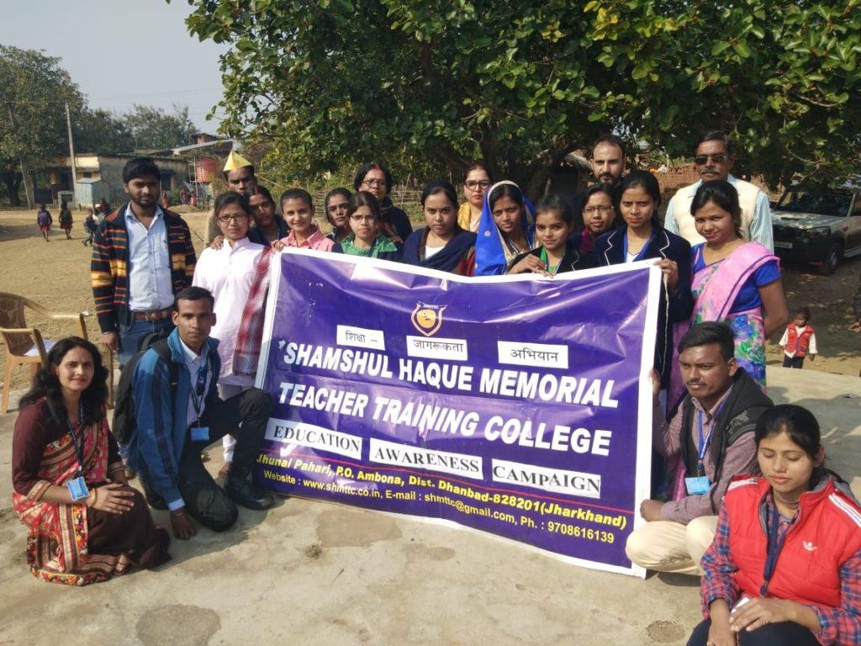
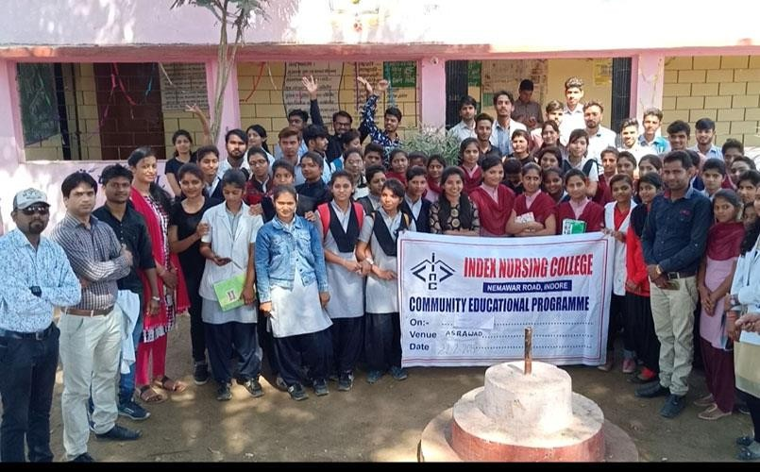
Needed Facilities In Rural Areas
1. Awareness camps need to be conducted

Slide 33
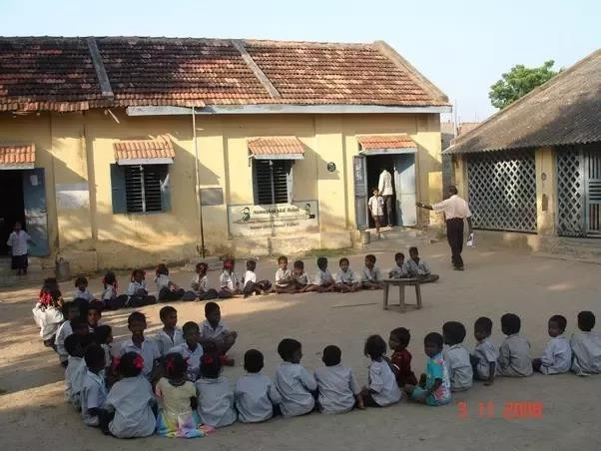
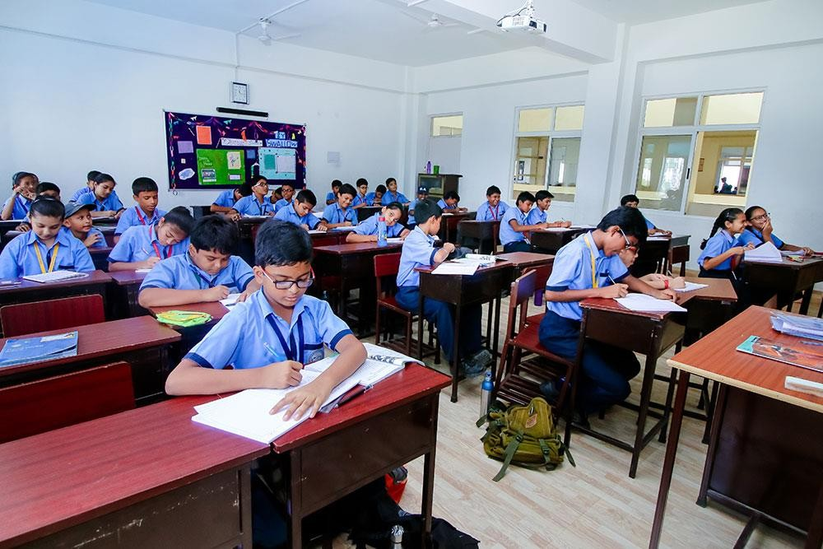
2. Local schools need to established
3. Infrastructure need to be developed

Slide 34
Description of the Community awareness programs conducted with respect to the problems and their outcomes.
To raise awareness about the lack of access to education services in the community and to promote the short-term and long-term solutions recommended, a community awareness program was conducted. The program was designed to inform community members about the importance of education and to engage them in the process of finding solutions.
We're kicking off with "Read to Succeed" literacy workshops, held weekly in the village community center. Led by students, these workshops feature interactive activities and storytelling sessions to make learning engaging and enjoyable. Our goal is to equip community members with basic reading and writing skills.
Moving forward, our "Education for All" advocacy campaign aims to mobilize support for formal schools and educational infrastructure in the village. Through rallies and collaboration with local leaders, students advocate for policy changes and investment in educational initiatives, emphasizing the transformative power of education.
Empowering villagers with skills in community development and leadership, our "Community Builders" workshops facilitate participatory planning and action planning sessions. By taking ownership of their development priorities, community members drive positive change in their villages..
Lastly, our "Empower Her, Empower All" campaign challenges gender stereotypes and fosters inclusive social norms. Through workshops and community dialogues, students engage villagers in conversations about women's empowerment and the role of men and boys as allies in promoting gender equality.
To reinforce the importance of education and bolster support at home, we will host parental education workshops. These sessions will provide parents with valuable insights into creating a conducive learning environment and offer practical strategies for assisting their children with homework and engaging in educational activities together as a family.
Building a sense of camaraderie and academic support among students, we will establish peer tutoring programs. Older students will mentor and tutor younger peers, sharing their

Slide 35
expertise in subjects where they excel. Through these programs, students will not only improve their academic performance but also cultivate collaborative learning skills.
Recognizing the significance of informed career decisions, we will organize career counseling sessions for students. These sessions will facilitate exploration of various career paths, identification of personal interests and strengths, and insights from guest speakers representing diverse professions. By offering guidance and inspiration, students will be better equipped to navigate their future career choices.
To address financial barriers to education, we will launch scholarship and financial aid awareness campaigns. Through workshops and informational sessions, students will learn about available scholarships, grants, and financial aid opportunities, along with guidance on application processes and eligibility criteria.
Embracing the digital age, we will introduce digital literacy programs to equip students with essential digital skills. These programs will cover basic computer literacy, internet safety, and online research skills. Access to digital resources and technologies will enhance learning outcomes and empower students in an increasingly digital world.
Recognizing the importance of inclusive education, we will advocate for special education inclusion initiatives. Training sessions for teachers, awareness campaigns, and peer support programs will promote acceptance, understanding, and inclusion within the school community, ensuring that all students receive the support they need to thrive academically and socially.

Slide 36
Report of the mini–project work done on Education and Dropout Rate in the Community.
A mini-project report typically includes the following sections:
Introduction:
This report addresses high dropout rates in a village with inadequate educational resources, aiming to propose solutions for improved educational outcomes.
Objectives:
Identify dropout causes, assess educational facilities, explore socioeconomic impacts, propose strategies.
Literature Review:
Reviews factors influencing dropout rates, such as socioeconomic status and school infrastructure, based on existing research.
Methodology:
Uses surveys and interviews to collect data from community members and professionals on education and dropout issues.
Results:
Highlights high dropout rates, economic barriers, and challenges in educational infrastructure and resources.
Discussion:
Interprets findings, compares with literature, emphasizes the need for infrastructure improvement and community engagement.
Conclusion:
Urges action to reduce dropout rates through infrastructure upgrades, awareness programs, and policy support.

Slide 37
Recommendations:
Suggests further research, infrastructure investment, community involvement, and policy advocacy for improved educational outcomes.
References:
Lists all sources cited in the report for verification.
Appendices:
Includes survey questionnaires, interview transcripts, and additional data supporting findings.

Slide 38
Introduction:
This report documents "Education and Dropout Rate" project, which aims to address the educational challenges faced by a small village experiencing high dropout rates. The project seeks to identify the underlying causes of this issue and develop strategies to improve student retention and educational outcomes.
The purpose of this report is to provide a comprehensive overview of the activities undertaken, methodologies employed, and results achieved during the mini-project. The community in focus has been struggling with inadequate educational facilities and resources, prompting the need for this initiative to create sustainable educational solutions.
Objectives:
The objectives of the mini project were as follows:
To identify the challenges faced by the community members in accessing quality education.
To assess the quality and availability of existing educational facilities in the community.
To identify the economic and social factors that impact student retention and dropout rates.
To explore potential solutions to address the challenges faced by the community members in accessing education.
To recommend short-term and long-term strategies to improve educational facilities and reduce dropout rates in the community.
The research questions that guided the mini-project were:
What are the challenges faced by the community members in accessing quality education?
How adequate are the existing educational facilities in the community?
What economic and social factors impact student retention and dropout rates in the community?

Slide 39
What potential solutions exist to address the challenges faced by the community members in accessing education?
What short-term and long-term strategies can be recommended to improve educational facilities and reduce dropout rates in the community?
The overall goal of the mini-project was to identify solutions to improve the educational facilities in the community and ensure that its students have access to quality education.
Literature Review:
The literature review for the mini-project "The Path to Knowledge: Reducing the Dropout Rate" explores key concepts and previous research related to education, student retention, and dropout prevention strategies. The review underscores the significance of accessible and adequate educational facilities in promoting student success and retention. Studies consistently highlight that proximity to quality education directly correlates with improved academic outcomes, particularly in rural and underserved areas.
Research indicates that educational accessibility is influenced by various economic and social factors, including income levels, parental education, and availability of transportation. Socioeconomic disparities significantly impact educational equity, with lower-income communities experiencing greater barriers to accessing quality education. Community-based educational initiatives and public policies play a crucial role in addressing these disparities and improving overall educational outcomes.
The literature also emphasizes the importance of community engagement and partnerships in educational development. Collaborative efforts between schools, government agencies, and community organizations are essential for establishing sustainable educational solutions. Asset-based community development approaches have been effective in leveraging local resources and fostering community participation in educational initiatives.
In conclusion, the literature review highlights the complex interplay of factors influencing educational access and retention, underscoring the critical need for tailored, community- centered educational solutions. Effective public policies and intersectoral partnerships are vital for addressing educational disparities and promoting equity within communities.

Slide 40
Methodology:
The methodology used for the mini-project involved both primary and secondary data collection. The primary data was collected through surveys and interviews conducted with members of the community, while the secondary data was gathered through a review of relevant literature on the topic.
The survey was conducted with a sample size of 100 individuals selected randomly from the community. The survey questionnaire was designed to collect information on the demographics of the participants, their awareness of the educational situation in the community, and their suggestions for improving educational services in the area.
In addition to the survey, interviews were conducted with teachers and educational professionals in nearby cities who had experience working in rural areas. The interviews aimed to gather information on the challenges faced by educational providers in the community and potential solutions to the problems.
The collected data was then analysed using descriptive statistics, including frequency tables and charts, to identify the most common themes and trends in the responses.
Overall, the methodology used in this mini-project aimed to provide a comprehensive understanding of the educational situation in the community and to identify potential solutions that could be implemented to improve access to quality education.
Results:
The following are the main findings of the mini-project:
Lack of Access to Quality Education: The survey results showed that a significant proportion of the community members did not have access to quality education due to the lack of adequate educational facilities. Nearly 65% of the respondents reported that they must travel long distances to access better educational services.
Low Awareness of Educational Importance: The survey results revealed that many people in the community had low awareness of the importance of education. Only 45% of the respondents reported that they had a good understanding of the benefits of education and its role in personal and community development.

Slide 41
High Dropout Rates: The survey results showed that the community experienced high dropout rates, particularly among middle and high school students. Over 50% of the respondents reported that they or someone in their family had dropped out of school before completing their education.
Economic Barriers: The survey indicated that economic barriers, such as the need for children to work to support their families, were a significant factor contributing to high dropout rates. Nearly 60% of the respondents cited financial constraints as a reason for dropping out of school.
Shortage of Qualified Teachers: The interviews conducted with educational professionals revealed a shortage of qualified teachers in the area, which was a significant challenge in providing quality education to the community.
The above findings highlight the urgent need for educational services in the community.
Discussion:
The discussion of the results of the mini-project reveals several important findings. The lack of adequate educational facilities in the community is a major concern and can lead to significant educational disadvantages among the students. This is further compounded by the socioeconomic conditions of the community, which limit their access to quality educational facilities in nearby towns.
One important implication of these findings is the urgent need for the establishment of better educational infrastructure within the community. This would not only provide the students with access to necessary educational resources but would also improve their overall academic performance and future opportunities. Moreover, the lack of quality education is a significant barrier to economic development, as it limits the ability of the community to develop a skilled workforce.
Another important implication of the findings is the need for greater community awareness about the importance of education. The community could benefit from educational programs that provide information about the benefits of education, career opportunities, and the importance of completing school. These programs can be organized in collaboration with educational professionals and organizations to ensure the dissemination of accurate and reliable information.

Slide 42
Finally, the findings of the mini-project highlight the need for greater government support and intervention in the community. The government could provide financial and logistical support for the establishment of educational facilities and awareness programs. Additionally, the government could incentivize qualified teachers to work in the community by offering benefits such as housing allowances, bonuses, or professional development opportunities.
In conclusion, the lack of quality educational facilities in the community has serious implications for the academic and socio-economic future of its residents. The findings of the mini- project highlight the need for urgent action to address this issue through the establishment of better educational infrastructure, greater community awareness, and government support.
Conclusion:
Based on the findings of the mini-project, it can be concluded that the lack of quality educational facilities in the community has led to several educational challenges among the students. The absence of adequate educational resources has made it difficult for students to receive quality education, leading to high dropout rates and limited future opportunities.The study also revealed that there is a lack of awareness among the residents about the importance of education and the benefits of completing school. This has resulted in higher dropout rates and limited socio-economic development in the community.
Therefore, it is recommended that the concerned authorities take immediate action to improve the educational infrastructure in the community. This would provide the students with access to quality educational resources and improve their academic performance and future opportunities. Additionally, it is recommended that educational awareness campaigns be conducted regularly to educate the residents about the benefits of education and the importance of completing school. This would help in reducing dropout rates and promoting overall educational development in the community.
In conclusion, improving educational infrastructure and conducting educational awareness campaigns are essential steps that need to be taken to improve the educational outcomes in the community. The findings of this mini-project underscore the urgent need for action to address the educational challenges faced by the students.

Slide 43
Recommendations:
Based on the findings and implications of the mini-project, the following recommendations are suggested:
Conduct further research to identify the reasons behind the high dropout rates and find solutions to overcome the identified barriers.
The concerned authorities should take necessary steps to establish better educational infrastructure in the community to ensure better access to quality education.
Awareness campaigns should be conducted to educate the community members about the importance of education and the benefits of completing school.
Special focus should be given to providing financial support and scholarships to students from low-income families to reduce economic barriers to education.
The involvement of the community in the planning and implementation of educational programs can be ensured by creating community-based educational committees.
Proper training and support should be provided to the teachers to improve the quality of education provided to the students.
The government should allocate sufficient funds for the development of educational infrastructure in rural and remote areas to ensure equal access to quality education for all.
By implementing these recommendations, the community can ensure better access to quality education and improve the overall educational outcomes for its students.
References:
Here are some websites related to the topic of "Community Service Report on Education and Dropout rate":
1. UNESCO (United Nations Educational, Scientific and Cultural Organization.) - Education: https://en.unesco.org/themes/education

Slide 44



Organization for Economic Co-operation and Development (OECD) - Education:
https://www.oecd.org/education
National Center for Education Statistics (NCES) - Dropout Rates: https://nces.ed.gov
National Council of Educational Research and Training (NCERT): https://ncert.nic.in
Centre for Civil Society (CCS) - Education Reform in India: https://ccs.in
Right of Children to Free and Compulsory Education Act - https://en.wikipedia.org/wiki/Right_of_Children_to_Free_and_Compulsory_Education_Act,_2 009
Appendices:
Farming Others Unemployed
4.1
23.6
72.3
OCCUPATION

Slide 45




GENDER
Male Female
51
49
EDUCATION PROGRESS
Educating Uneducating
47.7
52.3

Slide 46





INTREST IN EDUCATION
Yes No May be
13.3
7.1
79.6
PLACE OF EDUCATION
Within the village Out of the village
33.8
66.2

Slide 47








INFRASTRUCTURE IN VILLAGE
Good Average Bad
22.8
42.6
34.6
DROPOUT REASONS
Financial Transpotation Health Issues Education Facilities Others
6.9
24.8
33.8
14.9
19.6

Slide 48
CHAPTER 6: RECOMMENDATIONS AND CONCLUSIONS OF THE MINI-PROJECT
Based on the findings of the mini project on the education and dropout rate in the community, the following recommendations and conclusions can be made:
Recommendations:
Enhance Educational Infrastructure:
The primary recommendation is to enhance the educational infrastructure within the community. This involves developing and improving educational facilities to create a conducive learning environment, ensuring that schools are equipped with modern educational tools, resources, and qualified teachers.
Implement Mentorship Programs:
Implementing mentorship and counseling programs is also crucial to support students both academically and emotionally, offering guidance on career paths and the significance of education.
Increase Community Engagement:
Increasing community engagement is essential for fostering stronger relationships between schools, parents, and the community. This can be achieved by organizing community events and workshops to highlight the value of education.
Address Socioeconomic Barriers:
Addressing socioeconomic barriers is another key recommendation. Providing financial support and scholarships to students from low-income families, introducing school meal programs, and offering free transportation can significantly reduce the financial burden on families.
Strengthen Early Childhood Education:
Strengthening early childhood education is necessary to ensure children are well-prepared for primary school. This involves investing in early childhood education programs and encouraging enrollment in pre-school and kindergarten programs.

Slide 49
Tailored Interventions for At-Risk Students:
For students at risk of dropping out, tailored interventions should be provided. This includes offering additional tutoring, after-school programs, and support services to keep them engaged in their education.
Promote Inclusive Education:
Promoting inclusive education is vital to ensure that education is accessible to all children, including those with disabilities. Implementing policies and practices that support diversity and inclusion in schools can help achieve this goal.
Improve Teacher Training and Retention:
Finally, improving teacher training and retention is critical. Investing in continuous professional development for teachers and creating incentives and support systems can help retain qualified teachers in the community.
Conclusions:
High Dropout Rates:
The mini project identified a high dropout rate among students in the community, indicating a critical issue that needs to be addressed.
Inadequate Educational Resources:
The schools in the community lack adequate resources and infrastructure, which hampers the quality of education.
Socioeconomic Challenges:
Many students face socioeconomic challenges that impact their ability to stay in school, such as financial constraints and lack of support at home.
Low Community Involvement:
There is also a low level of community involvement and awareness regarding the importance of education, contributing to higher dropout rates.

Slide 50
Insufficient Support for At-Risk Students:
Additionally, students at risk of dropping out do not receive enough support and intervention to keep them engaged in their education.
In conclusion, the high dropout rate in the community is a significant challenge that requires immediate attention. Enhancing educational infrastructure, implementing mentorship programs, increasing community engagement, addressing socioeconomic barriers, strengthening early childhood education, providing tailored interventions for at-risk students, promoting inclusive education, and improving teacher training and retention are crucial recommendations to tackle this issue. By addressing these challenges, the community can improve educational outcomes and reduce dropout rates, thereby fostering a better future for its youth.

Slide 51
Student Self-Evaluation for the Community Service Project
Student Name: M.Sreeram
Registration No: 23761A4236
Period of CSP: From:
To:
Date of Evaluation:
Please rate our performance in the following areas:
Rating Scale: Letter grade of CGPA calculation to be provided
1 | Oral communication | 1 | 2 | 3 | 4 | 5
2 | Written communication | 1 | 2 | 3 | 4 | 5
3 | Proactiveness | 1 | 2 | 3 | 4 | 5
4 | Interaction ability with community | 1 | 2 | 3 | 4 | 5
5 | Positive Attitude | 1 | 2 | 3 | 4 | 5
6 | Self-confidence | 1 | 2 | 3 | 4 | 5
7 | Ability to learn | 1 | 2 | 3 | 4 | 5
8 | Work Plan and organization | 1 | 2 | 3 | 4 | 5
9 | Professionalism | 1 | 2 | 3 | 4 | 5
10 | Creativity | 1 | 2 | 3 | 4 | 5
11 | Quality of work done | 1 | 2 | 3 | 4 | 5
12 | Time Management | 1 | 2 | 3 | 4 | 5
13 | Understanding the Community | 1 | 2 | 3 | 4 | 5
14 | Achievement of Desired Outcomes | 1 | 2 | 3 | 4 | 5
15 | OVERALLPERFORMANCE | 1 | 2 | 3 | 4 | 5
Date:
Signature of the Student

Slide 52
Student Self-Evaluation for the Community Service Project
Student Name: S.Narendra Kumar
Registration No: 23761A4257
Period of CSP: From:
To:
Date of Evaluation:
Please rate our performance in the following areas:
Rating Scale: Letter grade of CGPA calculation to be provided
1 | Oral communication | 1 | 2 | 3 | 4 | 5
2 | Written communication | 1 | 2 | 3 | 4 | 5
3 | Proactiveness | 1 | 2 | 3 | 4 | 5
4 | Interaction ability with community | 1 | 2 | 3 | 4 | 5
5 | Positive Attitude | 1 | 2 | 3 | 4 | 5
6 | Self-confidence | 1 | 2 | 3 | 4 | 5
7 | Ability to learn | 1 | 2 | 3 | 4 | 5
8 | Work Plan and organization | 1 | 2 | 3 | 4 | 5
9 | Professionalism | 1 | 2 | 3 | 4 | 5
10 | Creativity | 1 | 2 | 3 | 4 | 5
11 | Quality of work done | 1 | 2 | 3 | 4 | 5
12 | Time Management | 1 | 2 | 3 | 4 | 5
13 | Understanding the Community | 1 | 2 | 3 | 4 | 5
14 | Achievement of Desired Outcomes | 1 | 2 | 3 | 4 | 5
15 | OVERALLPERFORMANCE | 1 | 2 | 3 | 4 | 5
Date:
Signature of the Student

Slide 53
Student Self-Evaluation for the Community Service Project
Student Name: B.Nitheesh kumar
Registration No: 23761A4207
Period of CSP: From:
To:
Date of Evaluation:
Please rate our performance in the following areas:
Rating Scale: Letter grade of CGPA calculation to be provided
1 | Oral communication | 1 | 2 | 3 | 4 | 5
2 | Written communication | 1 | 2 | 3 | 4 | 5
3 | Proactiveness | 1 | 2 | 3 | 4 | 5
4 | Interaction ability with community | 1 | 2 | 3 | 4 | 5
5 | Positive Attitude | 1 | 2 | 3 | 4 | 5
6 | Self-confidence | 1 | 2 | 3 | 4 | 5
7 | Ability to learn | 1 | 2 | 3 | 4 | 5
8 | Work Plan and organization | 1 | 2 | 3 | 4 | 5
9 | Professionalism | 1 | 2 | 3 | 4 | 5
10 | Creativity | 1 | 2 | 3 | 4 | 5
11 | Quality of work done | 1 | 2 | 3 | 4 | 5
12 | Time Management | 1 | 2 | 3 | 4 | 5
13 | Understanding the Community | 1 | 2 | 3 | 4 | 5
14 | Achievement of Desired Outcomes | 1 | 2 | 3 | 4 | 5
15 | OVERALLPERFORMANCE | 1 | 2 | 3 | 4 | 5
Date:
Signature of the Student

Slide 54
Student Self-Evaluation for the Community Service Project
Student Name: G.Seshagiri Rao
Registration No: 23761A4223
Period of CSP: From: To:
Date of Evaluation:
Please rate our performance in the following areas:
Rating Scale: Letter grade of CGPA calculation to be provided
1 | Oral communication | 1 | 2 | 3 | 4 | 5
2 | Written communication | 1 | 2 | 3 | 4 | 5
3 | Proactiveness | 1 | 2 | 3 | 4 | 5
4 | Interaction ability with community | 1 | 2 | 3 | 4 | 5
5 | Positive Attitude | 1 | 2 | 3 | 4 | 5
6 | Self-confidence | 1 | 2 | 3 | 4 | 5
7 | Ability to learn | 1 | 2 | 3 | 4 | 5
8 | Work Plan and organization | 1 | 2 | 3 | 4 | 5
9 | Professionalism | 1 | 2 | 3 | 4 | 5
10 | Creativity | 1 | 2 | 3 | 4 | 5
11 | Quality of work done | 1 | 2 | 3 | 4 | 5
12 | Time Management | 1 | 2 | 3 | 4 | 5
13 | Understanding the Community | 1 | 2 | 3 | 4 | 5
14 | Achievement of Desired Outcomes | 1 | 2 | 3 | 4 | 5
15 | OVERALLPERFORMANCE | 1 | 2 | 3 | 4 | 5
Date:
Signature of the Student
Student Self-Evaluation for the Community Service Project

Slide 55
Evaluation by the Person In-charge in the Community/Habitation
Student Registration No:
Period of CSP:
From: To:
Date of Evaluation:
Name of the Person In-charge:
Address with Mobile number:
Please rate the student’s performance in the following areas:
Please note that your evaluation shall be done independent of the
Student’s self-evaluation
Rating Scale: 1 is lowest and 5 is highest rank
1 | Oral communication | 1 | 2 | 3 | 4 | 5
2 | Written communication | 1 | 2 | 3 | 4 | 5
3 | Proactiveness | 1 | 2 | 3 | 4 | 5
4 | Interaction ability with community | 1 | 2 | 3 | 4 | 5
5 | Positive Attitude | 1 | 2 | 3 | 4 | 5
6 | Self-confidence | 1 | 2 | 3 | 4 | 5
7 | Ability to learn | 1 | 2 | 3 | 4 | 5
8 | Work Plan and organization | 1 | 2 | 3 | 4 | 5
9 | Professionalism | 1 | 2 | 3 | 4 | 5
10 | Creativity | 1 | 2 | 3 | 4 | 5
11 | Quality of work done | 1 | 2 | 3 | 4 | 5
12 | Time Management | 1 | 2 | 3 | 4 | 5
13 | Understanding the Community | 1 | 2 | 3 | 4 | 5
14 | Achievement of Desired Outcomes | 1 | 2 | 3 | 4 | 5
15 | OVERALLPERFORMANCE | 1 | 2 | 3 | 4 | 5
Date:
Signature of the Supervisor

Slide 56
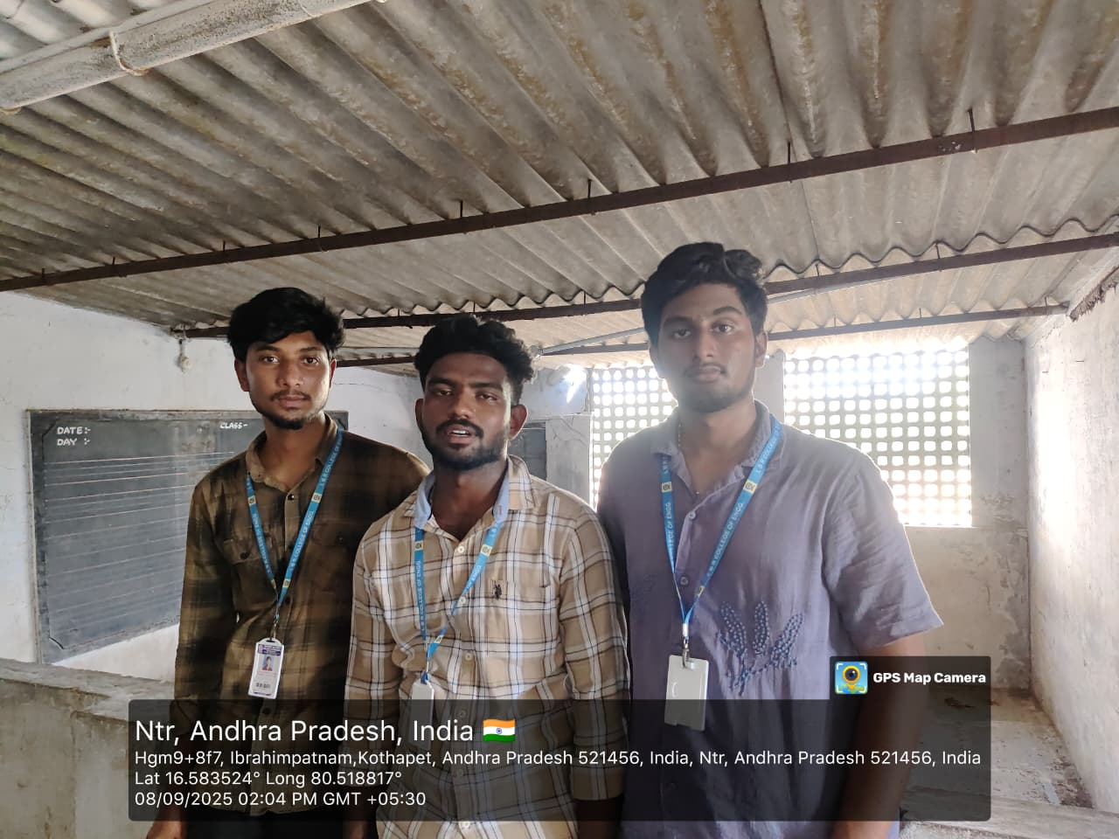
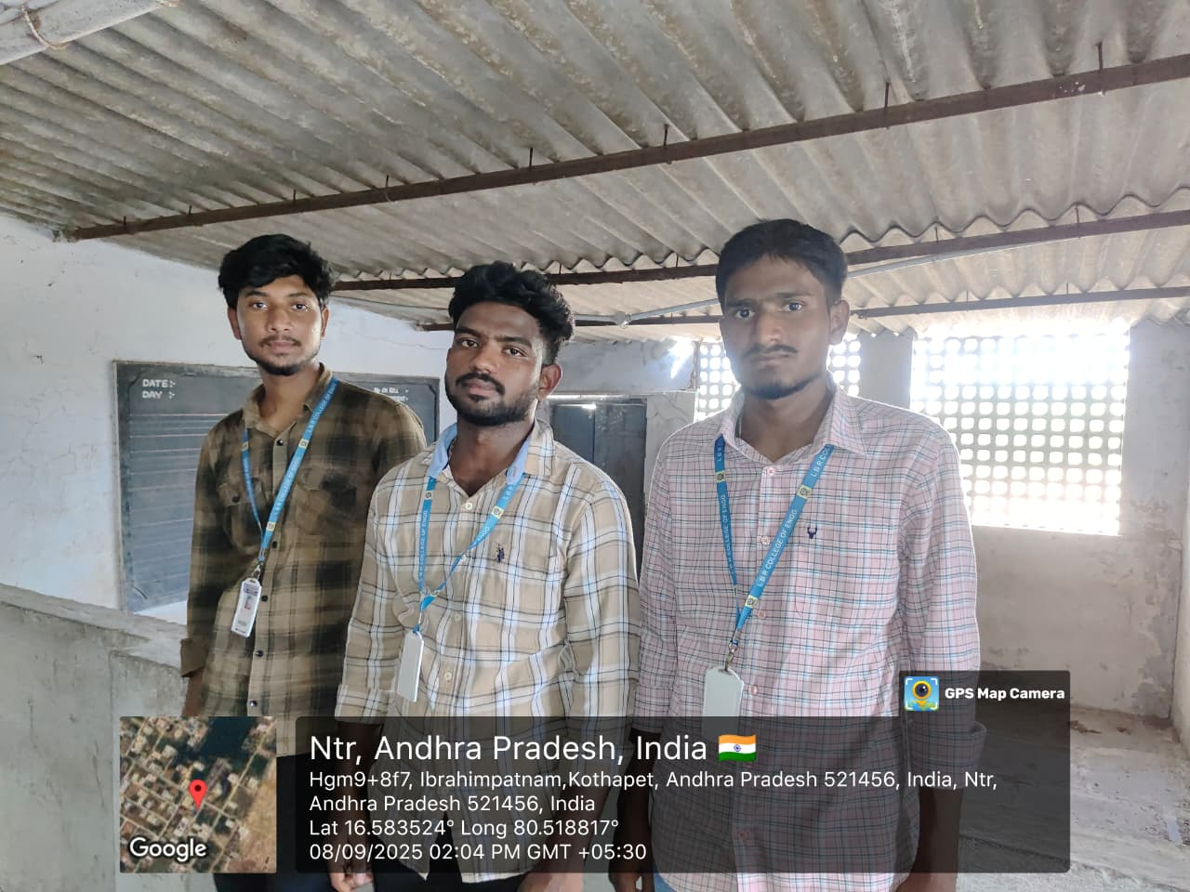
Photos And Details
Figure 1: Team Members Surveying In the school
Figure 2: Team Engaging and Waiting for the students

Slide 57
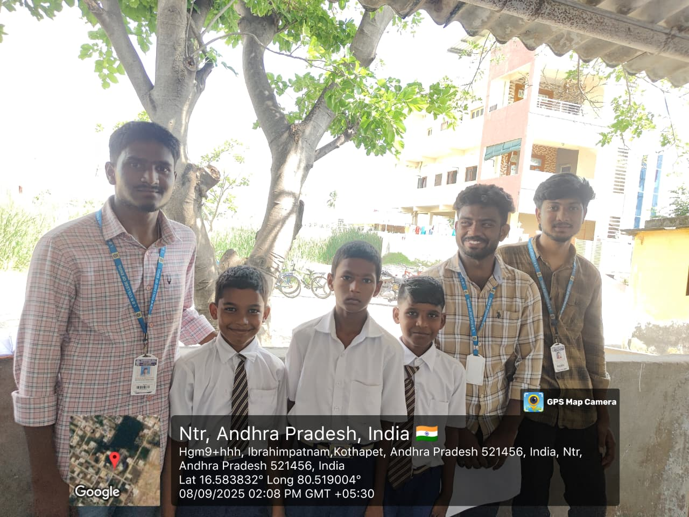
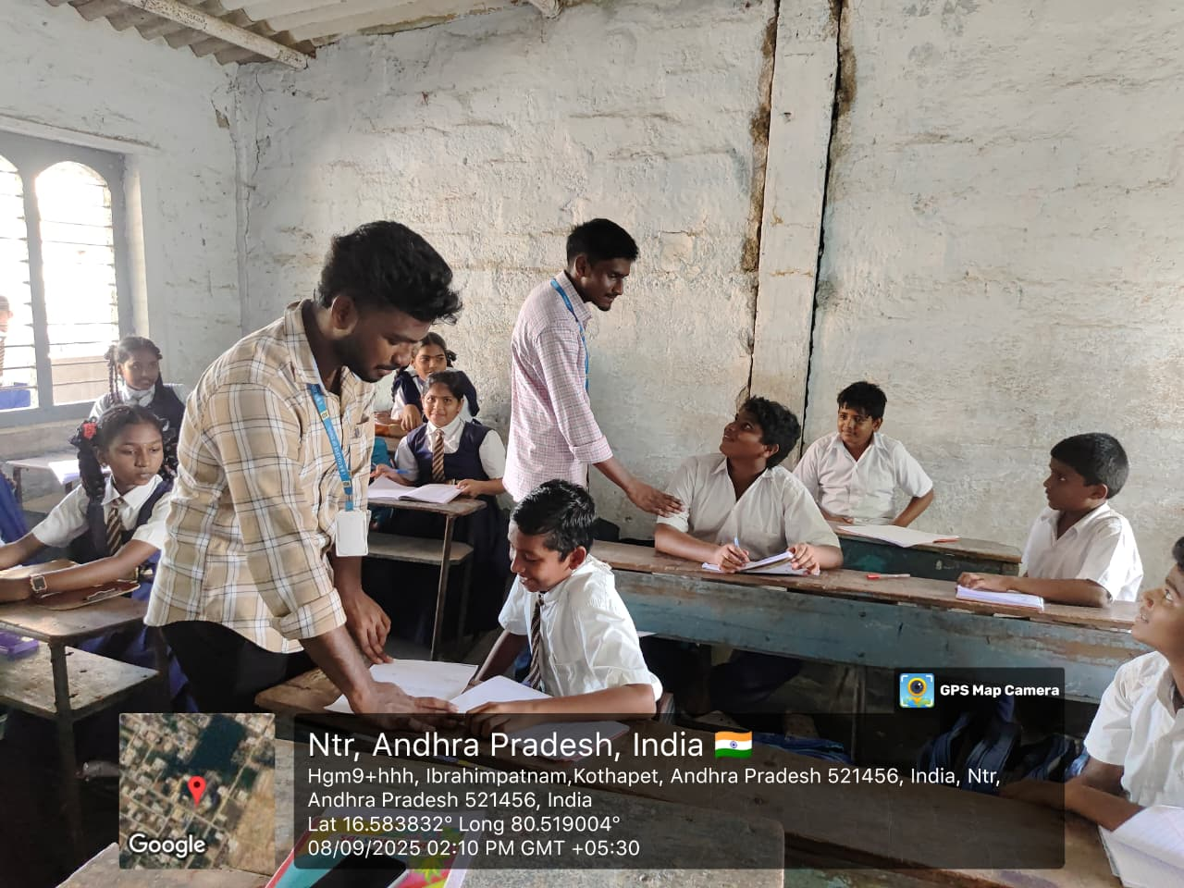
Figure 3: Collecting Information from Students
Figure 4: Interviewing Students about School Dropout Factors

Slide 58
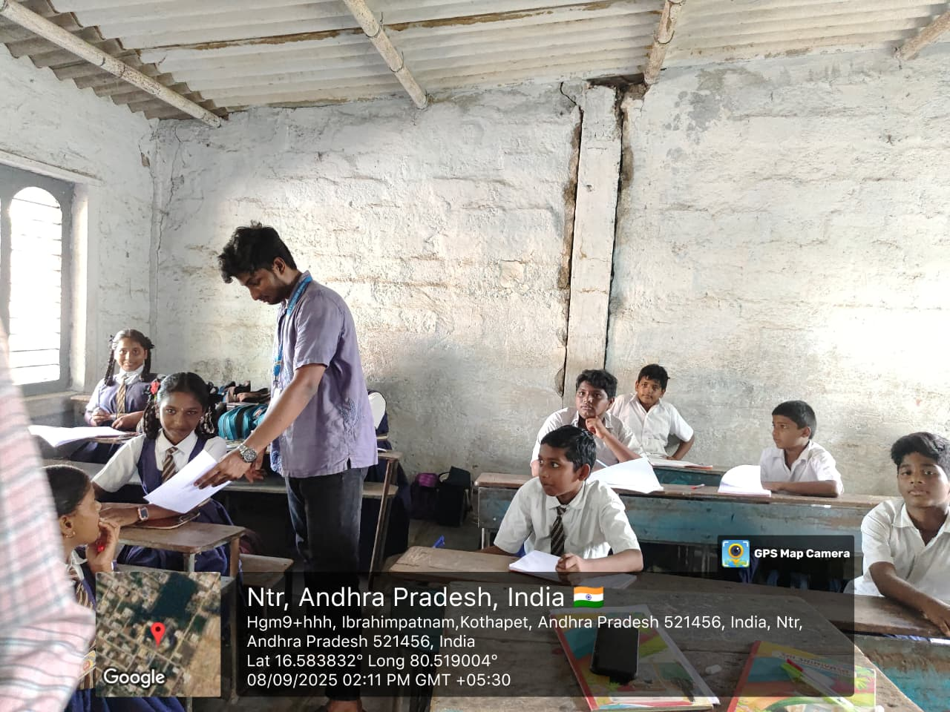
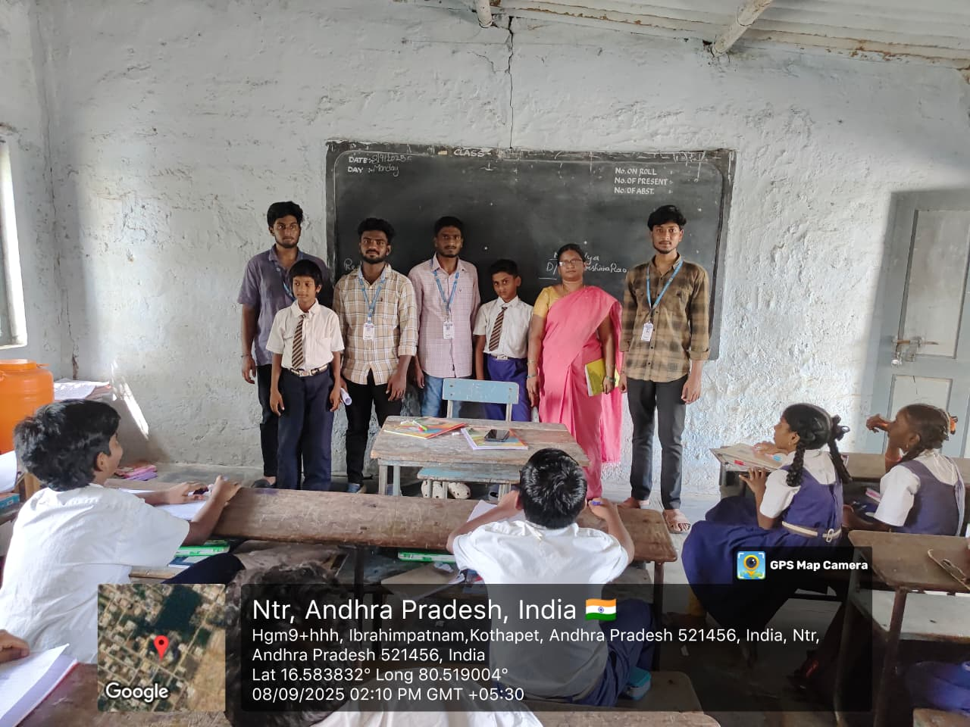
Figure 5: Gathering Data form the students
Figure 6: Team Documenting Responses from the teacher and students

Slide 59
64

