Slide 1
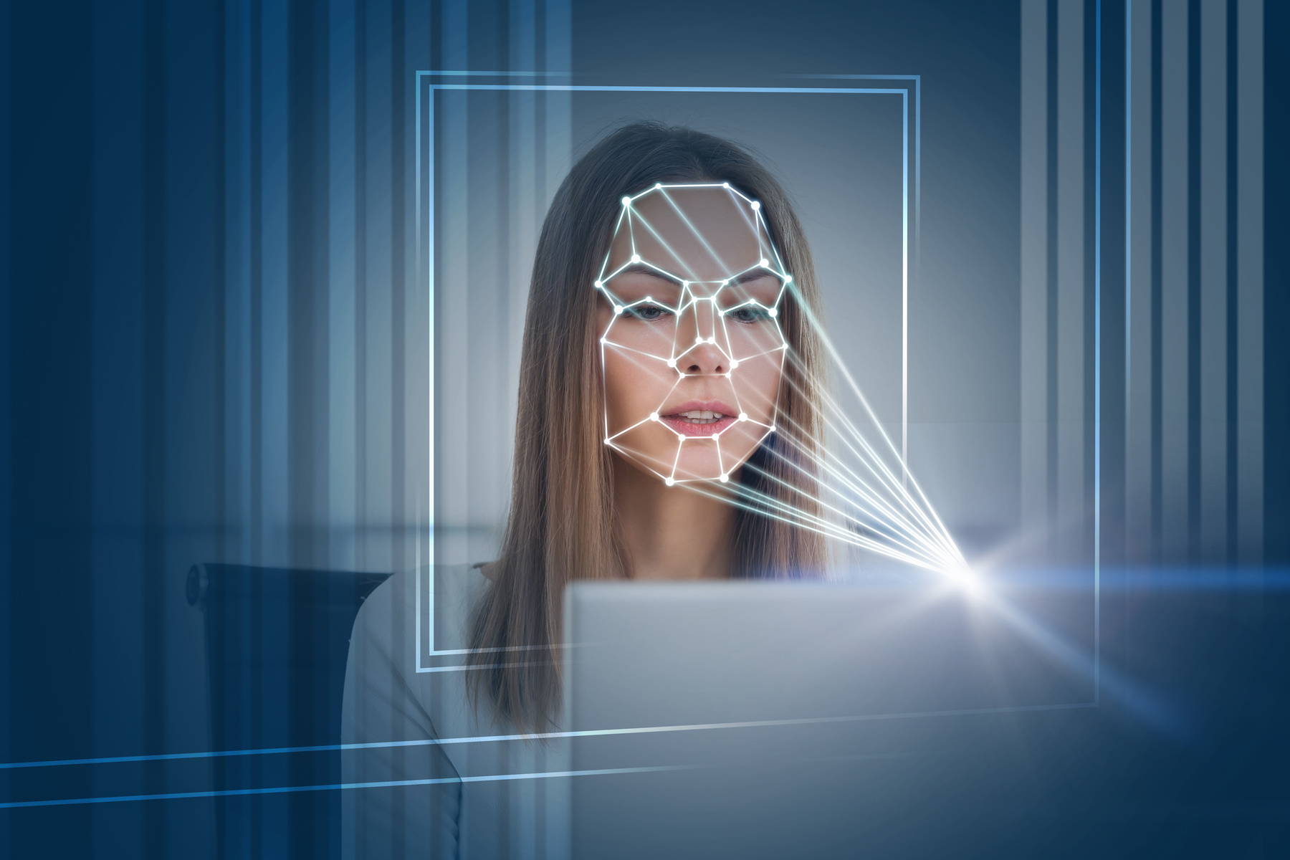
SHAWK
SMART INDIA HACKATHON 2025
Automated Biometric Attendance System
Enhancing rural education with face recognition and Biometric technology
SREERAM | ROHITH | KEERTHAN | SRILATHA | LIKHITHA | AASIMA

Slide 2
Addressing Attendance Challenges in Rural Schools: Key Concepts
Many rural schools face high absenteeism rates affecting student learning and progress.
Manual attendance methods are time-consuming and prone to errors, reducing efficiency.
Lack of technology integration leads to inequitable access to educational resources and support.
A reliable attendance system can enhance student accountability and engagement in rural education.

Slide 3
Objectives of the Automated Attendance System
Improve attendance rates through reliable tracking of student presence.
Ensure accurate records by minimizing human error in attendance management.
Enhance student engagement with a modern, tech-driven approach to attendance.
Foster a secure learning environment through biometric verification for all students.

Slide 4
Proposed Biometric Attendance System Overview
Our system aims to enhance attendance tracking in rural schools through an automated biometric and face recognition solution, ensuring accuracy and efficiency.
Simplified Attendance Process
Enhanced Accuracy
User-Friendly Interface
The biometric system will streamline attendance by automating the check-in/check-out process, reducing manual errors and saving time for teachers.
By utilizing advanced face recognition technology, our system ensures that attendance records are accurate and eliminates proxy attendance, enhancing accountability.
The system features an intuitive interface for both educators and students, making it easy to navigate and access attendance data without technical expertise.

Slide 5
Key Features of Our System
High Accuracy
Time Efficiency
User-Friendly Interface
Secured Data
Our Automated Biometric & Face Recognition system ensures precision in attendance tracking, minimizing errors and providing reliable data for rural schools. This technology significantly enhances the accountability of student attendance.
With rapid processing capabilities, our system allows for instantaneous attendance marking, reducing the time spent on manual roll calls. This efficiency enables teachers to focus more on instruction rather than administrative tasks.
The system prioritizes data security through encryption and strict access controls, ensuring that student information remains confidential and protected from unauthorized access, thereby building trust within the community.
Designed with simplicity in mind, our interface ensures that both educators and students can navigate easily without extensive training. This fosters a seamless adoption of technology in rural educational environments.

Slide 6
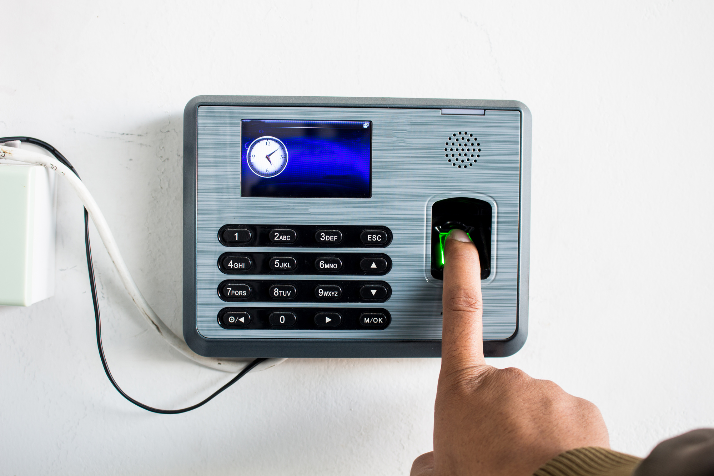
System Architecture of Attendance System
The Automated Biometric & Face Recognition Attendance System utilizes advanced technology to streamline attendance tracking in rural schools. By integrating biometric data and facial recognition algorithms, the system enhances accuracy and efficiency, ensuring that students are accounted for accurately while minimizing administrative workload. This innovative solution aims to transform the educational experience in rural areas.
A streamlined approach to enhanced attendance management and student tracking.

Slide 7
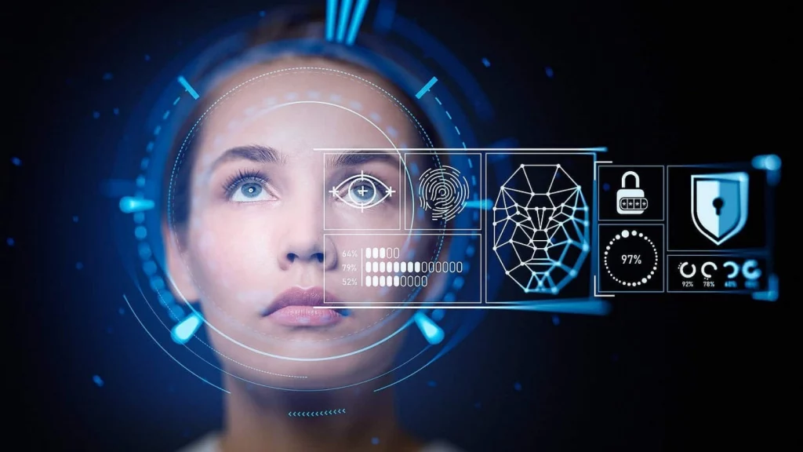
System Architecture of Attendance System
The system uses ML-based face recognition with biometric backup to record student attendance. Data is first stored locally for reliability and later synced to a secure cloud database. Teachers and admins can track attendance via dashboards, while parents receive instant SMS/WhatsApp updates. This ensures accuracy, transparency, and easy adoption in rural schools
Smart ML-powered Attendance – Accurate, Reliable, and Ready for Rural Schools

Slide 8
Implementation Plan: Steps for Deployment and Integration in Schools
Conducting thorough needs assessment to tailor the system to local requirements.
Collaborating with school authorities to ensure smooth integration and support.
Training staff and students on operating the biometric and face recognition system.
Regular monitoring and feedback collection to enhance system effectiveness and user experience.

Slide 9
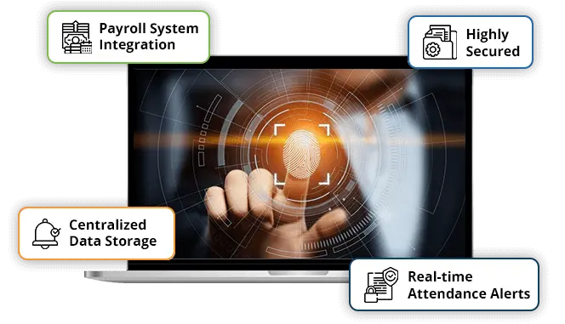
Use Cases for Biometric Attendance
The Automated Biometric & Face Recognition Attendance System offers practical applications in rural schools. For instance, it streamlines the attendance process, eliminating manual errors and reducing time spent on roll calls. This system can also enhance security by accurately identifying students, thus preventing unauthorized access. Additionally, it enables teachers to monitor attendance patterns, helping to identify students with frequent absences and providing timely interventions. Such a system not only simplifies administrative tasks but also fosters a more secure and efficient learning environment.

Slide 10
Benefits of the Automated System
Increased Attendance
Reduced Manual Errors
Fast Tracking
Enhanced Security
The use of biometric technology allows for rapid attendance recording, enabling schools to efficiently manage large student populations without delays or interruptions during classes.
The automated biometric and face recognition system ensures higher student attendance by simplifying the check-in process, making it more efficient and user-friendly for students in rural schools.
By automating attendance tracking, the system minimizes human error, ensuring accurate records and reducing discrepancies that can arise with traditional manual methods.
With biometric identification, the system provides secure access control to school facilities, ensuring that only authorized individuals can enter and interact with students, thus enhancing overall safety.

Slide 11

Challenges and Solutions Overview
Implementing an Automated Biometric & Face Recognition Attendance System in rural schools presents several challenges. One major obstacle is the lack of reliable internet connectivity, which can hinder real-time data processing. Another issue is the resistance to new technology among educators and administrators. To mitigate these problems, we propose offline functionality for attendance tracking and provide comprehensive training sessions. Engaging local stakeholders can also foster acceptance and ensure successful adoption of the system in rural communities.

Slide 12
Future Enhancements: Upgrades for an Efficient Attendance System
Integration of AI algorithms for improved recognition accuracy and speed.
Development of a mobile app for real-time attendance tracking and notifications.
Incorporation of data analytics to monitor attendance trends and improve engagement.
Implementation of multi-language support to cater to diverse rural communities.

Slide 13
Conclusion: Key Takeaways and Call to Action
Our Automated Biometric & Face Recognition Attendance System promises to revolutionize attendance management in rural schools, enhancing efficiency and accuracy.
Key Takeaway 1
Key Takeaway 2
Call to Action
The system significantly reduces administrative burden, ensuring that teachers can focus more on education rather than attendance tracking.
Implementing this technology will enhance school attendance rates, leading to improved educational outcomes and community engagement.
Join us in transforming rural education - support our initiative by collaborating or providing resources for implementation. Let's make a difference together!

Slide 14

Frontend developed and deployed with user-friendly dashboards, training modules, and real-time alert screens.”

Slide 15

Thank You for Your Attention and support !
CONNECT WITH US FOR MORE INFORMATION AND UPDATES!
CSE(AI & ML)
LBRCE
MYLAVARAM

