Slide 1
ECG Interfacing
Section : ‘D’
Semester : IV
Team :
1.Mukta V Satish
2.Sreesha S Kuruvadi

Slide 2
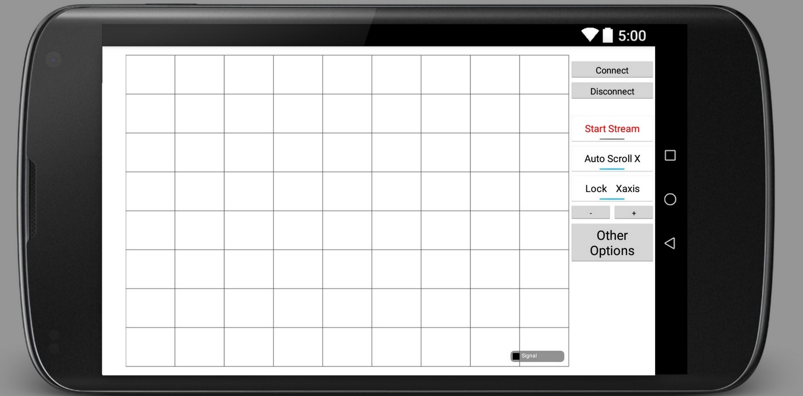
Graph View

Slide 3
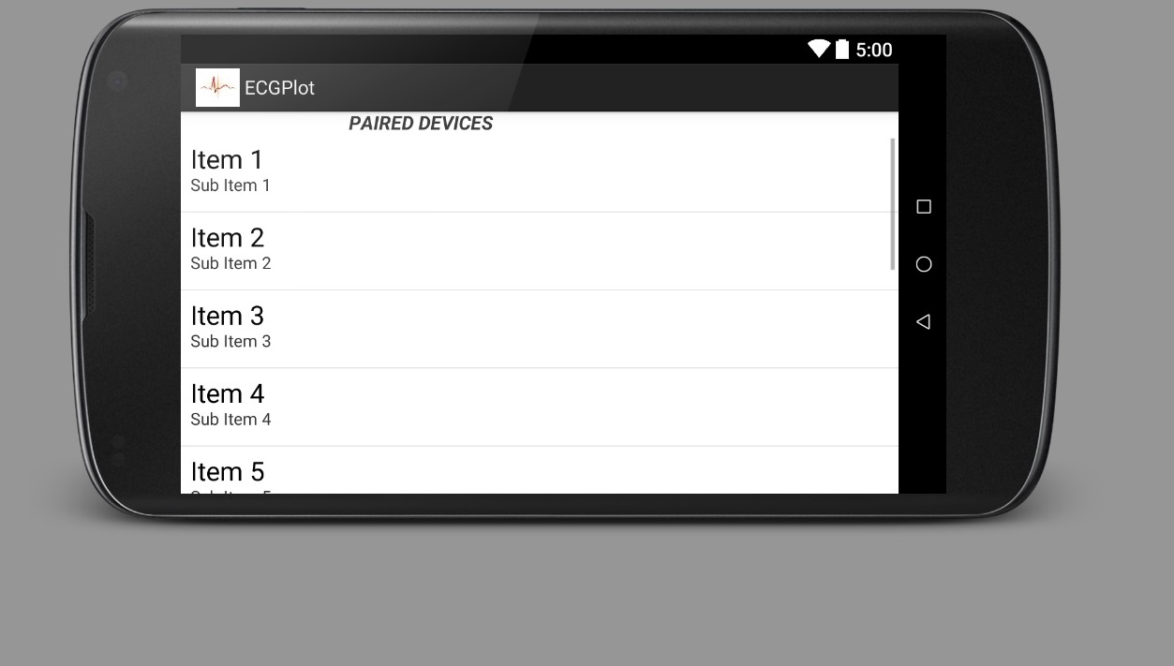
Item List For Paired Devices

Slide 4
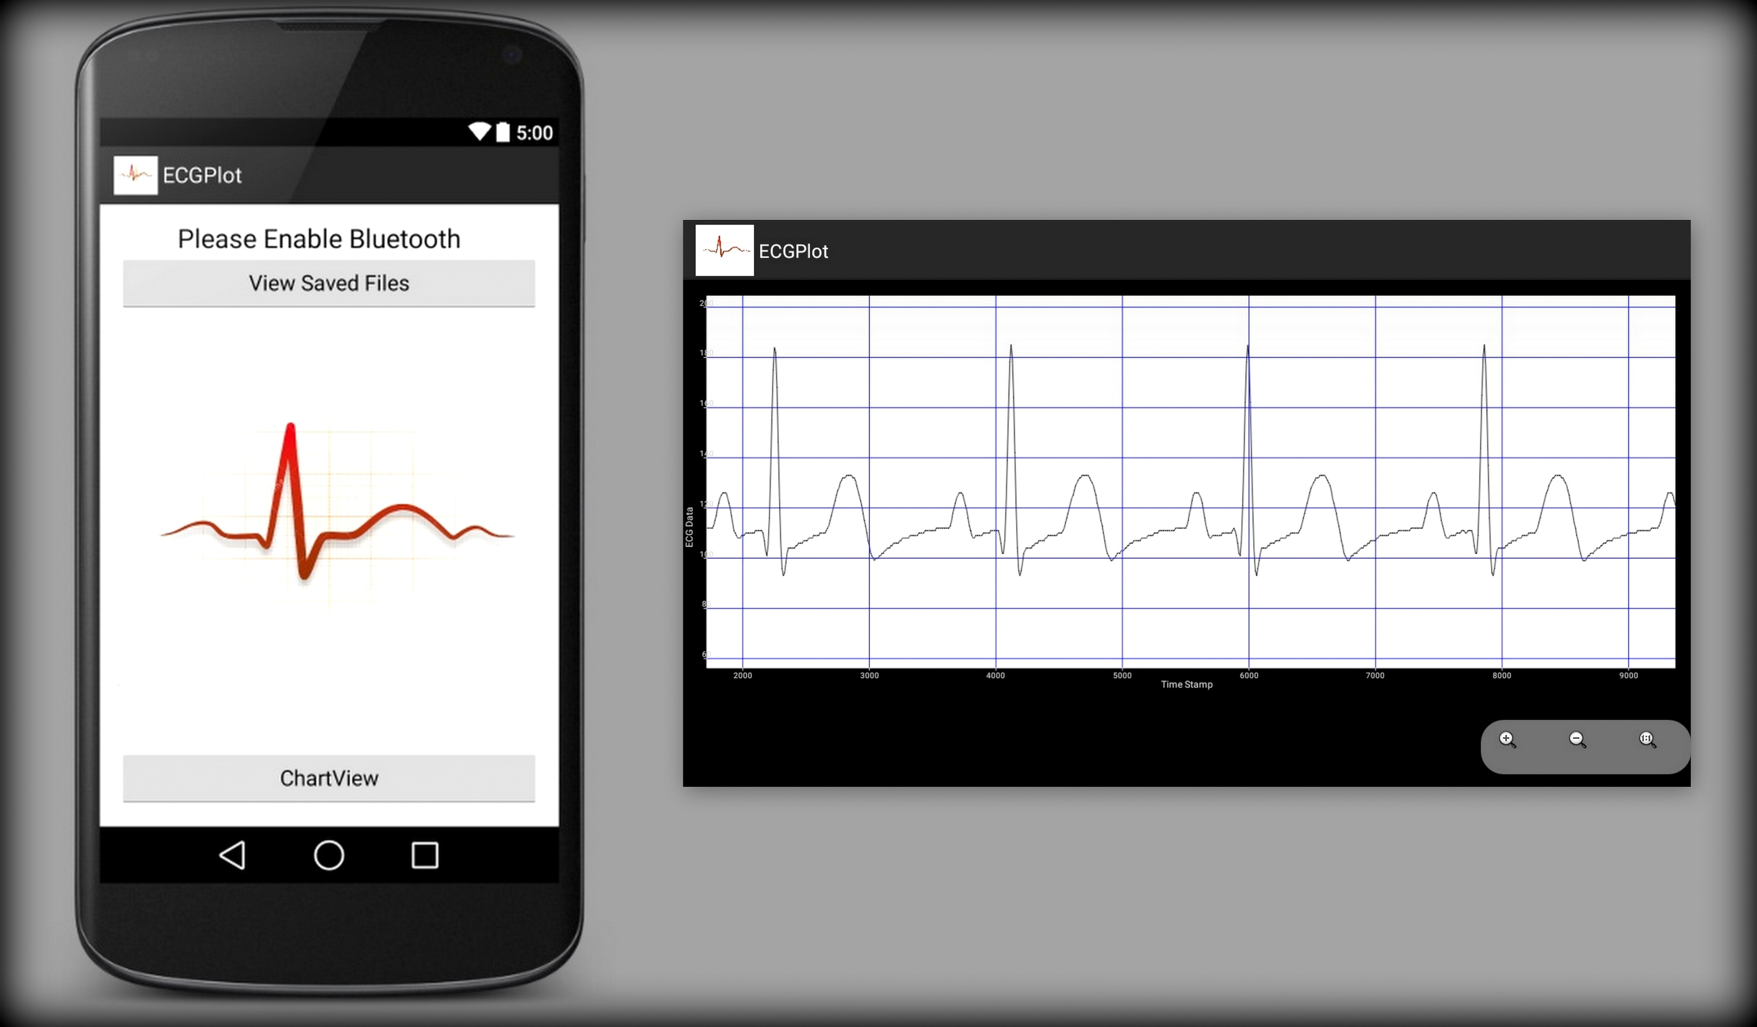
Graph to View Saved Files

