Slide 1
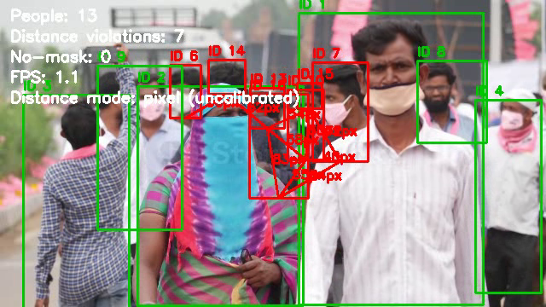
MSc PROGRESS MEETING · WEEK S2
Deep Learning Based Real-Time Face Mask Detection and Social Distance Analysis in Surveillance Environments
Improving and rigorously evaluating a COVID-era surveillance pipeline.
Live prototype output (this project)
Sreeshanth Sivanantham
MSc Advanced Computer Science (Artificial Intelligence)
Supervisor: Sebastian Ordyniak
COMP5200M · University of Leeds · 30 June 2026
Notes:
Open by stating the title and that this is the Week S2 progress meeting. Make the one-line framing: the topic is fixed and dated, so the value is in improving and rigorously evaluating the baseline. Point at the prototype image: 'this already runs.'

Slide 2
1
Aim & Research Question
AIM
RESEARCH QUESTION
Design, implement, and evaluate a real-time system that detects face-mask non-compliance and social-distancing violations from surveillance video, to support safer public environments.
How well do COVID-era mask and distancing pipelines generalise to demographically diverse, real-world surveillance — and can perspective-corrected distancing and bias-aware data measurably improve their reliability?
Notes:
The aim is the system; the research question is what lifts it above a 2021 re-run. Stress 'generalise to diverse populations' and 'measurably improve' — everything in the project becomes evidence for or against this question.

Slide 3
2
The Starting Baseline
Two open-source MIT projects, combined — my cited reference point, not my contribution.
Video feed
›
Person detection
(YOLOv3)
›
Face + mask
(MobileNetV2)
›
Distance
(pixel threshold)
›
Alerts / overlay
The orange stage (pixel-threshold distance) is the baseline's weakest point — see next slide.
Sources: chandrikadeb7/Face-Mask-Detection · saimj7/Social-Distancing-Detection-in-Real-Time (both MIT, cited).
Notes:
Be upfront: this is two public repos stitched together and is my reference, fully cited. Walk left-to-right through the pipeline. Flag the orange box now so the next slide lands.

Slide 4
3
Where the Baseline Falls Short
1
YOLOv3 detector
2
Pixel-threshold distance
3
No person tracking
Outdated — slower and less accurate than current detectors.
No camera calibration; wrong across perspective.
Per-frame only; cannot follow a person over time.
Each gap is a concrete opportunity for an MSc-level contribution.
4
One narrow dataset
5
Privacy not built
Mostly East-Asian faces; untested on others.
Discussed in the report, never implemented.
Notes:
This is the pivot. Don't apologise for the baseline's flaws — they are the project. Name each one quickly; the dark card reframes the whole list as opportunity.

Slide 5
4
My Contributions
Baseline weakness | My contribution
Outdated YOLOv3 | Modern tracked detector (YOLOv8/11 + ByteTrack)
Pixel-threshold distance | Perspective-corrected metric distance (homography → metres)
No tracking | Per-person tracking with violation history
Narrow, biased dataset | Bias-aware cross-dataset evaluation (BAFMD)
Privacy not implemented | Face anonymisation built + honest, rigorous evaluation
Same fixed topic and title — the contribution is depth, method, and rigour, not the subject.
Notes:
Read this as 'for every weakness, here's my fix.' The headline contributions are the perspective-corrected distance and the bias-aware evaluation. Reassure the assessor the title is unchanged.

Slide 6
5
Progress So Far: Working Prototype
Re-implemented as a clean, modular, original pipeline — runs end-to-end.
Person detection + multi-object tracking integrated.
Perspective-corrected distance module built and unit-tested.
Privacy face-blurring implemented.
Runs on CPU today; real-time on GPU.
Prototype output on test footage — tracked people, close-contact violations flagged in red.
Notes:
This is your proof you've moved past planning. Mention you ran it yourself on a Mac. The image is your own output, not the baseline's.

Slide 7
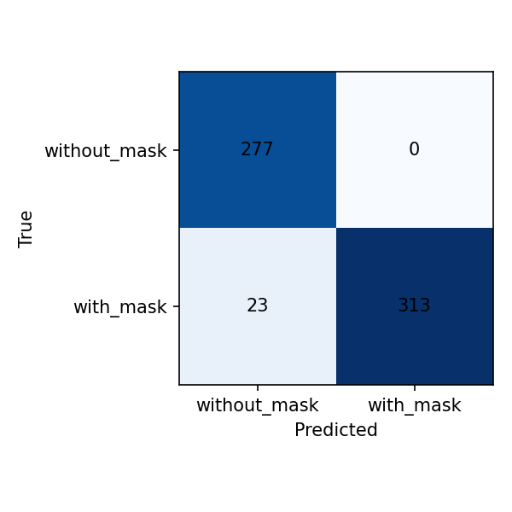
6
Evaluation: Early Result & Plan
96%*
Evaluation plan
Pixel vs perspective distance — controlled before/after.
BAFMD cross-dataset generalisation gap.
FPS measured on stated GPU hardware.
Error analysis: lighting, crowd density, occlusion.
in-dataset accuracy
*optimistic — tested on the model's own training data. Honest cross-dataset numbers are the real target.
Mask classifier, held-out test (613 images).
Notes:
Lead with honesty: the 96% is flattering because it's the model's own data. That candour signals maturity. The plan slide shows you know what a real evaluation looks like.

Slide 8
7
Responsible Use & Ethics
A
Bias, quantified
B
Privacy by design
Measure performance gaps across demographics (BAFMD) and report them openly.
Face anonymisation implemented; minimise retained personal data.
C
Human in the loop
D
Transparency
A support tool for operators — not automated enforcement.
Limitations stated plainly; no overclaiming of accuracy.
Ethics is integrated into the results, not a tacked-on chapter — and it is weighted at Leeds.
Notes:
Tie bias to your evaluation results, and point out the privacy blurring is actually built. This is where your project is unusually strong — lean in.

Slide 9
8
Plan to Submission (31 Aug) & Risks
S3
Refine design after this meeting
Key risks & mitigations
Dataset approval delay / dead Twitter links — request already sent; diverse fallback ready.
GPU access for real-time — measure FPS on Leeds machines; CPU fallback works.
Calibration accuracy — use a known-size reference; report distance as approximate.
S4–S5
Testing & validation; draft Chapter 4
S6
Finalise Chapter 4; write Chapter 5
S7
Conclusions; finalise dissertation
31 Aug
Submit
Notes:
Acknowledge the timeline is tight and you're slightly behind the plan — normal, and the meeting is formative. Showing you've named the risks and have mitigations is what reassures the assessor.

Slide 10
Questions & Discussion
My questions for you:
Is the scope and contribution pitched right for an MSc distinction?
What would a strong mark look like for this project?
Sreeshanth Sivanantham · COMP5200M · University of Leeds · 30 June 2026
Notes:
Close by inviting feedback and asking your two questions directly. The assessor's answer on what a strong mark looks like is the most valuable thing you can leave with.

