Slide 1


AI-Based Intelligent Intrusion Detection and Real-Time Security Monitoring System
Supervised by:
Dr.Anoop.M
Sreeshanth Basineni(192372238)
Uchuru Pavanesh Reddy(192372103)
CSA-1717
Artificial Intelligence

Slide 2
Introduction
This project aims to develop an AI-Based Intelligent Intrusion Detection and Real-Time Security Monitoring System. The system is designed using three main modules:
Motion Detection and Surveillance Module – continuously monitors the environment using a camera to detect any movement.
Human Detection and Face Recognition Module – identifies if the detected object is a human and verifies their identity by comparing their face with known faces in the database.
Alert and Notification Module – automatically sends alerts , if an unknown or unauthorized person is detected.

Slide 3
Objectives
To detect motion in a secured area using a camera.
To Identify if the detected object is a human.
To recognize faces using AI and match with known faces.
To Send alerts if an unknown person is detected.
To Improve safety using automated, real-time monitoring.

Slide 4
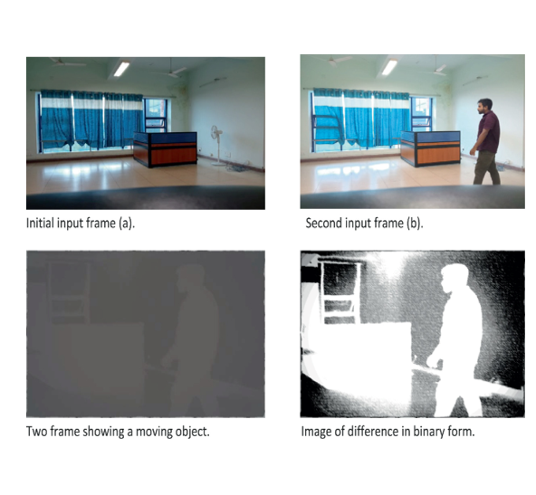
Module 1: Motion Detection and Surveillance
Continuously monitors video feeds from surveillance cameras.
If motion is detected, checks for the presence of faces in the moving region.
Applies AI-based face detection techniques to locate faces for further processing.
Prepares data for human verification and face recognition modules.

Slide 5
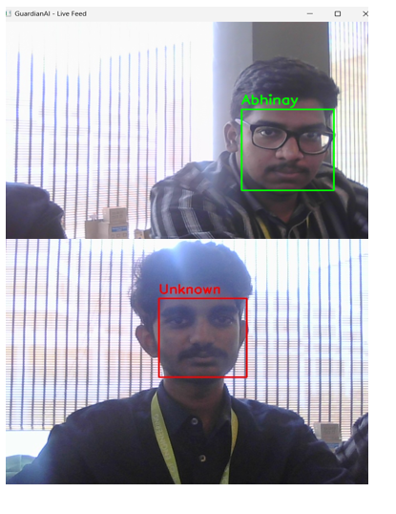
Module 2: Human Detection and Face Recognition
Confirms whether detected motion belongs to a human.
Once a human is detected, locates the face using face detection algorithms and verifies.
Compares the detected face with a database of authorized individuals using face recognition models.
Flags unknown or suspicious faces for immediate alerts and further review.

Slide 6
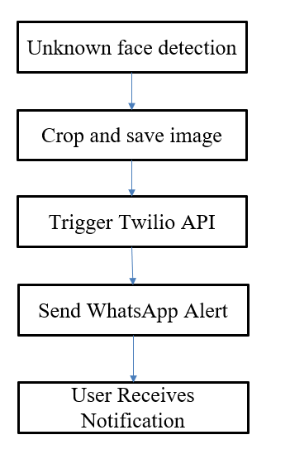
Module 3: Alert and Notification
Sends instant alerts via whatsapp through api when an unauthorized intruder is detected.
Activates security lights to deter intruders.
Records and logs details of the event for later analysis.
Provides real-time updates and status reports to security personnel.
Supports customizable notification settings for different types of events.

Slide 7
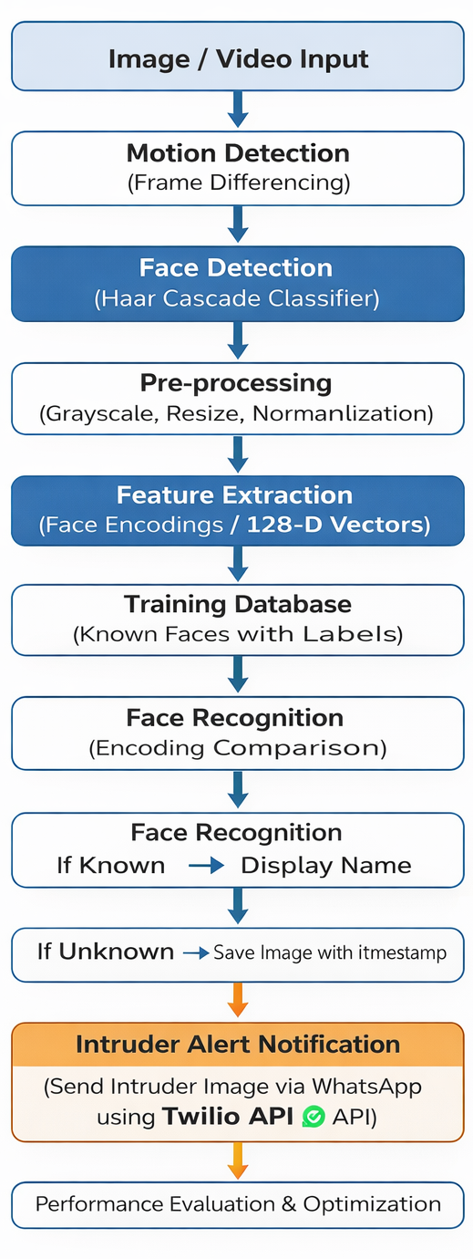
Implementation
Develop an optimized smart surveillance system using a five-module pipeline: Motion Detection → Face Detection → Face Recognition → Unknown Face Storage → Intruder Alert (WhatsApp via Twilio).
The system activates face detection only when motion is detected to reduce unnecessary processing.
If an unknown intruder is detected, the system sends the captured image instantly via WhatsApp.

Slide 8
Results & Discussion
The system accurately detected motion and triggered face recognition only when needed, saving processing time.
Face recognition identified known individuals with about 90–93% accuracy, and unknown faces were flagged correctly.
The alert system sent notifications within 2–3 seconds, including the intruder's image, detected date and time with image file.
The system performed best in well-lit areas, low-light conditions slightly reduced accuracy.
Overall, the system was fast, reliable, and suitable for home or office security with very few false alarms.

Slide 9
Challenges & Limitations
Face recognition may fail in low-light or dark environments.
Accuracy drops if the face is partially covered or turned away.
The system needs internet access to send alerts.
Only faces stored in the database can be recognized.
Low-end hardware can cause delays in detection and processing.

Slide 10
Future Scope
Add night vision support for low-light detection.
Track intruders across multiple cameras.
Let the system learn and improve over time using AI.
Connect with drones for outdoor intruder tracking.

Slide 11
Conclusion
The system detects motion and recognizes faces accurately.
It sends instant alerts when an unknown person is found.
Helps improve security in homes and offices.

Slide 12
References
Kaur, B. D. (2024). AI system for detecting intruders using cameras and face recognition. Springer – Intelligent Systems and Applications.
Rahim, A. et al. (2023). Smart home security using face recognition and CNN models. Sensors Journal.
Irfan, E., & Jacob, C. (2024). Face recognition using deep learning in CCTV systems. IEEE Conference Proceedings.
Pasha, M. J. et al. (2023). AI-based intruder detection and alert system for homes. International Journal of Intelligent Systems.
Kunwar, A. (2025). Face recognition and spoofing detection using AI models. arXiv preprint.

Slide 13
Thank You!

