Slide 1
EMERGENCY BLOOD CONNECTOR
A Full-Stack Platform for Real-Time Blood Donor-Patient Matching
Student Details
Maralakshikari Sreeshwan (24EG105Q47)
Project Guide
Name
Designation

Slide 2
Index
Introduction
Problem Statement
Objectives
Scope of the Project
Existing System
Proposed System
Software & Hardware Requirements
System Design
Flowchart & Algorithm
Modules Description
Results / Output Screens
Advantages & Limitations
Future Enhancements
Conclusion
Live Deployment & Repository
References

Slide 3
Introduction
The Gap in Emergency Blood Access
Timely blood access remains one of the most fragile links in emergency healthcare in India.
Families rely on ad-hoc phone calls, WhatsApp broadcasts and social media appeals — slow, unstructured and unverifiable.
Emergency Blood Connector (EBC)
A full-stack MERN (MongoDB, Express.js, React, Node.js) web application connecting Donors, Requesters and Admins on a single platform.
Severity-based alerts (GREEN / YELLOW / RED / BLACK) automatically prioritise the most critical requests.
A two-step verified donation workflow eliminates false donation claims.
Gamified rewards — points, levels, badges — drive sustained donor engagement.
Built with React 19 & Express.js 5; deployed on Vercel, Render and MongoDB Atlas.

Slide 4
Problem Statement
No centralised, filterable registry of donors by blood group, location and real-time availability.
Requesters must contact dozens of potential donors individually — most ineligible, unavailable or too far away.
Hospital-level donor lists are rarely digitised or accessible to the public.
No standard way to prioritise by medical urgency — critical cases get lost among routine appeals.
No verification that a donation actually took place — enabling double-booking and false claims.
Donors who consistently show up cannot be recognised or rewarded.
EBC closes this gap with a structured, verifiable and prioritised digital platform.

Slide 5
Objectives
Build a full-stack, role-based web application connecting donors, requesters and administrators on one platform.
Implement secure JWT authentication (HTTP-only cookies) with bcrypt password hashing and strict role-based access control.
Design an automatic blood-group compatibility engine so donors see only requests they are eligible to fulfil.
Implement a severity-based alert and priority scoring system (GREEN / YELLOW / RED / BLACK).
Build a two-step donation verification workflow — donor self-report followed by requester confirmation.
Design a gamified engagement system — points, six donor levels, milestone badges and a public leaderboard.
Provide administrators a dashboard for monitoring users, requests, donations and platform-wide analytics.
Develop a responsive, mobile-friendly UI using React 19, Tailwind CSS 4 and Redux Toolkit 2.
Deploy the complete application on cloud infrastructure — Vercel, Render and MongoDB Atlas.

Slide 6
Scope of the Project
Registration & Login: JWT authentication, bcrypt hashing, optional Cloudinary profile image
Blood Request Management: structured requests, auto-generated request numbers, priority score & expiry
Donor Discovery & Matching: state and blood-group filtered feed, sorted by priority score
Verified Donation Workflow: two-step confirmation before any reward is applied
Gamification: points, donor levels, badges and a public leaderboard
Notifications & Admin Oversight: in-app alerts and a platform-wide analytics dashboard
Out of Scope
SMS / WhatsApp notifications, OTP mobile verification, email-based password reset
Real-time (WebSocket) notification delivery, hospital verification workflow
Native mobile application, payment gateway, multi-language support

Slide 7
Existing System
Manual & Social-Media Outreach: no compatibility filtering or verification; repeated effort for every emergency
Hospital & Blood Bank Registers: siloed, often paper-based, no public search interface
eRaktKosh (Govt. of India): inventory / blood-bank focused; no peer-to-peer request matching or gamification
Friends2Support: contact happens off-platform; no request lifecycle or donation verification
State / District Helplines: entirely manual matching; no persistent digital donor history
Common gap: no existing platform unifies compatibility matching, urgency prioritisation and a verified donation lifecycle in one system.

Slide 8
Proposed System
A unified, free, role-based platform combining real-time compatibility matching, urgency prioritisation, a verified donation lifecycle and gamified engagement.
Clean 3-tier client-server architecture: React 19 SPA (frontend) → Express.js 5 REST API (backend) → MongoDB via Mongoose 9 (data).
Severity-Based Alert & Priority Engine — auto priority score and urgency-proportional expiry per request.
Blood Compatibility Engine — automatic donor-to-recipient matching, revalidated server-side.
Two-Step Verified Donation Workflow — prevents double-booking and false donation claims.
Gamification & Notification Engines — points/levels/badges plus in-app alerts for every lifecycle event.
Administrative Analytics Engine — live blood-group, alert-level and state-wise distribution.

Slide 9
Software & Hardware Requirements
Hardware Requirements
Processor: Intel Core i3 (min), i5+ recommended | RAM: 4 GB min, 8 GB recommended
Storage: 10 GB free space | Internet: broadband, 2 Mbps minimum | Display: 1366×768 minimum
Input: keyboard and mouse, or a touchscreen device for mobile access
Software Stack
Frontend: React 19.2, Vite 8, Tailwind CSS 4.3, Redux Toolkit 2.12, React Router 7.17, React Hook Form 7.79, Axios 1.17
Backend: Node.js 18+, Express.js 5.1, Mongoose 9.0, JWT 9.0.2, bcryptjs 3.0.2, Multer 2.2.0, Cloudinary 2.10.0, cookie-parser 1.4.7
Database & Hosting: MongoDB Atlas (cloud) | Vercel (frontend) | Render (backend)
Dev Tools: VS Code, Google Chrome, npm 9+

Slide 10
System Design
Three-tier client-server architecture: React 19 SPA (presentation) → Express.js 5 REST API (application) → MongoDB via Mongoose (data).
Every endpoint is namespaced by domain (/auth, /request-api, /donor-api, /notification-api, /admin-api) and JWT + role-protected, barring a few public read endpoints.
Entity-Relationship Overview
User (1) → (N) BloodRequest — a requester creates many requests
User (1) → (N) Donation — a donor completes many donations
User (1) → (N) Notification — a user receives many notifications
BloodRequest (1) → (N) Donation — a request is fulfilled by many donations
Compound indexes on {role, isAvailable, state, bloodGroup} and {status, priorityScore} keep donor matching and the priority feed efficient at scale.

Slide 11
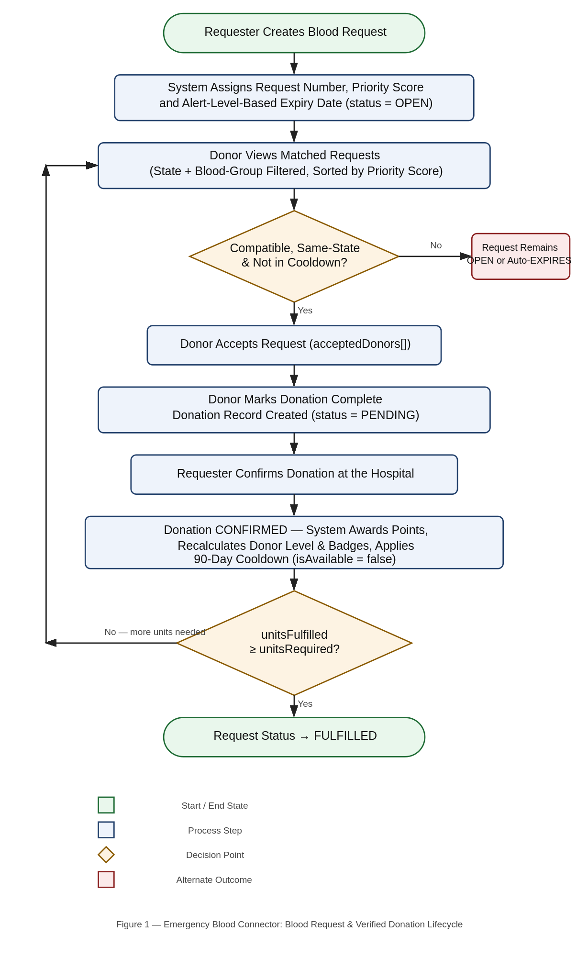
Flowchart & Algorithm
1
Create Request
Requester submits patient, hospital & urgency details — priority score and expiry are calculated automatically at creation.
2
Match & Accept
Compatible, available donors in the same state see the request in their feed and accept it.
3
Mark Donation Complete
Donor reports completion after donating — this creates a PENDING record; no rewards are applied yet.
4
Requester Confirms
Points, donor level, badges and the 90-day cooldown are applied only after the requester confirms.
Figure 1: Blood Request and Verified Donation Lifecycle

Slide 12
Flowchart & Algorithm — Pseudocode Summary
Algorithm 1 — Request Creation: priority score = alertLevelScore (GREEN:10, YELLOW:30, RED:60, BLACK:100) + unitsRequired; expiry set proportional to urgency (1–7 days)
Algorithm 2 — Donor Matching: open requests filtered by state and blood-group compatibility, sorted by priority score
Algorithm 3 — Two-Step Donation: accept → mark complete (PENDING) → requester confirms → points, level, badges & 90-day cooldown applied
Algorithm 4 — Automatic Expiry: lazy sweep flips overdue OPEN requests to EXPIRED on every read
Algorithm 5 — Admin Oversight: activate/deactivate users, force-close requests, aggregate platform-wide statistics

Slide 13
Modules Description (1 of 2)
1. Authentication & Profile Module: registration, login, JWT issuance, profile edit and password change via CommonAPI (/auth)
2. Blood Request Management Module: create, edit, close, soft-delete requests; auto request numbers, priority & expiry via RequestAPI
3. Donor Matching & Action Module: matched-requests feed, accept-request and complete-donation actions with full eligibility checks
4. Donation Confirmation Module: requester/admin-only endpoint that atomically confirms a donation and applies all rewards

Slide 14
Modules Description (2 of 2)
5. Gamification Module: calculatePoints, calculateLevel and calculateBadges utilities plus leaderboard & rank endpoints
6. Notification Module: persists an in-app notification for every lifecycle event via a shared createNotification utility
7. Administrative Module: user/request management, account activation, and a statistics endpoint for platform analytics
Together, these seven modules keep route handlers focused on validation and data access while reusable business logic lives in a dedicated utils/ layer.

Slide 15
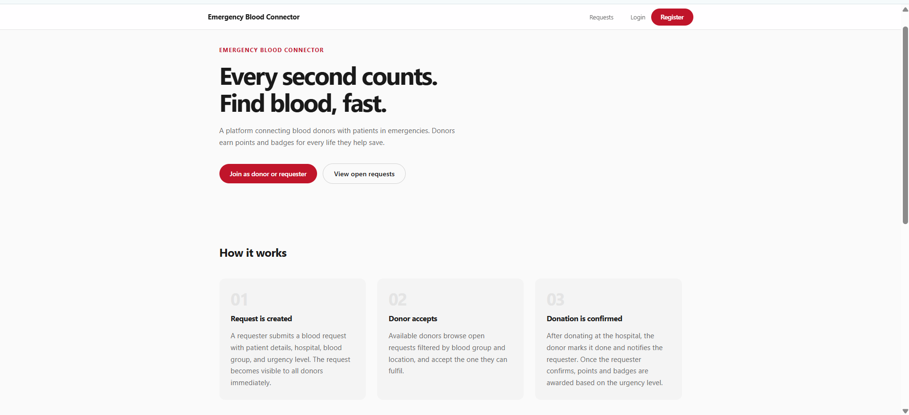
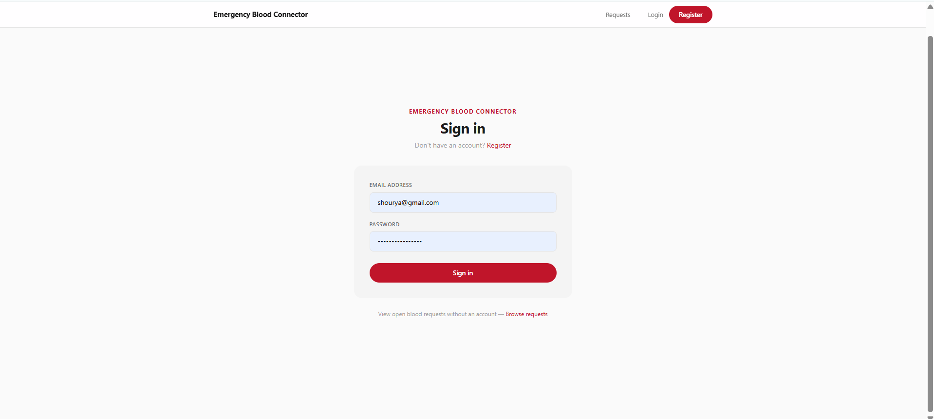
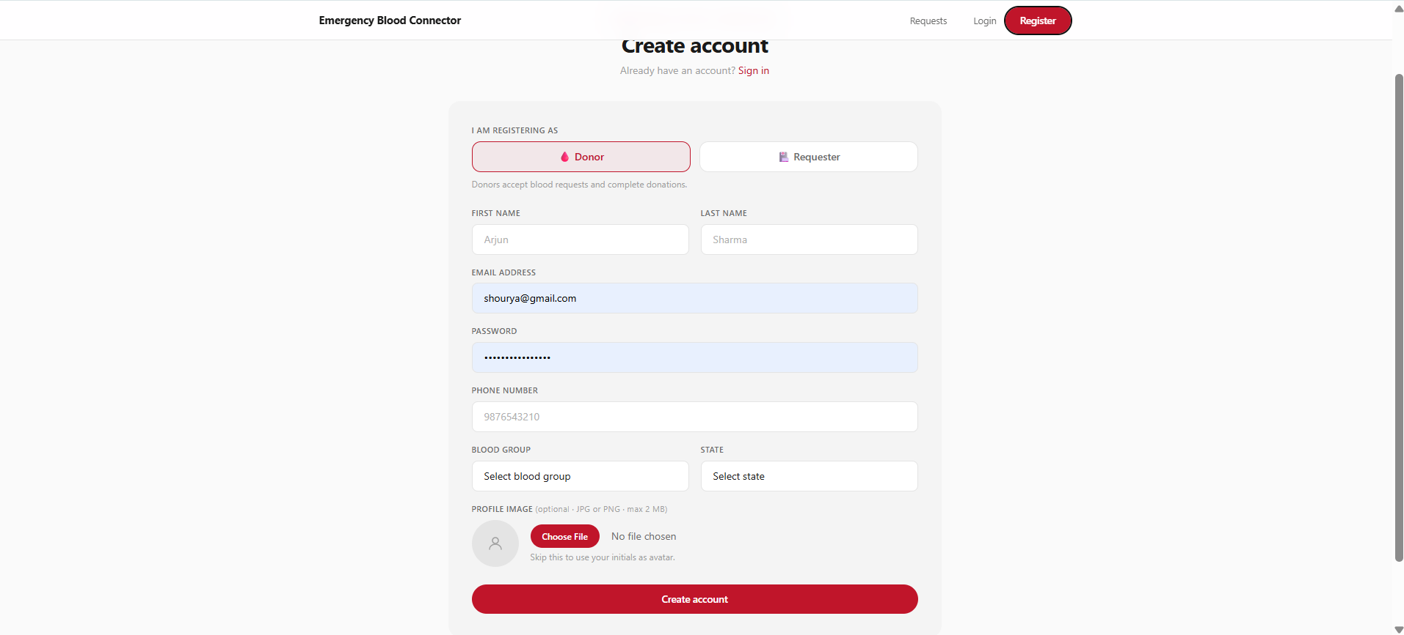
Results / Output Screens — Public & Authentication
The public landing page introduces the platform, while a standard email/password flow handles sign-in and account creation for both donors and requesters.
Fig. 2: Home Page
Fig. 3: Login Page
Fig. 4: Register Page

Slide 16
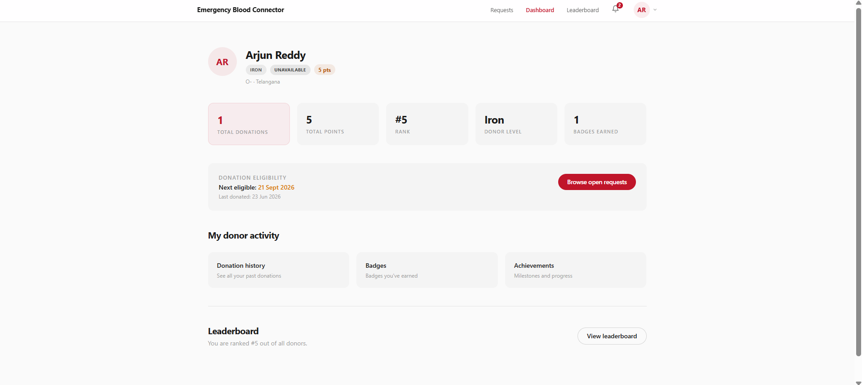
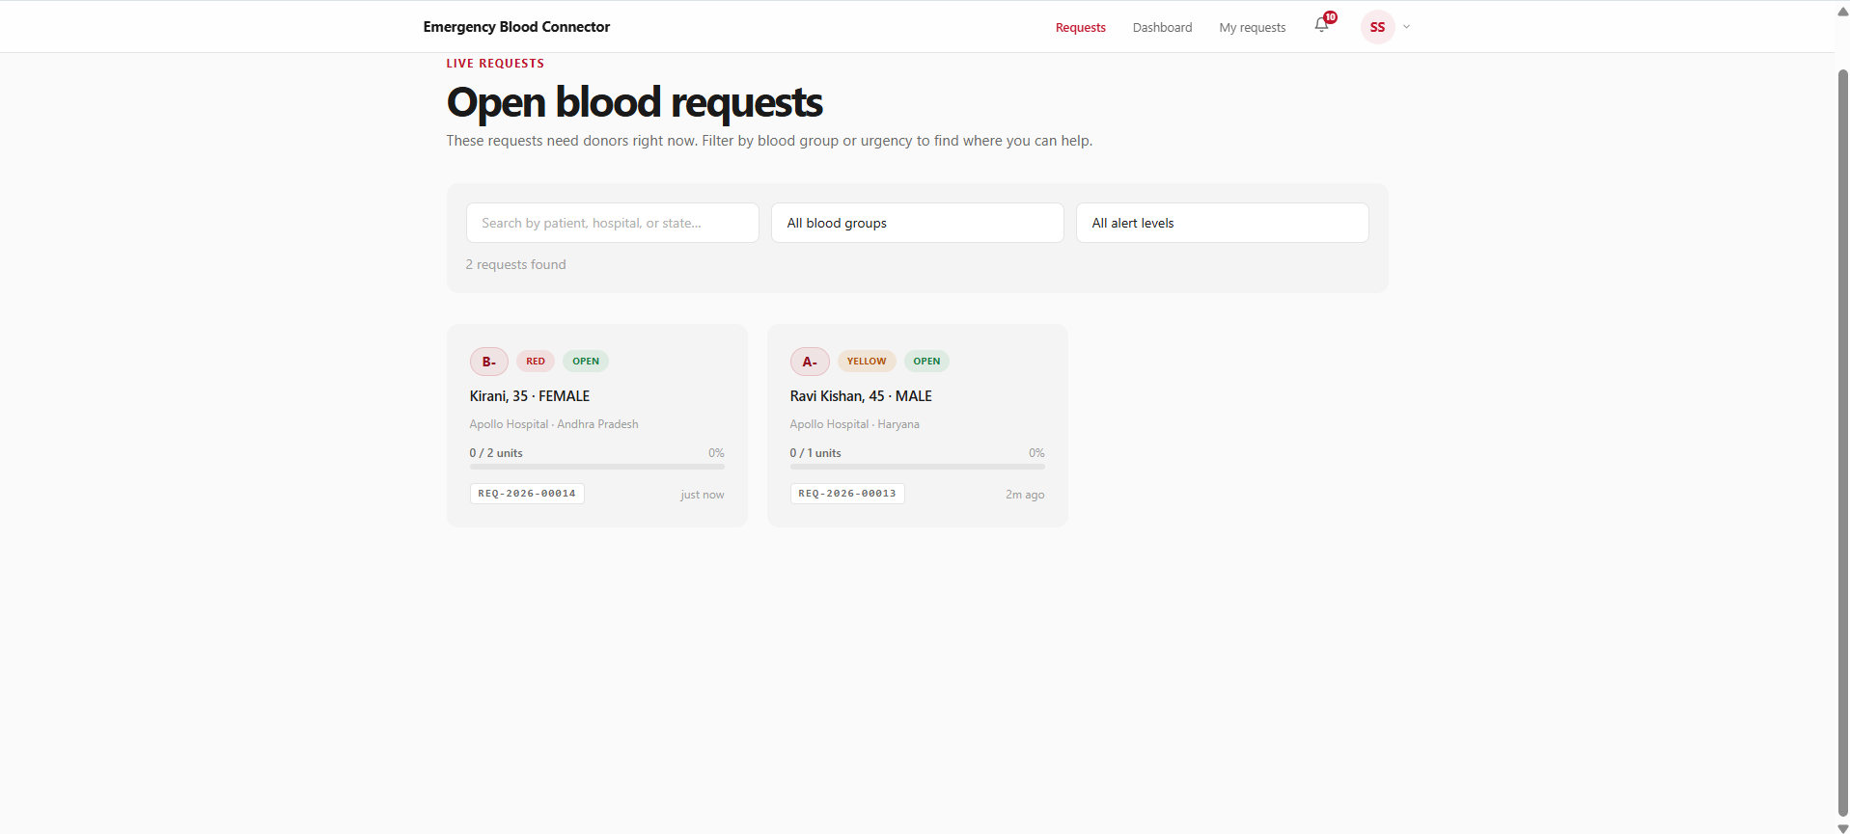
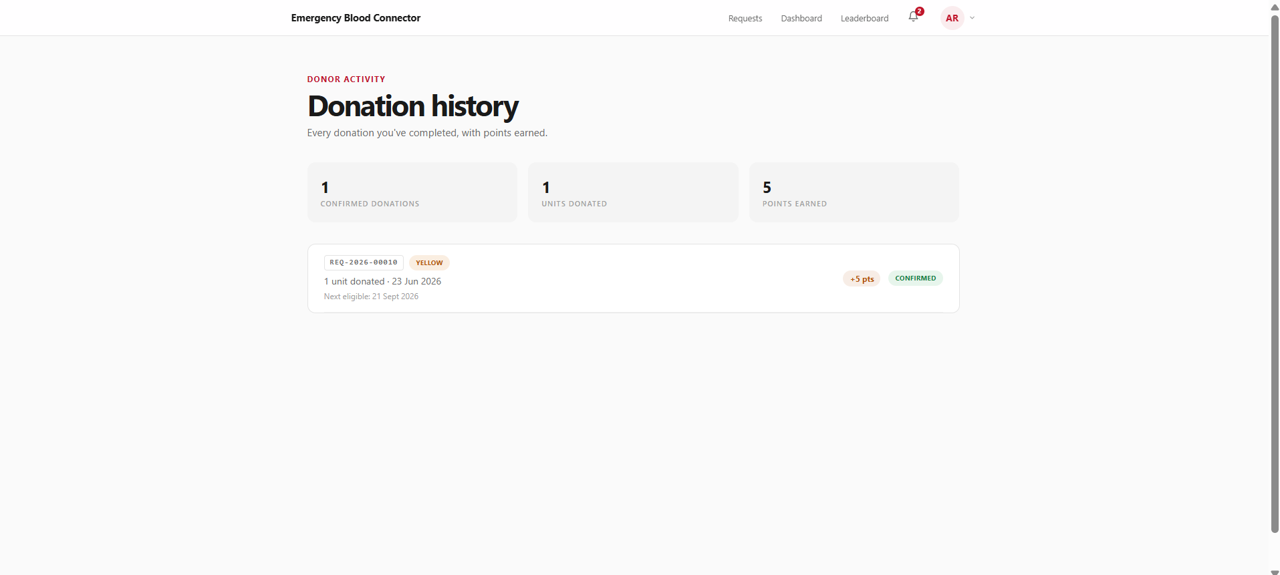
Results / Output Screens — Donor Experience
Donors track their impact from a personal dashboard, browse open requests filtered to their blood group and state, and review their full donation history.
Fig. 5: Donor Dashboard
Fig. 7: Open Requests Feed
Fig. 10: Donation History

Slide 17
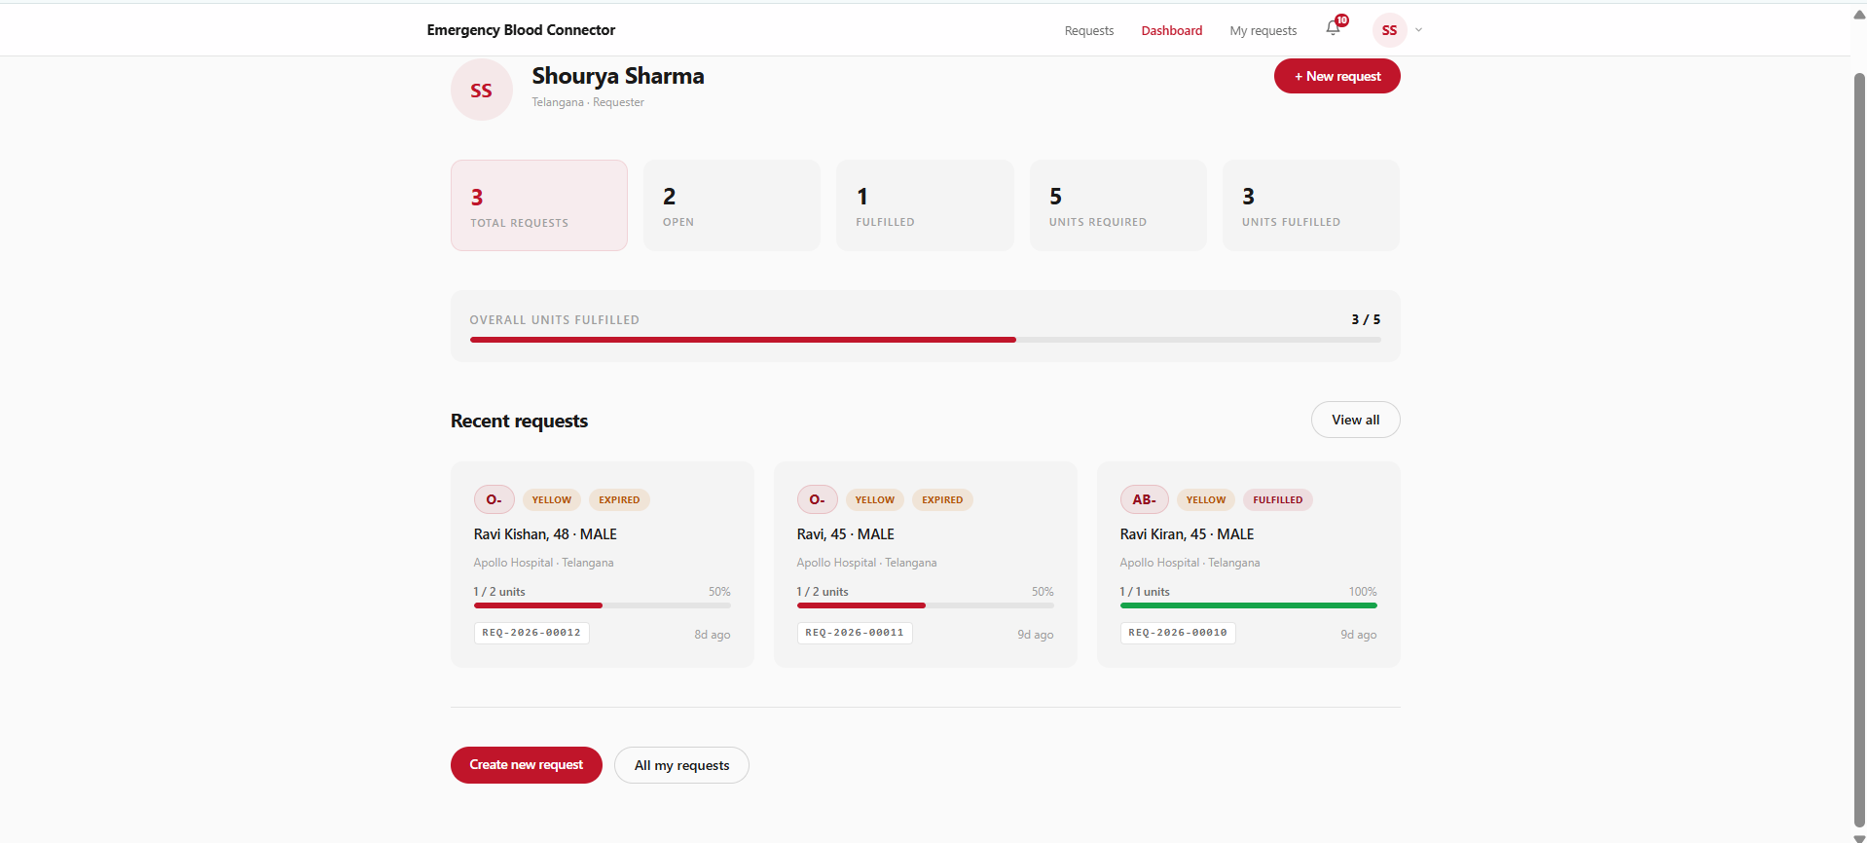
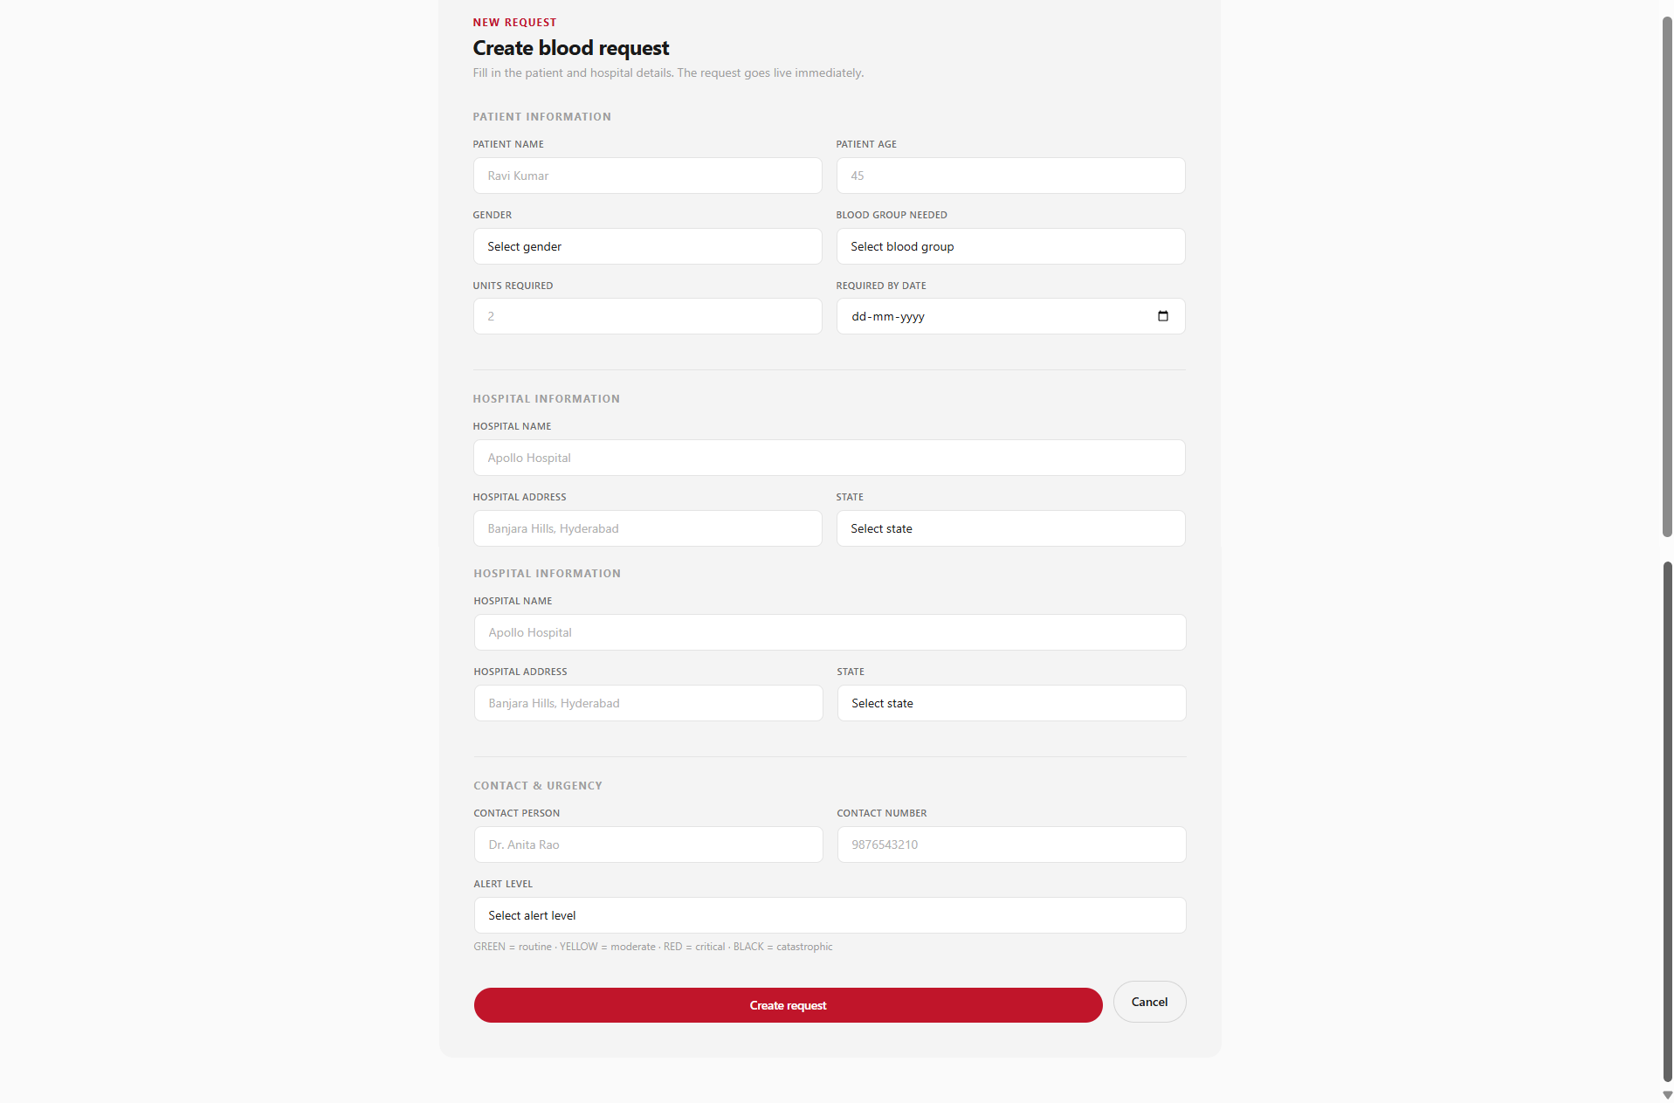
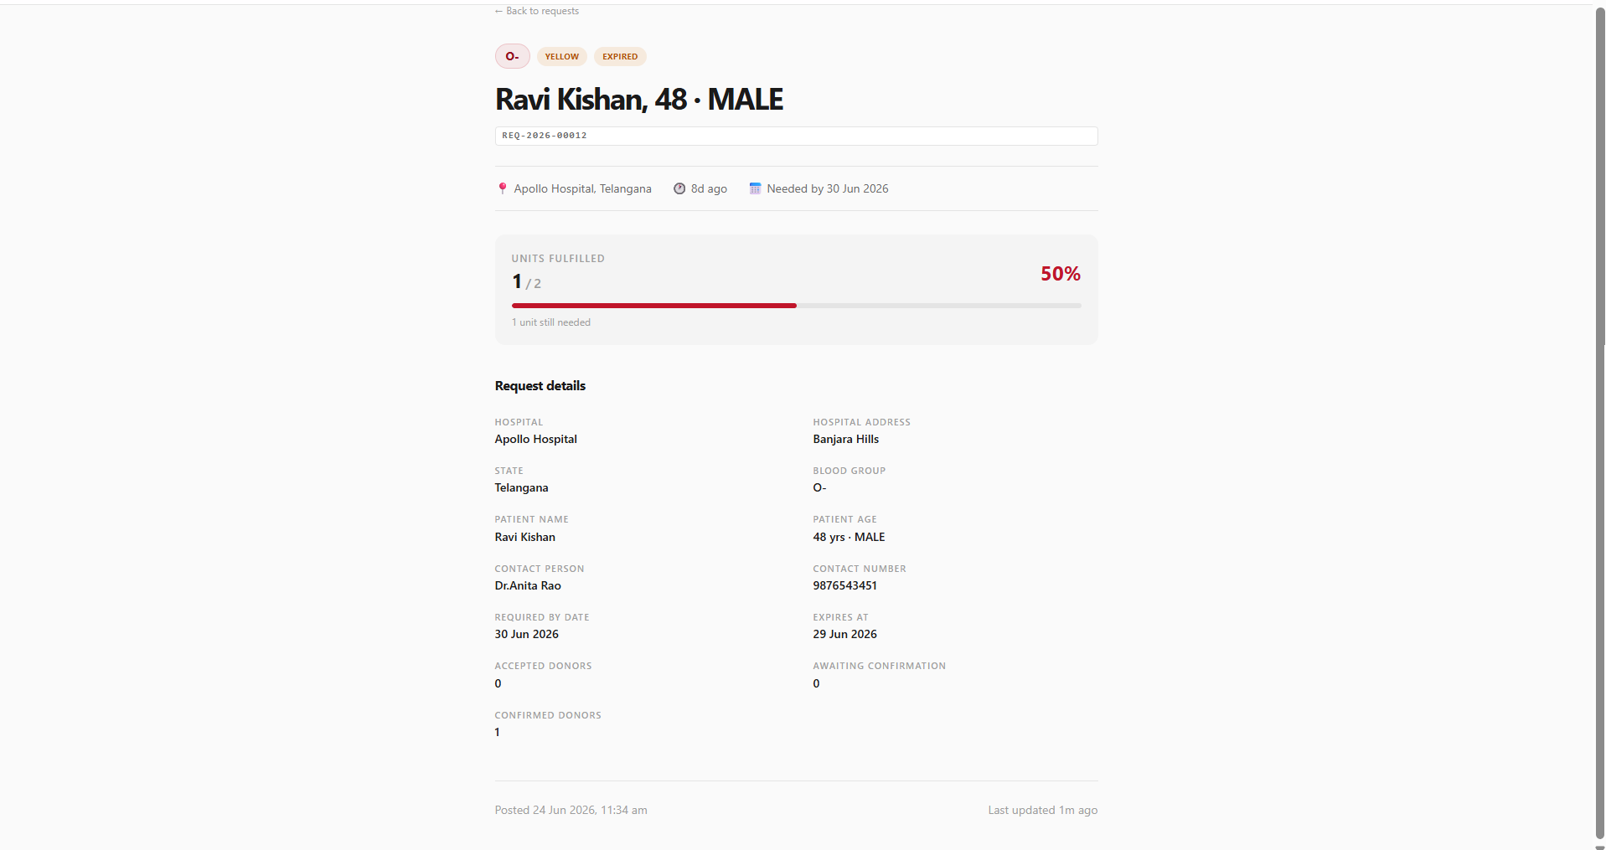
Results / Output Screens — Requester Experience
Requesters manage their active and past requests from a dedicated dashboard, submit new emergencies through a structured form, and track each request's progress in detail.
Fig. 6: Requester Dashboard
Fig. 9: Request Detail Page
Fig. 8: Create Request Form

Slide 18
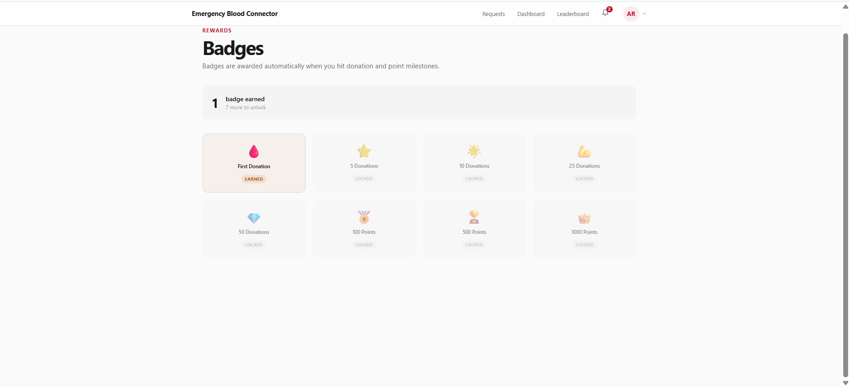
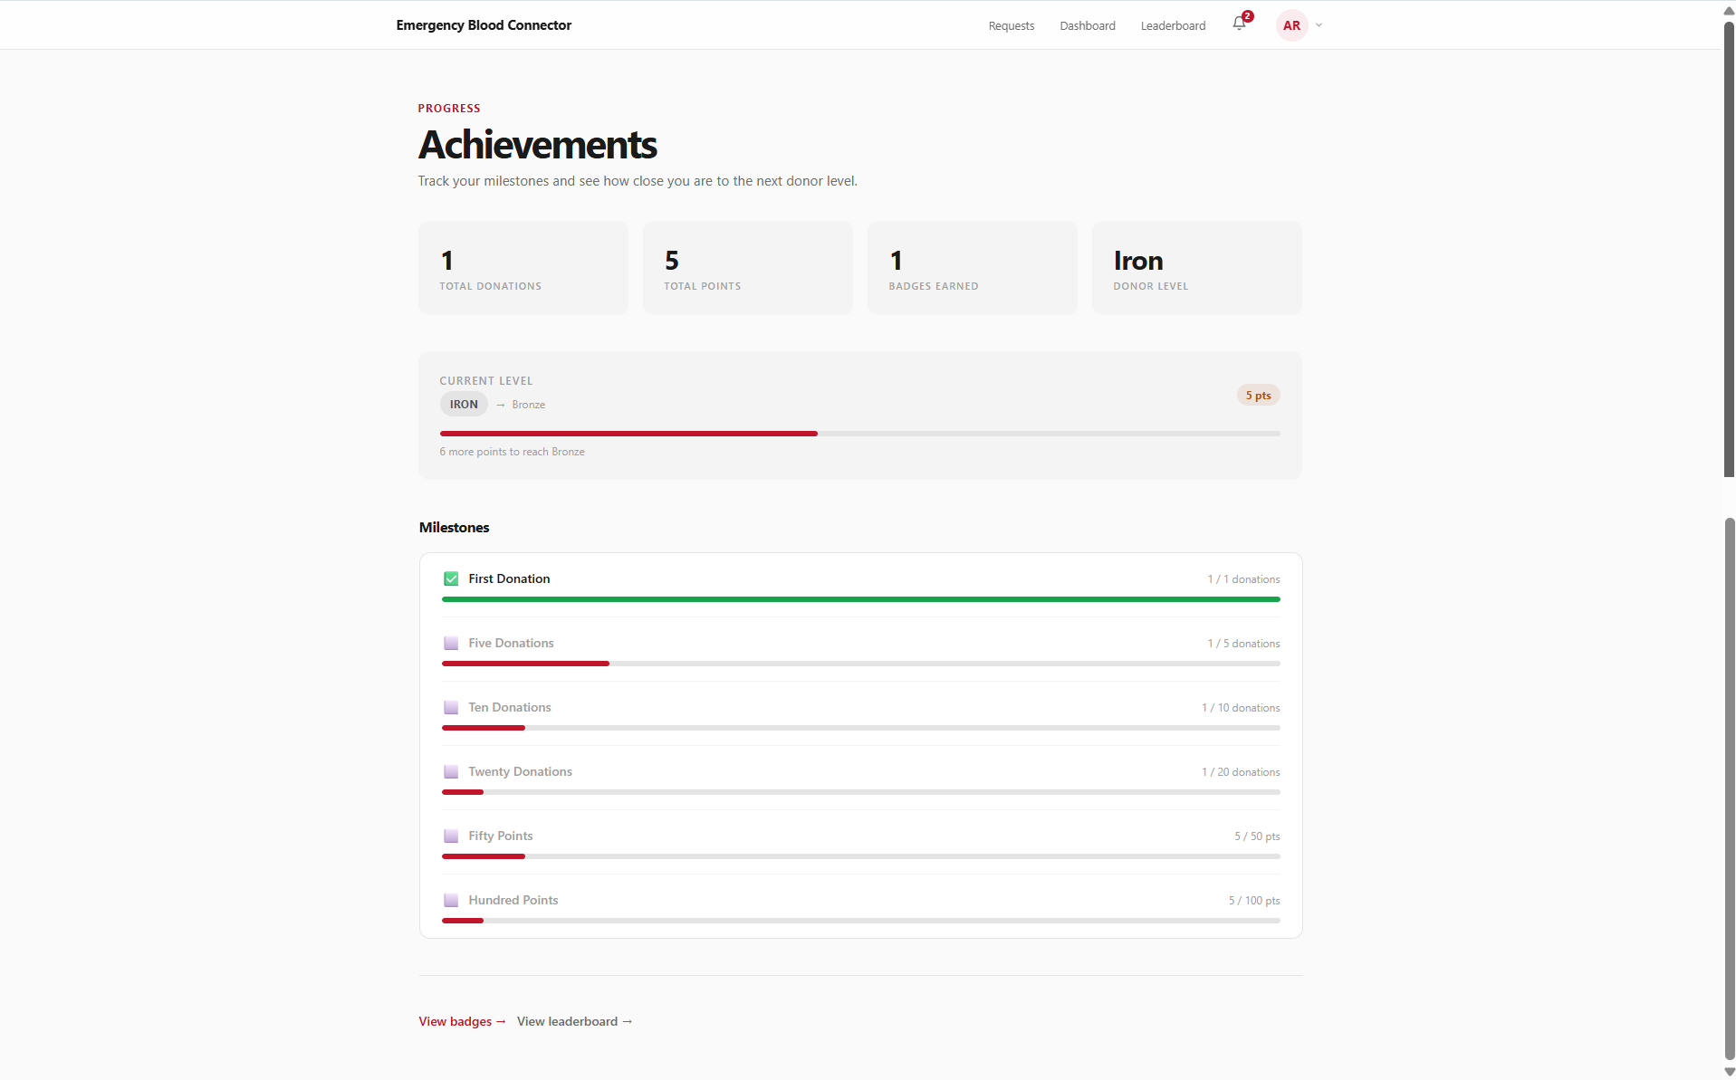
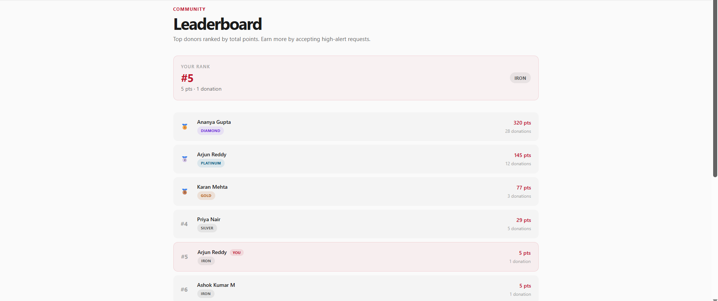
Results / Output Screens — Engagement & Rewards
The gamification layer keeps donors motivated — milestone badges, a level and achievement tracker, and a public leaderboard ranking the platform's top contributors.
Fig. 11: Badges Page
Fig. 13: Leaderboard Page
Fig. 12: Achievements Page

Slide 19
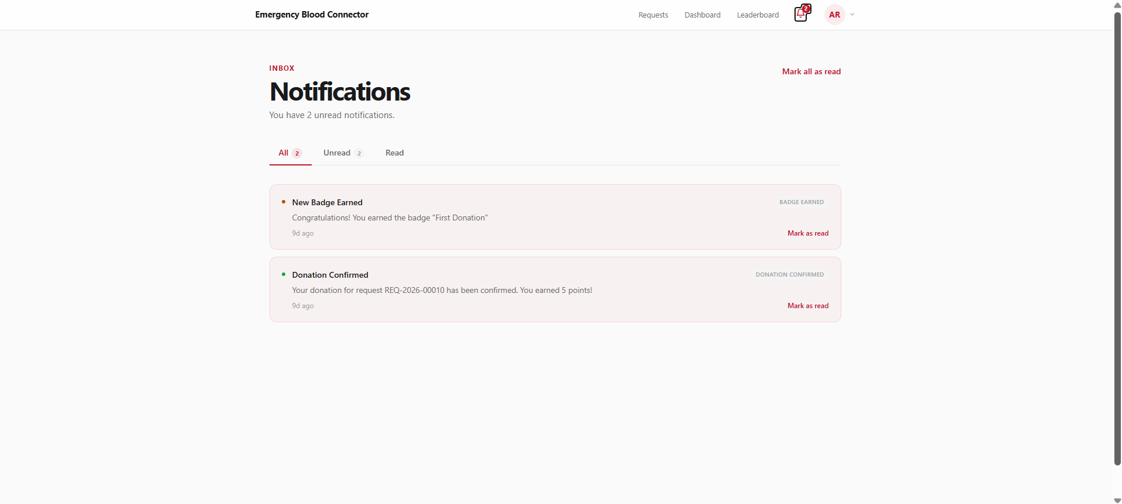
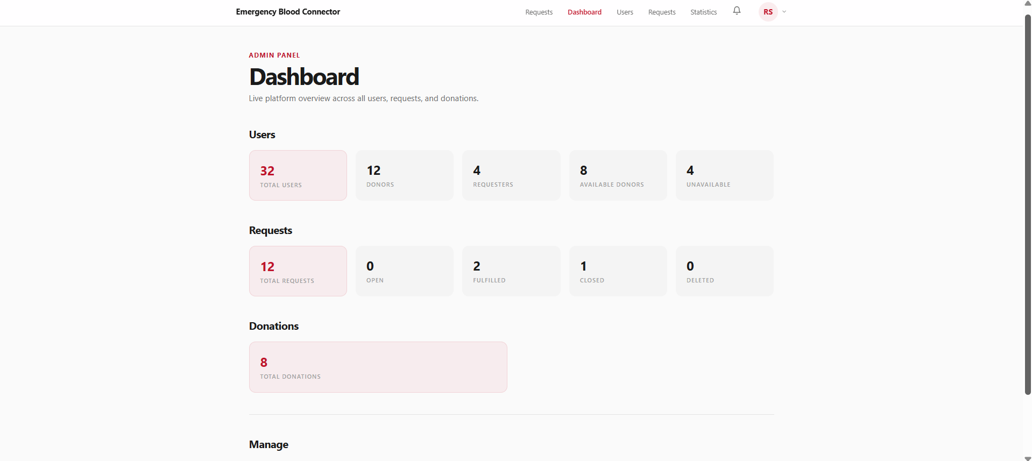
Results / Output Screens — Notifications & Admin Overview
Every lifecycle event — acceptance, confirmation, badge earned — raises an in-app notification, while administrators get a live, platform-wide summary on login.
Fig. 14: Notifications Page
Fig. 15: Admin Dashboard

Slide 20
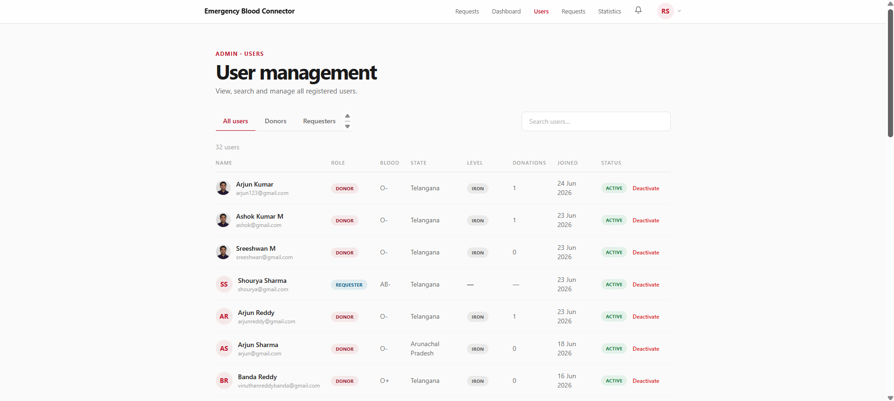
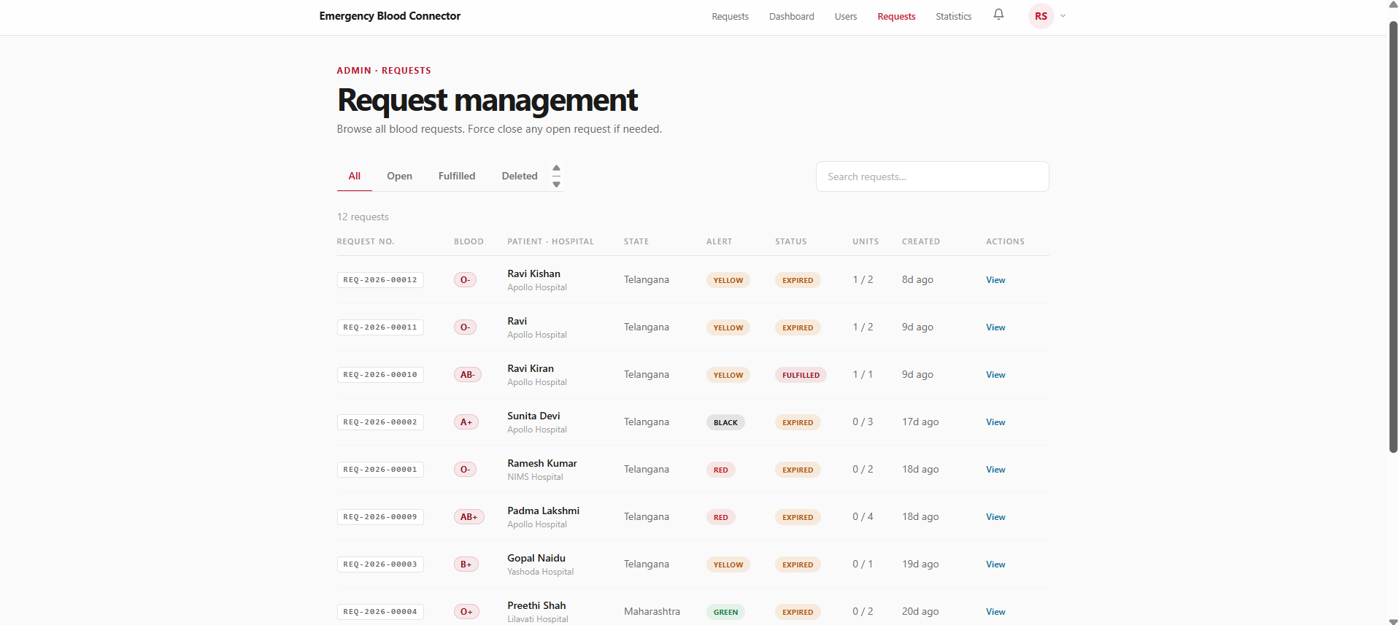
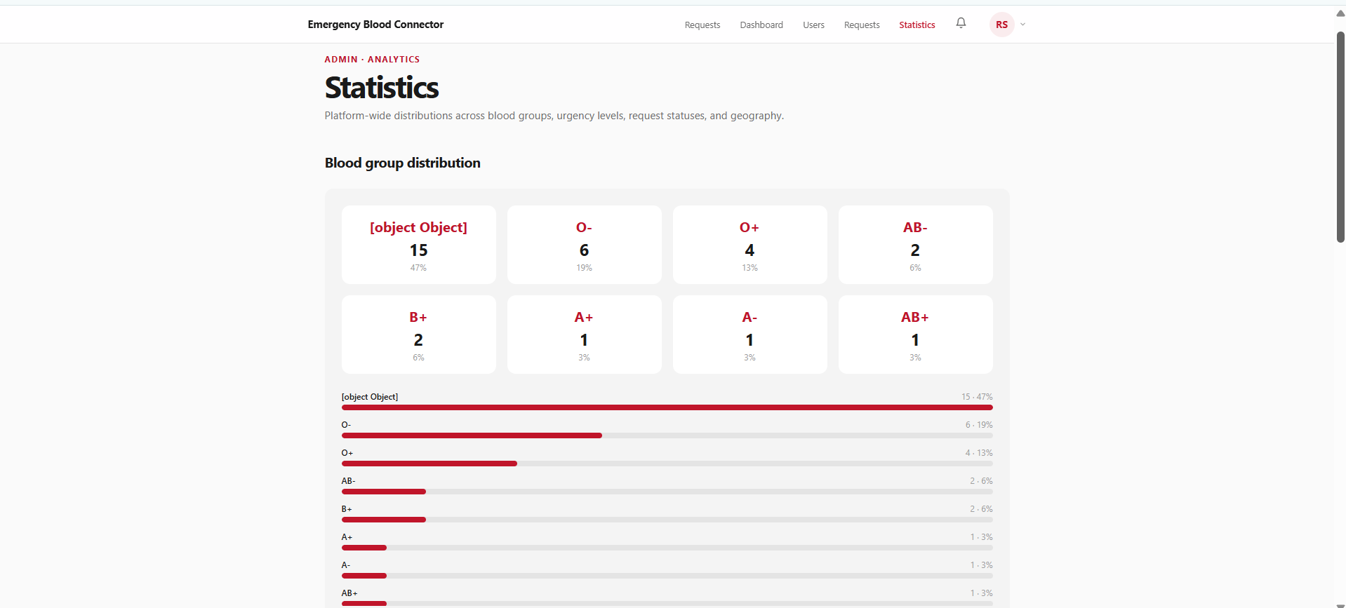
Results / Output Screens — Admin Management
Administrators can manage user accounts, force-close or review any blood request, and drill into platform-wide statistics across blood groups, urgency and geography.
Fig. 16: Admin User Mgmt
Fig. 17: Admin Request Mgmt
Fig. 18: Admin Statistics

Slide 21
Advantages & Limitations
Advantages
Free and open — no cost or licensing barriers
Automatic compatibility filtering eliminates wasted outreach
Severity-based prioritisation surfaces critical cases first
Two-step verification prevents double-booking & false claims
Gamification drives long-term donor retention
Limitations
In-app notifications only — no SMS / WhatsApp / push
No OTP verification or email-based password reset yet
No native mobile app or automated test suite
Matching is state-level, not precise geolocation

Slide 22
Future Enhancements
Email & SMS Notifications — alert users even when not actively on the app
OTP-Based Verification — stronger identity assurance at registration
Email-Based Password Reset — remove dependency on an authenticated session
Hospital Verification Workflow — activate the existing isHospitalVerified flag
Real-Time Notifications — WebSocket-based push delivery
Native Mobile Application — React Native apps for Android & iOS
Geolocation-Based Matching — distance-based donor-requester matching
Blood Bank / Hospital Integration — surface institutional stock alongside donor matches

Slide 23
Conclusion
Emergency Blood Connector addresses a real, persistent gap in India's emergency healthcare ecosystem by connecting donors directly with patients in need.
Automatic compatibility matching, severity-based prioritisation and a two-step verified donation workflow ensure critical requests are surfaced first and rewards are only ever applied to genuine donations.
A full gamification layer — points, levels, badges, leaderboard — targets the repeat-donor retention problem that most existing solutions leave unaddressed.
Built on a modern, actively maintained MERN stack and deployed on Vercel, Render and MongoDB Atlas, the project demonstrates practical full-stack development and business-logic-driven system design applied to a genuinely high-stakes problem.

Slide 24
Live Deployment & Repository
Frontend: deployed on Vercel — emergency-blood-connector-lilac.vercel.app
Backend: deployed on Render — emergency-blood-connector-kbw2.onrender.com
Database: MongoDB Atlas (cloud)
Source Code: github.com/SreeshwanMaralakshikari/Emergency_Blood_Connector
Every feature described in this presentation — from blood-group compatibility filtering to the donation confirmation workflow — exists as working, tested and deployed code, rather than as a proposed or partially implemented feature.

Slide 25
References
React Documentation — react.dev, 2026
Express.js — expressjs.com, 2026
MongoDB Documentation — mongodb.com/docs, 2026
Mongoose — mongoosejs.com/docs, 2026
Redux Toolkit — redux-toolkit.js.org, 2026
React Hook Form — react-hook-form.com, 2026
Tailwind CSS — tailwindcss.com/docs, 2026
Vite — vitejs.dev, 2026
JSON Web Tokens — jwt.io/introduction, 2026
Cloudinary Documentation — cloudinary.com/documentation, 2026
Vercel Documentation — vercel.com/docs, 2026
Render Documentation — render.com/docs, 2026
eRaktKosh, Ministry of Health & Family Welfare — eraktkosh.mohfw.gov.in, 2026
Friends2Support — friends2support.org, 2026

