Slide 1

Generative AI [7CS 1018]
Alliance School of Advanced Computing
Project Title:Smart Prompt Optimization for Reducing LLM API Cost
AI/ML ‘D’ Sec, 7th Semester
Batch : 2023 - 2027
Presented by:
Pudi Pavani - 2023BCSE07AED340
Sreesuwin S R - 2023BCSE07AED341
Bhanu Gowtham K - 2023BCSE07AED344
Teja Sreya A - 2023BCSE07AED345
Name of the Mentor: Ms. Lalli K

Slide 2

I. Introduction
Large Language Models (LLMs) increasingly rely on long prompts containing instructions, context, and examples.
Longer prompts increase input-token consumption, inference latency, and API expenditure.
Prompt compression reduces unnecessary tokens while attempting to preserve the information required by the LLM.
However, aggressive compression may remove semantically important information, reducing response quality.
This motivates a cost-aware optimization framework that minimizes tokens while maintaining an acceptable quality level.

Slide 3
II. EXISTING ANALYSIS & RESEARCH GAP
Existing Analysis | Key Contribution / Finding | Related Research Gap
Liskavets et al. AAAI 2025 Context-Aware Sentence Encoding | Identifies relevant sentences and achieves substantial compression while improving efficiency over token-level approaches. | Quality vs. Compression Aggressive compression can remove important semantic information and degrade response quality.
Zehle et al. ICML/PMLR 2025 CAPO: Cost-Aware Prompt Optimization | Uses evolutionary optimization and racing; jointly optimizes instructions and few-shot examples while considering prompt length. | Cost of Optimization Repeated LLM evaluations during automatic optimization can introduce significant API cost.
CostRoute IEEE 2026 Output-Cost-Dominant Pre-Dispatch Routing | Considers input and predicted output costs when routing requests between LLM providers; uses a cost–quality efficiency criterion. | Total API Cost Practical expenditure depends on both input/output token usage and provider pricing.
Goenka et al. Frontiers in AI 2026 CORAL | Jointly optimizes LLM routing and adaptive prompts using multi-objective optimization for cost-efficient deployment. | Prompt Optimization + Model Routing Prompt optimization and model selection have often been studied separately.

Slide 4
IV: PROBLEM STATEMENT
Develop a prompt optimization framework that reduces unnecessary input tokens.
Evaluate multiple compression levels while preserving relevant information.
Measure the relationship between compression ratio, API cost, and response quality.
Identify an optimal compression level subject to a minimum quality constraint.
Demonstrate measurable cost reduction with acceptable quality degradation.

Slide 5
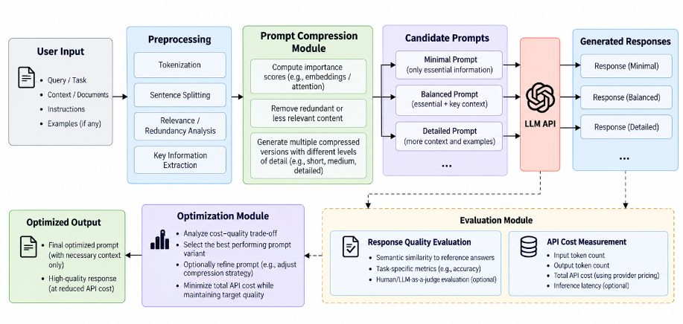
V. ARCHITECTURE DIAGRAM

Slide 6
VII . REFERENCES
Liskavets, B., Ushakov, M., Roy, S., Klibanov, M., Etemad, A., & Luke, S. K. (2025). Prompt Compression with Context-Aware Sentence Encoding for Fast and Improved LLM Inference. Proceedings of the AAAI Conference on Artificial Intelligence, 39(23), 24595–24604. DOI
Zehle, T., Schlager, M., Heiß, T., & Feurer, M. (2025). CAPO: Cost-Aware Prompt Optimization. Proceedings of the Fourth International Conference on Automated Machine Learning, Proceedings of Machine Learning Research, 293, 18/1–45. Proceedings of Machine Learning Research
Li, Z., Liu, Y., Su, Y., & Collier, N. (2025). Prompt Compression for Large Language Models: A Survey. Proceedings of the 2025 Conference of the Nations of the Americas Chapter of the Association for Computational Linguistics: Human Language Technologies, 1, 7182–7195. ACL Anthology
Pan, Z., Wu, Q., Jiang, H., Xia, M., Luo, X., Zhang, J., Lin, Q., Rühle, V., Yang, Y., Lin, C.-Y., Zhao, H. V., Qiu, L., & Zhang, D. (2024). LLMLingua-2: Data Distillation for Efficient and Faithful Task-Agnostic Prompt Compression. Findings of the Association for Computational Linguistics: ACL 2024. ACL Anthology
Jiang, H., Wu, Q., Luo, X., Li, D., Lin, C.-Y., Yang, Y., & Qiu, L. (2024). LongLLMLingua: Accelerating and Enhancing LLMs in Long Context Scenarios via Prompt Compression. Proceedings of the 62nd Annual Meeting of the Association for Computational Linguistics, 1, 1658–1677. ACL Anthology
Jiang, H., Wu, Q., Lin, C.-Y., Yang, Y., & Qiu, L. (2023). LLMLingua: Compressing Prompts for Accelerated Inference of Large Language Models. Proceedings of the 2023 Conference on Empirical Methods in Natural Language Processing, 13358–13376. ACL Anthology
Li, Y., Dong, B., Guerin, F., & Lin, C. (2023). Compressing Context to Enhance Inference Efficiency of Large Language Models. Proceedings of the 2023 Conference on Empirical Methods in Natural Language Processing, 6342–6353. ACL Anthology
Goenka, S., Khekare, G., Adhikari, P., Tyagi, A., & Tyagi, D. (2026). CORAL: Co-evolutionary optimization of routing and adaptive prompts for cost-efficient LLM deployment. Frontiers in Artificial Intelligence, 9, 1891737. Frontiers

Slide 7













Department of Computer Science and Engineering Alliance School of Advanced Computing
THANK YOU
©ASAC – Alliance University, 2026. All rights reserved. Unauthorized reproduction or distribution is prohibited.

