Slide 1


Consumer Goods Analysis
ATLIQ HARDWARE Company
Ad Hoc SQL Insights for Consumer Goods Trends

Slide 2
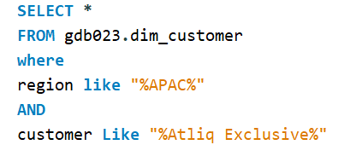
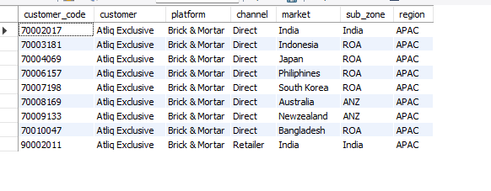
Request : 1
Provide the list of markets in which customer "Atliq Exclusive" operates its
business in the APAC region.
Insight :
All customers belong to "Atiq Exclusive" and use the "Brick & Mortar" platform.
Most channels are "Direct", except one "Retailer" entry for India.
Customers are spread across APAC, covering sub-zones: India, ROA, and ANZ.

Slide 3
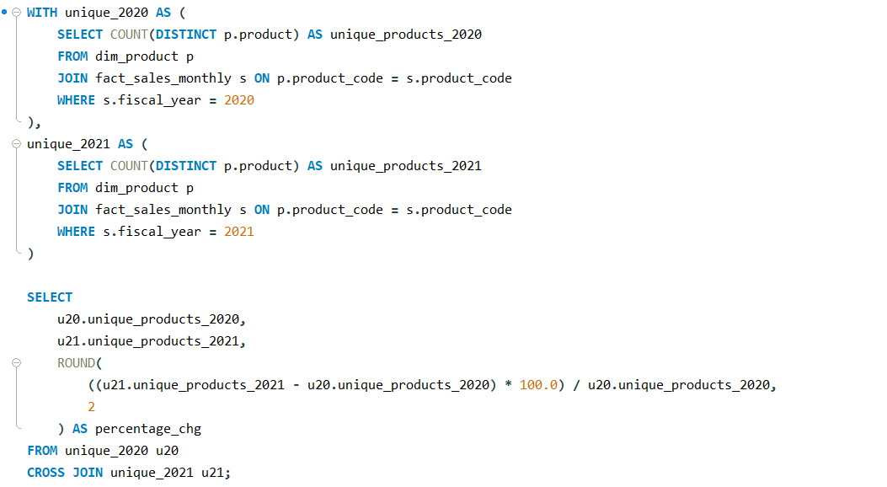
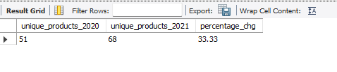
Request : 2
What is the percentage of unique product increase in 2021 vs. 2020? The final output contains these fields,
unique_products_2020
unique_products_2021
percentage_chg
Insights:
AtliQ Hardware increased its product offerings from 51 in 2020 to 68 in 2021,
showing a growth of 17 unique products.
This reflects a 33.3% increase, indicating strategic expansion or diversification.

Slide 4
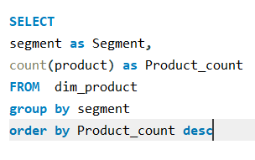
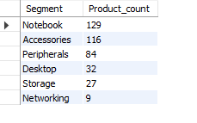
Request : 3
Provide a report with all the unique product counts for each segment and sort them in descending order of product counts. The final output contains
2 fields,
segment
product_count

Slide 5
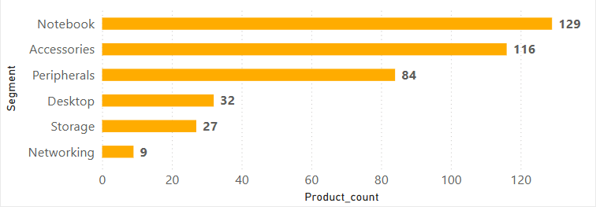
Insight:
Notebook and Accessories together make up the majority of the product lineup, indicating strong focus on portable and add-on devices.
Networking has the least number of products (only 9), suggesting it might be a less prioritized or emerging segment.
The product distribution shows a clear tilt toward consumer-oriented segments rather than enterprise hardware

Slide 6
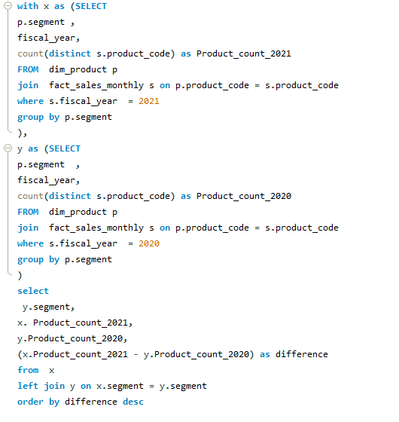
Request : 4
Follow-up: Which segment had the most increase in unique products in 2021 vs 2020? The final output contains these fields,
segment
product_count_2020
product_count_2021
difference

Slide 7
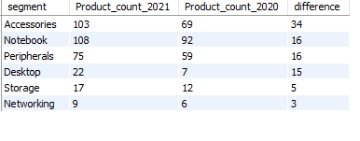
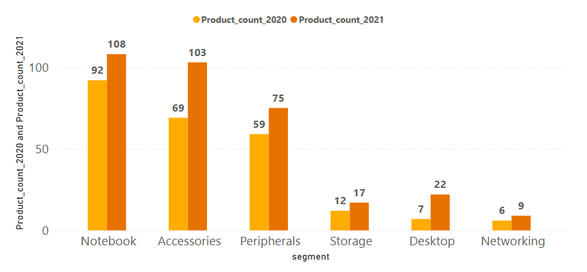
Insight:
All segments saw an increase in product count from 2020 to 2021, showing overall expansion in AtliQ Hardware's product portfolio.
Accessories had the highest growth in absolute numbers, rising from 69 to 103 products — a 49% increase.
Desktop experienced the most significant percentage growth, more than tripling from 7 to 22 products.

Slide 8
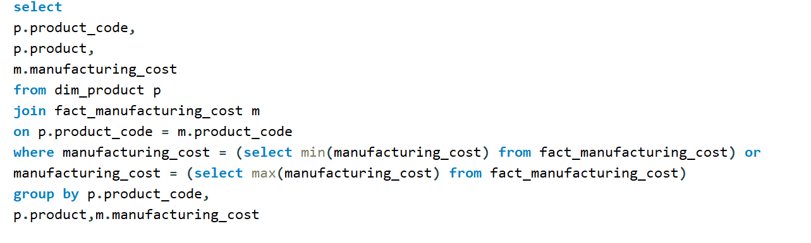

Request : 5
Get the products that have the highest and lowest manufacturing costs. The final output should contain these fields,
product_code
product
manufacturing_cost

Slide 9
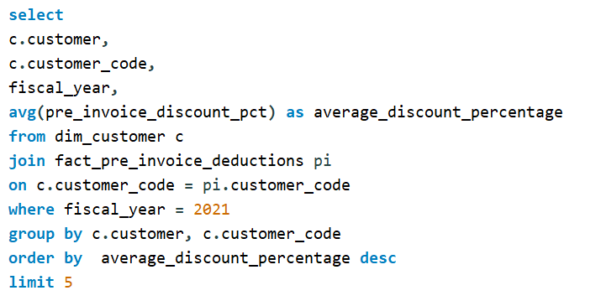
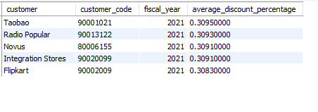
Request : 6
Generate a report which contains the top 5 customers who received an average high pre_invoice_discount_pct for the fiscal year 2021 and in the
Indian market. The final output contains these fields,
customer_code
customer
average_discount_percentage

Slide 10
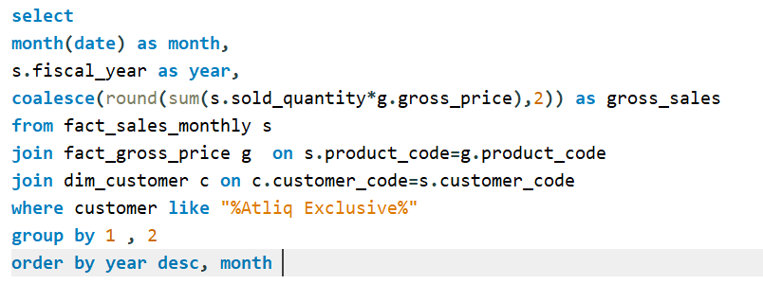
Request : 7
Get the complete report of the Gross sales amount for the customer “Atliq Exclusive” for each month. This analysis helps to get an idea of low and
high-performing months and take strategic decisions.
The final report contains these columns:
Month
Year
Gross sales Amount

Slide 11
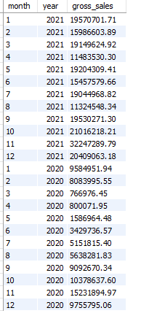
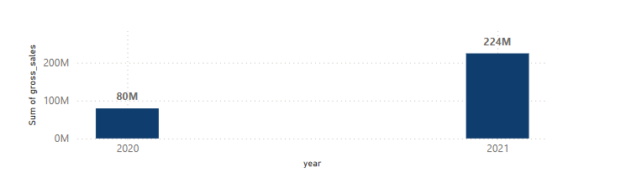
Insight:
This is a 180% increase, suggesting successful strategies in product expansion or market reach.

Slide 12
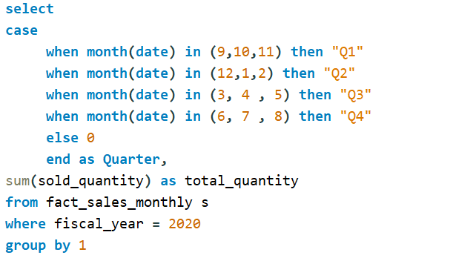
Request : 8
In which quarter of 2020, got the maximum total_sold_quantity? The final output contains these fields sorted by the total_sold_quantity,
Quarter
total_sold_quantity
AtliQ Hardware Technologies follows a fiscal year from September to August, your quarters would be structured like this:
📅 Fiscal Quarter Mapping:
Q1: September – November
Q2: December – February
Q3: March – May
Q4: June – August

Slide 13
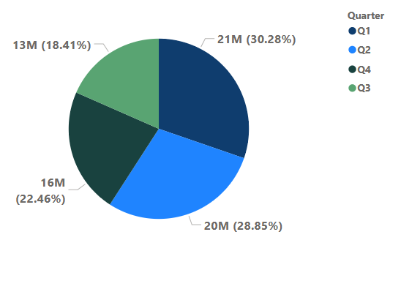
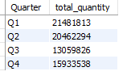
Insight:
Q1 (Sep–Nov) had the highest sales at 21M (30.28%), indicating a strong start to the fiscal year.
Q3 (Mar–May) recorded the lowest sales at 13M (18.41%), suggesting a potential dip in demand or operational slowdowns.
Sales were relatively balanced across Q2 and Q4, with Q2 at 20M (28.85%) and Q4 at 16M (22.46%), showing consistent performance through mid and end of the fiscal cycle.

Slide 14
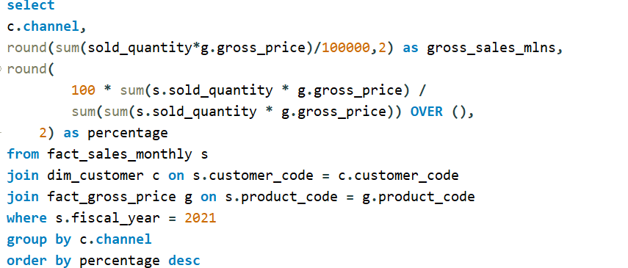
Request: 9
Which channel helped to bring more gross sales in the fiscal year 2021 and the percentage of contribution? The final output contains these fields,
channel
gross_sales_mln
percentage

Slide 15
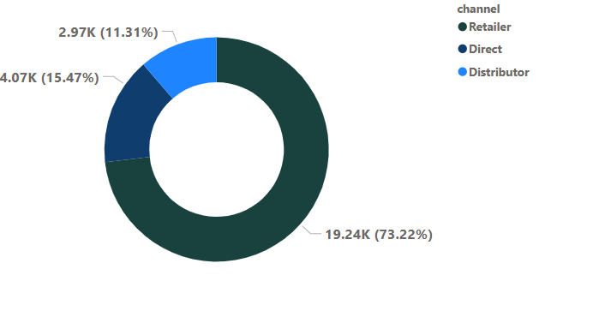
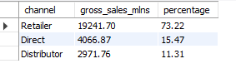
Insight:
AtliQ Hardware heavily relies on the Retailer channel, which accounts for over 73% of total sales, while Direct and Distributor channels contribute much less. This shows a strong dependence on retail partners for revenue.

Slide 16
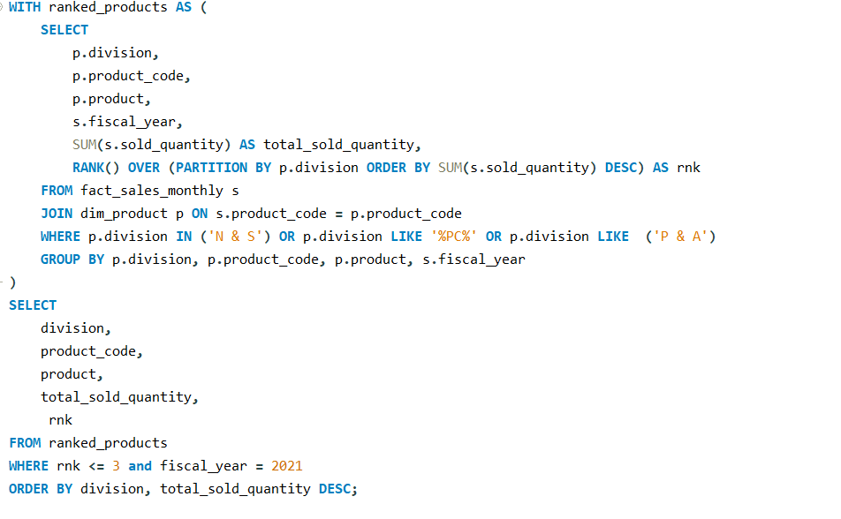
Request: 10
Get the Top 3 products in each division that have a high total_sold_quantity in the fiscal_year 2021? The final output contains these fields,
division
product_code
product
total_sold_quantity
rank_order

Slide 17
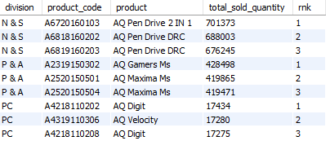
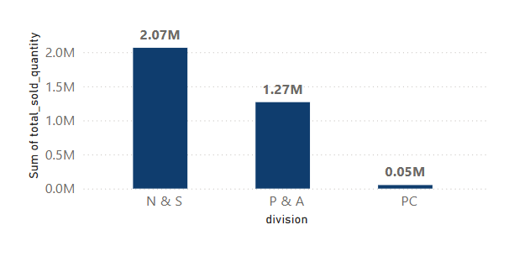
Insight:
Top Performing Division:
N & S is the best-performing division with 2.07 million units sold.
Majority of sales come from Pen Drive products.
Moderate Performer:
P & A sold 1.27 million units.
Main contributors are Gamers Ms and Maxima Ms products.
Underperforming Division:
PC division sold only 0.05 million units.
All products in this division have very low sales.

