Slide 1

Exploratory Data Analysis
G2M Case Study
Sreevatsa Nukala
11/19/2022

Slide 2
Agenda
Executive Summary
Problem Statement
Approach
EDA
EDA Summary
Recommendations

Slide 3
Problem Statement
Summary
XYZ is a private firm in US. Due to remarkable growth in the Cab Industry in last few years and multiple key players in the market, it is planning for an investment in Cab industry, and as per their Go-to-Market(G2M) strategy they want to understand the market before taking a final decision.
Objective
Provide actionable insights to help XYZ firm in identifying the right company for making investment.
Analysis
Data Exploration
Profit by Gender and Company
Profit Over Time
Patterns in Ride Frequency and Profit
Profit by City
Recommendations for Investment

Slide 4
Data Exploration
Data
17 Features
Timeframe of the data: 2016-01-31 to 2018-12-31
Total data points: 355,032
Manipulations
Type changes for date, population, users, etc.
Merge into master DataFrame
Price Charged and Cost of Trip features used to calculate profit

Slide 5
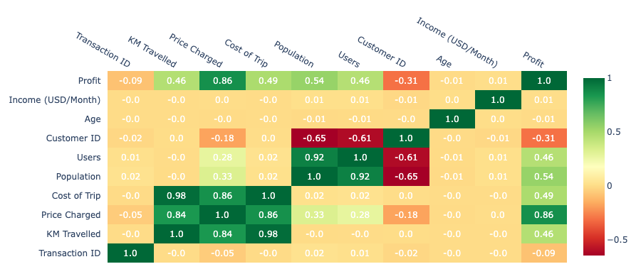
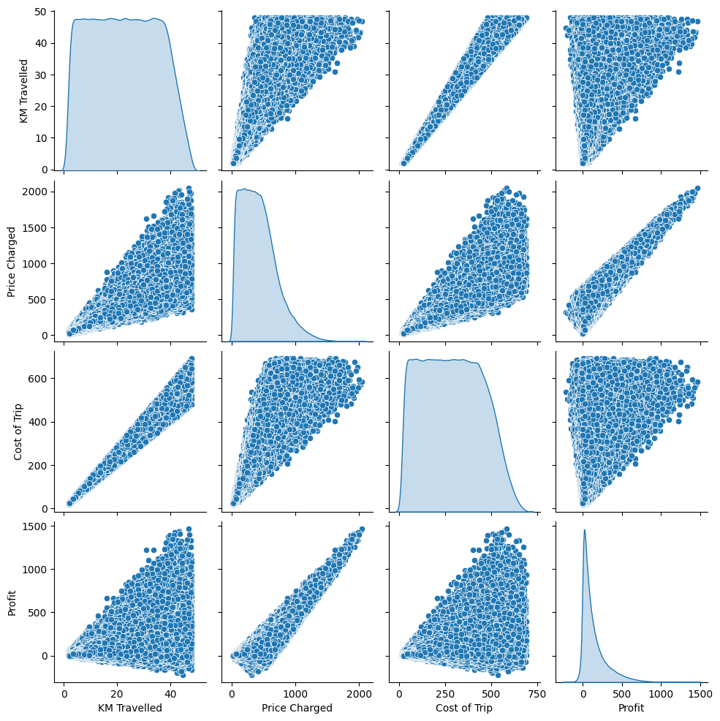
Feature Correlation
KM Travelled has a strong positive correlation to Cost of Trip and Price Charged
No correlation between Age or Income to any of the other variables
Profit also has strong positive relationship to Price Charged
Strong correlation between Population and Users (intuitive)

Slide 6
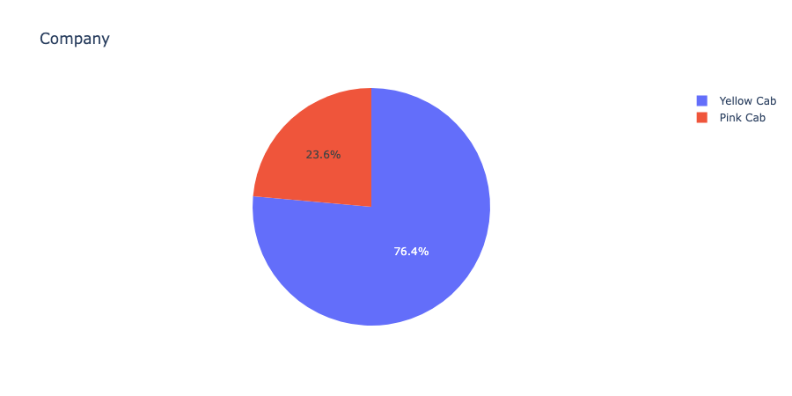
Market Share
Yellow Cab controls significantly more of the cab market compared to Pink Cab

Slide 7
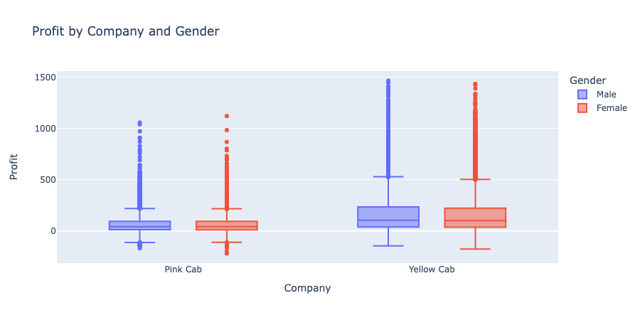
Profit Distribution by Gender and Company
Yellow Cab and Pink Cab have same minimum profit
Q₁, median, Q₃, and max profit higher for Yellow Cab
No difference between gender

Slide 8
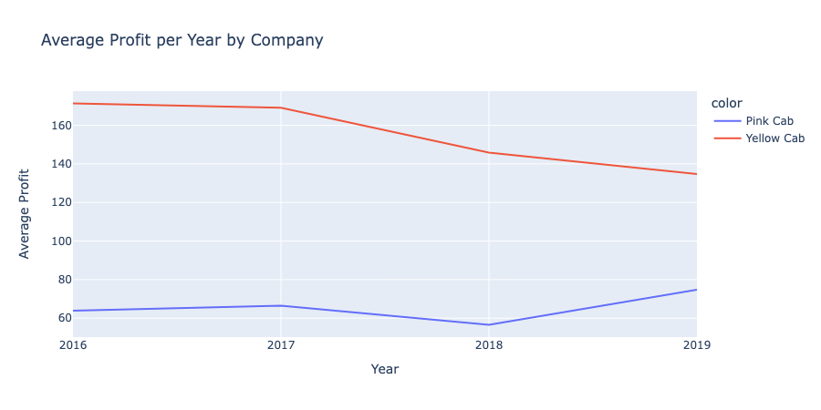
Average Yearly Profit
Similar pattern of profit over the years between the cab companies
Pink Cab seems to have an increase in profit for 2019 while Yellow Cab has decrease in profit
*Don’t have the full data for 2019 but current data might suggest outlook for 2019

Slide 9
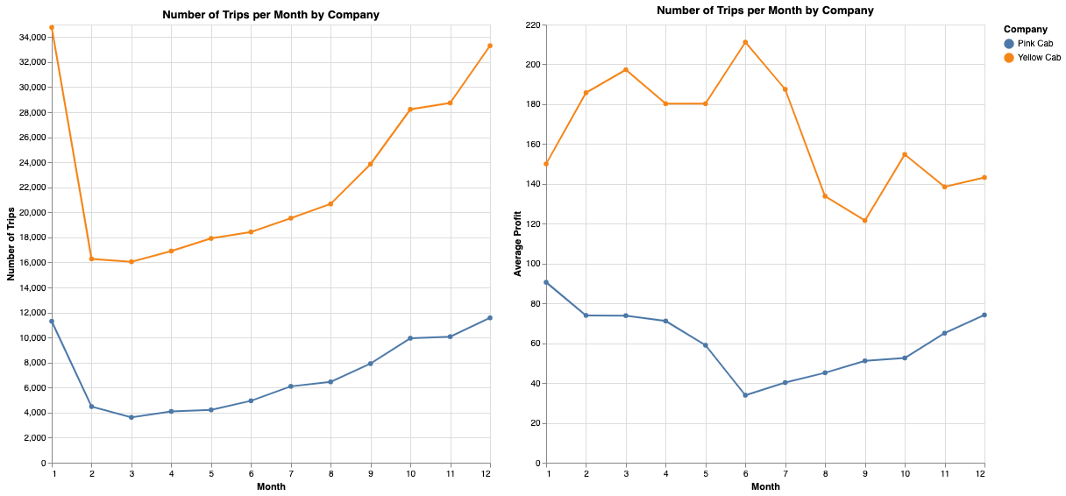
Travel Frequency and Profit Throughout Year
Users highest in Jan. and Dec. for both companies
Other than Jan, number of users increases throughout the year
No consistent pattern in profit throughout the year for either company
June - highest profit month for Yellow Cab but lowest profit for Pink Cab

Slide 10
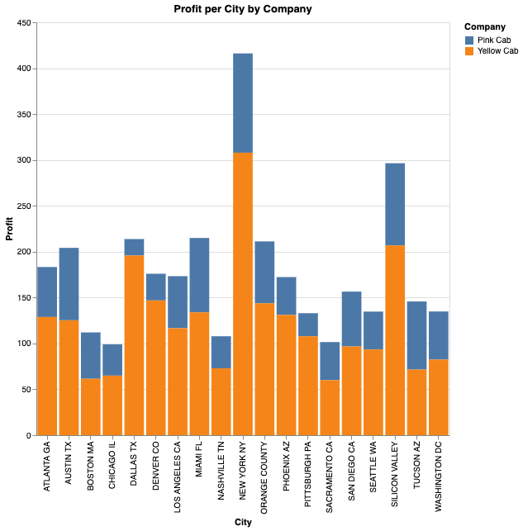
Profit by City
Market share of profit in all represented cities is majority Yellow Cab
Consistent with higher profit and larger customer base found previously

Slide 11
Recommendations
We have evaluated both the cab companies on following points and found Yellow Cab to be better than Pink Cab:
Customer Reach: Yellow Cab has much larger hold of cab industry with ~76% of dataset captured. Yellow cab has higher customer reach in all 20 recorded cities as well.
Profit Distribution: Yellow Cab shown to have much higher profit capability with higher max and median profit with larger range.
Average Yearly Profit: Yellow Cab maintains higher profit compared to Pink Cab with similar pattern of profit. However, they incur a disadvantage in analysis with possible decrease in profit for 2019 while Pink Cab could see increase in profit compared to 2018.
Monthly Ride Frequency and Profit: Yellow Cab and Pink Cab maintain similar trend in ride frequency per month, but profit is much more variable per month. Yellow Cab has higher ride frequency and profit, displaying larger market share of users and profit.
We recommend Yellow Cab for investment.

Slide 12
Thank You

