Slide 1

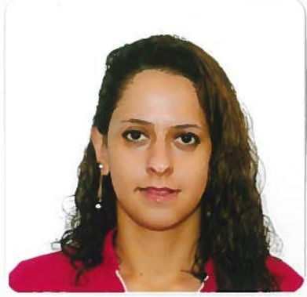
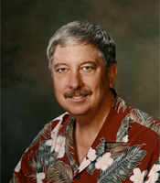
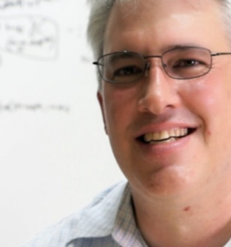
TCRβ Repertoire Modeling Using a GPU-Based In-Silico DNA Recombination Algorithm
In Collaboration with
Department of Immunobiology
(Jeffrey Frelinger, Adam Buntzman)
Gregory Striemer
Elnaz T. Yazdi

Slide 2
DNA Recombination
Immune systems of jawed vertebrates depend on DNA (VDJ) recombination
Determines diversity of antigen receptors; Immunoglobulins, T-cell receptors (TCRs)
Rearrangement of gene segments to allow for antigen recognition
Help scientists better understand immune system responses to foreign antigens

Slide 3
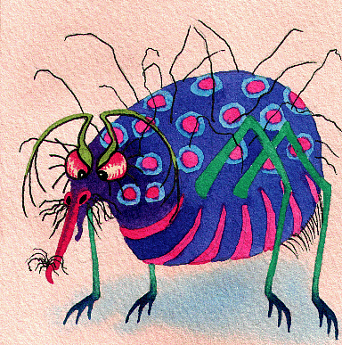
DNA Recombination
Consists of the rearrangement of sets of:
Variable (V) Genes (20 sequences)
Diversity (D) Genes (2 sequences)
Joining (J) Genes (12 sequences)
Non-templated (n) -Nucleotides create additional diversity at VDJ junctions

Slide 4
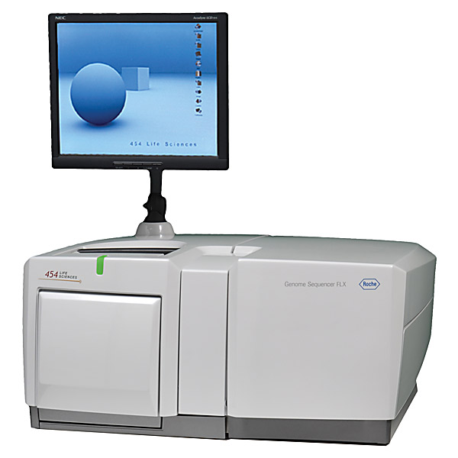
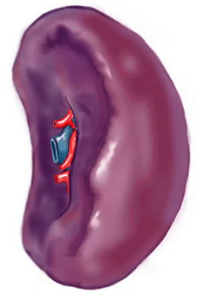
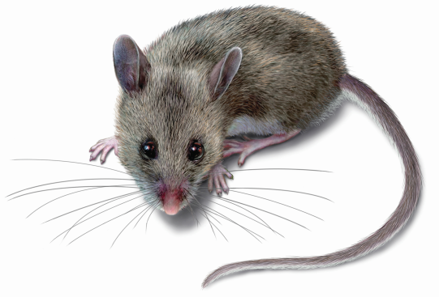
Obtaining In-Vivo Sequences
Use Sequence Alignment to “Call” V, D, and J sequences, find errors
ACCTGCAGTGCAGATCTG GGGACAGGGGGC TTTGCAAACACAGAAGTCTTC
V
D
J

Slide 5


DNA Recombination
V + N + D + N’ + J
V
J
ACCTGCAGTGCAGATCTG
TTTGCAAACACAGAAGTCTTC
D
GGGACAGGGGGC
N
N’
+
+
+
+
ACCTGCA
TGCA
CAGGGG
ACAG
CAGAAGTCTTC
ACCTGCATGCACAGGGGACAGCAGAAGTCTTC

Slide 6
DNA Recombination
V (362 possible termini variations for 20 seqs)
J (283 possible variations for 12 seqs)
D (230 paths for DB1, 275 paths for DB2)
N-Nucleotide: 4^{m} (m is length of ‘N’)
Possible Recombination Paths with m=10:
398,292,334,673,920
Peta-scale Computing
Amenable to fine-grain parallelism
Prior studies have only explored sub-sets of recombinant repertoire

Slide 7
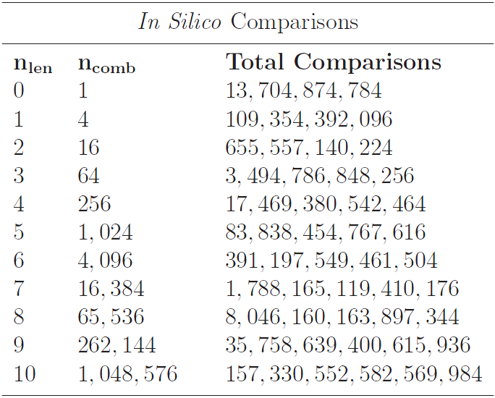
DNA Recombination

Slide 8
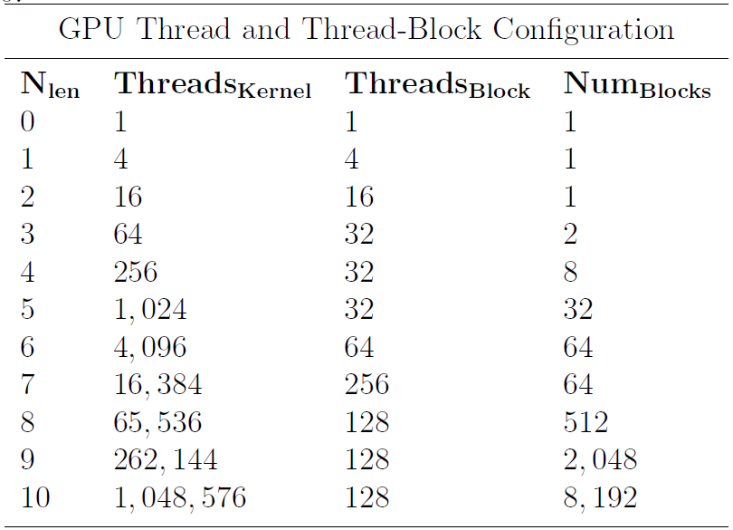
DNA Recombination
Each thread generates a unique n-nucleotide
Total threads launched is based on length of nucleotide: 4^{m} threads (always divisible by warp-size when m > 2)
Each thread performs its own recombination with V, D, and J
NVIDIA K20X using CUDA versus Serial Code running on an Xeon 2.83GHz.
2.34 days vs 260 weeks

Slide 9
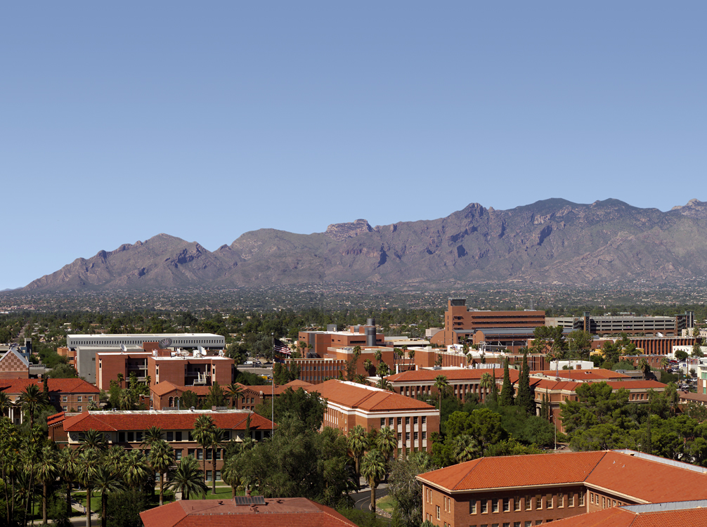
Questions?

