Slide 1

Developing a Highly Parallelized TCR Synthesis Algorithm on GPGU and FPGA for Acceleration the Study of Immune System
Elnaz Tavakoli Yazdi
Advisor: Ali Akoglu
Committee: Salim Hariri and Tosiron Adegbija
University of Arizona
Department of Electrical and Computer Engineering
tavakoliyazdi@email.arizona.edu

Slide 2
Outline
V(D)J recombination process
Biological perspective
Algorithmic perspective
GPU implementations
Baseline GPU implementation
Bit-wise GPU implementation
Multi-GPU implementation
FPGA implementations
N-level parallelization method
VJ-level parallelization method
Summary
Future work

Slide 3
V(D)J Recombination Process

Slide 4
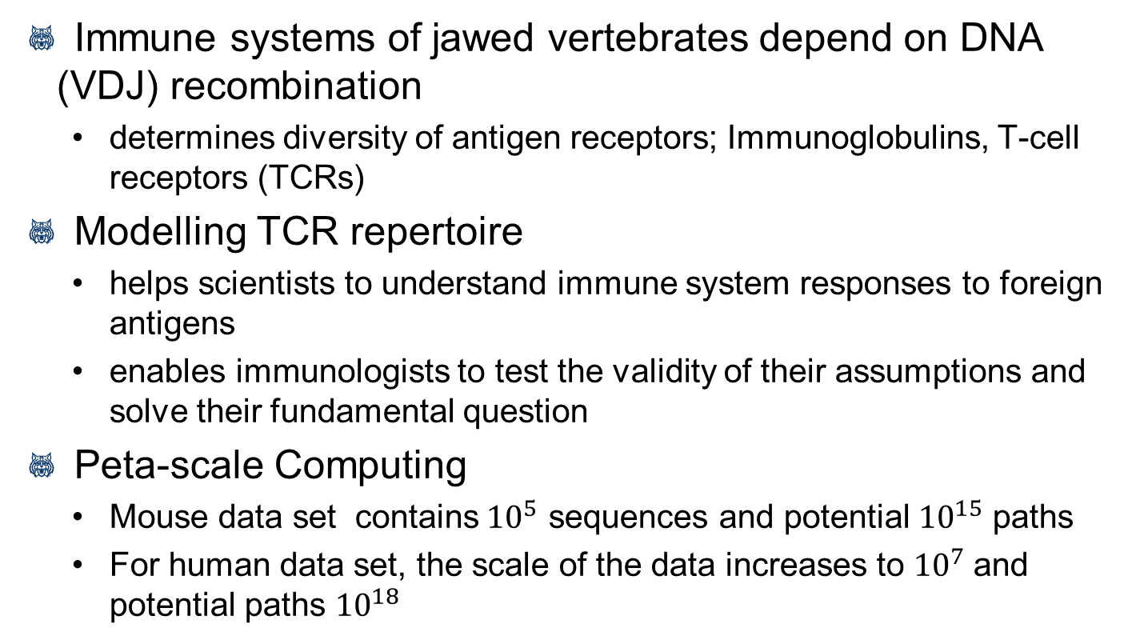
Motivation- DNA Recombination
Immune systems of jawed vertebrates depend on DNA (VDJ) recombination
determines diversity of antigen receptors; Immunoglobulins, T-cell receptors (TCRs)
Modelling TCR repertoire
helps scientists to understand immune system responses to foreign antigens
enables immunologists to test the validity of their assumptions and solve their fundamental question
Peta-scale Computing
Mouse data set contains${ 10}^{5}$ sequences and potential${ 10}^{15}$ paths
For human data set, the scale of the data increases to ${10}^{7}$and potential paths ${10}^{18}$

Slide 5
V(D)J Recombination Algorithm
Consists of the rearrangement of sets of:
Variable (V) Genes (20 sequences)
362 possible termini variations
Diversity (D) Genes (2 sequences)
230 paths for DB1
275 paths for DB2
Joining (J) Genes (12 sequences)
283 possible variations
Each sequence is generated using four bases (A, C, T, G)
Non-templated (n) -Nucleotides create additional diversity at VDJ junctions
4^{m} (m is length of ‘N’)

Slide 6
V(D)J Recombination Algorithm
Consists of three steps:
Step Zero
Step One

Slide 7
V(D)J Recombination Algorithm
Step Two
Step Three

Slide 8
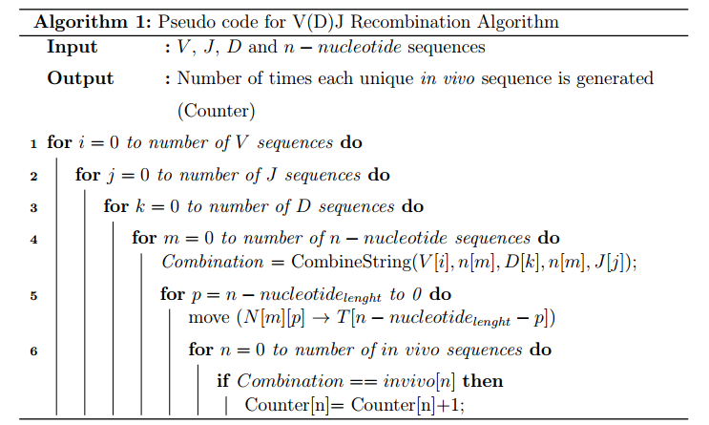
V(D)J Recombination Algorithm
Recombination process from algorithmic respective

Slide 9
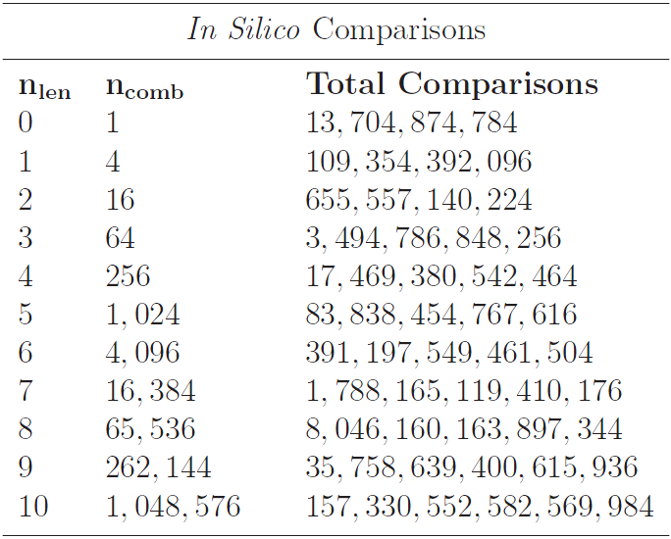
True V(D)J problem size
Possible Recombination Paths with m=10: 398,292,334,673,920

Slide 10
GPU Implementations

Slide 11
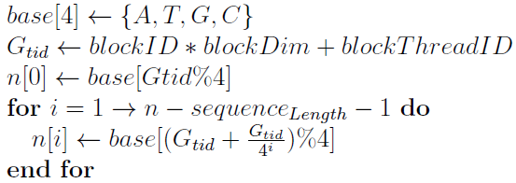
Baseline GPU Implementation
An n-level parallelization approach
Each thread generates a unique n-nucleotide
Total threads launched is based on length of nucleotide: 4^{m} threads (always divisible by warp-size when m > 2)
Each thread performs its own recombination with V, D, and J
with global memory coalescing, shared memory broadcasting, and very fine granularity
G. Striemer, H. Krovi, A. Akoglu, B. Vincent, B. Hopson, J. Frelinger, and A. Buntzman, “Overcoming the limitations posed by tcrβ repertoire modeling through a gpu-based in-silico dna recombination algorithm," in IEEE Proceeding 28th Int. Parallel and Distributed Processing Symp, pp. 231-240, May 2014.

Slide 12
Contributions
Devising a bit-wise GPU-based implementation of recombination process
Extending the bit-wise implementation to a multi-GPU environment
Utilizing the N-level parallelization approach for the FPGA-based implementation of the recombination process
Devising a VJ-level parallelization approach for FPGA implementation

Slide 13
Bit-wise GPU Implementation
Representing each base with two bits
Reducing memory footprint
Fetching four characters with one memory access
Zero padding sequences to be divisible by eight
Padded bits
Full byte

Slide 14
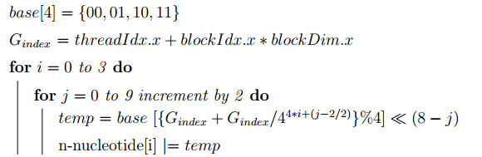
Bit-wise GPU Implementation
N-Level parallelization approach
Task generator
In vivo sequences are partitioned into 240 groups
20 V gene
12 J gene

Slide 15
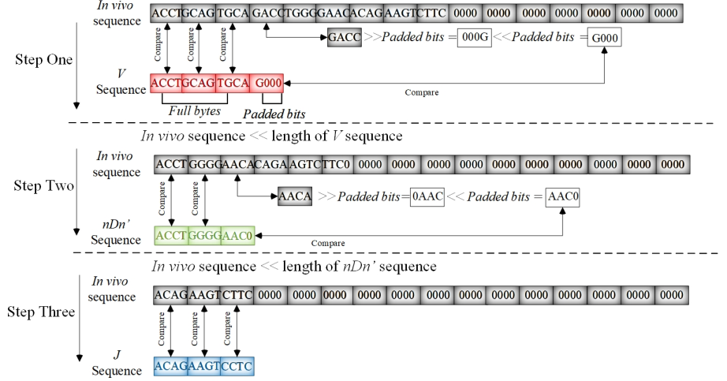
Bit-wise GPU Implementation
Comparison process

Slide 16
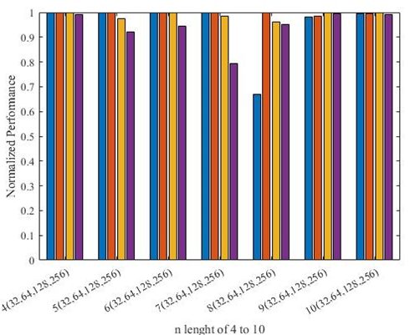
Experimental Results for GPU Implementation
Thread-block Configuration analysis
Normalized value of 1 represents the
best performance for a given length
20% reduction in performance of n=7
for 256 threads per block
Lower thread-block utilization
35% reduction in performance
of n= 8 for 32 threads per block
Thread-block configuration
64 for n length 4 to 8
128 for n length 9 and 10

Slide 17
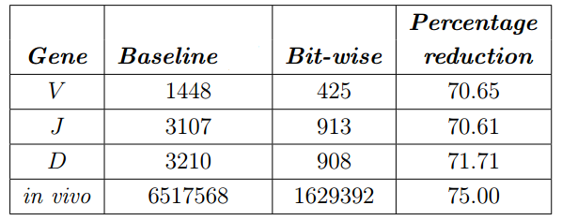
Bit-wise Simulation Results
Memory Footprint
Reducing constant memory by
a factor of 3.4
Reducing global memory by
a factor of 4

Slide 18
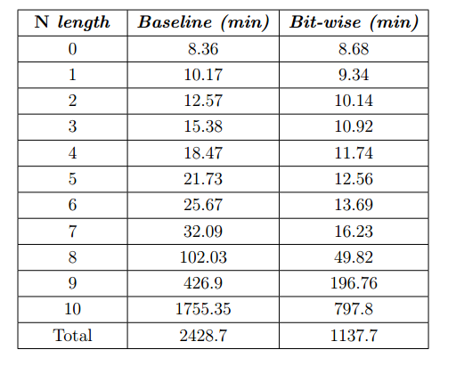
Bit-wise Simulation Results
Execution Time
Reducing total execution time by
a factor of 2.1

Slide 19
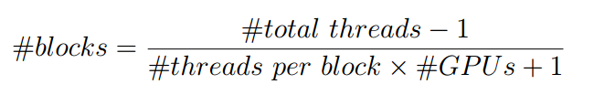
Multi-GPU Implementation
Defining global Index
Workload distribution
Performing reduction process
Collecting results to the root node

Slide 20
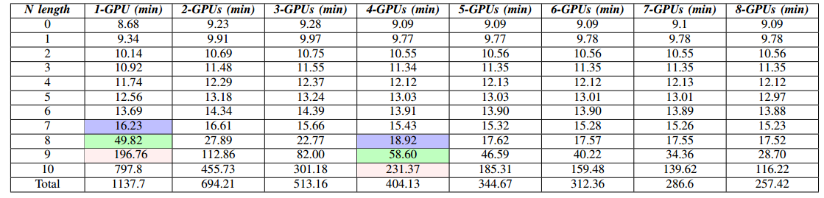
Multi-GPU Simulation Results
Execution Time
Slight increase for n-nucleotide length of less than eight
Observing the benefit from a multi-GPU environment for n-nucleotide length of greater than seven
Increase in execution time by about a factor of four at each increments of the n-nucleotide length
Almost same execution time for two consecutive n lengths, while using one GPU and four GPUs

Slide 21
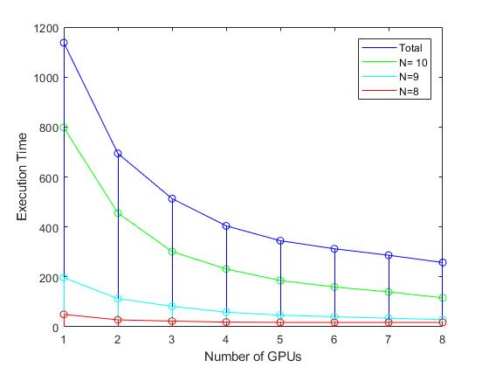
Multi-GPU Simulation Results
Execution Time

Slide 22
FPGA Implementations

Slide 23
Architecture I
Hardware architecture for N-level parallelization approach

Slide 24
Architecture I
Hardware architecture for N-level parallelization approach

Slide 25
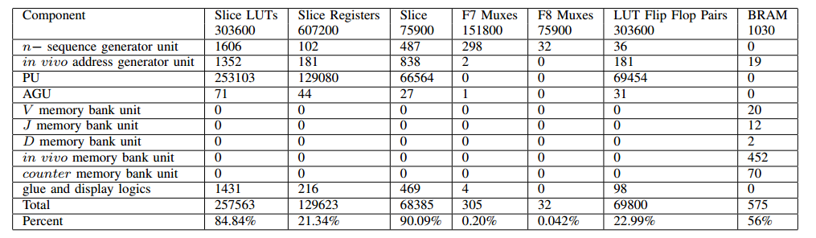
Simulation Results for N-Level Parallelization
Resource Utilization

Slide 26
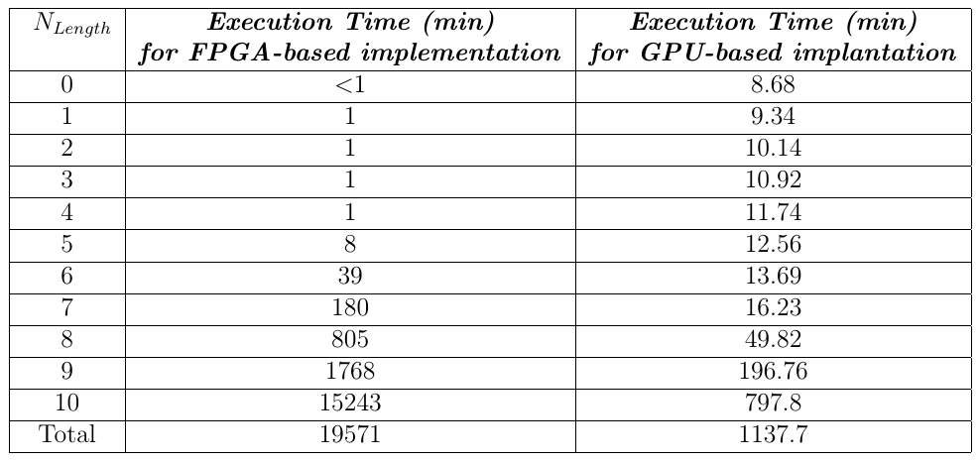
Simulation Results for N-Level Parallelization
Execution Time

Slide 27
Advantages and Disadvantages of N-level method
Advantages
Even workload distribution across CUs
Parallel comparison process
Elimination of the repetitive computations for generating in silico sequences.
Disadvantages
Large critical path delay
due to the communication between the n-sequence initiator unit and CUs
No overlap between the execution of two consecutive component

Slide 28
Architecture II
Hardware architecture for VJ-level parallelization approach

Slide 29
Architecture II
Hardware architecture for VJ-level parallelization approach

Slide 30
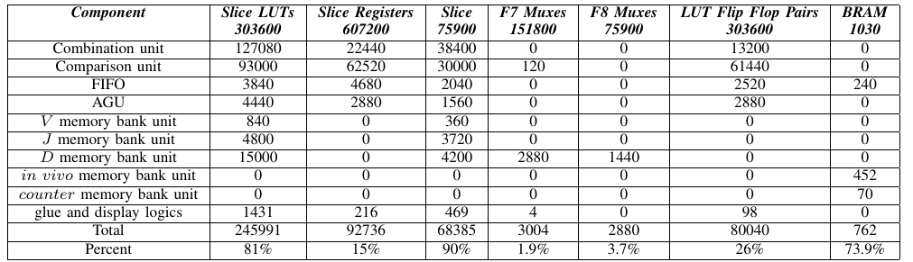
Simulation Results for VJ-Level Architecture
Resource Utilization

Slide 31
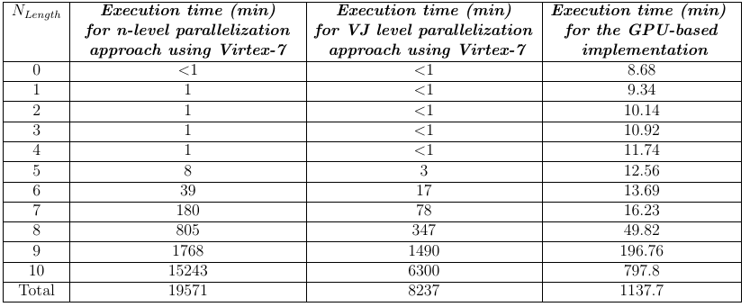
Simulation Results for VJ-Level Architecture
Execution Time

Slide 32
Summary and Future Work

Slide 33
Summary
Devising a bit-wise GPU-based implementation of the V (D)J recombination algorithm
Reduces the constant memory and global memory footprint by factors of 3.4 and 4
Reducing the execution time by a factor of 2.1
Presenting a multi-GPU implementation for the bitwise recombination
Reduces the execution time with increasing the number of GPUs
Mapping the recombination process on FPGA using N-level method
Developing a VJ-level parallelization method for the FPGA implementation
Reducing the execution time by a factor of 2.3 in comparison with N-level method

Slide 34
Future Work
Expand to research recombination repertoire of humans
Currently have 50 million sequences from 100 humans
Several formats require significant pre-processing
Additional performance optimizations
Proposing scalable implementation of recombination process for the multi-GPU environment
Utilizing hash function to speed up the comparison process

Slide 35
Questions?

Slide 36
Additional Slides

Slide 37
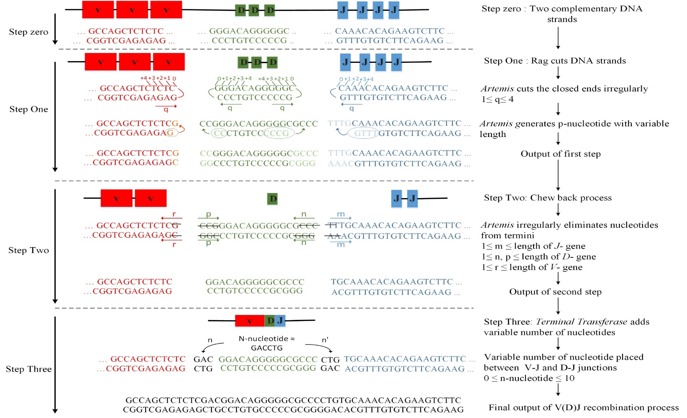
V(D)J Recombination Algorithm

Slide 38
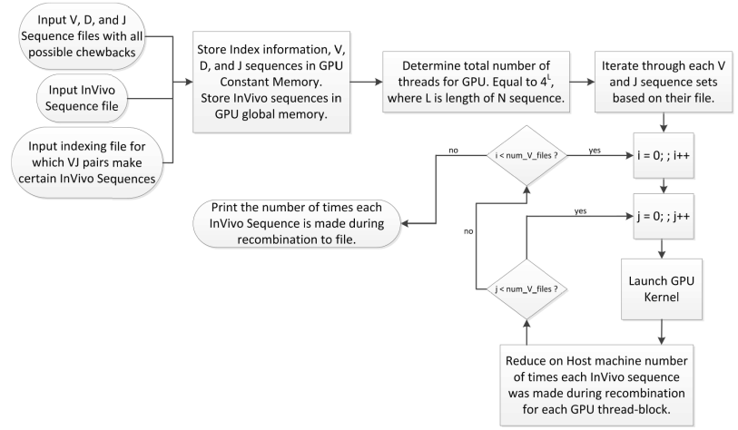
Baseline GPU-based Implementation

Slide 39
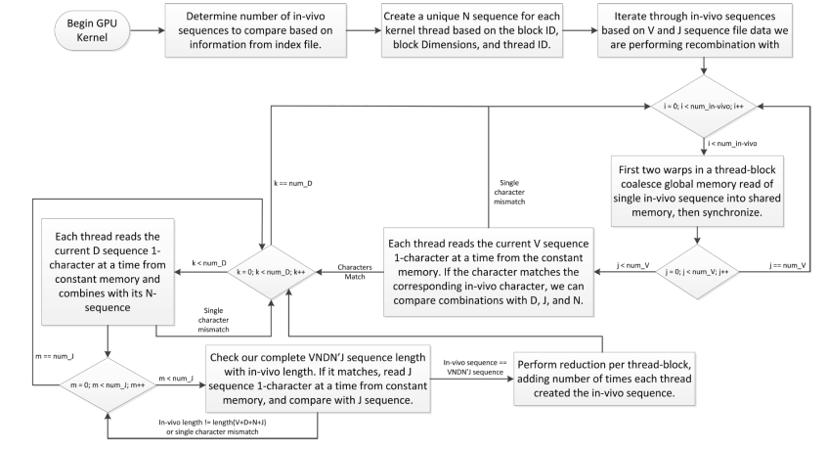
Baseline GPU-based Implementation

Slide 40
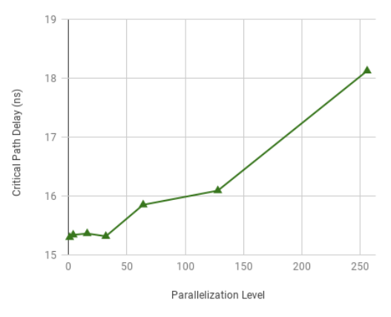
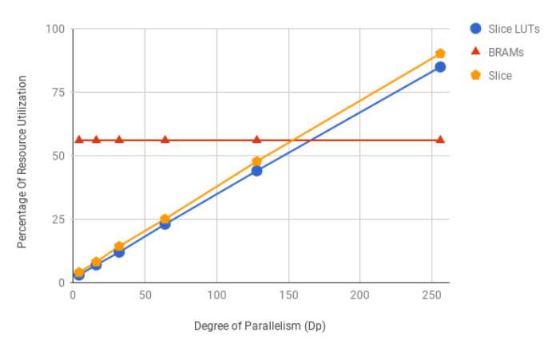
FPGA-based Implementation
Determining the degree of parallelism
Correlation between Dp and resource utilization.
Resource utilization for a single computation unit (CU)
Correlation between Dp and critical path delay

Slide 41
FPGA-based Implementation
Hardware architecture for N-level parallelization approach
Address Generator Unit (AGU)
Generating address for V, D, and J memory bank units
Memory bank Unit
J Memory
Containing all 12 J sequence with the chewback and palindromic forms
V Memory
Containing all 20 V sequence with the chewback and palindromic forms
D Memory
Containing D1 and D2 sequence with the chewback and palindromic forms
In-vivo Memory
Containing 240 BRAMs which keep one VJ group of in vivo sequence
Counter Memory
Containing 240 BRAMs which are assigned to one VJ group

Slide 42
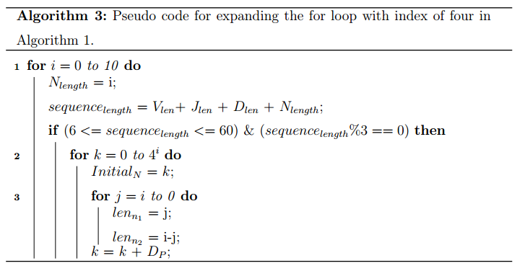
FPGA-based Implementation
Processing Unit (PU)
N-nucleotide Initiator Unit
sending Initial n-nucletotide as a reference starting address to all CUs

Slide 43
FPGA-based Implementation
Processing Element(PU)
Computation Unit
Concatenation Unit
using an or gate to concatenate the V , n1, D, n2 and J sequences in the given order to form a 128-bit sequence
Comparison Unit
Using 128-bit comparator
In vivo Address Generator Unit
Generating address for In-vivo and counter memory bank units
Containing two arrays (startingarray, endingarray )
Size of 19*240
Determining the address based on the VJ group and length of in silico sequence

Slide 44
FPGA-based Implementation
Hardware architecture for VJ-level parallelization approach
Memory bank Unit
J Memory
Containing two J sequences with the chewback and palindromic forms
V Memory
Containing one V sequence with the chewback and palindromic forms
D Memory
Containing D1 and D2 sequence with the chewback and palindromic forms
In-vivo Memory
Containing two BRAMs in which each keeps one VJ group of in vivo sequence
Counter Memory
Containing two BRAMs in which each is assigned to one VJ group of in vivo

Slide 45
FPGA-based Implementation
Hardware architecture for VJ-level parallelization approach
Combination Unit
Consists of five steps
Calculating the length of in silico sequence and check its validity
Setting the length of n1 and n2 sequence
Calculating shift amount for each sequence and do concatenation
Checking the status of FIFO and pass the in silico sequence if not full
Adjusting the length of n1 and n2 nucleotide along with the binary value of n-nucleotide sequenc

Slide 46

FPGA-based Implementation
Hardware architecture for VJ-level parallelization approach
Comparison Unit
Consists of five steps
Checking the status of FIFO to have at least four sequences
Reading one or four in silico sequence from buffer
Extracting the length and groupid of in silico sequence
Comparing the in vivo sequence with fetched sequences
Updating counter memory

Slide 47
FPGA-based Implementation
Hardware architecture for VJ-level parallelization approach
FIFO
Eliminate the communication between units
Overlapping between the execution of two consecutive units
Performing parallel comparison
Determining size of FIFO
Remaining below 85% BRAM utilization
Assigning 1 × 36Kb BRAM to each PU
Up to 256 in silico sequences

Slide 48
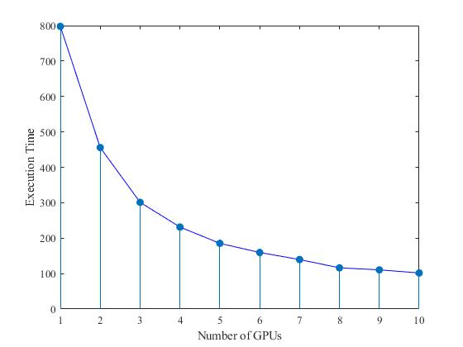
FPGA-based Implementation

