Slide 1
Bit-wise and Multi-GPU Implementations of the DNA Recombination Algorithm
Elnaz Tavakoli Yazdi, Ankur Limaye, Ali Akoglu, Tosiron Adegbija, and Adam Buntzman
Department of Electrical and Computer Engineering, The University of Arizona, Tucson, AZ 85721

Slide 2
Outline
Motivation
V(D) J Recombination Process
Biological Perspective
Algorithmic Perspective
GPU implementations
Baseline GPU implementation
Bit-wise GPU implementation
Multi-GPU implementation
Results
Future work

Slide 3
Motivation
DNA recombination essential for immune systems of jawed vertebrates
determines diversity of antigen receptors; Immunoglobulins, T-cell receptors (TCRs)
TCR recognizes an antigen, which induces immune system response to eliminate the antigen
Modeling the TCR repertoire
Helps researchers to understand the immune system responses to foreign antigens
Enables immunologists to test the validity of their assumptions and solve their fundamental question
Peta-scale Computing
Mouse data set contains 10⁵ sequences and potential 10¹⁵ paths
For human data set, the scale of the data increases to 10⁷ and potential paths 10¹⁸
Simulating the recombination process is time consuming
Striemer et al. successfully modeled the mouse TCR repertoire for the first time
Simulation time: 16 days (NVIDIA GTX480 GPU), estimated 52 weeks on a general-purpose processor
G. Striemer, H. Krovi, A. Akoglu, B. Vincent, B. Hopson, J. Frelinger, and A. Buntzman, “Overcoming the limitations posed by TCR repertoire modeling through a GPU-Based in-silico DNA recombination algorithm,” in Parallel and Distributed Processing Symposium, pp. 231–240, May 2014.

Slide 4
V(D)J Recombination Algorithm
Immune systems achieve diversity in TCR repertoire through V(D)J recombination process
Involves a rearrangement of the variable (V), diversity (D), and joining (J) gene segments in a combinatorial way chosen from members of each gene family
In mice, it consists of the rearrangement of sets of
20 sequences of V genes with 362 possible termini variations
2 sequences of D genes with 230 paths for DB1 and 275 paths for DB2 variations
12 sequences of J genes with 283 possible termini variations
Each sequence is generated using four bases (A, C, T, G)
Non-templated (n) -Nucleotides create additional diversity at V(D)J junctions
4m (m is length of ‘N’)
D. G. Schatz, and Y. Ji, “Recombination centers and the orchestration of V(D)J recombination,” Nature Reviews Immunology, vol. 11, No. 4, pp. 251–263, April 2011

Slide 5
V(D)J Recombination Algorithm
Consists of three steps:
Step Zero:
a
A
A
Step One:

Slide 6
V(D)J Recombination Algorithm
Step Two:
a
A
aA
Step Three:

Slide 7
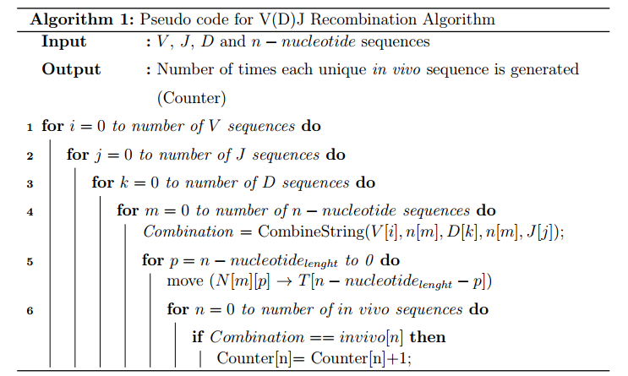
V(D)J Recombination Algorithm
Algorithmic perspective:

Slide 8
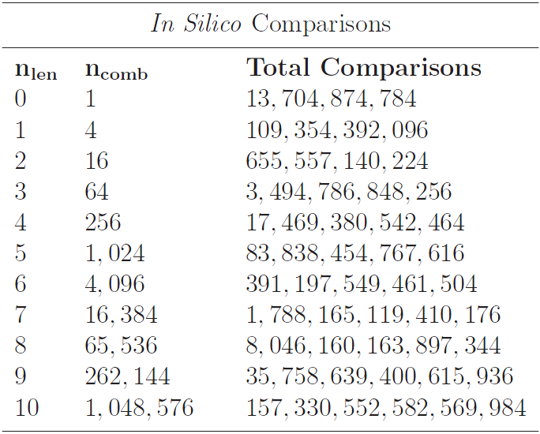
V(D)J Recombination Algorithm Problem Size
Possible recombination paths for m=10 : 398,292,334,673,920

Slide 9
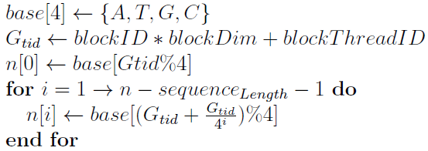
Baseline GPU Implementation
An n-level parallelization approach
Each thread generates a unique n-nucleotide
Total threads launched is based on length of nucleotide: 4^{m} threads (always divisible by warp-size when m > 2)
Each thread performs its own recombination with V, D, and J
With global memory coalescing, shared memory broadcasting, and very fine granularity
G. Striemer, H. Krovi, A. Akoglu, B. Vincent, B. Hopson, J. Frelinger, and A. Buntzman, “Overcoming the limitations posed by tcrβ repertoire modeling through a gpu-ased in-silico dna recombination algorithm," in IEEE Proceeding 28th Int. Parallel and Distributed Processing Symp, pp. 231-240, May 2014.

Slide 10
Contributions
Devising a bit-wise GPU-based implementation of recombination process
Extending the bit-wise implementation to a multi-GPU environment
Utilizing the N-level parallelization approach for the recombination process

Slide 11
Experimental Setup
P100 GPU Streaming Multiprocessor

Slide 12
Bit-wise GPU Implementation
Representing each base with two bits
Reducing memory footprint
Fetching four characters with one memory access
Zero padding sequences to be divisible by eight
Padded bits
Full byte

Slide 13
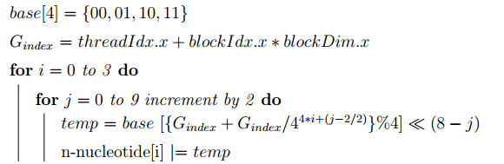
Bit-wise GPU Implementation
N-Level parallelization approach
Task generator
In vivo sequences are partitioned into 240 groups
20 V gene
12 J gene

Slide 14
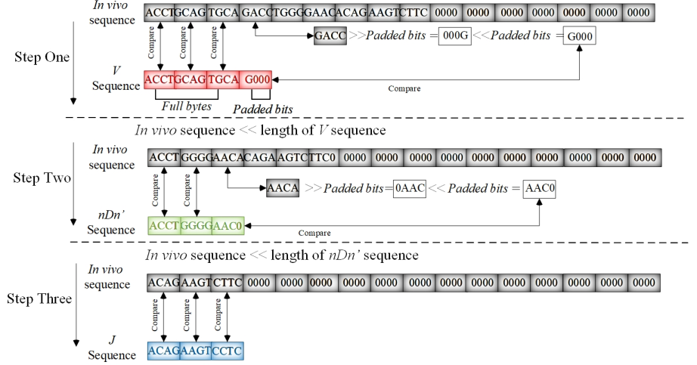
Bit-wise GPU Implementation
Comparison Process:

Slide 15
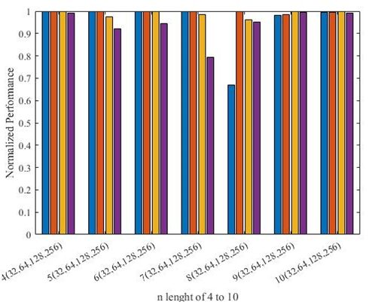
GPU Implementation Results
Thread-block Configuration analysis
Normalized value of 1 represents the best performance for a given length
20% reduction in performance of n=7 for 256 threads per block (tpb)
Lower thread-block utilization
35% reduction in performance of n= 8 for 32 tpb
Thread-block configuration
64 for n length 4 to 8
128 for n length 9 and 10

Slide 16
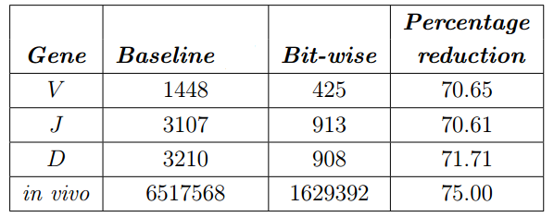
Bit-wise Simulation Results
Memory Footprint
Reducing constant memory by a factor of 3.4x
Reducing global memory by a factor of 4

Slide 17
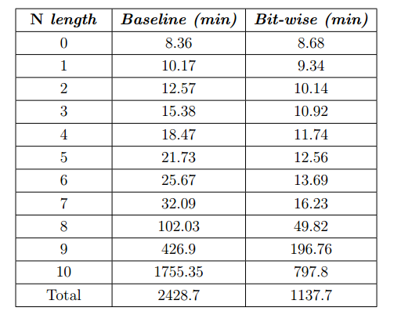
Bit-wise Simulation Results
Execution Time
Reducing total execution time by a factor of 2.1

Slide 18
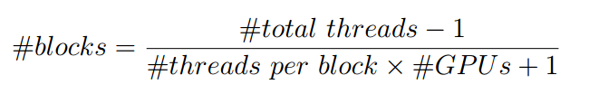
Multi-GPU Implementation
Defining the global Index:
Workload distribution
Performing reduction process
Collecting results to the root node

Slide 19
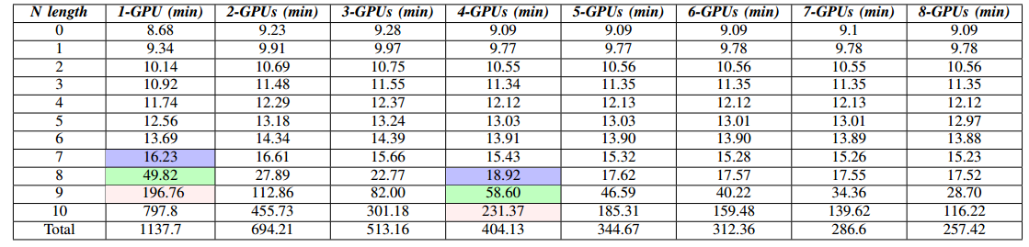
Multi-GPU Simulation Results
Execution Time
Slight increase for n-nucleotide length of less than eight
Observing the benefit from a multi-GPU environment for n-nucleotide length of greater than seven
Increase in execution time by about a factor of four at each increments of the n-nucleotide length
Almost same execution time for two consecutive n lengths, while using one GPU and four GPUs

Slide 20
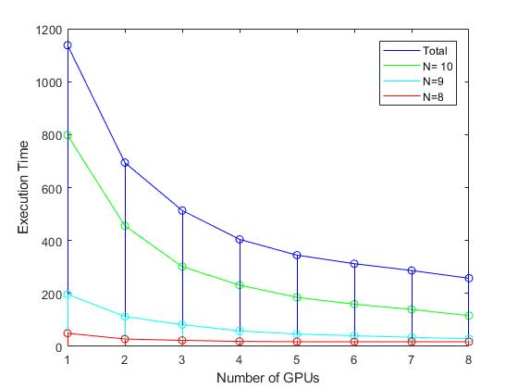
Multi-GPU Simulation Results
Execution Time

Slide 21
Future Work
Expand to research recombination repertoire of humans
Currently have 50 million sequences from 100 humans
Several formats require significant pre-processing
Additional performance optimizations
Proposing scalable implementation of recombination process for the multi-GPU environment
Utilizing hash function to speed up the comparison process

