Slide 1

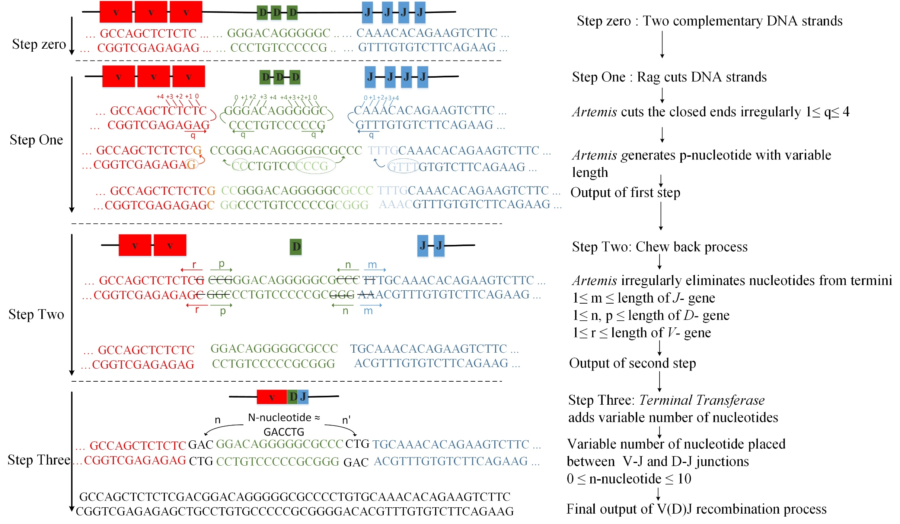
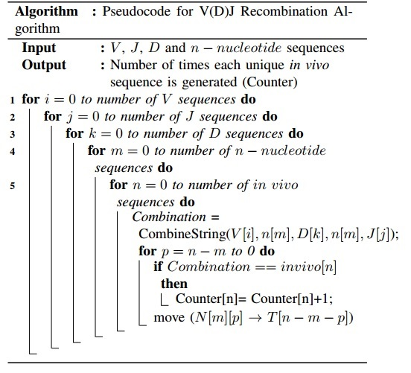
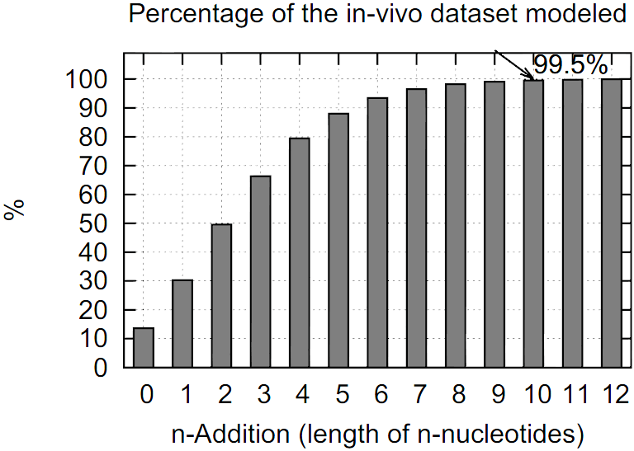
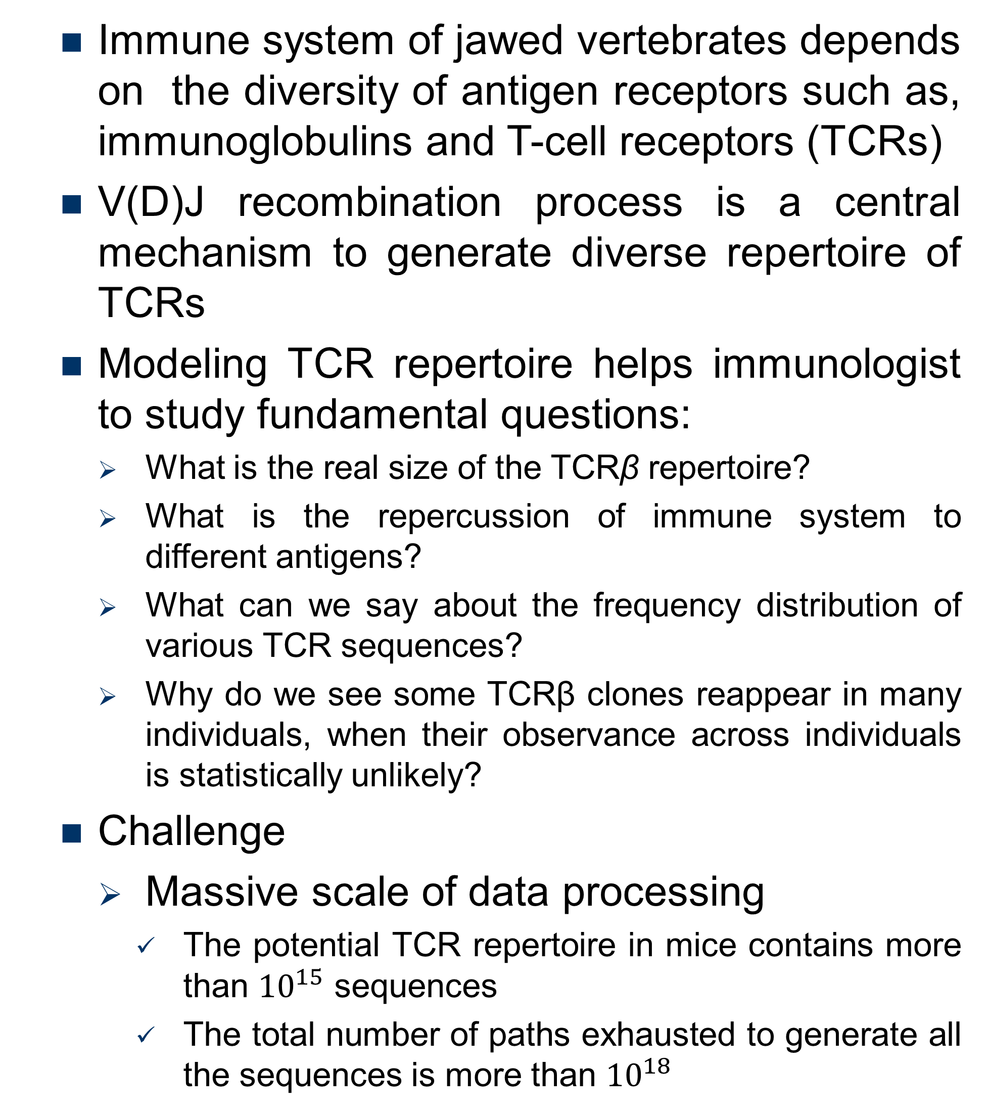
TCRβ Repertoire Reconstruction Through GPU-Based Implementations
${Elnaz Tavakoli Yazdi}^{∗},{Adam Buntzman}^{ŧ}$, ${Ali Akoglu}^{∗}$
* Department of Electrical and Computer Engineering University of Arizona , $ŧ$BIO5 Institute University of Arizona
Emails: tavakoliyazdi@email.Arizona.edu, buntzman@email.Arizona.edu, akoglu@amail.Arizona.edu
Problem Description
V(D)J Recombination Process
Immune system of jawed vertebrates depends on the diversity of antigen receptors such as, immunoglobulins and T-cell receptors (TCRs)
V(D)J recombination process is a central mechanism to generate diverse repertoire of TCRs
Modeling TCR repertoire helps immunologist to study fundamental questions:
What is the real size of the TCRβ repertoire?
What is the repercussion of immune system to different antigens?
What can we say about the frequency distribution of various TCR sequences?
Why do we see some TCRβ clones reappear in many individuals, when their observance across individuals is statistically unlikely?
Challenge
Massive scale of data processing
The potential TCR repertoire in mice contains more than ${10}^{15}$ sequences
The total number of paths exhausted to generate all the sequences is more than ${10}^{18}$
Brief view of the V (D)J recombination process. The figure shows p-nucleotide formation with length one for V - gene termini, two for left side of D- gene termini, four for right side of D- gene termini and four for J- gene termini in step one. Example depicts elimination of one nucleotide on the V-gene termini, three nucleotides on both side of the D-gene and two nucleotides on J- gene termini.
Approaches
DNA Recombination Algorithm
GPU Hardware Architecture
We implement the DNA recombination algorithm through the graphics processing unit (GPU) using the CUDA programming environment
We exploit two optimization techniques to improve the performance of GPU baseline implementation
We take advantages of Open MPI to launch Multiple GPUs for data operations
We Perform bit-wise operations in the recombination process
Biological Impact
The K20x GPU architecture
Comparison of Different Implementations
Convergent Recombination Hypothesis (CHR)
CRH appears to be incorrect: In-silico production frequencies have no predictive potential for sequence frequency in-vivo
N Length | Baseline GPU Implementation (GTX480) (min) | Baseline GPU Implementation (K20x) (min) | Multi-GPU implementation (2 GPUs–K20x) (min) | Bit-Wise Representation (K20x) (min)
0 | 31 | 30 | 30 | 22
1 | 38 | 35 | 35 | 45
2 | 46 | 41 | 41 | 49
3 | 57 | 48 | 48 | 53
4 | 66 | 48 | 47 | 56
5 | 77 | 54 | 53 | 60
6 | 95 | 106 | 61 | 64
7 | 323 | 87 | 72 | 147
8 | 1031 | 418 | 191 | 411
9 | 4528 | 838 | 551 | 1469
10 | 17170 (~ 13 days) | N/A | 2237.8 (~2.4 days) | N/A
Reference
G. Striemer, H. Krovi, A. Akoglu, B. Vincent, B. Hopson, J. Frelinger, and A. Buntzman, “Overcoming the limitations posed by TCRβ repertoire modeling through a GPU-based in-silico DNA recombination algorithm,” in 2014 IEEE 28th International Parallel and Distributed Processing Symposium, May 2014, pp. 231–240

