Slide 1
Poster Presentation:
A reusable framework for text analysis and comparison

Slide 2
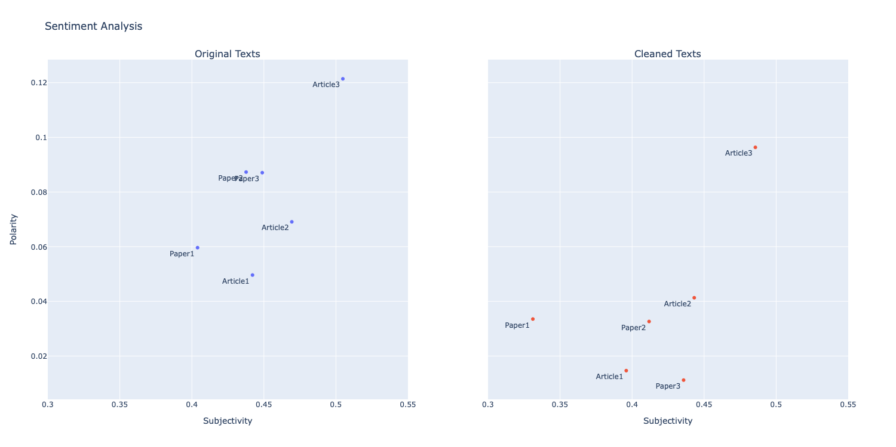
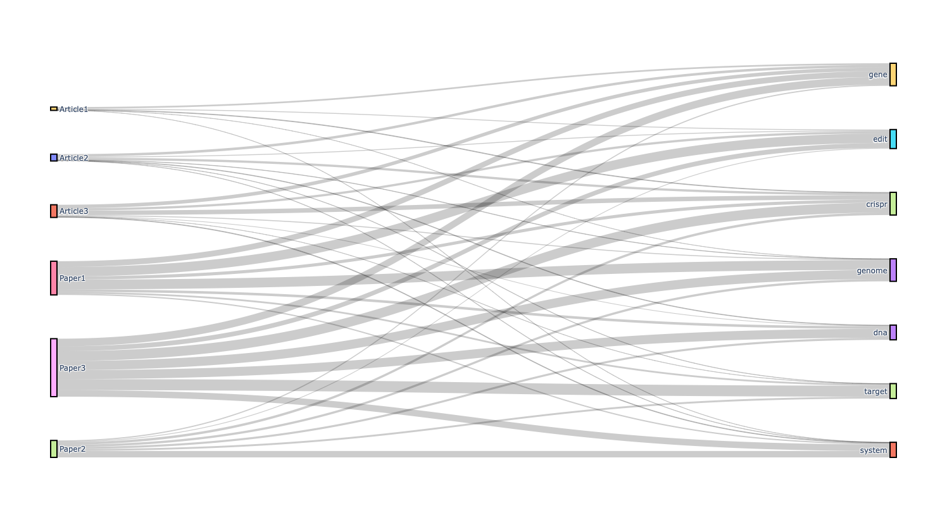
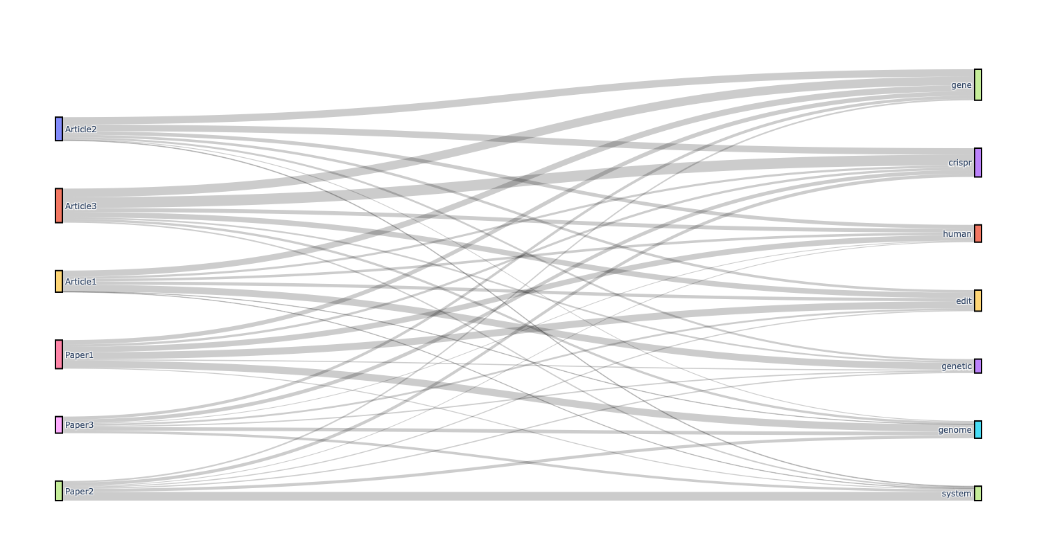
Natural Language Processing on Texts about CRISPR Sreevatsa Nukala
References [1] R. Barrangou, “The roles of crispr–cas systems in adaptive immunity and beyond,”Current Opinion in Immunology, vol. 32, pp. 36–41, 2015, innate immunity. [Online]. Available: https://www.sciencedirect.com/science/article/pii/S0952791514001563
[2] F. B. Ayano ̆glu, A. E. El ̧cin, and Y. M. El ̧cin, “Bioethical issues in genome editing by CRISPR-Cas9 technology,” Turk. J. Biol., vol. 44, no. 2, pp. 110–120, Apr. 2020. 3
[3] P. Hsu, E. Lander, and F. Zhang, “Development and applications of crispr-cas9 for genome engineering,” Cell, vol. 157, no. 6, pp. 1262–1278, 2014. [Online]. Available: https://www.sciencedirect.com/science/article/pii/S0092867414006047
[4] S. Sufian, “The dark side of crispr,” Scientific American, Feb 2021. [Online]. Available: https://www.scientificamerican.com/article/the-dark-side-of-crispr/
[5] “Full stack genome engineering,” Synthego. [Online]. Available: https://www.synthego.com/learn/crispr
[6] L. Warneck-Silvestrin, “The promises of crispr genome editing in biomedicine,”Labiotech.eu, Mar 2021. [Online]. Available: https://www.labiotech.eu/interview/crispr-therapeutics-genome-editing/.
Sentiment analyses of original and processed/cleaned versions of texts
Sankey diagram of text to most common words (absolute frequency)
Sankey diagram of text to most common words (relative frequency)

