Slide 1

INT200 : Human Pose Estimation using Deep Learning in Python
INT 200 Internship
First Review
Team Members
1. Sreevijnya M (E0221040)
2. S Rehalya Shree (E0221022)
Project Guide
Prof. B Nirmala

Slide 2
Introduction
Human pose estimation (HPE), which has been extensively studied in computer vision literature, it involves estimating the configuration of human body parts from input data captured by sensors, in particular images and videos.
HPE provides geometric and motion information of the human body which has been applied to a wide range of applications (e.g., human-computer interaction, motion analysis, augmented reality (AR), virtual reality (VR), healthcare, etc.).
With the rapid development of deep learning solutions in recent years, such solutions have been shown to outperform classical computer vision methods in various tasks including image classification, semantic segmentation, and object detection. Significant progress and remarkable performance have already been made by employing deep learning techniques in HPE tasks.

Slide 3
Objective (1/2)
Yoga asanas are considered to be an effective natural remedy for dealing with thyroid disorders like Hypothyroidism.
While it may not be able to cure the condition instantly, but it can help in keeping the glands healthy and regulate metabolism, thereby preventing any further complications.
The aim is to create a Deep Learning model which estimates the yoga poses for the disorder and to verify whether the poses are correct or not.

Slide 4
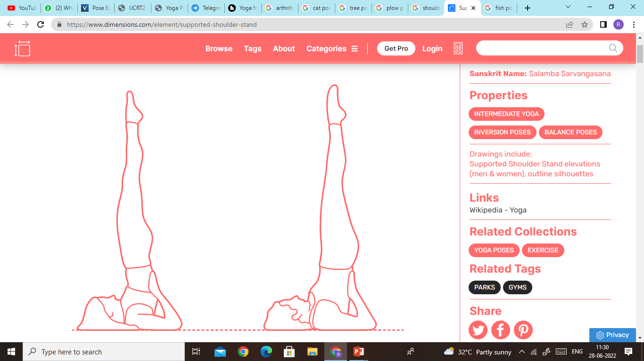
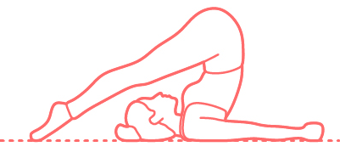
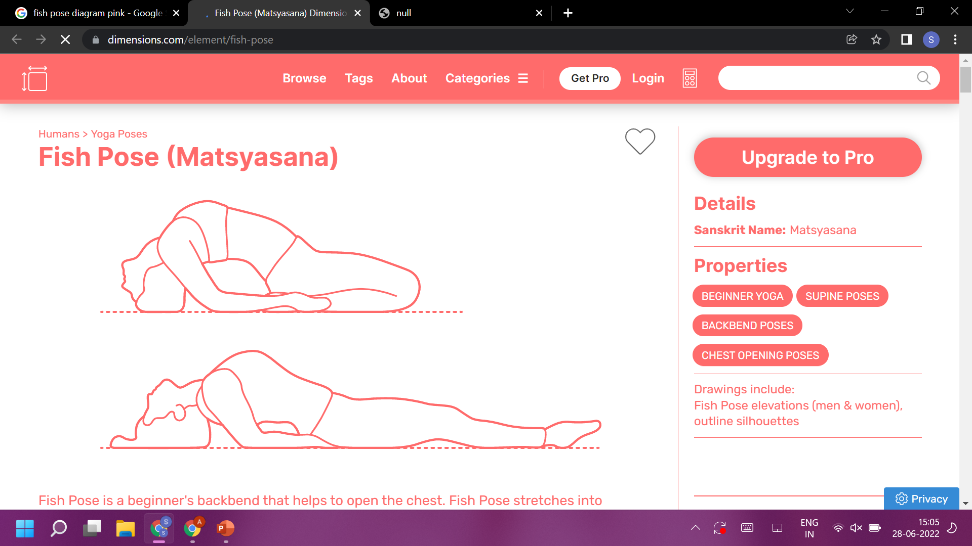
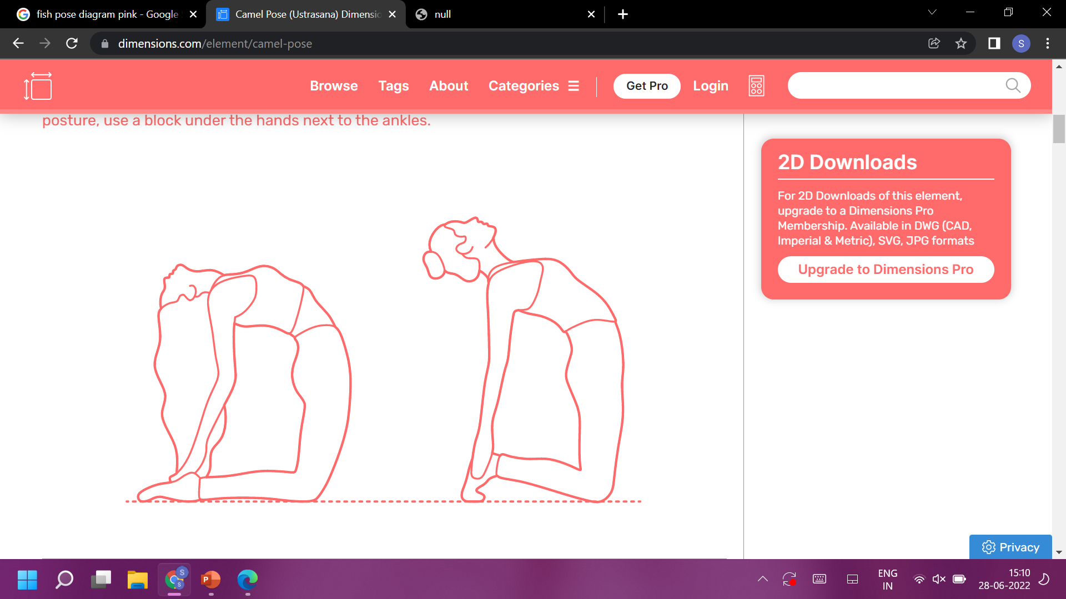
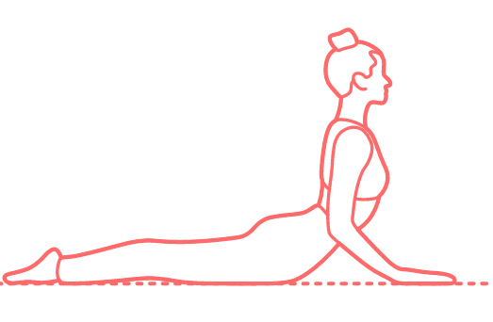
Objective (2/2)
Yoga poses as input data.
Halasana
Sarvangasana
Matsyasana
Bhujangasana
Ustrasana

Slide 5
Research survey
S.NO | Title | Author | Year | Overview
1. | Yoga Pose Classification Using Deep Learning | Shruti Kothari | 2020 | CNN based model. Used OpenPose-based method Accuracy: 99%
2. | Deep Learning-Based Human Pose Estimation | Ce Zheng, Wehhan Wu, Chen Chen, Ju Shen, Nasser Kehtarnava, Mubarak Shah | 2022 | It’s a CNN based method for predicting . Used OpenPose-based method
3. | Yoga Pose Detection and Classification Using Deep Learning | Anurag Sinha | 2020 | It’s both CNN and LSTM methodand OpenPose-based method. Accuracy: 99.38%

Slide 6
Work Flow
Continuous process
Data collection
Data preparation
Train a model
Evaluation
Serve model
Retrain model
Data as images or videos
From google or recording ourselves
Structured or non structed
EDA
20 images
5 images of correct pose
15 images of wrong pose
Algorithm
Overfit then regularize
Tune hyperparameters
Evaluation metrics
Feature importance
Training/interference cost
Put your model in production
Worst examples
Revaluate
Are old predictions are valid?
Collect more data (or improve model)

Slide 7
Work done (1/3)
Machine Learning
It is the field of study that gives computers the capability to learn without being explicitly programmed.
Supervised ML
Unsupervised ML
Reinforcement ML
Deep Learning
Deep Learning is a subclass of Machine Learning that learns to represent the world as a layered hierarchy of concepts. Each process is defined as more straightforward ideas and more abstract representations calculated in less abstract ones.
GiHub repostistory
https://github.com/Sreevijnya/Machine-learning

Slide 8
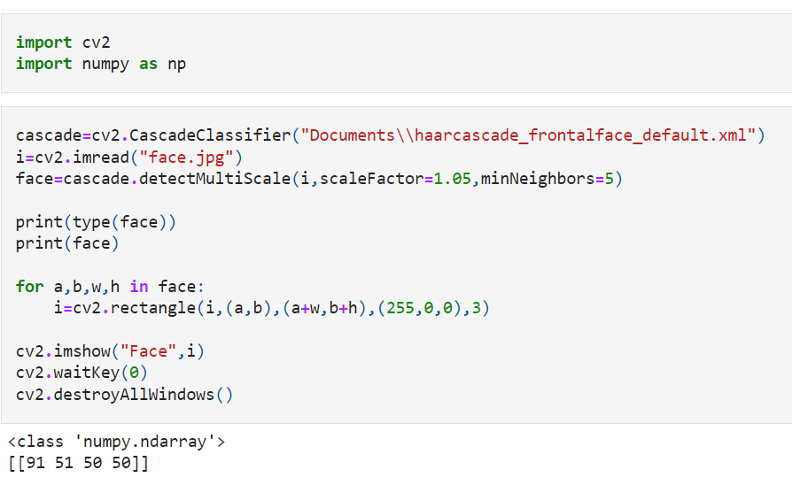
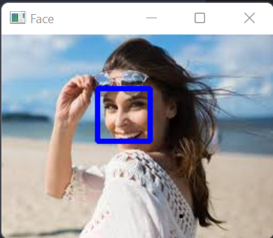
Work done (2/3)
Code for Face Detection
From an Image

Slide 9
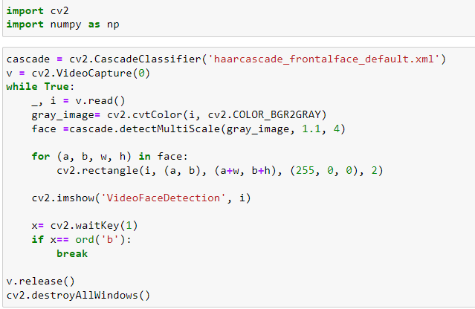
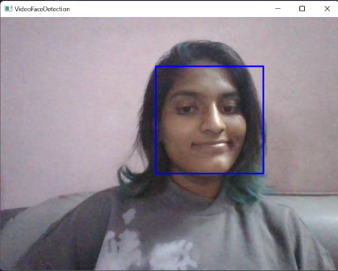
Work done (3/3)
From a video

Slide 10
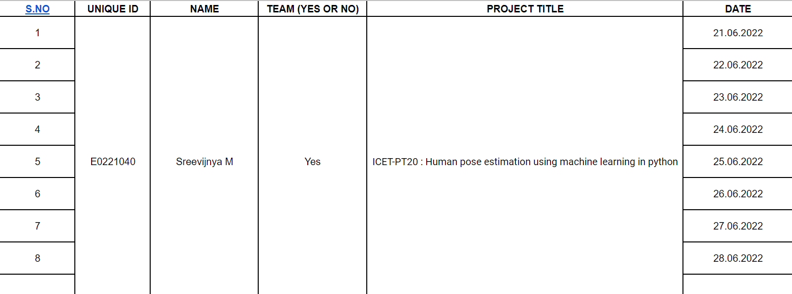
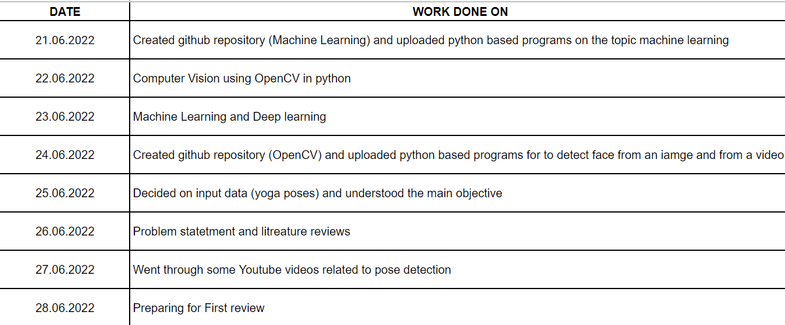
Timeline of the work

Slide 11
References
https://www.ndtv.com/health/8-yoga-poses-for-reversing-hypothyroidism-1881562
https://scholarworks.sjsu.edu/cgi/viewcontent.cgi?article=1932&context=etd_projects
file:///C:/Users/admin/Downloads/paper.pdf
https://www.researchgate.net/publication/346659912_Yoga_Pose_Detection_and_Classification_Using_Deep_Learning
https://www.youtube.com/watch?v=-ZrDjwXZGxI&feature=youtu.be
https://www.youtube.com/watch?v=7IFhsbfby9s

Slide 12
Thank you

