Slide 1
Group Number: 6
A Comparative Time Series Analysis for Predictive Supply Optimization: From ARIMA to XGBoost
Presented By:
Venkata Satya Sreeya Chandrapati
Geethika Kattamanchi Satheesh Kumar

Slide 2

EXECUTIVE SUMMARY
Objective: Optimize bike allocation & reduce wait times
Data Source: https://archive.ics.uci.edu/dataset/275/bike+sharing+dataset
Data Handling: Fixed disruptions (Hurricane Sandy) using interpolation
User Behavior:
Weekday peaks -> registered users
Weekend spikes -> casual users
Outcome:
30-day forecast (Jan 2013)
15% safety buffer
Ops window: 3–4 AM

Slide 3



The Mobility Gap: Why Predict Bike Demand?
Predicting bike-sharing demand is more than just a mathematical exercise; it is the backbone of reliable urban transportation. This project utilizes 17,544 hours of data and machine learning to support proactive rebalancing and system resilience.
Reduces Waiting Times
Predicting "Stock-outs“
Ensure bikes at peak (8 AM, 5PM)
Improves Operational Flow
Identify Surplus zones
Rebalancing efficiency
Builds System Resilience
Capture weather impact (e.g., rain drop)
Enable proactive response

Slide 4
The Balancing Act: Demand vs. Supply
Current bike-sharing operations are often reactive, leading to significant service gaps during peak hours. This project identifies the structural and environmental drivers of these gaps to build a proactive rebalancing framework.
Problem Statement
The Availability Crisis | Environmental Sensitivity
Problem: System "stock-outs" at 8 AM and 5 PM on weekdays discourage commuter reliance. | Problem: Sudden weather shifts (rain/snow) and extreme events like Hurricane Sandy create massive surpluses that strain storage capacity.
Impact: High waiting times and decreased user retention. | Impact: Operational inefficiency and potential equipment damage.

Slide 5
The Foundation: Dataset & Structural Challenges
To build a reliable forecast, we audited 17,544 hourly observations spanning two years (2011–2012) from the Capital Bikeshare system in Washington, D.C.
The data is rich with temporal and environmental features, but it arrived with significant structural “shocks” that required advanced data engineering.
High-Frequency Data | Exogenous Regressors
Hourly & Daily Records: Captures every rental from system launch to maturity. | Environmental Variables: Tracks temperature, humidity, wind speed, and weather situations (Clear, Misty, Rain/Snow).
Temporal Features: Holidays, working days, seasons, and day-of-week identifiers. | Target Variable: Total rental count (cnt), decomposed into Casual and Registered segments.
The Three Major Data Challenges:
System Shocks (Hurricane Sandy): Filled gaps using interpolation
Sensor Anomalies: Corrected unrealistic values (e.g., humidity ~0%)
Non-Stationarity: Applied differencing (1st & 2nd order)

Slide 6
From Raw to Refined: The 4-Step Cleaning Pipeline
Before modeling, the dataset underwent a rigorous multi-stage audit to ensure that environmental shocks and sensor errors did not compromise the integrity of our forecasts.
Temporal Alignment & Integrity Audit
Intelligent Imputation (The "Sandy" Solution)
Outlier Correction & Sensor Repair
Stationarity Transformation
Notes:
Aligned dates and hours ensuring a seamless timeline.
Used Linear Interpolation to bridge gaps by environmental shocks. Linear interpolation is a method used to estimate unknown values between two known data points by assuming a straight-line relationship.
Had issues with sensor errors such as humidity and temperature.
Stationary transformation to stabilize the data mean before giving it to the models.

Slide 7

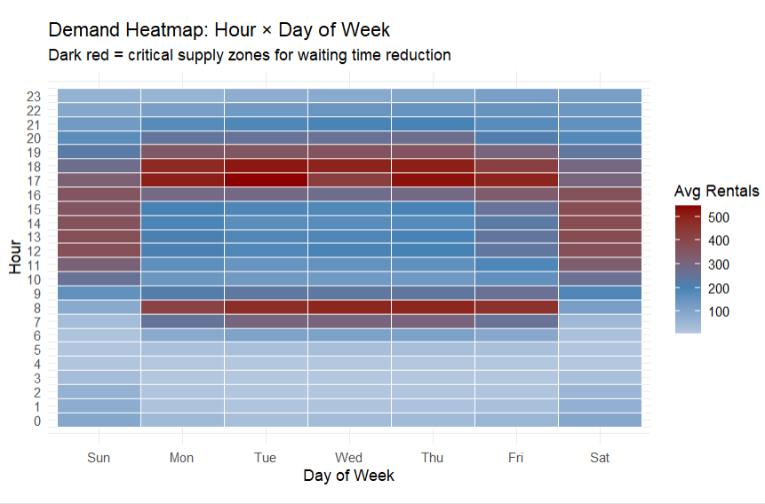
EDA: Heatmap: Hour x Day of Week
🚦 Peak Commute Corridors:
8 AM and 5–6 PM on weekdays exceed 500 rentals.
📊 Weekday Intensity:
Wednesday and Thursday evenings are peak demand moments.
🚴 Leisure Distribution:
Weekend demand is lower and evenly spread from 10 AM–4 PM.
⏱️ Operational Window: Hours 0–6 AM show near-zero demand ideal for station rebalancing.

Slide 8
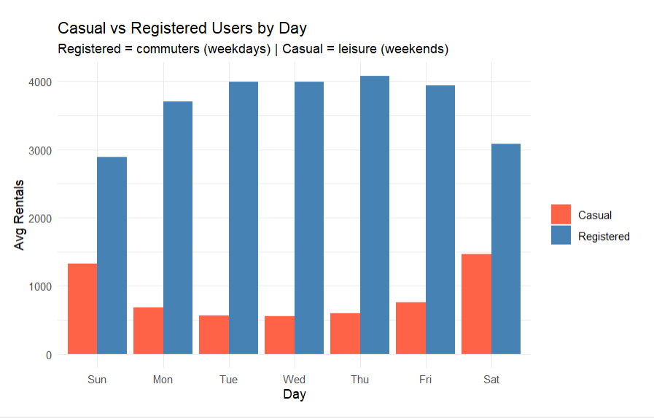
EDA: Casual vs Registered Users by Day
📊 User Behavior Split: Registered users dominate weekdays (commute-driven demand)
🏖 Weekend Shift: Casual users spike on weekends (leisure usage)
📉 Midweek Stability: Tue–Thu shows consistent registered demand peak
🔄 Demand Pattern: Clear bimodal structure -> weekday commute vs weekend leisure

Slide 9
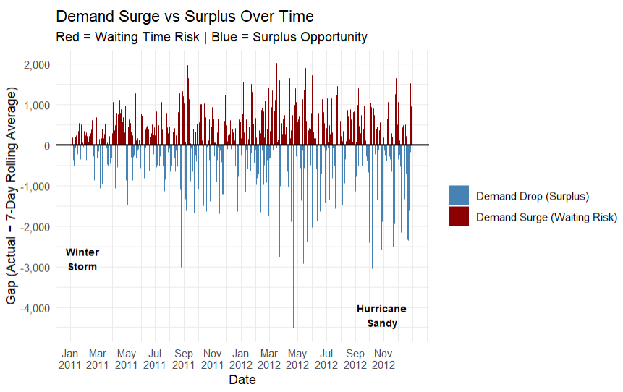
EDA: Demand Surge vs Surplus Over Time
📈 Waiting Risk
Frequent surges above rolling average
🌧️ Weather Surplus
Sharp drops during extreme weather
⚠️ System Shocks
Major events (e.g., Hurricane Sandy) disrupt demand
🧠 Operational Insight
Requires ~15% supply buffer
Notes:
The Baseline (0 Line): The horizontal black line represents the 7-day rolling average of ridership. It acts as the "expected" demand based on recent history.
Red Bars (Demand Surge/Waiting Risk): These bars represent days when actual demand significantly exceeded the expected average. For operations, this is the "Waiting Risk" zone, where stations are most likely to be empty, leaving riders without bicycles.
Blue Bars (Demand Drop/Surplus Opportunity): These bars show when ridership plummeted below the expected average. This indicates a "Weather Surplus," where bikes sit idle because users are avoiding travel due to poor conditions.
Identifying System Shocks: The plot clearly isolates major external events that broke normal ridership patterns. You can see massive blue drops for the Winter Storm in early 2011 and Hurricane Sandy in late 2012, which caused systemic shutdowns.
Strategic Operational Insight: Because these surges and drops are frequent and sometimes extreme, the analysis concludes that the system cannot run on a "perfect fit" supply. It requires a ~15% supply buffer to absorb these unpredictable spikes and minimize waiting times for users.

Slide 10
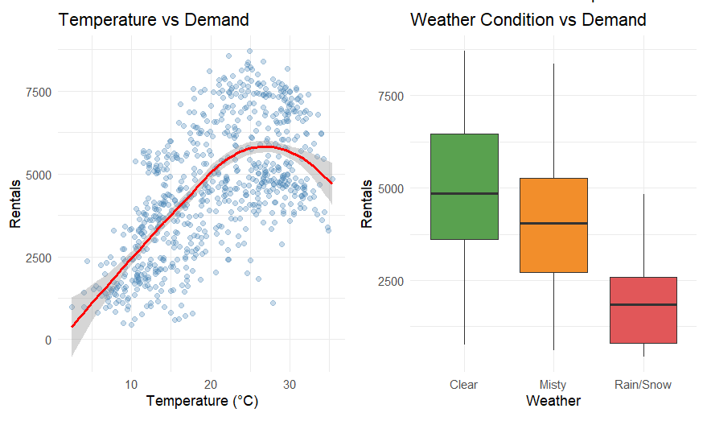
EDA: Weather Impact (Temp + Weather Situation)
🌡️ Temperature Effect
Peak demand around ~25°C
🌧️ Weather Impact
Rain/snow -> ~60% demand drop
🌫️ Mild Disruptions
Mist/fog -> ~15% reduction
📊 Model Insight
Weather needed as exogenous feature

Slide 11
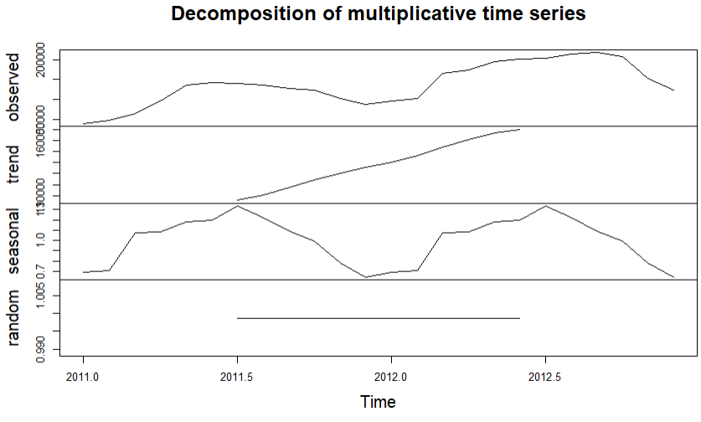
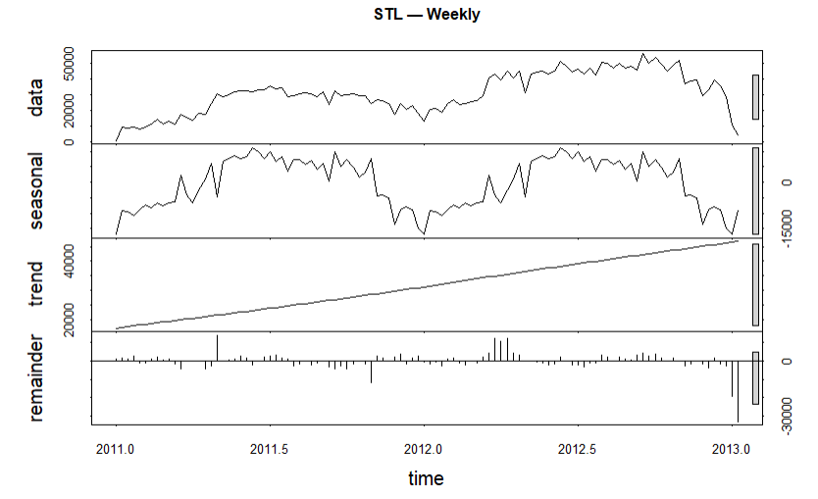
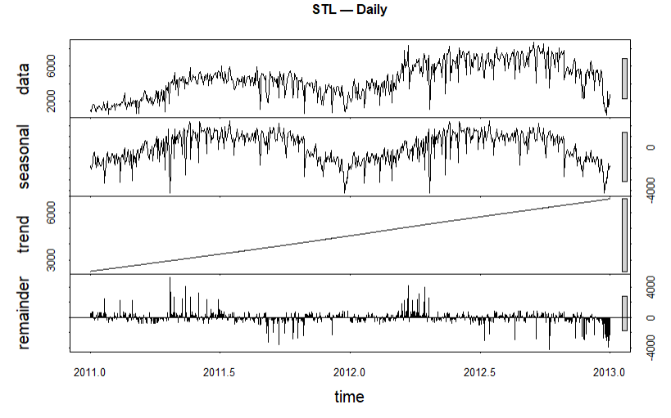
STL & Multiplicative Decomposition
Linear Trend:
Both daily and weekly views reveal smooth, consistent growth in system adoption from 2011 to 2012.
Multi-Seasonality:
STL captured high-frequency weekly cycles, while Multiplicative models accounted for expanding annual peaks.
Shock Isolation:
The "Remainder" component successfully isolated the massive negative residuals from the Hurricane Sandy shutdown.
Notes:
Decomposition analysis using both STL and classical multiplicative methods revealed three key structural characteristics of the bike sharing demand series. First, a consistent linear upward trend was identified across daily, weekly and monthly aggregations confirming steady system adoption growth from 2011 to 2012. Second, multi-seasonality was confirmed — STL captured high-frequency weekly cycles while the multiplicative model accounted for expanding annual seasonal amplitude. Third, the remainder component successfully isolated the massive negative residual corresponding to the Hurricane Sandy shutdown in October 2012, validating the effectiveness of the event-based outlier treatment applied during data cleaning."

Slide 12
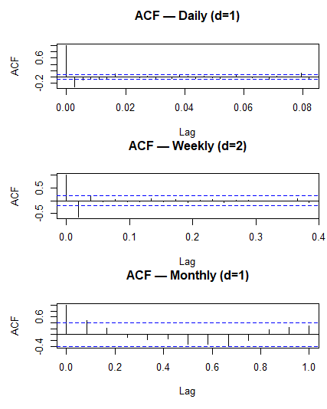
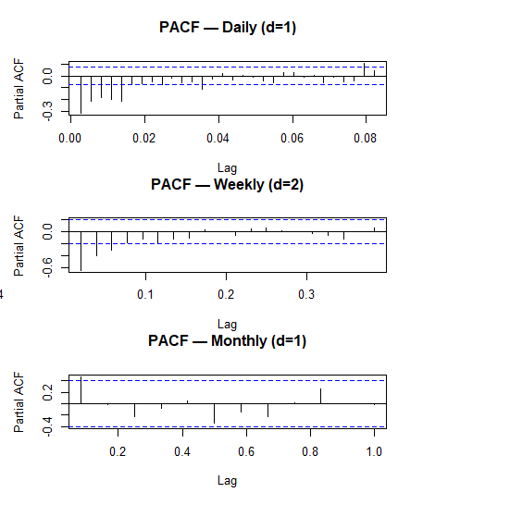
Feature Engineering & Lag Analysis
The Problem
Initial ADF tests confirmed the raw data were non-stationary (p > 0.05), meaning the mean shifted over time.
The Fix
We applied First-Order (d=1) and Second-Order (d=2) differencing to stabilize the series.
Validation
Transformation cleared the path for reliable ACF/PACF identification and ARIMA model selection.
Notes:
How do you determine p and q from ACF/PACF? ACF plot determines MA order (q) — the lag where ACF cuts off sharply. PACF plot determines AR order (p) — the lag where PACF cuts off sharply. If both tail off gradually → ARMA process. What do the blue dotted lines represent? A: They represent 95% confidence bounds. Spikes beyond these lines are statistically significant autocorrelations that the model needs to account for. Why are most lags within the blue bounds? A: Because differencing successfully removed the trend-induced autocorrelation. Remaining significant lags at early positions guide our p and q selection
ARIMA(2,1,3) means: → Look back 2 days (AR=2) → Differenced once (I=1) → Use last 3 errors (MA=3)

Slide 13

Model Validation: The Train/Test Split Strategy
To ensure our forecasts are robust and reliable, we implemented a strict chronological split to simulate real-world forecasting.
The Chronological Split
Total Scope: 731 days of historical bike-sharing data.
Training Set (92%): 671 days (Jan 2011 – Nov 1, 2012).
Hold-Out Test Set (8%): 60 days (Nov 2, 2012 – Dec 31, 2012).
Integrity Check: Zero overlap was used to prevent “data leakage.”
2. Time Series Object Creation
We tailored our time series objects to match the specific strengths of each model:
Holt-Winters: Weekly seasonality (7)
Main Models (MSTS): Weekly (7) + Annual (365) seasonality
Notes:
"92/8 was chosen to maximize training data given our 2-year dataset constraint.
We done the temporal splitting here because as to increase training set – if followed 80/20 split it has undertrained on the summer seasons bcoz test set is rather becomes 5 months period
We acknowledge overfitting risk especially in XGBoost and mitigated it through cross validation and regularization
A larger dataset would allow more conventional 80/20 splitting."
Two TS objects were created because Holt-Winters only accepts single frequency input and fails with multi-seasonal objects, while all main comparison models required MSTS capturing both weekly and annual cycles simultaneously for fair evaluation."

Slide 14
Phase 1 : The Statistical Battle
Goal: Evaluate the predictive accuracy of multiple mathematical frameworks to identify the optimal supply engine.
Model Name | Key Advantage | MAE | RMSE | MAPE (%)
Seasonal Naive | Simple benchmark for seasonal repetition. | 1638.08 | 1925.47 | 37.2%
Holt-Winters | Captures basic weekly seasonality. | 1695.08 | 2250.31 | 88.6%
TBATS | Handles multiple seasonal cycles (7 & 365). | 1415.95 | 1968.86 | 77.0%
ARIMA | Standard for stationary, linear trends. | 2118.59 | 2682.05 | 104.7%
TBATS: Lowest MAE, but weak on low-demand (high MAPE)
Key Insight: Strong seasonality in bike demand
Conclusion: Statistical models insufficient -> moved to ML (XGBoost)
Notes:
Seasonal naïve - no any calculations or math hidden behind it simply learns from the past seasonal cycle – just a minimum perfomance baseline model – means every model has to beat this
HOlt winter- LEVEL (Alpha) → Current average demand, TREND (Beta) → Is demand growing or shrinking?, SEASON (Gamma) → Repeating weekly pattern, Final forecast = Level + Trend + Seasonal pattern
TBATS - Handles MULTIPLE seasonalities → Weekly (7) + Annual (365) together → → Models error structure with ARMA
MAPE = 77% → Still poor MAE = 1415 → Actually lowest MAE! Why high MAPE despite low MAE? → Low demand days (weekends/holidays) had large percentage errors → MAPE penalizes errors on low demand days more heavily → Model still missed winter decline → Only 671 training days insufficient to learn full annual cycle

Slide 15
Phase 2: Advanced Modeling Framework
🚀 Prophet Framework
⏱ Multi-seasonality: Annual + Weekly
🎉 Holiday effects: Built-in US calendar
🌦 External regressors: Weather features
⚙️ XGBoost Engine
🔁 Lag features: 1, 7, 30-day memory
📉 Non-linearity: Captures complex demand
🧪 CV tuning: 5-fold optimization
Model Performance Comparison
Model | MAE (↓) | RMSE (↓) | MAPE (↓)
🏆 XGBoost | 666.09 | 831.93 | 23.75%
🔵 Prophet | 691.78 | 941.02 | 25.6%
💡 Insight:
XGBoost outperforms due to lag-driven memory + nonlinear modeling
Notes:
"Prophet was developed by Facebook specifically for business time series. It decomposes demand into three components — trend, seasonality and holidays — and fits them separately before combining. We enabled annual and weekly seasonality simultaneously, added US public holidays directly from its built-in calendar, and included temperature, humidity, windspeed and weather situation as external regressors. "XGBoost is a gradient boosting machine learning model that learns complex non-linear relationships between features. We engineered lag features capturing 1-day, 7-day and 30-day memory of demand ---- telling the model what happened yesterday, last week and last month.
A 7-day rolling average was also included as a feature. To prevent overfitting on our limited 671-day training set we used 5-fold cross validation with early stopping to find the optimal number of trees
"XGBoost outperformed Prophet primarily because the 7-day rolling average and lag-1 features captured 77% of predictive power combined
5-fold is standard industry practice balancing bias-variance tradeoff.

Slide 16
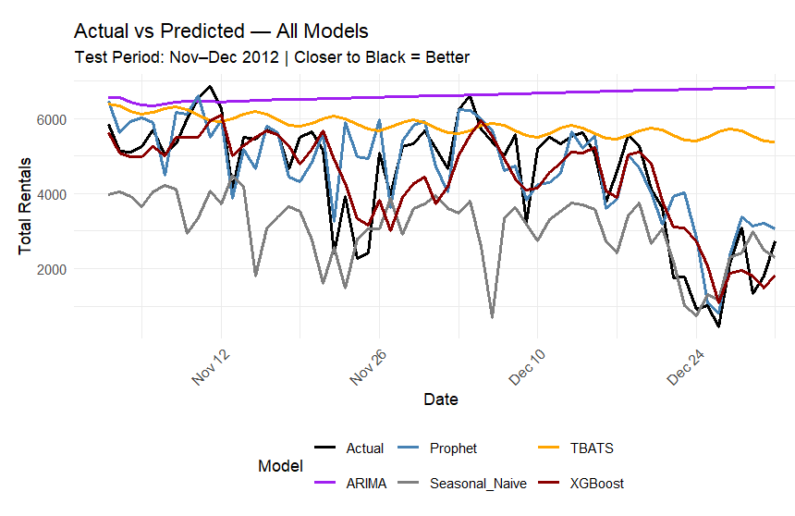
Phase 3: The Final Showdown
Key Performance Insights
📈 Best Models: XGBoost & Prophet track actual demand most closely
⚠️ Weak Models: ARIMA & TBATS miss sharp demand changes
🌊 Volatility Capture: ML models capture weather/holiday dips
🏆 Bottom Line: XGBoost = lowest error (MAPE ~23.8%)
Notes:
"XGBoost and Prophet are the clear winners — both track actual demand patterns including weekly cycles and winter decline. The gap between these advanced models and the statistical baselines is dramatic — from 23.8% to 37.2% minimum for baselines."
ARIMA and TBATS both fail on the same fundamental issue — inability to capture annual seasonality with limited training data. This directly validates our model selection rationale from the beginning of Phase 2."
advanced models incorporating multi-seasonality, non-linearity and exogenous variables significantly outperform classical statistical approaches for bike sharing demand forecasting, with XGBoost emerging as the optimal model for daily supply optimization."

Slide 17
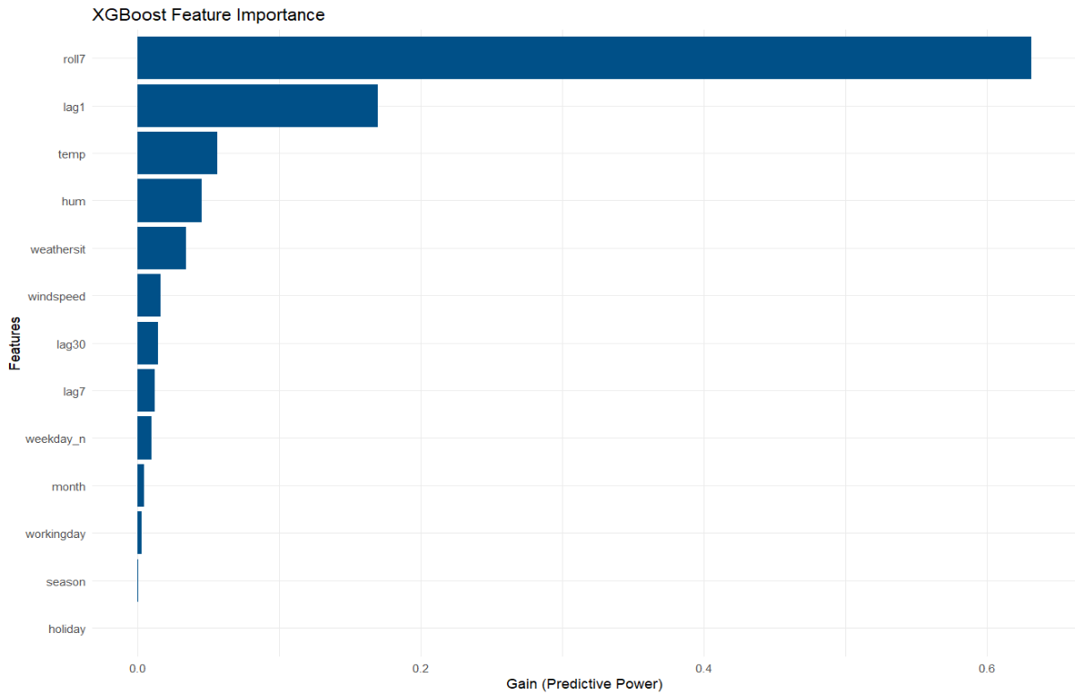
XGBoost Feature Importance
Predictive Insights
The model heavily prioritizes Temperature and Lagged Ridership, confirming that DC's supply needs are driven by environmental comfort and historical memory.
Notes:
7-day rolling average of rentals → "What was the average demand over the last week?"
lag1 → 15% importance 🥈 → Yesterday's actual rental count → "How many bikes were rented yesterday?"
emp → 8% importance 🥉 → Temperature → "Is it warm enough to cycle?"
Humidity → High humidity = uncomfortable cycling

Slide 18
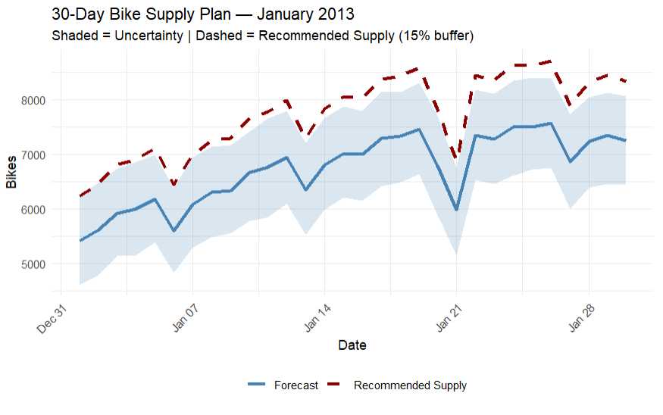
Business Application: The Supply Plan
The ultimate goal of this project is to move from reactive maintenance to proactive supply optimization. Based on our high-precision forecast, we have developed a data-driven strategy for January 2013.
Supply Strategy
+15% Buffer -> Prevent stock-outs
99% Availability Target
Dynamic Scaling -> Adjust for low-demand periods
Operational “Sweet Spots”
3–4 AM Window -> Best time for redistribution
Zero Disruption -> Ready before morning commute
Notes:
The blue line shows Prophet's 30-day demand forecast for January 2013. The shaded region represents the uncertainty interval — wider shading means higher forecast uncertainty. The dashed red line is our recommended supply level set at 15% above the forecast throughout the month.
How did you arrive at 15% buffer specifically? Is it scientifically justified? A: The 15% figure was derived from our model's MAPE of 25.63% for Prophet. Since our forecast can be off by approximately 25% in worst case, a 15% buffer provides partial coverage of forecast uncertainty. In practice this would be refined using actual operational data on maintenance rates and redistribution delays.
"By maintaining supply at forecast plus 15% we target 99% bike availability — meaning customers find available bikes 99% of the time they visit a station
Dynamic scaling - "Supply is not uniform across all days. The dashed line adjusts daily — lower on weekends and higher on weekdays — reflecting the demand pattern
3-4 AM Window:
"Our intraday EDA identified 3-4 AM as the optimal redistribution window with near-zero demand across all days. Maintenance teams can safely rebalance stations during this window

Slide 19

Conclusion and Future Work
Conclusion:
Forecasting Impact: Reduced wait times via optimized supply
Prediction Model: XG- Boost
Operations: +15% buffer & 3–4 AM window validated
Future Work & Enhancements:
Real-time Rebalancing (GPS-based)
Advanced Modeling (Gamma GLMM)
External Data (events, holidays)
Sustainability Optimization (routing efficiency)

Slide 20
References
Academic & Data Sources
Fanaee-T, H., & Gama, J. (2014). Event labeling combining ensemble detectors and background knowledge. Progress in AI, 2(2-3), 113-127.
UCI Machine Learning Repository. Bike Sharing Dataset. Dataset Source
Chen, T., & Guestrin, C. (2016). XGBoost: A Scalable Tree Boosting System. KDD '16.
Media Sources:
https://abcnews.com/US/hurricane-sandy-mass-transit-systems-closing-ahead-storm/story?id=17582687

Slide 21
Thank you
Any Questions?

